Slide 1

VibraImage in the world
Ing. Filip Krejčík

Slide 2
Presentation structure
Where is/was the VibraImage used?
Russian airports
Sochi Olympic Games 2014
Implementation in Vaclav Havel Airport Prague

Slide 3
Where is/was the VibraImage used?
Sochi Olympic Games 2014
South Korea Police Department
Okhotny Ryad Metro Station (Moscow)
Russian airports
Shopping center in St. Petersburg

Slide 4
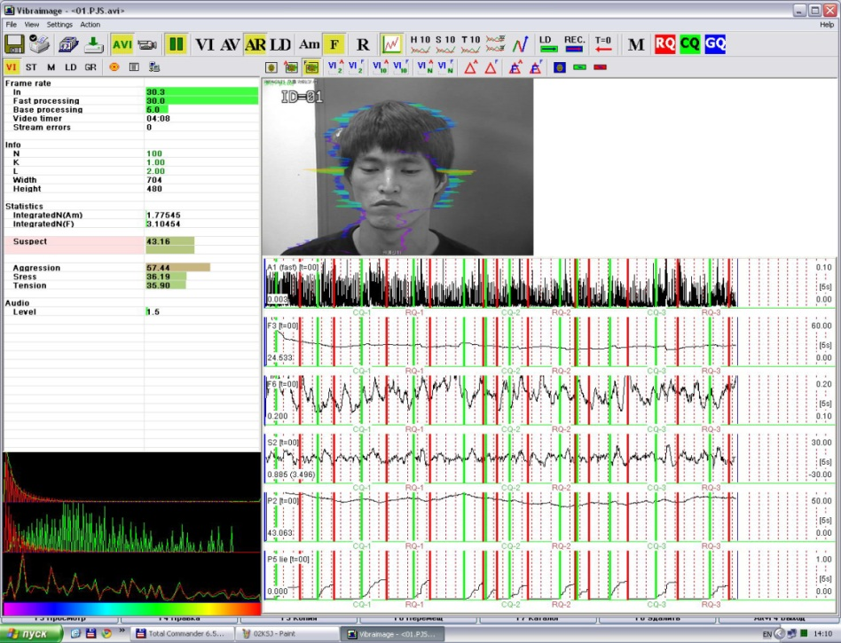
Where is/was the VibraImage used?
Okhotny Ryad, Moscow metro station
Lie detection, Seoul Police Department

Slide 5
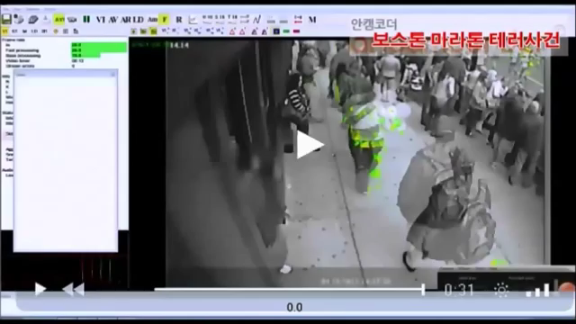
Detection of the terrorist – Boston Marathon 2013
Source: https://www.youtube.com/watch?v=GZlQ-k9KQ-w

Slide 6
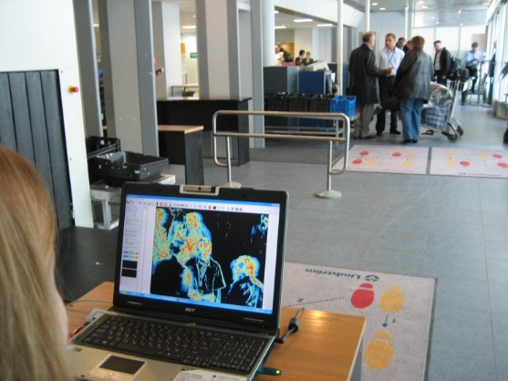
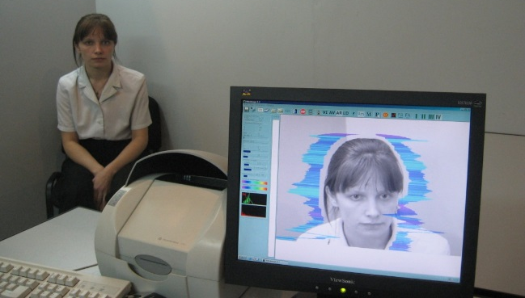
Russian airports
Pulkovo airport
Testing mode: 6/2007, Operating mode: 12/2008
Error rate
  FAR: 0%
  FRR: 10%
Domodedovo airport
Testing mode: 2007, Operating mode: 1/2009
Error rates
  confidential
Sheremetyevo airport
Testing mode: 2007, Operating mode: 1/2009
Error rates
  confidential

Slide 7
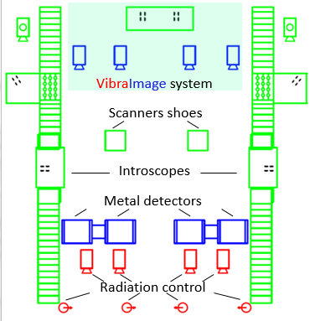
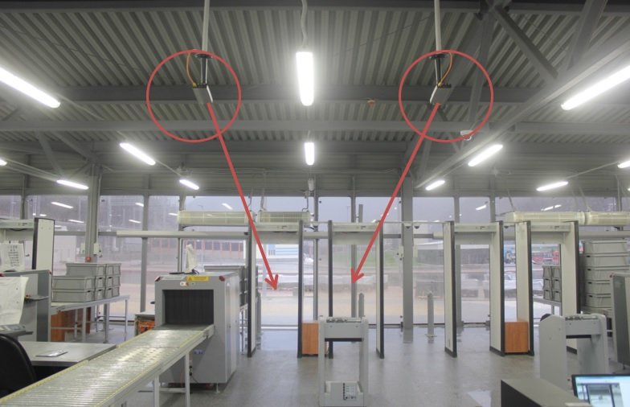
Sochi 2014
Main goal: to use VibraImage as a part of security control
17 checking pavilions
262 VibraImage cameras
131 computers
Every visitor checked!!!

Slide 8
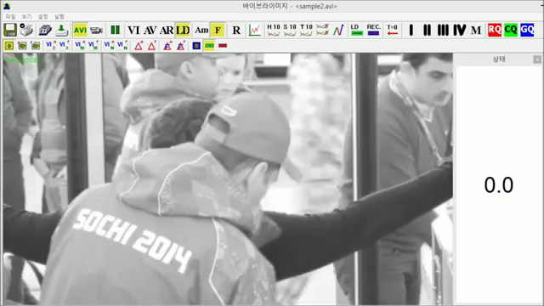
Sochi 2014
Source: https://www.youtube.com/watch?v=QAsEEgic1Sg

Slide 9
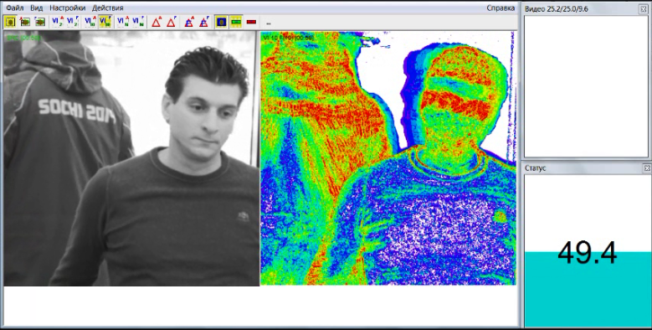
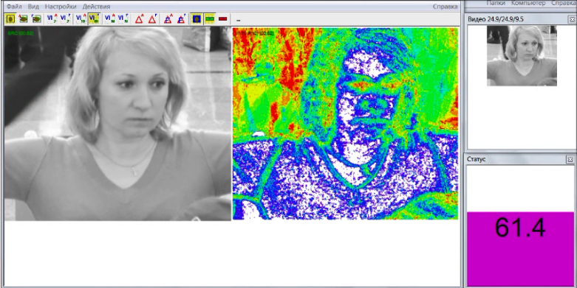
Sochi 2014 - results
2.7 million visitors
120 000 visitors each day during peak loading
5-15 capture each day
FRR: 8%
Number of serious illegal actions => 0

Slide 10
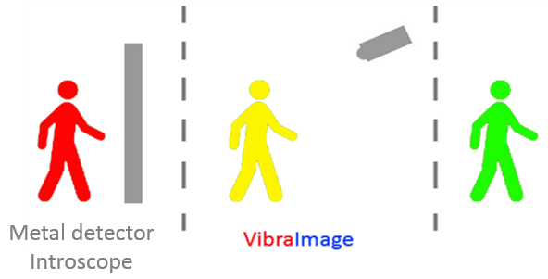
Implementation of the VibraImage in Vaclav Havel Airport Prague
Location
  Area of security control
Macromode
Setup of the camera (angle of view, distance, height)

Slide 11
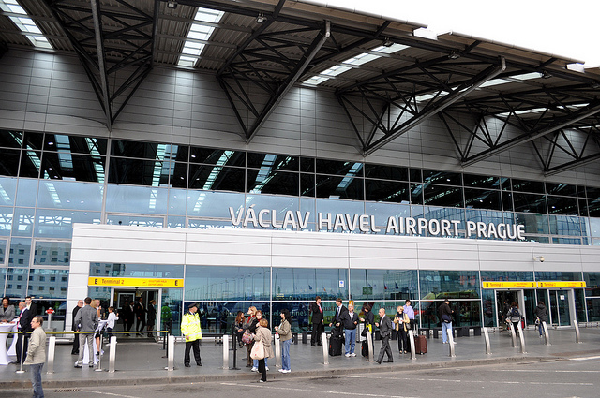
Vaclav Havel Airport Prague
2 terminals
  T1 – decentralized security control
  T2 – centralized security control
28 checkpoints
2 layouts of frame detectors

Slide 12
Legislation
Regulation (EC) No 272/2009
  Hand search, walk-through metal detection (WTMD), hand-held metal detection (HHMD), explosive detection dogs, explosive trace detection (ETD)
Regulation (EU) No 185/2010
  testing conditions

Slide 13
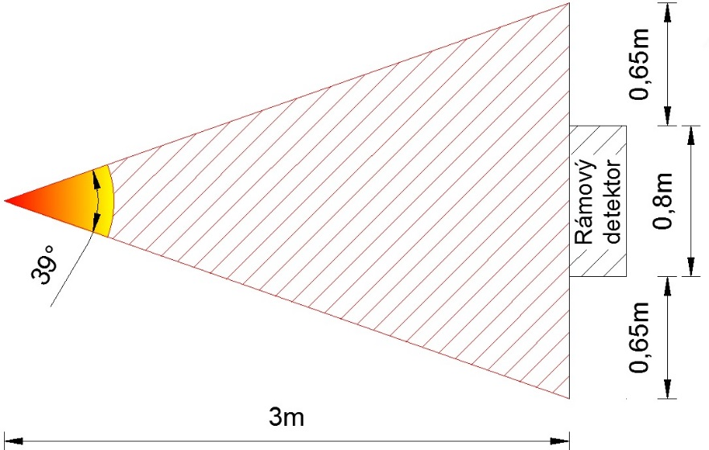
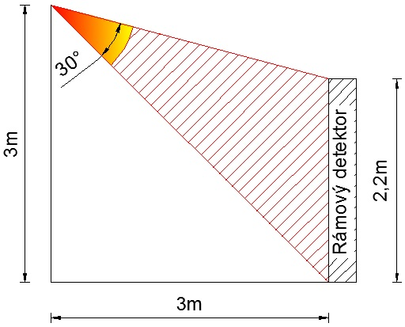
Setup of the camera – single frame detector
Distance
  3m
Height
  3m
Focal Length
  7.5 mm
Angle of view
  Horizontal 39°
  Vertical 30°

Slide 14
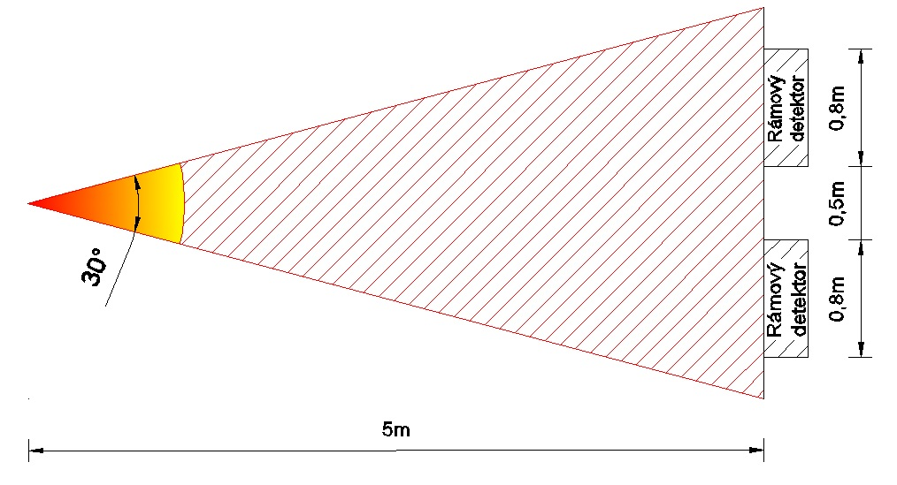
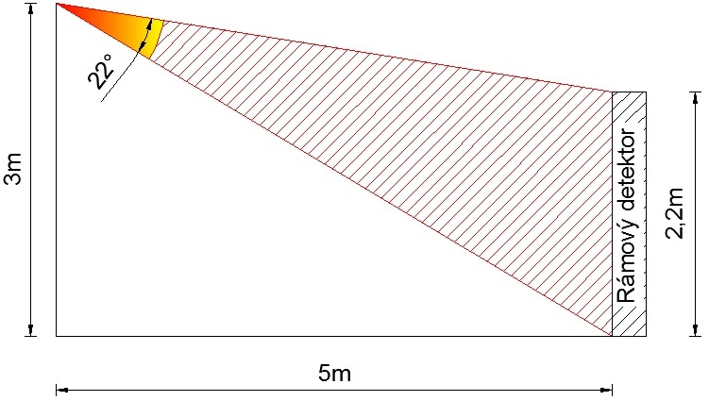
Setup of the camera – double frame detector
Distance
  5m
Height
  3m
Focal Length
  10 mm
Angle of view
  Horizontal 30°
  Vertical 22°

Slide 15
Useful contacts and sources
www.psymaker.com
www.elsys.ru
Prof. Viktor Minkin: minkin@elsys.ru
  ELSYS Corp, Ltd., Prospect Toreza 68, St. Petersburg, 194223, Russia
  elsys@infopro.spb.su
Source: Behavior Detection System VibraImage Manual 8.1, ELSYS Corp, SPb., 2011

Slide 16
Thank you for your attention!
Ing. Filip Krejčík
filip9krejcik@gmail.com

