Slide 1
The 4th International Open Science Conference
The Vibraimage Technology
Psychophysiological Response Dynamics
to Complex Stimuli
Viktor Minkin
Elsys Corp
Saint Petersburg, Russia, 2021
Notes:
The report combines several works presented in the conference proceedings and aimed study the dynamics of the psychophysiological responses to presented stimuli. In real life, a person is always under the influence of many external factors, therefore, the study of the dynamics of the psychophysiological responses to constantly arising stimuli allows one to characterize human behavior in a real situation most fully and determine the characteristics of the personality.

Slide 2
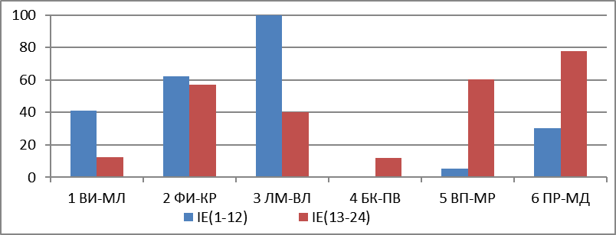
VibraNLP program. Human Psychophysiological Response to Complex Stimuli
NDI |  | 4
MI+,F+ | 66 | 34
MI(3),F(3) | 92 | 8
MI+(IE),F+(IE) | 48 | 52
MI(3IE),F(3IE) | 65 | 35
F(U),F(S) | 58 | 42
Pretestingstimuli
Multi
factorial stimuli
Pretesting
Basic testing
Comparative profile,
IFS
Person
profile
Notes:
The study of the psychophysiological responses to stimuli was carried out on a group of 20 people using VibraNLP program.
VibraNLP program allows to change the period of external stimuli presentation, control PPS and synchronize the initial moment of stimuli presentation with the minimum or maximum position of brain activity. Since VibraNLP program presents non-repetitive, but similar stimuli at the preliminary testing stage, it is an ideal tool for studying the dynamics of psychophysiological response when presented with neutral and multifactorial stimuli.
Each subject in the group was tested 18 times with different settings, which did not cause addiction and made possible to identify statistical patterns in the change of studied parameters.
The presented scheme of the VibraNLP program is somewhat different from the structural scheme of the first report, it highlights the sequence of actions, not metrological transformations.

Slide 3
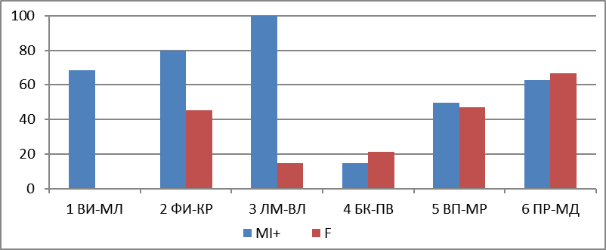
Personality Profile and Investigated Factor Score
(YN+IE) Результат
N |  | MI | F | Δ | Δ% | q(MI) | q(F)
1 | ЛМ-ВЛ | 100 | 15 | 85 | 85,20% | 5;5 | 17.1;18.1
2 | ФИ-КР | 80 | 45 | 35 | 43,53% | 5;3 | 15.2;15.2
3 | ВИ-МЛ | 69 | 0 | 69 | 100,00% | 5;3 | 13.3;14.3
4 | ПР-МД | 63 | 67 | -4 | -5,79% | 1;1 | 23.4;24.4
5 | ВП-МР | 49 | 47 | 3 | 5,30% | 6;6 | 21.5;22.5
6 | БК-ПВ | 15 | 21 | -6 | -30,46% | 6;1 | 19.6;20.6
 | MI+,F+ | 66 | 34 | 32 | 31,70%
 | MI(3),F(3) | 81 | 19 | 61 | 61,16%
 | F(U),F(S) | 69 | 31 | 39 | 38,52%
Integrated profile of conscious and unconscious responses to the factor
Результат IE
N |  | MI(IE) | F(IE) | Δ | Δ% | q(MI) | q(F)
1 | ЛМ-ВЛ | 100 | 40 | 60 | 59,94% | 5;5 | 17.1;18.1
2 | ФИ-КР | 62 | 57 | 5 | 8,47% | 5;3 | 15.2;15.2
3 | ВИ-МЛ | 41 | 12 | 29 | 70,15% | 5;3 | 13.3;14.3
4 | ПР-МД | 30 | 78 | -47 | -60,79% | 1;1 | 23.4;24.4
5 | ВП-МР | 5 | 60 | -55 | -91,42% | 6;6 | 21.5;22.5
6 | БК-ПВ | 0 | 12 | -12 | -100,00% | 6;1 | 19.6;20.6
 | MI+(IE),F+(IE) | 48 | 52 | -4 | -4,10%
 | MI(3IE),F(3IE) | 65 | 35 | 30 | 30,09%
 | F(U),F(S) | 58 | 42 | 16 | 15,76%
Profile of unconscious response to the factor
NDI |  | 4
MI+,F+ | 66 | 34
MI(3),F(3) | 92 | 8
MI+(IE),F+(IE) | 48 | 52
MI(3IE),F(3IE) | 65 | 35
F(U),F(S) | 58 | 42
Investigated Factor Score (IFS)
Notes:
I remind that VibraNLP program presents neutral and multifactorial stimuli to a subject, comparing the psychophysiological response to them. Neutral stimuli make possible to construct a personality profile based on multiple intelligences or psychological accentuations, and with the correct decomposition of personality characteristics into components, the principle of decomposition itself should not affect the test result. Multifactorial stimuli include linguistic binding to the constructed profile and the investigated factor, in our example, the predisposition to terrorism.
VibraNLP allows the researcher to independently form text questions and visual stimuli for solving an arbitrary research problem. In this study, standard questionnaires were formed for 24 stimuli (12 neutral and 12 multifactorial) and a shortened one for 12 stimuli, including 6 neutral and 6 multifactorial.
Since it is difficult to assume a rapid change in the susceptibility to terrorism in the subjects, the score of the factor under study should be unchanged with the correct formation of the questionnaire, regardless of its duration.

Slide 4
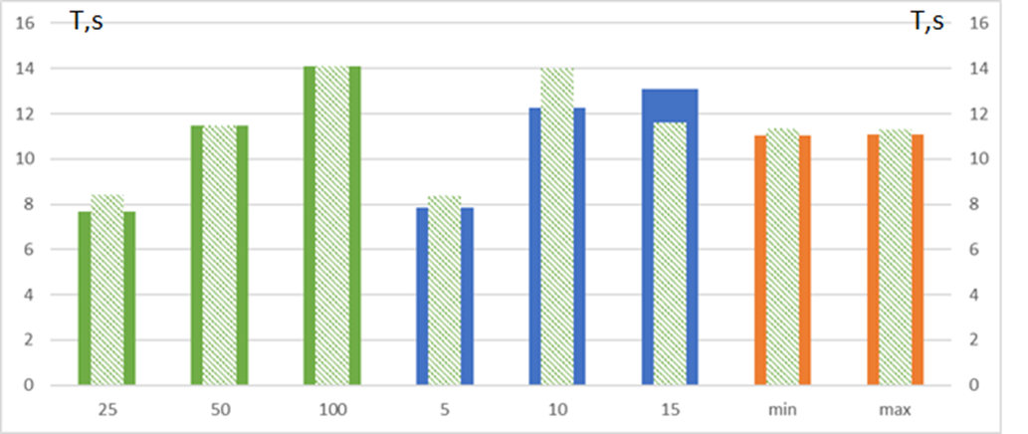
Stimuli-PPR Desynchronization
Dependence of PPR desynchronization relative to the presented stimuli for Neutral stimuli (external column of the histogram) and Multifactorial stimuli (internal column of the histogram). The horizontal axis shows testing settings (from left to right): N = 25; 50; 100 - the number of accumulation frames for interframe difference. PESP = 5; 10; 15. Min-Max - testing start from minimum or maximum PPS value. Mean values of desynchronization parameter obtained for 24 stimuli of 10 subjects (180 tests).
Notes:
This slide shows the histogram of the PPR desynchronization for the group of subjects with different program settings for responses to neutral stimuli (external bars) and multifactorial stimuli (internal bars).
By PPR desynchronization, I mean the degree of delay or advance of the PPR change in the moments of neutral and multifactorial stimuli presentation.
It follows from the presented histogram that the degree of desynchronization increases with an increase in the accumulated interframe difference from 25 to 100 frames, approximately the same for neutral and multifactorial stimuli.
Changing the period of stimuli presentation from 5 to 15s leads to a different nature of dependences for neutral and multifactorial stimuli at 10 and 15 seconds. The maximum desynchronization is observed for multifactorial stimuli with 10 second period of presentation for external stimuli and 15 sec of neutral stimuli.
The start of presentation moment from the minimum and maximum position of brain activity is practically does not affect the desynchronization.

Slide 5
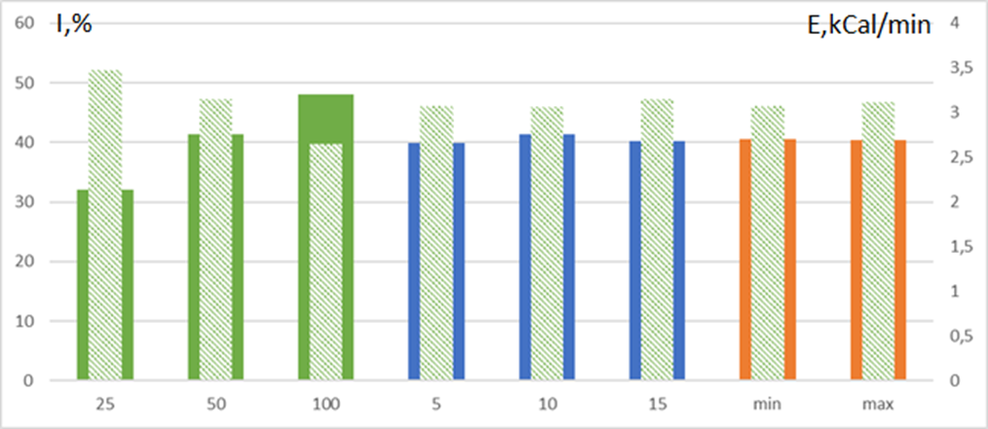
Information and Energy Component of PPS
Dependence of information (I) and energy (E) components of PPS relative to the testing settings. Information component (external column) and Energy component (internal column). The horizontal axis shows testing settings (from left to right): N = 25; 50; 100 - the number of accumulation frames for interframe difference. PESP = 5; 10; 15. Min-Max - testing start from minimum or maximum PPS value. Mean values of desynchronization parameter obtained for 24 stimuli of 10 subjects (180 tests).
Notes:
The presented histogram shows the multidirectional nature of the change in the information and energy components with an increase in the interframe difference from 25 to 100 frames, which shows the dependence of the magnitude of the measured psychophysiological characteristics on the software settings.
At the same time, the change in the period of stimuli presentation and the start of the launch depends weakly on the informational and energy components of the PPS.

Slide 6
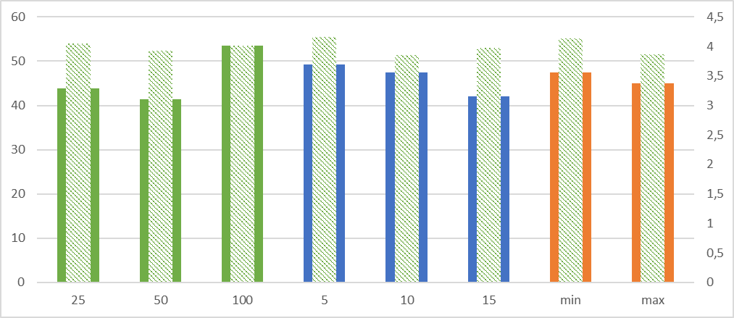
Brain Activity Period (BAP)
and Investigated Factor Score (IFS)
BAP, s
IFS, score
Histogram of BAP (external column) and IFS (internal column) relative to testing settings. The horizontal axis shows testing settings (from left to right):
N = 25; 50; 100 - the number of accumulation frames for interframe difference. PESP = 5; 10; 15. Min-Max - testing start from minimum or maximum PPS value. Mean values of desynchronization parameter obtained for 24 stimuli of 10 subjects (180 tests) are given.
6
Notes:
The greatest value of BAP is observed with the maximum accumulation of interframe difference, and the most clear dependence of the increase in BAP occurs when the period of stimulus presentation decreases from 15 to 5 seconds.
The highest IFS is observed when stimuli start from the minimum value of brain activity and when stimuli are presented for 5 seconds.
The presented statistical results require explanation and construction of physical and physiological models of the observed phenomena.

Slide 7
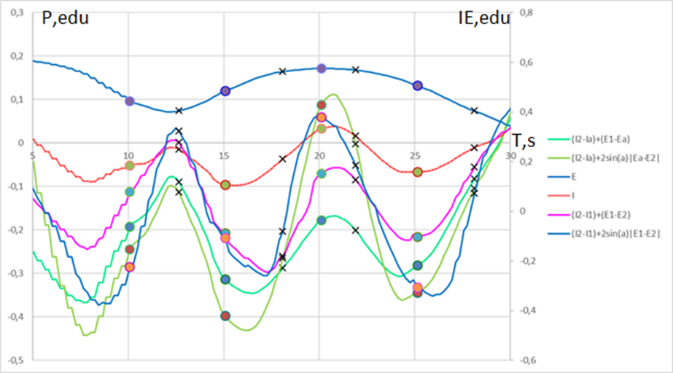
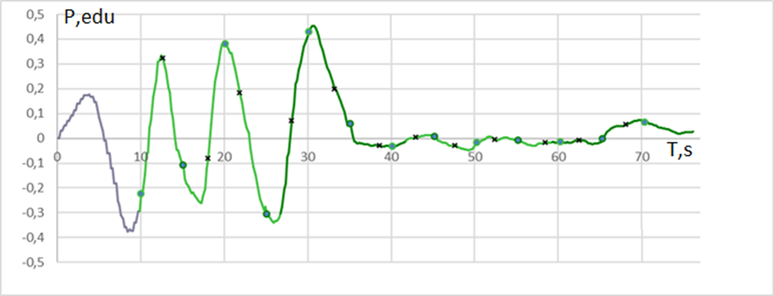
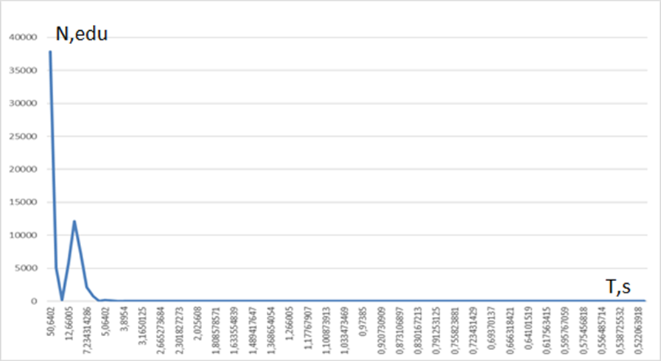
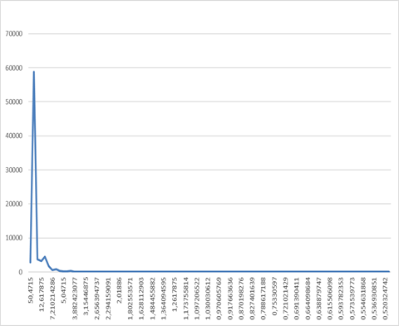
Dynamics of PPS Changes upon Presentation of Stimuli
Full testing LOf05_NLP. PESP = 5 s
Fragment of testing. A round mark is the moment of stimuli presentation, a cross indicates the time of response to a stimulus. PESP = 5 s.
Notes:
Let's consider a fragment and full graphs during PPS testing to understand the processes that are taking place.
Let's start with a test fragment that clearly shows the change in the psychophysiological state depending on the stimuli presented. With a 5 second period of presentation of external stimuli, several stimuli are presented during one period or front of PPS change.
At the same time, the amplitude of the psychophysiological response to neutral and multifactorial stimuli can differ significantly, as the graph of the PPS changes during full testing shows.
The spectrum of PPS changes may have a peak reflecting PESP, or it may not have such a peak, depending on the characteristics of a subject.

Slide 8
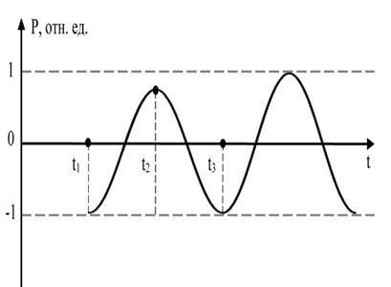
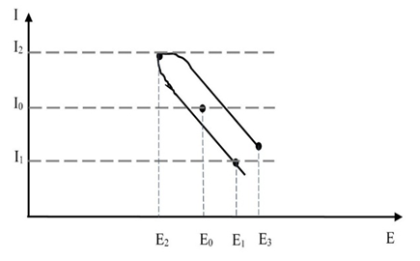
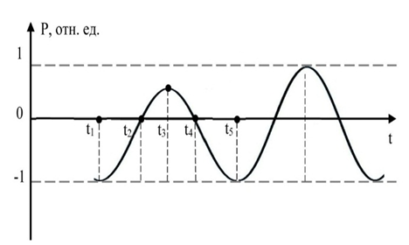
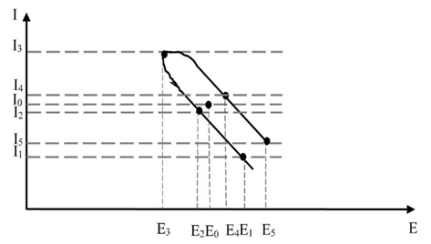
Schematic PPS dynamics
Relative
units
Ideal stimulus-response synchronization with a long period of stimulus presentation (> 15 s)
Relative
units
Real synchronization of stimulus-response with a short period of stimulus presentation (<10 s)
Notes:
With a long period of presentation of stimuli (more than 15 seconds per stimulus), ideally, a complete adjustment of the period of change in brain activity for a double period of presentation of the stimulus is possible. Then the change in stimulus is accompanied by a change in the change in the direction of the PPS.
This principle is basing for classical psychophysiological detection of lies, it decreases the influence of one stimulus on another.
With a short five-second period of presentation, there are several stimuli per one wave or front of increase- decrease in PPS, since a person does not have time to consciously respond to complex stimuli, and the period of brain activity increases with a decrease in the period of presentation of external stimuli.

Slide 9
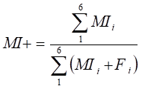
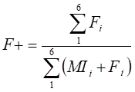
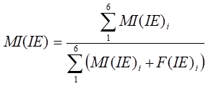
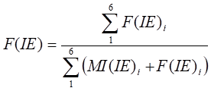
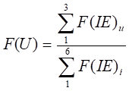
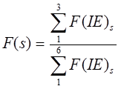
Approaches to Scoring a Factor in Classic and Accelerated Presentation of Stimuli
Test passing criteria:
(MI+) – (F+)> 0 NDI
Score of integral (conscious + unconscious) responses
Test passing criteria:
MI(IE) – F(IE) > 0 NDI
Score of unconscious response
Test passing criteria:
F(U) – F(S)>0 NDI
Comparative assessment of significant and insignificant components of unconscious responses
Notes:
This means that the traditional criteria for passing testing, worked out in classical psychophysiological testing, must be changed when switching to accelerated testing with a stimulus presentation period of about 5 seconds.
Statistics have shown that the test subjects' score remains unchanged with the opposite approach to the criteria for assessing unconscious parameters with a short period of stimuli presentation relative to the classical one.

Slide 10
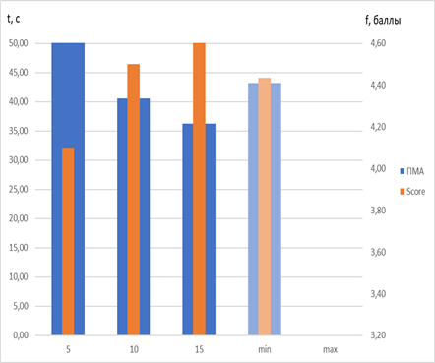
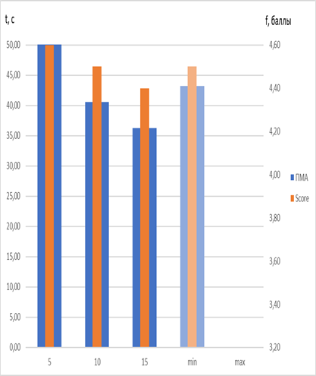
BAP and IFS Dependences from PEPS
Dependence of BAP (blue) and IFS (orange) for the differential assessment of paired stimuli from PEPS (5,10,15 s)
Dependence of BAP (blue) and IFS (orange) for the modular assessment of paired stimuli from PEPS
(5,10,15 s)
Notes:
The slide shows histograms of changes in the period of cerebral activity and the point score of the factor under study for various options for calculating the point score. In the left figure, orange bars show the classic version of the BIF calculation for differential assessment of paired stimuli, and in the right figure, the modular BIF assessment. At the same time, the change in the calculation of the factor assessment, naturally, does not affect the blue histogram of the PMA, it is the same in both figures.
Note that the classical version of the calculation shows the maximum score (4.6) with a 15-second period of stimulus presentation, and with a decrease in the period of stimulus presentation to 10 and 5 seconds, the score begins to decrease and is 4 with a 5-second stimulus presentation.
The modernized modular version of the calculation (right figure) shows the opposite picture, it gives a higher score of 4.6 with 5 seconds of stimulus presentation, and the score decreases with an increase in the period of stimulus presentation.
Since the group of people was unchanged, and the initial test results were processed by different methods, it is logical to draw the following rather important conclusion.
Presentation of 5 second stimuli allows to obtain the same results in personality testing as in classical testing with a stimulus presentation period of more than 15 seconds.

Slide 11
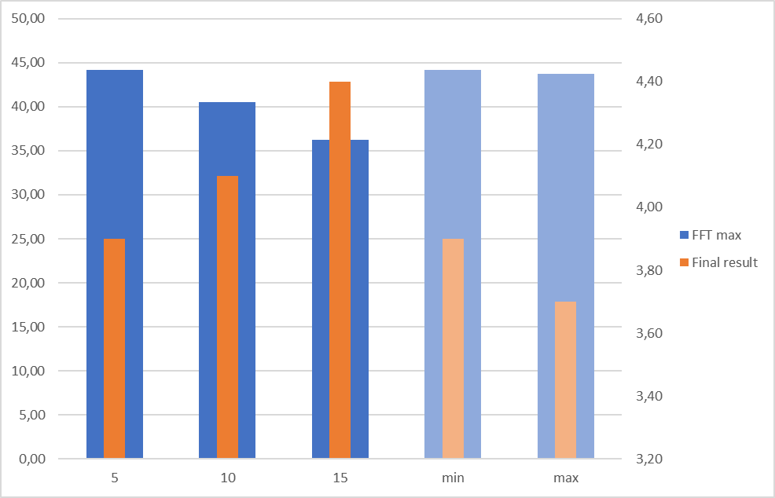
BAP and IFS Dependences from PEPS
BAP, s
IFS, score
Dependence of BAP and IFS assessment for PESP (T = 5, 10, 15 s) and the start of stimuli presentation from (Min, Max) PPS with fixed VibraNLP program settings N = 25. The left vertical axis shows BAP value, the right vertical axis shows IFS value.
Notes:
The previous results were obtained when testing a group of 20 people with different software settings for summing the interframe difference N = 25; fifty; 100 questionnaires for 24 questions.
For additional verification of the results obtained, a new testing of a group of 10 people was carried out with fixed settings for summing the interframe difference N = 25, which confirmed the results obtained and the drop in the score when the period of stimulus presentation decreased from 15 to 5 seconds by the questionnaire by 12 questions.
At the same time, the group's higher point score was also confirmed when starting from the minimum point of brain activity relative to tests that started from the maximum point of brain activity.

Slide 12
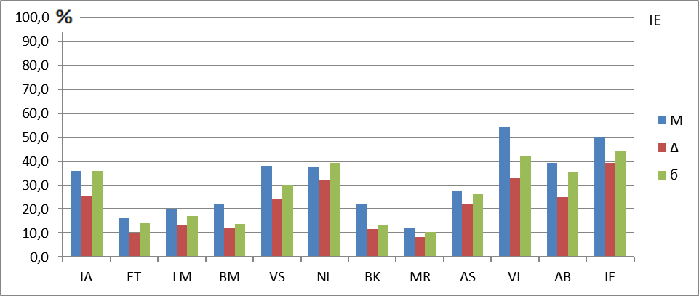
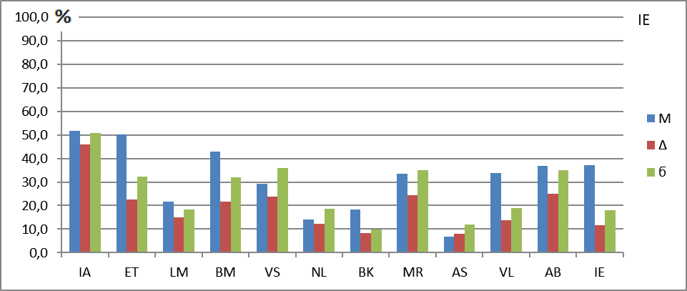
Average PPR of Subjects with Fixed Software Settings
Averaged PPR of subjects with fixed program settings: start Max,
N = 25, PEPS = 5 s.
Averaged PPR of subjects at fixed program settings: start Min,
N = 25, PPVS = 5 s.
Notes:
Let’s now consider the unconscious response to neutral and multifactorial stimuli when starting from the maximum and minimum values ​​of brain activity. Let me remind you that six left stimuli are neutral, and six right are multifactorial.
Note that when starting from the maximum, the most pronounced is the unconscious reaction to the right stimuli (upper graph), and when starting from the minimum, the reaction to the left stimuli is most pronounced (lower graph).
All the results described so far have concerned the study of the unconscious reaction of the subjects to the presented stimuli.

Slide 13
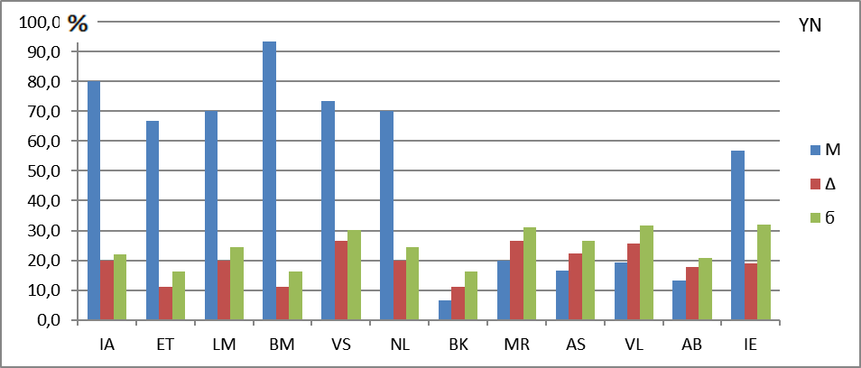
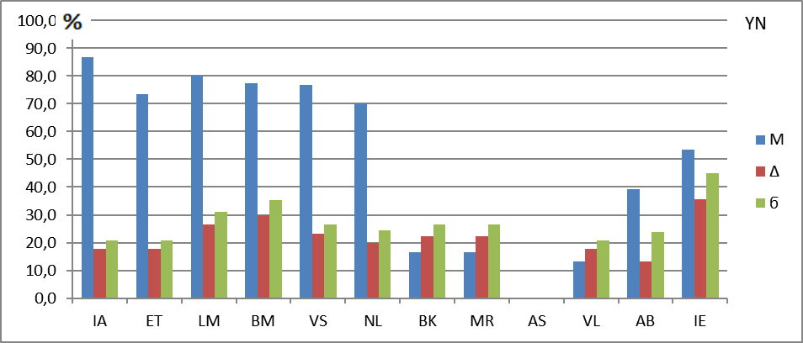
Conscious Responses of the Subjects
Averaged conscious response of the subjects with fixed program settings: start Max, N = 25, PEPS = 5 s.
Averaged conscious response of the subjects with fixed program settings: start Min, N = 25, PPVS = 5 s.
Notes:
On this slide, we will consider the profiles of the subjects' conscious responses at the start of stimuli presentation from the maximum position of brain activity (upper figure) and minimum position (lower figure).
It follows from the above figures that the conscious responses of the subjects (answers Yes-No) also differs at different initial moments of presentation of stimuli. For example, when starting from the maximum, the conscious responses to the 4th stimulus prevails, and when starting from the minimum, to the first. The conscious responses to multifactorial stimuli is also noticeably different; it has zero value when responding to the fourth stimulus from the end only in the lower figure.

Slide 14
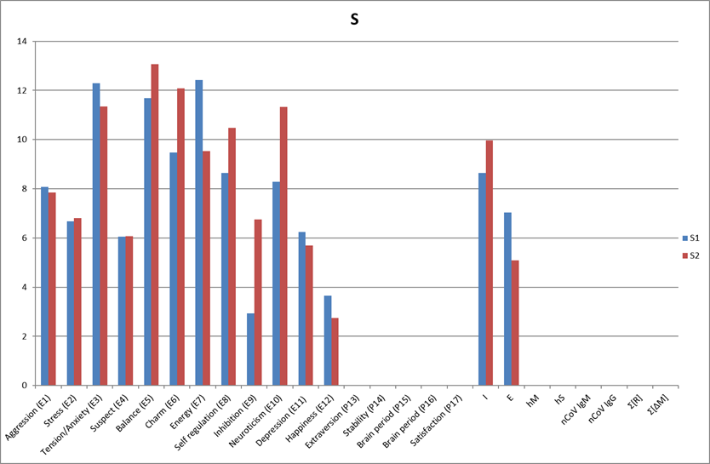
SD of PPS parameters at Different Testing Start
Averaged SD values ​​of PPS parameters at the start of testing
with the maximum (Max) value (group 1 blue bars) and minimum (Min) values ​​(group 2, red bars).
Notes:
Since VibraNLP program allows registering not only the response to stimuli, but also creates standard M files with instantaneous and averaged values ​​of behavioral parameters, it was interesting to see their change when starting from the minimum and maximum positions of brain activity. The most significant changes in the groups were observed for the SD of the Inhibition parameter; the value of the spread of this parameter at the start from the minimum of brain activity was more than 2 times higher than the value of the spread of Inhibition at the start from the maximum point of brain activity.
Thus, the study revealed significant changes in behavioral parameters not only from the magnitude of the period of the presented stimuli, but also from the moment of presentation of the ongoing physiological, more precisely, chronobiological processes.

Slide 15
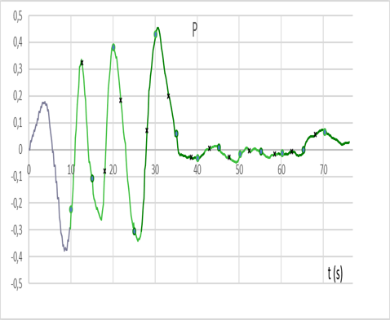
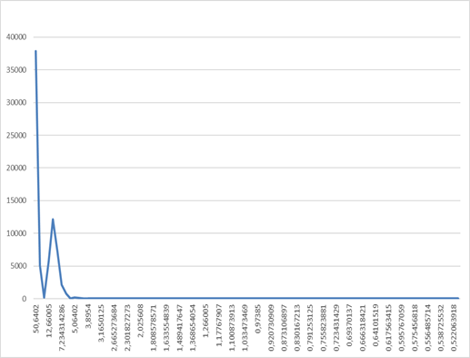
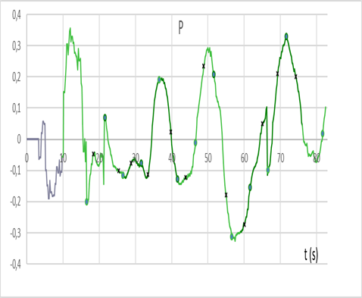
Chronobiology and Homeokinesis
Explicit dependence of the stimulus response to the type of stimuli
Implicit dependence of the stimulus response to the type of stimuli
Notes:
The reasons for these dependencies are homeokinesis and the chronobiological relationship of behavioral parameters. These graphs show the possibility of changing the nature of the chronobiological process of brain activity under the influence of external factors, but no external factors can cancel the periodicity of changes in time for each behavioral or physiological parameter.
Presumably, the chronobiological dependence of most of the behavioral parameters makes it possible to ensure greater evolutionary stability for a person as a biological species. Each language has its own sayings, such as "measure seven times, cut once", or "count to 10 until a decision is made." Most likely, a short pause allows a person to assess decision-making from different angles on a biological level, because every second a person changes, at the moment he is no longer the same as he was a second ago.
Was the ancient Greek philosopher Heraclitus right when he argued that one cannot enter the same river twice? Most likely, not quite right, since when monitoring a psychophysiological state, one can choose identical points (minimum or maximum) at which a person is in approximately the same psychophysiological state.

Slide 16
Conclusion
Chronobiological rhythms affect unconscious and conscious responses that differ at opposite points of brain activity rhythm − the beginning of growth (Min) and the beginning of a decline (Max).
Conscious and unconscious responses to stimuli depend on the period of their presentation. For periods of stimuli presentation 5-15 seconds, is necessary to use various algorithms for processing stimulus response.
One-minute variability in behavioral parameters is no less important characteristic of a personality than the average value of a behavioral characteristic.
The results allows to look optimistically at the possibility of practical implementation of a quick one-minute profiling to an arbitrary factor with an objective stimulus material with accuracy not inferior to classical psychophysiology.
Notes:
Study have shown a significant effect of human chronobiological rhythms, primarily the rhythm of brain activity, on his unconscious and conscious reactions, which differ significantly at opposite points of the rhythm of brain activity or PPS - the beginning of growth (Min) and the beginning of decline (Max), and PMA can vary from several seconds to a minute when changing the stimuli affecting a person.
The reliability of the hypothesis put forward about the variability of the conscious and psychophysiological response of the subject to the stimulus, depending on the state of brain activity, is confirmed by the results obtained.
The lack of accounting for chronobiological rhythms when conducting psychophysiological studies significantly reduces the accuracy and reliability of the results obtained. Synchronization of the start of the moment of presentation of stimuli with chronobiological processes and, first of all, with respect to BAP, can significantly increase the accuracy and stability of the determination of PPS and IFS.

Slide 17
Thanks for the Attention!
Viktor Minkin
CEO Elsys Corp
e-mail: minkin@elsys.ru
www.elsys.ru
www.psymaker.com
Notes:
Thank you all for your attention!

