Slide 1
VIBRAIMAGE TECHNOLOGY DISTRIBUTION
IN JAPANESE MARKET
Kotoha Nonaka
Marketing 1st Div.

Slide 2
CONTENTS:
Introduction
Marketing Strategies
Brand Positioning
Media Appearance
Challenges
Japanese Tendency
Safe Environment
Application Cases
Conclusion

Slide 3
MARKETING STRATEGIES

Slide 4
II. MARKETING STRATEGIES:
Brand Positioning
Renaming as “DEFENDER-X” and “Mental-Checker”
-> Efficient establishment of brand images
-> Right market targeting
Participation in Exhibition
-> Gain of remarkable attention from Japanese major companies because of the system’s uniqueness
-> Gain of business partnerships

Slide 5
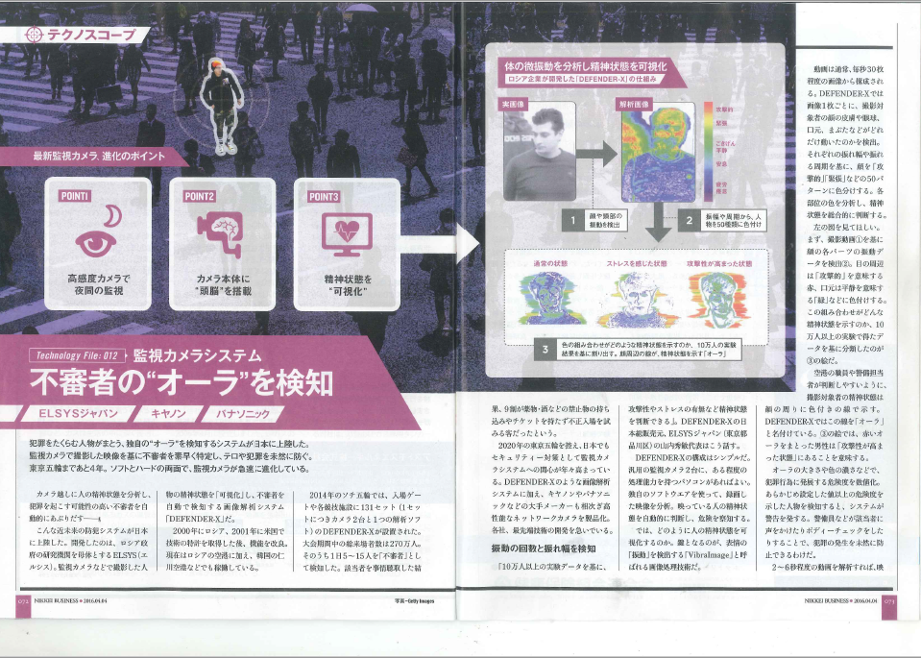
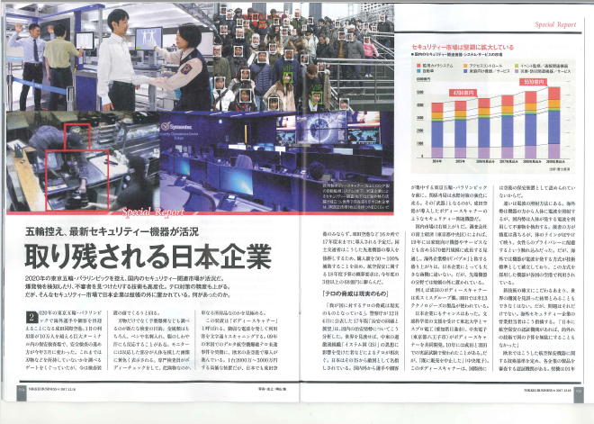
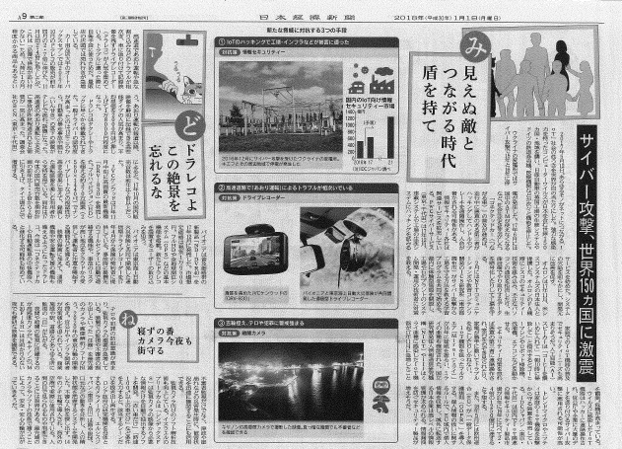
II. MARKETING STRATEGIES:
Media Appearance
DEFENDER-X and Mental-Checker have been covered by major TV channels and newspapers
- Example1: Nikkei (the most common economic press)

Slide 6
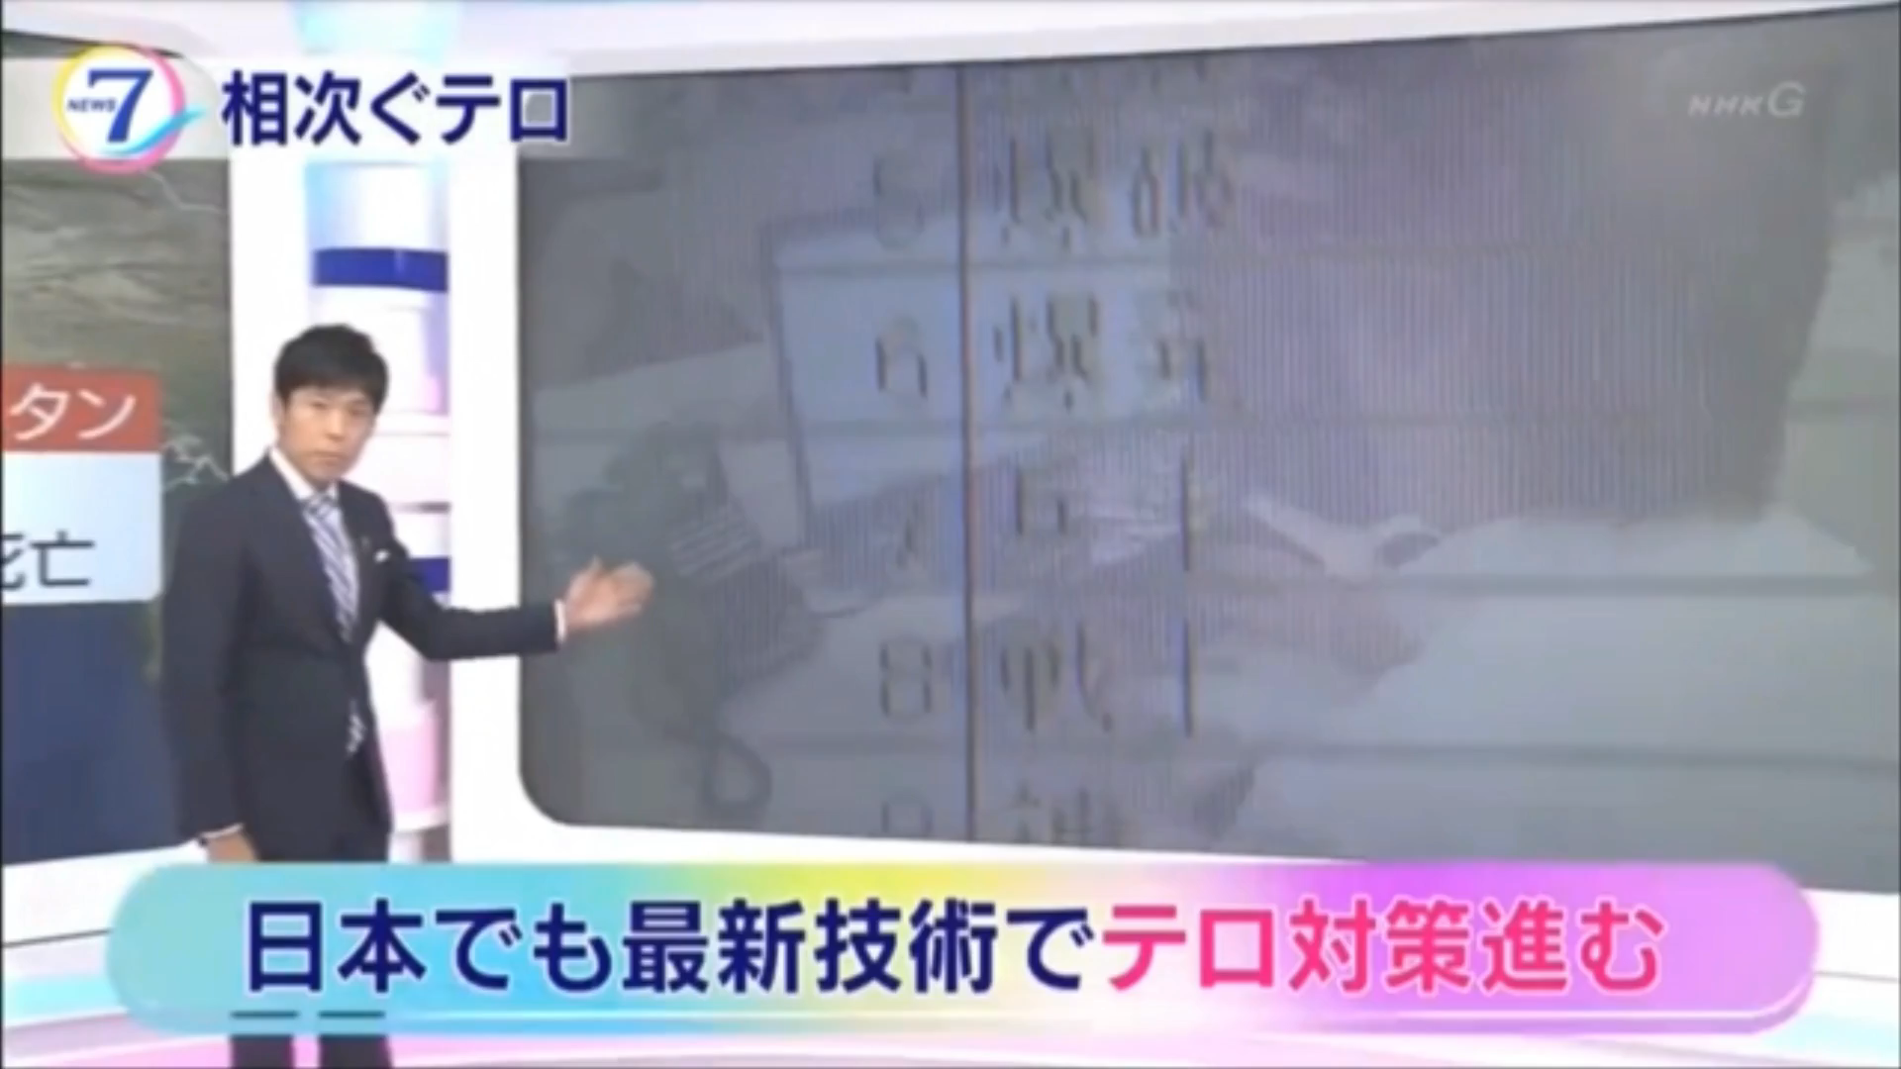
II. MARKETING STRATEGIES:
- Example2: NHK (only public broadcaster)
About 40 times of media coverage in 2.5 years

Slide 7
II. MARKETING STRATEGIES:
03/09/2016 RBB TODAY internet news
04/04/2016 Nikkei Business
06/19/2016 Fuji Television Network “Wide na Show”
07/10/2016 Nikkei Sangyo Shimbun
07/14/2016 AM Radio Station “NHK Journal”
07/28/2016 Fuji Television Network “OUT×DELUXE”
08/24/2016 Nikkei Sangyo Shimbun
10/03/2016 Nippon Television Network Corporation “WORLD GREAT TV”
11/27/2016 Tokyo Broadcasting System Television, Inc. “Gattiri Monday”
12/29/2016 TV Asahi Corporation “Morning Show”
12/30/2016 Tokyo Broadcasting System Television, Inc.
“TBS Houdou no hi 2016”
Nikkei Business Publications “Nikkei technology prospects
2017 -100 technologies which will change the world-“
(pp. 209-210)
01/30/2017 The Nihon Keizai Shinbun
04/01/2017 Kanagawa Shimbun (article about Defender-X Installation at Yokohama Ōsanbashi Pier)
05/14/2017 Tokyo Broadcasting System Television, Inc. “Hayashi-Sensei ga Odoroku Hatsumimi-gaku!”
05/28/2017 TV Asahi Corporation “TV Tackle”
05/28/2017 NHK “News 7”
06/15/2017 Nippon Television Network Corporation “Ikegami Akira ga Oshietai! Jitsuha …
na Hanashi”
06/22/2017 Weekly Shinchō June 29, 2017 Issue
10/04/2017 Nippon Television Network Corporation “news every.”
11/10/2017 Image Lab (monthly journal) Vol.28 No.11
11/11/2017 Fuji Television Network “MEZAMASHI
SATURDAY”
12/18/2017 Nikkei Business
12/25/2017 Radio Life (monthly journal) January issue
01/01/2018 The Nihon Keizai Shinbun
02/14/2018 The Nihon Keizai Shinbun electronic edition
03/10/2018 Image Lab (monthly journal) Vol.29 No.3
03/16/2018 NHK “Kinyo Ichikara”
03/31/2018 BS TBS “AI will change the future!”
04/16/2018 NHK “News Shibu5ji”
04/22/2018 Asahi Shimbun
05/01/2018 Tokyo Broadcasting System Television, Inc.
“Oshiete morau mae to ato”
…and more!!

Slide 8
CHALLENGES

Slide 9
III. CHALLENGES:
Japanese Tendency
Hedging risks is more important than taking risks
-> Showing cautious attitude to carry new, unknown technology
Japanese Safe Environment
Lack of a sense of danger against terrorism or serious crimes like murders
-> Focusing on preventing lighter crimes such as shoplifters to address the current needs

Slide 10
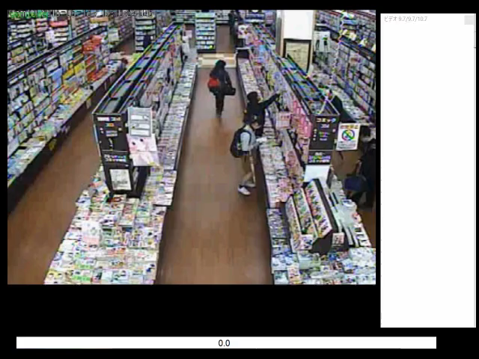

Slide 11
APPLICATION CASES

Slide 12
IV. APPLICATION CASES:
Domestic Cases
From retail stores to state-controlled facilities
International conventions and sporting events
International Cases
PyeongChang 2018 Winter Olympics
-> Expected to expand the application areas
internally and externally

Slide 13
CONCLUSION

Slide 14
THANK YOU!!

