Slide 1
DIAGNOSTICS OF CHARACTER ACCENTUATIONS IN DIFFERENT VARIANTS OF PSYCHOPHYSIOLOGICAL RESPONSES DYNAMICS
The 1st International Open Science Conference "The Vibraimage World."
NIKOLAENKO Y.N.

Slide 2
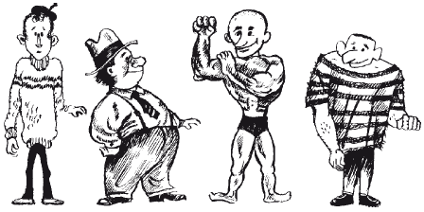
What is the difference between character and temperament?
Character and temperament are interrelated and depend on the physiological characteristics of the personality, on the types of higher nervous activity.
Notes:
Character and temperament are interrelated and depend on the physiological characteristics of the personality, on the types of higher nervous activity.

Slide 3
Character and temperament …
Temperament determines the dynamic characteristics of the individual's behavior, while character determines the conscious actions
Notes:
Temperament determines the dynamic characteristics of the individual's behavior (the level of general mental activity, the speed of reactions, the pace of work, etc.), while character determines the conscious actions of people in accordance with their moral and ethical norms, social values, needs and interests. This issue was raised quite sharply in connection with the specification of diagnostic criteria of extreme norm of character manifestations. Thus, despite the biological nature of the origin of the temperament, the nature and variations of its dynamics are a priority in predicting the behavior of a person and his social activity.

Slide 4
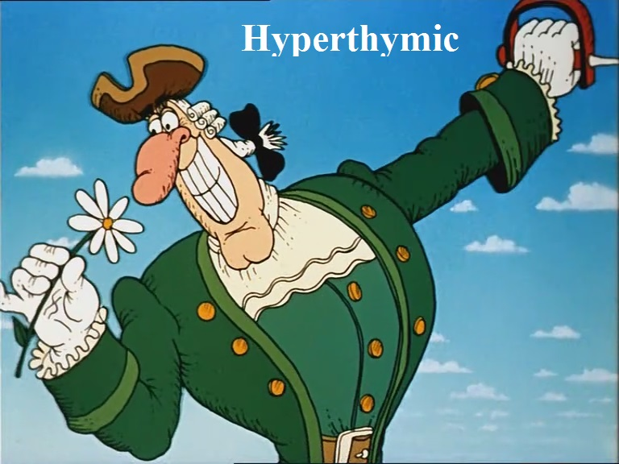
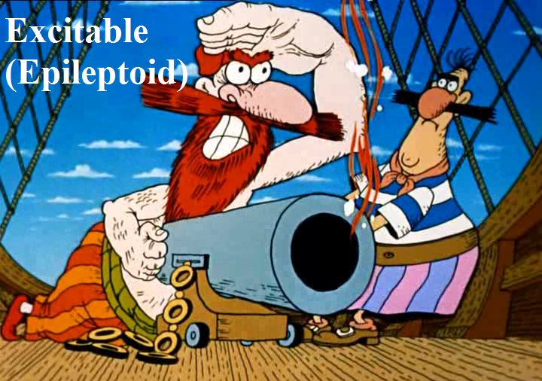
Accentuations of character …
Karl Leonhard (1968):
«Accentuation is, in essence, the same individual traits, but having a tendency to transition to a pathological state»
Notes:
The problem of diagnostics of borderline mental disorders is one of the central problems of psychiatry and psychology, as well as its separate branches.
In the full version, by Leonhard: "Accentuation" is traditionally understood as the extreme version of the norm of manifestation of character “.

Slide 5
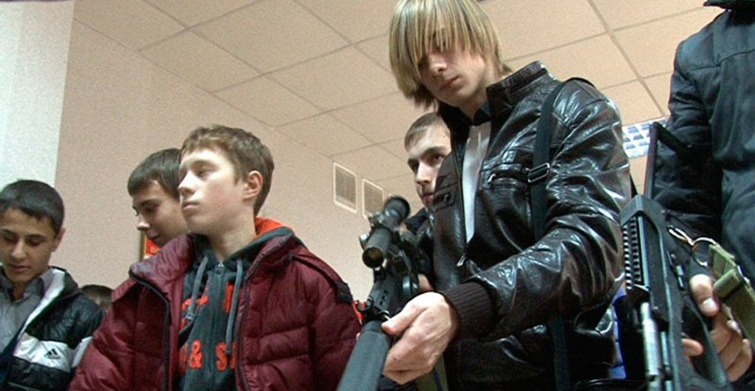
Higher risk of transition of character accentuation to a pathological level
Character accentuations higher risk of transition to a pathological level:
deviant behavior
delinquent behavior
Notes:
Character accentuations higher risk of transition to a pathological level: deviant behavior, delinquent behavior and other behavior problems. Character accentuations are a common phenomenon of adolescence. However, there is a certain segment of adolescents who have a higher risk of transition of character accentuation to a pathological level than their accentuated peers. This is a serious problem.

Slide 6
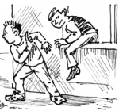
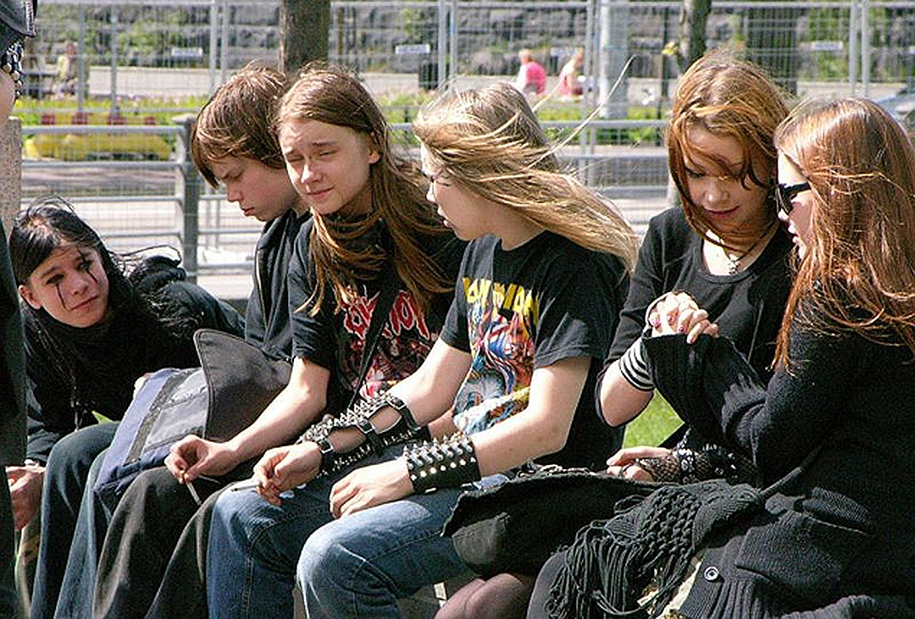
This is a serious problem. It is social problem
Character accentuations higher risk of deviant behavior:
to skip class
fights in school
Notes:
Since such adolescents are a real threat to society due to the reduced resistance of the psyche to exogenous and endogenous hazards. Accordingly, the solution of the problem that arises, involves the creation of a fundamentally new type of techniques with a higher predictive value than traditional psychological tests. This is a serious problem. Character accentuations higher risk of deviant behavior: to skip class, fights in school (between schoolchildren and even between schoolchildren and school staff).

Slide 7
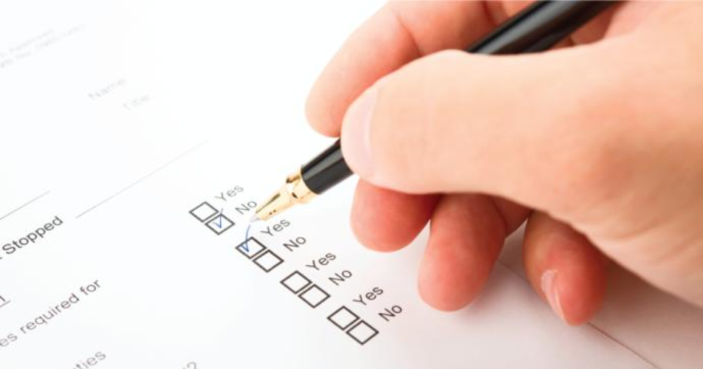
Vibraimage technology + accentuations of character = PsyAccent
conscious
The vibraimage allows you to register in real time, both conscious and unconscious "answers" to the questions of the questionnaire.
unconscious
Notes:
The vibraimage technology is one of the modern technologies that allows real-time tracking of the dynamics of psychophysiological reactions of a person on a number of parameters. If we consider the answers of the test subject as a criterion of conscious attitudes, then certainly there are unconscious attitudes. Unconscious attitudes are much less plastic than the conscious ones because they are not attached to a situational factor.
The vibraimage allows you to register in real time, both conscious and unconscious "answers" to the questions of the questionnaire.
This approach allows achieving greater predictive accuracy than the traditional survey method. The test results are more stable than in the traditional questionnaire because they reflect the average values between conscious and unconscious attitudes

Slide 8
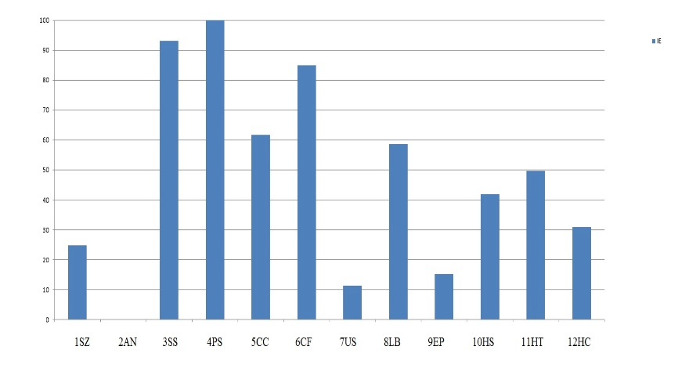
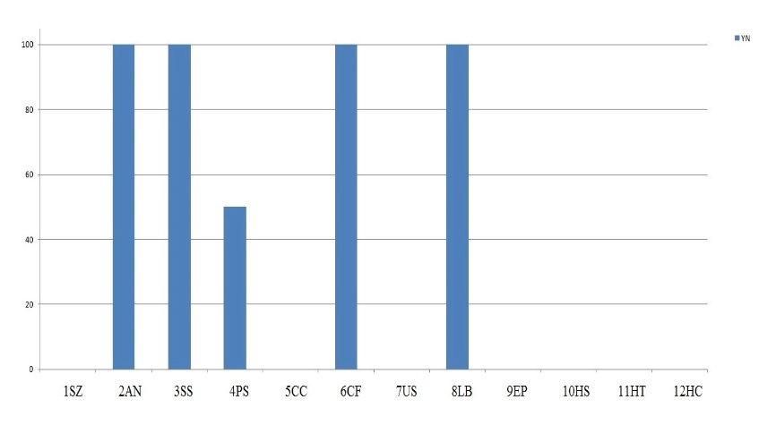
Vibraimage technology + accentuations of character = PsyAccent
The vibraimage allows you to register in real time, both conscious and unconscious "answers”…
Unconscious "answers”
Сonscious answer
Notes:
The test results are more stable than in the traditional questionnaire because they reflect the average values between conscious and unconscious attitudes. However, these are not all the advantages of this technology. For the first time, it becomes possible to diagnose a tendency to accentuations of character not only in the polar mode of YES / NO answers, but also to trace the dynamics of the psychophysiological state, i.e. in what aspects the mechanisms for compensating for accentuated traits are manifested, and how much they are developed (the level of hypercompensation or psychological defenses)

Slide 9
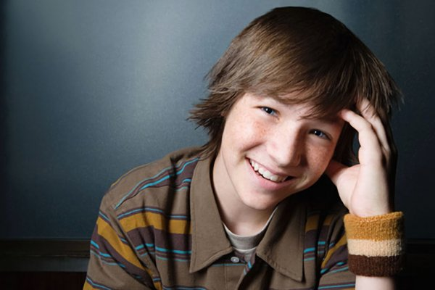
PsyAccent
The PsyAccent program contains 3 questionnaires:
• L12 - for adults (developed with reference to the concept of K. Leonhard)
• T12 - for adolescents and young men (developed with the support of A.Ye. Lichko's concept)
• PA - to determine the psychological compatibility of the patient and the doctor (developed with the support of A. Gnezdilov A.V concept)
Notes:
The PsyAccent program contains 3 questionnaires: L12 - for adults, T12 - for adolescents and young men, PA - to determine the psychological compatibility of the patient and the doctor. During the development of PsyAccent, we tried to take into account the main features of the age-related dynamics of character accentuations, as well as the likelihood of a complex life situation - such as late disease, which has a malignant course. The RA questionnaire is intended to help medical workers whose specialization is the treatment of malignant tumors.

Slide 10
Subject K., aged 17. Conscious answers
Legend:
Schizoid (SZ); Asthenoneurotic (AN); Sensitive (SS)
Psychasthenic (PS); Cycloid (СC); Conformal (CF)
Unstable (US); Labile (LB); Epileptoid (EP)
Hysteroid (HS); Hyperthymic (HT); Hyperthymic - Conformal (HC)
Notes:
Consider a specific example:. Standard psychological questionnaires allow to register only conscious answers of the subject i.e. only with a reliance on the results of self-assessment. According to diagram, there is a tendency to asthenoneurotic, sensitive, conformal and labile types (по классификации Личко) of accentuation equally expressed. At the same time, it is quite obvious that altogether four types of accentuation cannot be expressed in the same way in one person, regardless of the kind of questionnaire method he uses.

Slide 11
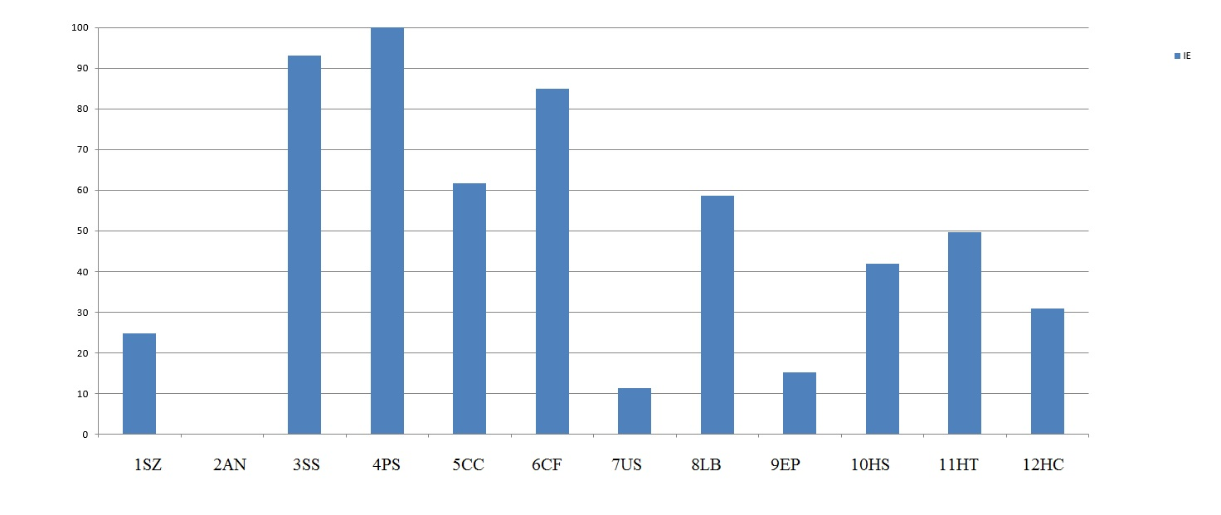
Subject K., aged 17. Unconscious responses (psychophysiological reaction)
Legend:
Schizoid (SZ); Asthenoneurotic (AN); Sensitive (SS)
Psychasthenic (PS); Cycloid (СC); Conformal (CF)
Unstable (US); Labile (LB); Epileptoid (EP)
Hysteroid (HS); Hyperthymic (HT); Hyperthymic - Conformal (HC)
Notes:
Diagnostics of accentuations of character based on the psychophysiological state (PPS) has a greater prognostic value than with a reliance only on the conscious responses of the subject. With this approach to diagnostics, it is impossible to obtain two or more identical reactions, as it was done in the analysis of conscious responses. Thus, in this subject, a psychasthenic and sensitive types of character accentuation predominate.

Slide 12
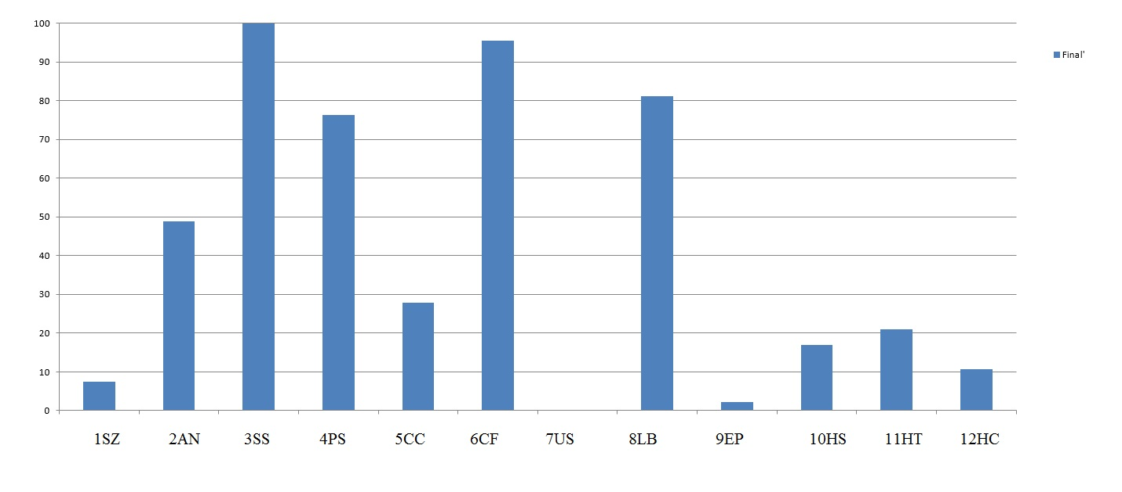
Subject K., aged 17. The average profile of accentuations character (based on the results of conscious responses and psychophysiological reactions).
Legend:
Schizoid (SZ); Asthenoneurotic (AN); Sensitive (SS)
Psychasthenic (PS); Cycloid (СC); Conformal (CF)
Unstable (US); Labile (LB); Epileptoid (EP)
Hysteroid (HS); Hyperthymic (HT); Hyperthymic - Conformal (HC)
Notes:
The obtained averaged data, between conscious responses and unconscious attitudes (in the form of a certain dynamics of psychophysiological reactions), in our opinion, more objectively reflect the tendency to accentuations of character than just conscious answers or unconscious attitudes. According to the data presented in diagram, it is possible to diagnose a mixed type of accentuations of character, with a predominance of sensitive (SS) and conformal (СF) traits. The results obtained have not only diagnostic but also prognostic value. With this type of combination of accentuations of character, there is the probability of deviant behavior. However, it can be assumed that the transition to the pathological level is tied to the defensive function of the psyche according to the sensitive type, or it is a consequence of the influence of the asocial group of peers, according to the conformal type.

Slide 13
Results
Possible to combine, within the framework of one tool (PsyAccent), the diagnostic and prognostic functions of the dynamics of borderline states, using the example of accentuations of character.
The study of accentuations of character in adolescents with the help of the vibraimage technology, in the mode of assessing conscious and unconscious responses, increases the reliability of the results obtained.
There is an opportunity to differentiate the accentuated adolescents of an increased risk group for the pathological dynamics of accentuations of character to the field of mental disorders and illegal actions.

Slide 14
Thank you for your attention!
Nikolaenko Y.N.
Ph.D
nikolaenko@elsys.ru
www.elsys.ru
www.psymaker.com

