Slide 1
The 2nd International Open Science Conference "Modern psychophysiology. The Vibraimage technology”
TYPICAL ERRORS OF VIBRAIMAGE TECHNOLOGY USERS
Sergey Didenko,
Elsys Corp., RF, St. Petersburg,
sergey@elsys.ru
Notes:
We always get feedback from the user and system customers, and have compiled statistics about frequent user errors. Typical errors, the reasons of this errors, and methods of elimination are presented in this report. This information will be useful for partners, customers and resellers of VibraImage Systems, for operators and technical support specialists.
The Vibraimage system (Vibraimage) is based on the vibraimage technology [1] and is designed for recording, analyzing and researching the psychophysiological state (PPS) of a person.

Slide 2
3 steps to result
1. Video
2. Processing
3. Results
Notes:
The first step - video. System uses a video fragment, which can come directly from a video camera or from a videofile. The amount of input information, the duration of this video and its quality, is a very important to calculate accurate results.
The next step is video analysis using special algorithms, in accordance with the settings made by the operator. On the final step system display the results of the analysis for operator or make text document with report. Also system can start some action (alarm etc.). The practical experience shows, that errors can appear at each of these steps and it is extremely important to avoid it during system operation.

Slide 3
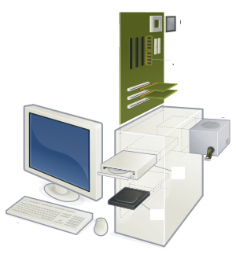
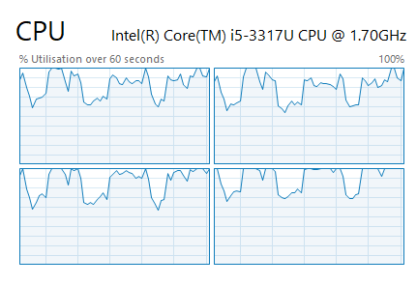
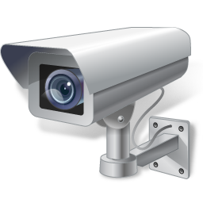
Hardware errors
Notes:
Already at the step of choosing the hardware, you should pay attention to the requirements specified in the system user manual.
To work with each specific vibraimage system, use descriptions dedicated to a specific system. For example, sometimes customer want to use computer with low-power processor.
Same situation with camera-sometimes it can`t work with system.

Slide 4
Setup errors
Notes:
It is necessary to install all the necessary components in accordance with the user manual for a software product to start system and work with it correctly. Otherwise, the system will not start or can work incorrectly. For example, error when somebody try to run system without driver of the key. In this case, system will not run.
To make installation right please reat user manual or additional articles.

Slide 5
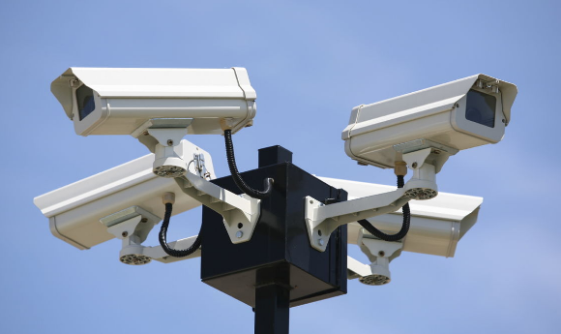
Place for camera
Notes:
Error may appear on the camera installation step. For example, installing the camera on a vibrating surface. This may be mounting the camera to the laptop screen, or you can put the camera on the table.
Therefore, the movements of the subject or operator can go through the table to the camera. In addition, in some cases, camera can be installed in public places. Moreover, vibrations transmitted through the structures of buildings. For example: vibrations from trains: at the station or vibrations from the elevators and escalators in shopping malls.
The cameras should be mounted on a solid base or tripod that provides sufficient stability.

Slide 6
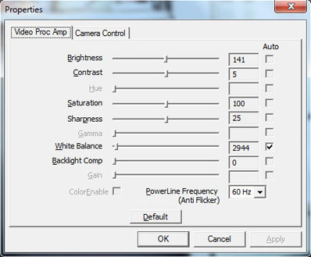
Camera settings
Notes:
In addition, it is necessary to remember that modern video cameras have the automatic functions. These functions can provide a good image for home purposes, but not always compatible with the vibraimage system. For example, parameters such as autofocus, auto exposure or auto noise reduction (meaning the suppression of digital noise of the image) can adversely affect the results.
Therefore, users should disable all automatic functions for the camera (depending on the specific situations, the installer partially enables the auto functions system), of the camera settings before starting the experiment or after restarting the system.

Slide 7
Low quality of video
Notes:
In some cases, can be a situation when low-quality video comes from the camera. This can occur for various reasons: the poor quality of the camera, low image quality settings, using of codecs, greatly reducing the quality.
The same error applies to video files obtained from any resources like youtube or stored independently by another programs Therefore, the quality of the incoming video should be carefully monitored visually and using special tools included into the system and described in the instruction manual.

Slide 8
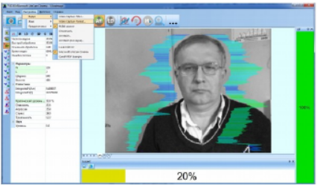
User errors
Notes:
Operators often allow a situation when a person or persons are located in the frame incorrectly.
To get correct results, it is necessary to carefully monitor that the person or persons in the frame are located in accordance with the requirements detailed in the description for the system.
To avoid this error, you should use the automatic quality control function, independently monitor the correctness of the object location and make trainings, allowing the operator to independently detect errors of this kind.
Operator should be able to understand influence of the error on the result and stop the experiment if it will be necessary. For example, during video recording for lie detection, someone distracts a person in a frame, the frequency of input frames drops critically, or another person passes in the background.
It is possible that the automatic error control function signals a low video quality, and research continues. Of course, this is not good situations to get accurate results, and it is necessary to start experiment again.
Sometimes, it can be not very good idea to analyze video in real time without video recording. It is better to record a video file during important experiment. So in case you can make the same test, but with different system settings.

Slide 9
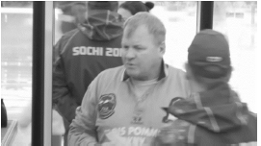
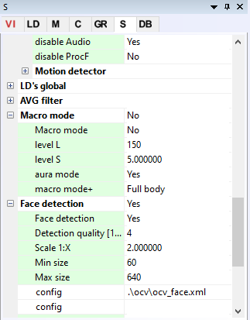
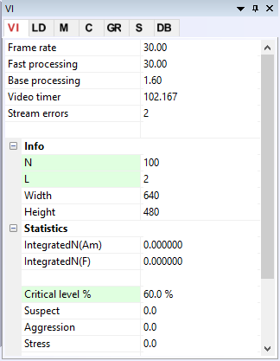
Incorrect settings/preset
Notes:
Modes that are designed to work with many people in the frame and those that are designed to work with one person in the frame, work differently. The most accurate results can be obtained if you work optimally.
For example, if you will use the «Micro» mode, when there are several people in the frame, results will be not very accurate. Several people in the frame − it is necessary to use the specially developed «Mix» or «Macro» modes for this.
Another very frequent mistake is working with the «macro» mode and «mix» mode with wrong choice of face detection algorithm or with wrong settings. You must choose parameters that are suitable for a particular system configuration.
This is influenced by many factors: camera angle, light, the number of people in the frame, the size of the room etc. An example is the choice of face detection mode, intended for the case when a person is sideways to the camera, when all people in the frame are facing this camera. Of course, often the operator tries to change the system settings, without having a complete idea of ​​the degree of this to the result. In such cases, detailed personnel training should be conducted in accordance with the level required to operate with the system.
At the same time, more superficial knowledge will be sufficient for the operator to work with the «Macro» mode, rather than working with lie detection. Also, in some cases, it is required to block the ability to change important parameters or not to show the interface to change them.
Always write the system settings in a separate file, if they differ from the default settings. Only a joint analysis of the system settings along with the recorded video can establish the reasons for a possible error in the operation of the vibrating image system or incorrect user actions.

Slide 10
Integration errors
Notes:
Vibraimage technology allows to integrate it with other security systems, or to write your own application using video analysis algorithms based on this technology. SDK and a brief for developers with the necessary information were developed for this case.
As practice shows, frequent problems during working with the SDK are not technical competencies, but a bad understanding of the system basic principles and bad understanding of important principles of working with technology.
To avoid difficulties during developing software that uses algorithms of vibraimage technology, you should carefully study and understand all the requirements for the input video, as well as evaluate the fundamental possibility of the project.
For example, the idea of ​​positioning a camera on a moving car to scan a crowd with high accuracy seems to be unrealizable. Also, you can use a special API that allows you to develop your application. You can receive video analysis results in a special format from the server. For software engineers, the technical component is also not complicated. However, as is the case with the SDK, it is not enough to understand the purpose of this tool.
You must understand the limitations of technology, which leads to difficulties in project implementation.
In some cases it is necessary to combine several computers with installed vibraimage systems into a network. For example, it can be useful to solve the problem of processing video from several cameras and displaying the results of the analysis to a single operator. To implement such architecture, special solutions were developed

Slide 11
Conclusion
For correct operation of software products based on Vibraimage technology, it is extremely important to understand the basic principles of the system.
Trainings should fully give an idea of the basic requirements for working with the system.
Notes:
For correct operation of software products based on Vibraimage technology, it is extremely important to understand the basic principles of the system [1-12], which allow avoiding other errors that are not described in this article. At the same time, special attention should be paid to the training of operators and users. Trainings should fully give an idea of the basic requirements for working with the system.
In addition, before starting any research or collecting information about several subjects, it is necessary to check the correctness of the video and system settings.

Slide 12
Thank you for attention!
Sergey Didenko,
Elsys Corp., RF, St. Petersburg,
sergey@elsys.ru
Notes:
Thank you for attention!

