Slide 1

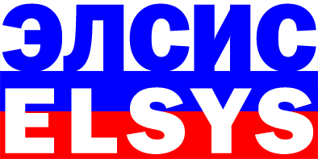
FORECASTING STUDENTS' PROGRESS AT UNIVERSITY EDUCATION BY TESTING MULTIPLE INTELLIGENCES USING VIBRAIMAGE TECHNOLOGY VIBRA_MI PROGRAM
P. I. Satserdov, V.A. Akimov, O.Y. Martinov, V.A. Minkin, Y.N. Nikolaenko, A.S. Kolpakov, M.S. Kupriyanov
Elsys Corp, Russia, Saint Petersburg
ETU «LETI», Russia, Saint Petersburg,
Notes:
Dear Colleagues. I am pleased to present you the second part of research of students multiple intelligence in LETI University. The main aim of this research was to check how could manipulative behavior with hidden motivation to miss classes influence to the results of MI testing.

Slide 2
Test’s conditions
Test period 20.11.18 – 10.12.18
Tested persons first-year students of the Faculty of Physics and Technology LETI
Students age range 17 – 20 years
Quantity of tested persons 84
Sex range 29 girls, 55 boys
Ethnic composition 100 % Russians
Notes:
To reach this aim in 2018 year were tested 84 first-year students of the Faculty of Physics and Technology LETI.

Slide 3
Test’s differences
 | 2017’s test | 2018’s test
Tested persons | All students | Students, who wants to be tested
Notes:
In comparison with 2017’s research, the research in 2018 had 1 main difference. Standard pre-test briefing was expand by information that pass the test could “person, who wants to do it”. So the concept “all students” was replaced by “students, who wants” to miss institution lessons.

Slide 4
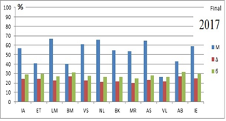
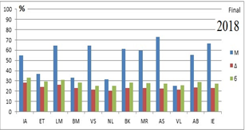
MI profile of 2017 and 2018 years testing
Logical-mathematical – 67 %
Natural – 65,5 %
Ascetic-Sacrificial – 64,6 %
Ascetic-Sacrificial – 72,6 %
Interpersonal – 66,9 %
Logical-mathematical – 66,5 %
Notes:
Matching of common MI profiles in 2017 and 2018 demonstrated differences is the rate of leading MI’s type. Logical-mathematical type in 2017 was the first over the Natural and Ascetic-Sacrificial MI types. But in 2018 Logical-Mathematical MI types is only on third place. At the same time, Ascetic-Sacrificial and Interpersonal are on the first and second places. It’s interesting, there are two same values in the percentage of Logical-Mathematical MI types in two independent selections for two years, but its found differences in the profile’s structure. This fact correlates with the hypotheses about impossibility to make a conclusion of abilities to technical or humanitarian sciences only on high percentage of one MI type.

Slide 5
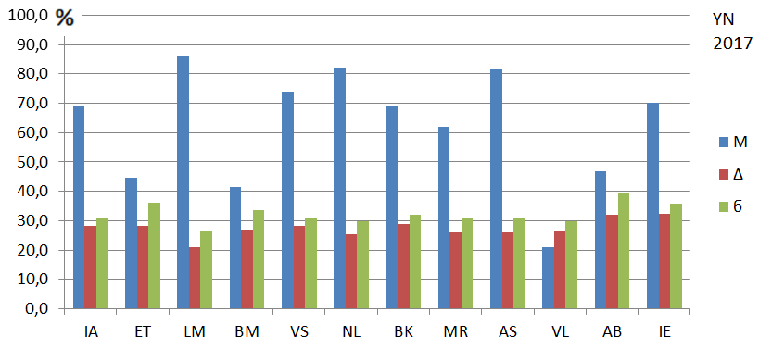
YN common profile of 2017 and 2018 years testing
Logical-mathematical – 83,6 %
Natural – 82 %
Ascetic-Sacrificial – 81,7 %
Ascetic-Sacrificial – 91,6 %
Interpersonal – 81,5 %
Logical-mathematical – 79,2 %
Notes:
Common profile of Conscious reactions in 2017 and 2018 are rather different. The LM MI type moves from the first to the third place. It shows that conscious opinion of students abilities changed. In 2018 year the interpersonal MI type is higher than Intrapersonal, what is typically for humanitarian profile. It confirms by values of logical-mathematical and visual-spatial types, which are lower than in 2017.

Slide 6
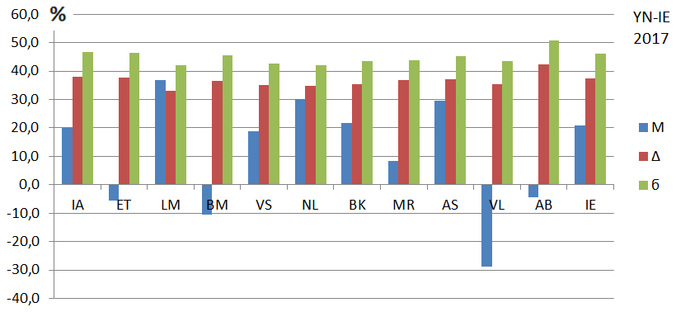
YN - IE common profile of 2017 and 2018 years testing
Logical-mathematical – 36,7 %
Natural – 30 %
Ascetic-Sacrificial – 29,5 %
Ascetic-Sacrificial – 39,5 %
Interpersonal – 32,9 %
Logical-mathematical – 27,3 %
Notes:
The difference between conscious and unconscious reactions with transition to the negative values illustrates the high individual significance of MI type. The range between minus 20 and 20 is coincidence of desired and valid. When the value is lower than minus 20, it means that this MI type is very significant with the unconscious reaction. The value higher than 20 is significant for conscious reaction.
Negatives values in 2018 shows that students are less satisfied about their personal successes. Verbal-linguistic MI type is the lowest in 17 and 18 both. It illustrates the typical difficulties of technic profile students. The high level of Interpersonal and Ascetic-sacrificial types shows that the common MI profile in 2018 is more social then in 2017.
There were changed stimulus – the pictures and questions - of the Natural MI type to decrease social desirability of the answers. So the level of the natural MI type in 2018 is lower that in 2017.
It can be added that first-year students consciously decreases some of their abilities – for example Existential-Theoretical and Verbal-linguistic. But unconsciously its abilities are developed rather well – more that students are thinking about them by themselves.

Slide 7
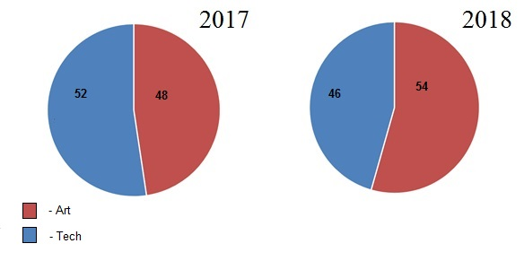
Art and Tech ratio
Notes:
Moreover, matching results of tests in 2017 and 2018 illustrated increasing of social profile over technical ones from 48 % to 54 %. We think, it gives a confirmation of theory of impossibility to make a conclusion of abilities to technical or social profile basing on raw data of Logical-Mathematical MI type percentage.

Slide 8
Results division
 | Based on | Group 1 | Group 2 | Group 3
Division 1 | Unified State Exam (USE) | average rating less 239 | average rating from 240 to 260 | average rating over 260
Division 2 | First exams (1S) | average rating less 3 | average rating from 3,01 to 3,99 | average rating over 4
Notes:
84 students, who has been tested by VibraMI, were divided into 3 groups, basing on Unified state exam – the exam that every person should pass in the end of school education and first exams results after the first semester in the University like in 2017. Summary results of USE were the measurement of progress’s estimation. Students were divided into 3 groups. In addition, based on first exams results students were divided into 3 more groups, depending on passing 4 exams. The first group contained students with the least progress. The second group contained students with average rating from 3 to 4. Student with average rating over 4 were in the third group.

Slide 9
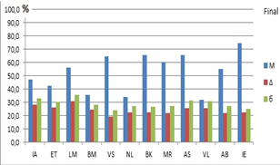
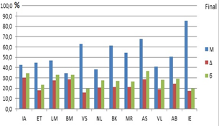
Group’s 1 MI profile (hidden motivation)
Div. 1 (USE):
1. Interpersonal – 74,7 %
2. Bodily-Kinesthetic – 65,9 %
3. Ascetic-Sacrificial – 65,4 %
…
6. Logical-Mathematical – 56,1 %
Div. 2 (1S):
1. Interpersonal – 85,3 %
2. Ascetic-Sacrificial – 68 %
3. Visual-Spatial – 63 %
…
7. Logical-Mathematical – 47 %
Notes:
Analysis of USE results in group 1 – students with the least progress, illustrated the dominance of interpersonal MI type. Second and following places are Bodily-Kinesthetic and Ascetic-Sacrificial. Logical-Mathematical MI type is on the 6-th place in the group of the least USE results. Matching USE results with first exams results, another disposition of MI types was found: Interpersonal, Ascetic-Sacrificial and Visual-Spatial are the first. Logical-Mathematical MI type is on the 7-th place. In 2017 it was 5-th place with 58,4 percentage. On the one hand, in matching USE and first exams result, Logical-Mathematical goes from 6-th to 7-th place in the MI types hierarchy, but on the other hand, differences in its rating is rather large – 56.1 % and 47 %. Comparison of group 1 results in 2017 and 2018 by rating of Logical-Mathematical MI type descending from 58.4 % in 2017 year to 47 % in 2018 year. These results confirm the fact, that tested persons had hidden motivation to miss the classes and weakest students were tested.

Slide 10
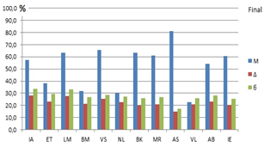
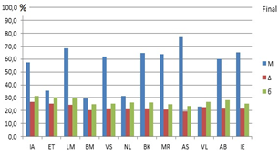
Group’s 2 MI
Div. 1 (USE):
1. Ascetic-Sacrificial – 81 %
2. Bodily-Kinesthetic – 63,3 %
3. Logical-Mathematical – 63,2 %
Div. 2 (1S):
1. Ascetic-Sacrificial – 77,1 %
2. Logical-Mathematical – 68,5 %
3. Interpersonal– 65 %
Notes:
According to the results of group 2 testing, logical-mathematical MI type is on the third place, whereas Ascetic-Sacrificial is the first and Bodily-Kinesthetic is the second. These results are in correlation with the first exams results. Logical-Mathematical MI type of student from group 2 goes to the second place. Ascetic-Sacrificial like mostly is the first placed, the third is Interpersonal. It seems, that student with the middle progress have a really good potential. The same trend is in 2017’s tests: Logical-Mathematical MI type is the second by USE results and on the first place by first exams results. Thus, students with middle progress had not hidden motivation to miss classes, comparative with the first group students.

Slide 11
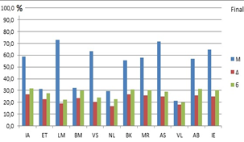
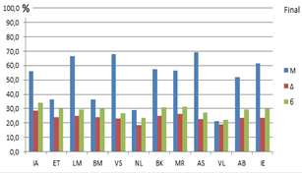
Group’s 3 MI
Div. 1 (USE):
1. Logical-Mathematical – 73,1 %
2. Ascetic-Sacrificial – 71,5 %
3. Interpersonal – 64,9 %
Div. 2 (1S):
1. Ascetic-Sacrificial – 69,3 %
2. Visual-Spatial – 67,9 %
3. Logical-Mathematical – 66,5 %
Notes:
On the first place of MI types in group 3 students with the highest progress is Logical-Mathematical, the second is Ascetic-Sacrificial, then is Interpersonal. After first exams, MI types disposition changed: the first became Ascetic-Sacrificial, the second – Visual-Spatial, then Logical-Mathematical. In 2017 Logical-Mathematical MI type was the third and by USE results, and by the results of first exams. This results gives a possibility to suggest, that group 3 in 2018 are weaker by their potential that students from group 3 in 2017. The most obvious suggestion is that the most successful student had not tested, because they prefer to visit classes.

Slide 12
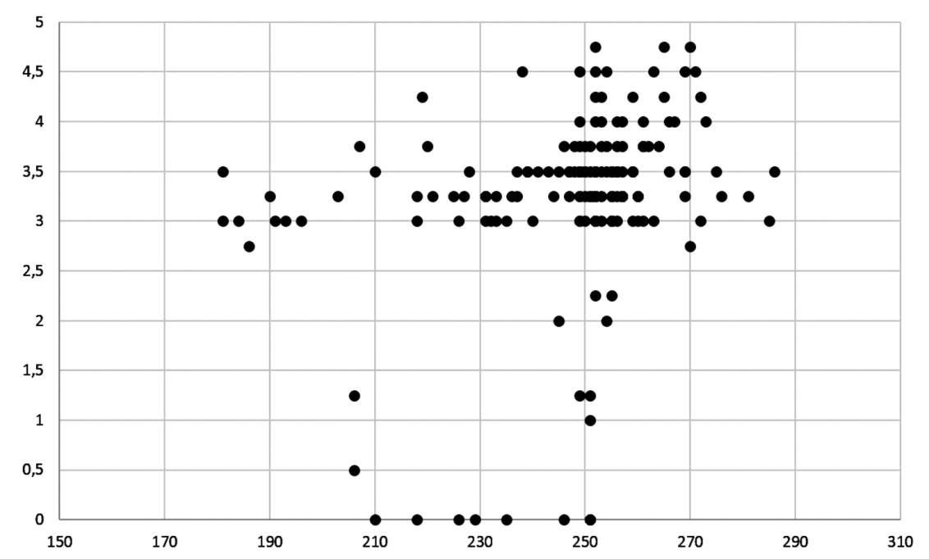
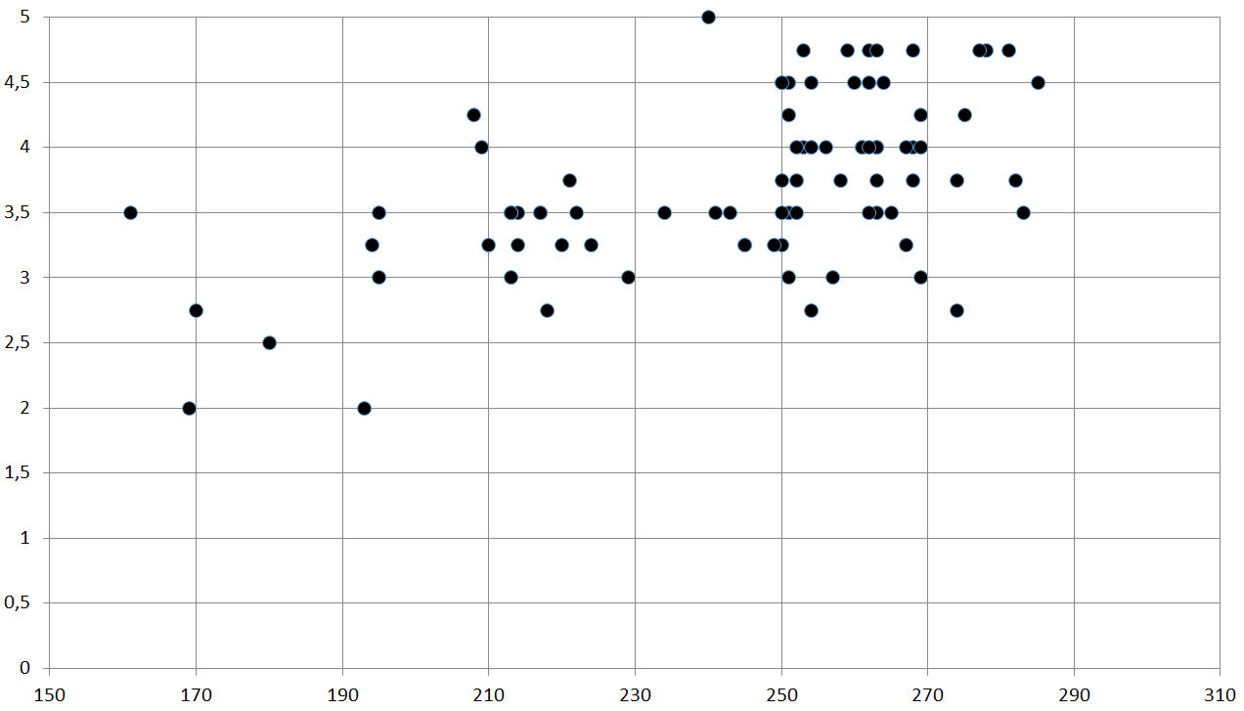
USE – 1S correlation
2017 year:
161 students;
0,28 PCC
2018 year:
84 students;
0,55 PCC
Notes:
The results of 2017’s research doesn’t illustrated the correlation between USE results and the results of the first exams. The Pearson correlation coefficient in 2017 was only 0,28. In 2018 this coefficient goes up to 0,55. It could be explained with the differences of university entrance’s rules. In 2018 the passing score of USE to enter the University was much lower.

Slide 13
USE – 1S correlation
2017 year:
161 students;
0,28 PCC
2018 year:
58 students
(without paid studying);
0,25 PCC
Notes:
When the results of the contract students (with low level USE results) in 2018 were deleted from the division, correlation decreased to 0,25. This value is very close to 2017, when it was necessary to have high score of the USE to start studying.

Slide 14
USE – 1S correlation
(free studying)
2017 year:
131 students;
0,16 PCC
2018 year:
54 students;
0,11 PCC
Notes:
Another interesting results matching is comparison of students who are studying for free and who are the winners of the different Olympiads in 2017 and 2018. The PCC between USE results and the results of the first exams is the lowest – 0,16 and 0,11.

Slide 15
USE – 1S correlation
PCC = 0,145;
Students: free studying
and Olympiad’s winners
Years: 2017-18
PCC = 0,272;
Students: all from 2017 and
free studying in 2018
Years: 2017-18
PCC = 0,55;
Students: all in 2018 (low passing
score to enter the University)
Years: 2018
Notes:
Here you can see dependence of the USE and the first exams results to PCC. From the first graph the higher USE results does not give the same high results of the first exams in University. So the PCC is low – only 0,145. The highest PCC is for students who were enter the University with the lowest USE score.
The second grand demonstrate that the best first exams result was showed by student with the lowest USE score.

Slide 16
Logical-Mathematical MI type
 | Group 1 | Group 2 | Group 3
2017 | 58,4 % 5 place | 66,1 % 1 place | 69,3 % 1 place
2018 (1S) | 47 % 7 place | 68,5 % 2 place | 66,5 % 3 place
Notes:
As we always focused on logical-mathematical MI type, lets match the percentage of its type in different years. But the expectation that this MI type is the most important to forecast students progress wasn’t confirm.

Slide 17
Conclusion
High USE results doesn’t guarantee successful studying in the University.
MI profile could make more successfully forecast about success in the University than USE.
Hidden motivation could influence to the results of MI testing.
4. It is impossible to make a conclusion of abilities to technical or social sciences only on high percentage of one MI type.
5. The most successful student weren’t tested.
Notes:
At the end, I want to make some results of the research. The main aim was reached – and we can confirm that hidden motivation of tested person could influence to the results.
Other result is that researches in 2017 and 2018 showed that high score of USE doesn’t guarantee any success at University education. It is more predictively to estimate MI type of the person to make a forecast about its future education success.
Other thesis of the researches is that it is impossible to make a conclusion of abilities to technical or social sciences only on high percentage of one MI type. So the MI profile shows the interest to the chosen specialty. But, unfortunately, the most successful student weren’t tested, because they prefer to visit classes.

Slide 18
Thanks for the attention!
Pavel Satserdov
elsys.ru
psymaker.com
Notes:
I thank all colleagues for your attention. I am sure that vibraimage technology will make life more safer, lasting and happy! Please, ask your questions, I will answer on it.

