Slide 1
DEVELOPMENT AND APPROBATION THE METHOD FOR STIMULI PRESENTATION DURING TESTING OF MULTIPLE INTELLIGENCES BY VIBRAIMAGE TECHNOLOGY
The 2nd International Open Science Conference "Modern psychophysiology. The Vibraimage technology"
Nikolaenko Yana
Ph.D, Senior Researcher Elsys Corp.

Slide 2
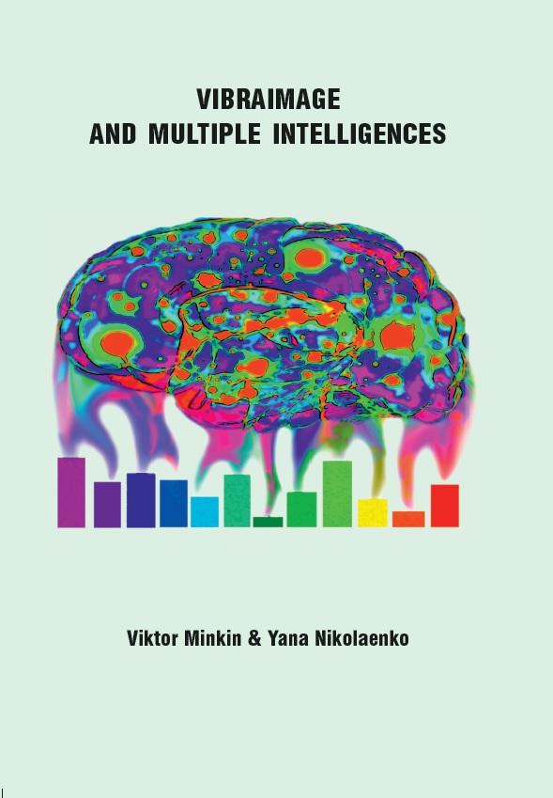
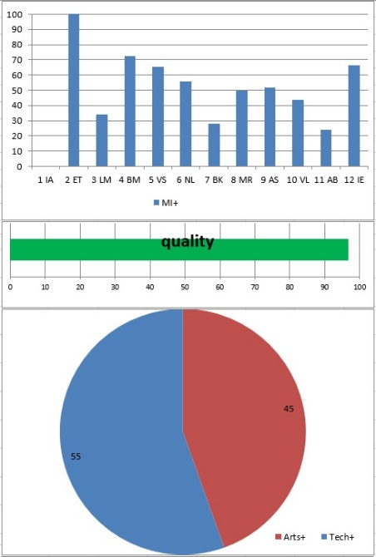
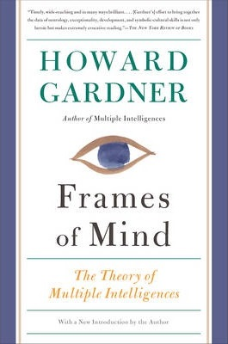
The VibraMI program
VibraMI – diagnostics of the person’s leading abilities, indicating specific areas of professional self-realization
Notes:
VibraMI program presents the augmented and expanded to 12 types classification of Gardner’s multiple intelligences, indicating the possibility of self-realization in a specific professional sphere. A questionnaire was developed in 24 questions, allowing diagnosing the severity of each of the multiple intelligences based on the current psycho-physiological state and the conscious responses of the subject.

Slide 3
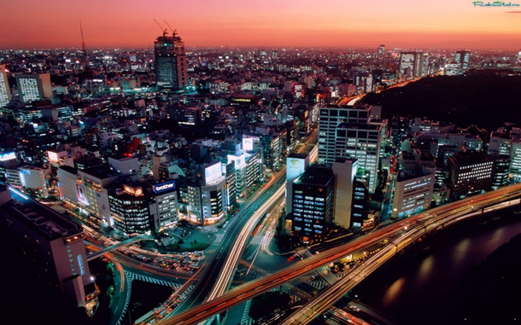
In 2018 year …
The principles of stimuli selection were analyzed:
questions-stimuli
stimuli-images
Details considered typical errors in the selection of incentives
Notes:
In 2018, for the first time, the results of stimuli selection used in VibraMI program were published based on the vibraimage technology. The principles of stimuli selection were analyzed: questions-stimuli and stimuli-images (factor of social desirability of answers, conflict of desires and possibilities, etc.). In the process of selecting stimuli, difficulties were identified in the dosing of the informational and emotional component, as well as a number of other problems that impede obtaining a statistically stable psychophysiological reaction. In this regard, it was decided to continue the study on the selection of incentives needed in working with software based on the vibraimage technology.

Slide 4
In 2019 year …
Participants
72 adolescents studying in secondary schools were tested in the age range of 14-16 years. It is 40 boys and 32 girls were tested
Notes:
It is necessary to experimentally confirm or disprove the validity of the existing incentives used in the linear opposition structure of the Gardner_12 questionnaire. This was done on 72 teens (teenagers). (дальше – текст из слайда).

Slide 5
Linear opposition structure of the Gardner_12 questionnaire and correlation analysis of pairs of questions: 2 and 11 pairs
The significance of differences with p ≤ 0.05
Notes:
The principle of MI pairs arrangement − opposition. The further in relation to the center (the sixth and seventh pairs form the center) are located pairs, the stronger the correlation. What is important: the correlation between questions responses is negative, not positive. The location of not only within the couple, but also for central symmetrical pairs is oppositional. Intrapersonal (IA) and interpersonal (IE) MI are located at the edges, forming a pair of 1 and 12. The key in determining the humanitarian or technical profile are the Logical-Mathematical (LM) and Bohemian-Artistic (AB) MI pairs, (-0.62), which are no less opposition in nature. Approaching the center marks a weakening of the correlation dependencies, their decay or even a transition to positive values: a pair of Visual-Spatial (VS) and Musical-Rhythmic (MR) MI (no correlation), Natural (NL) and Body-Kinesis (BK) MI, (0.35).
Thus, the Philosophical couple (PH) and Bohemian-Artistic (AB) MI are the most alarming. For these pairs, a small positive correlation of 0.12 was obtained (the significance of differences with p ≤ 0.05). There was a need to correct incentives.

Slide 6
Bohemian-Artistic/Creative MI types
Previous version Art-Bohemian (AB) | Current version Creative (CR)
21. I easily get used to the necessary style | 21. Your creative nature doesn’t know rest
22. I don't like to stand out from the crowd | 22. Thinking are more important than an embodiment
Notes:
Initially, it was decided to replace incentives within the same pair. This pair has become Artistic-Bohemian (AB) MI. Since it is in this pair of questions (AB MI) the pair of affirmative answers (instead of the opposition ones) were most often encountered
The result of changing the wording of the questions was a shift in the content, from the artistic component of the personality, to a wider channel − the creative component. In addition, opposition between ET-AB pairs was strengthened by shifting the focus to philosophical knowledge, in question 22. Thus, double opposition was achieved − within the AB pair and between PH-AB pairs.

Slide 7
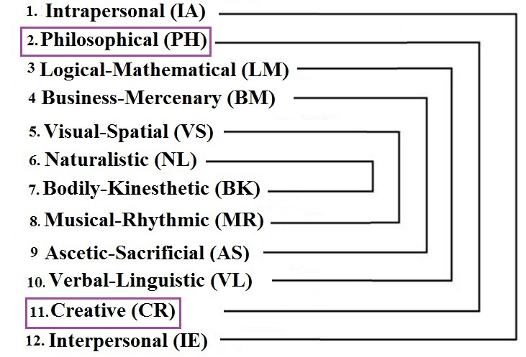
Изменения названия 11 пары МИ
Notes:
Accordingly, the name was changed from Bohemian-Artistic (AB) to Creative (CR). The changes also affected to visual stimuli (photo).

Slide 8
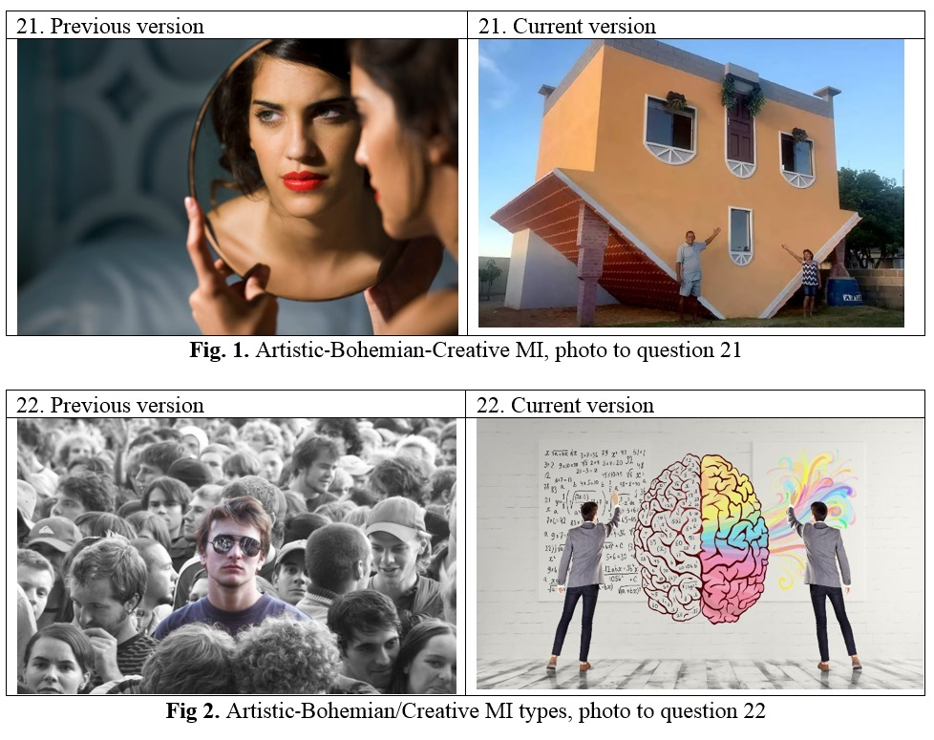
Коррекция стимулов: 2-я пара
Notes:
Selection of visual stimuli leads to the replacement of the stimulus photo, which was done. In our opinion, the unusual architecture of the house should have caused pleasant associations for a creatively gifted person, additionally provoking a positive answer to question 21 (fig.1). On the contrary, the existential choice between “comprehension” and “incarnation” was reflected in the form of the functional asymmetry of the brain (fig. 2).

Slide 9
Correlation analysis of MI types, after stimuli changing in Gardner_12
The significance of differences with p ≤ 0.05
Notes:
After replacing the stimuli questions and stimuli-photos in creative (CR) MI, a correlation analysis was performed again: The expected negative correlation was obtained, instead of the initial positive one, (tab. 3). However, the obtained correlation (-0.07), despite its negative values, turned out to be statistically unreliable. As it turned out, the majority of respondents answered in the affirmative as to question 3 of the Philosophical (PH), and to question 21 of the Creative (CR) MI type. Thus, the need to replace stimuli with Philosophical (PH) MI type.

Slide 10
Creative (CR) and Philosophical (PH) MI types, the result of changes in stimuli questions (final version)
MI type | Previous version | Current version
Creative (CR) | 21. I easily get used to the necessary style | 21. Your creative nature doesn’t know rest
 | 22. I don't like to stand out from the crowd | 22. Thinking are more important than an embodiment
Philosophical (PH) | 3. Philosophy gives readiness for every twist of fate. | 3. Lying on the couch and thinking is more important than fussing.
 | 4. Person must act, not thinking | 4. I have abilities to create something extraordinary
Notes:
It was decided to strengthen the emphasis on the dynamic component of the issues: passive-creative philosophical and actively-applied creative

Slide 11
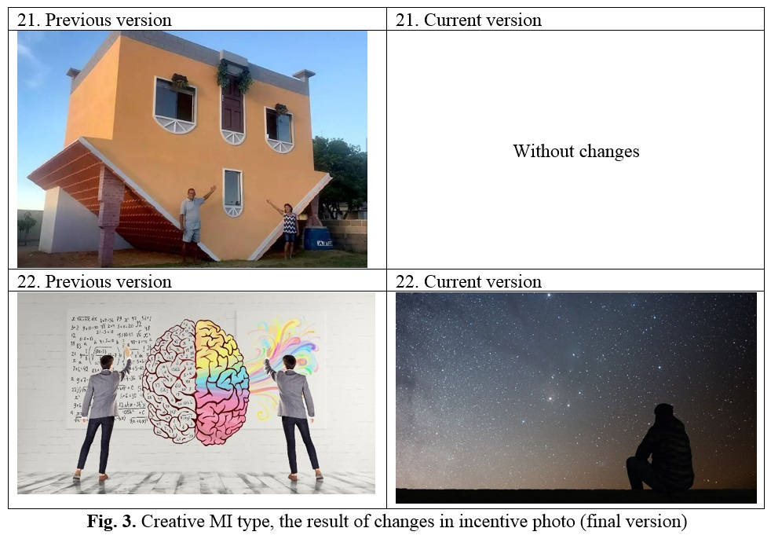
Notes:
Replacement of stimuli-photo creative (CR) occurred within 22 questions

Slide 12
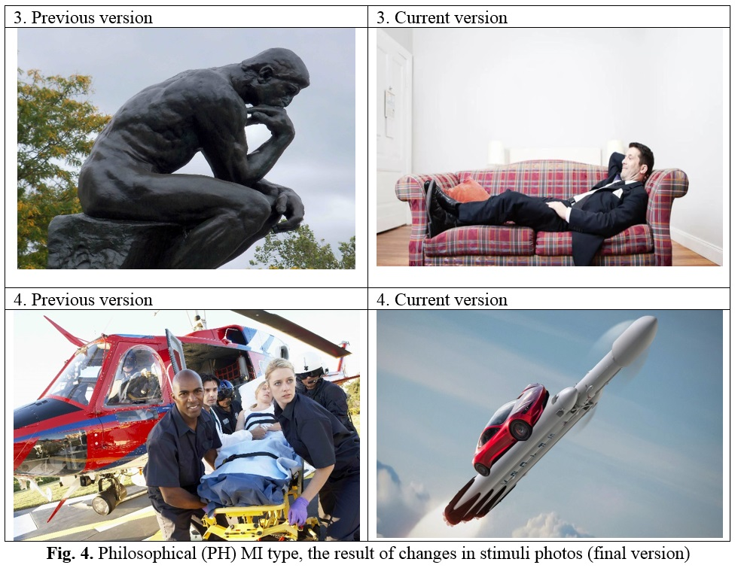
Notes:
The replacement of the stimulus-photo-philosophical (PH) was complete, due to significant changes in the content of the questions themselves: passive-creative philosophical and actively-applied creative

Slide 13
Correlation matrix analysis of MI types, after stimuli changing in Gardner_12 (final version)
The significance of differences with p ≤ 0.05
Notes:
After replacing the stimuli photos and stimuli questions in PH and CR MI, a statistically significant negative correlation was obtained (-0.29) between PH-CR pair. The obtained result shows that current stimuli questions and stimuli photos between ET- CR couple are chosen correctly for the line-opposite structure of the Gardner_12 questionnaire.

Slide 14
CONCLUSION
Replaced questions, incentives and photo incentives in the 2nd and 11th pairs of the VibraMI program questionnaire Gardner_12.
Conducted 3 pilot studies at different stages of the correction of incentives.
The validity of the available incentives used in the Gardner_12 questionnaire was confirmed.
Notes:
Заменены вопросы-стимулы и стимулы-фото во 2-й и 11-й парах опросника Gardner_12 программы ВибраМИ.
Проведены 3-и пилотажных исследования, на разных этапах коррекции стимулов
Подтверждена валидность имеющихся стимулов, используемых в опроснике Gardner_12.

Slide 15
Thank you for your attention!
Nikolaenko Y.N.
Ph.D
www.psymaker.com
Notes:
Thanks for you attention and welcome with questions!

