Slide 1


The 2nd International Open Science Conference
The Vibraimage Technology
PSYCHOLOGY VS BIOMETRICS AND CONSCIOUSNESS VS UNCONSCIOUS. ARE CONSCIOUSNESS AND UNCONSCIOUS THE ADDITIVE PARAMETERS?
Viktor Minkin
Elsys Corp, Russia, Saint Petersburg
2019
Notes:
Dear Colleagues. The topic of this report is quite philosophical, in practice it is a view of being and consciousness from a technical and metrological point of view.

Slide 2
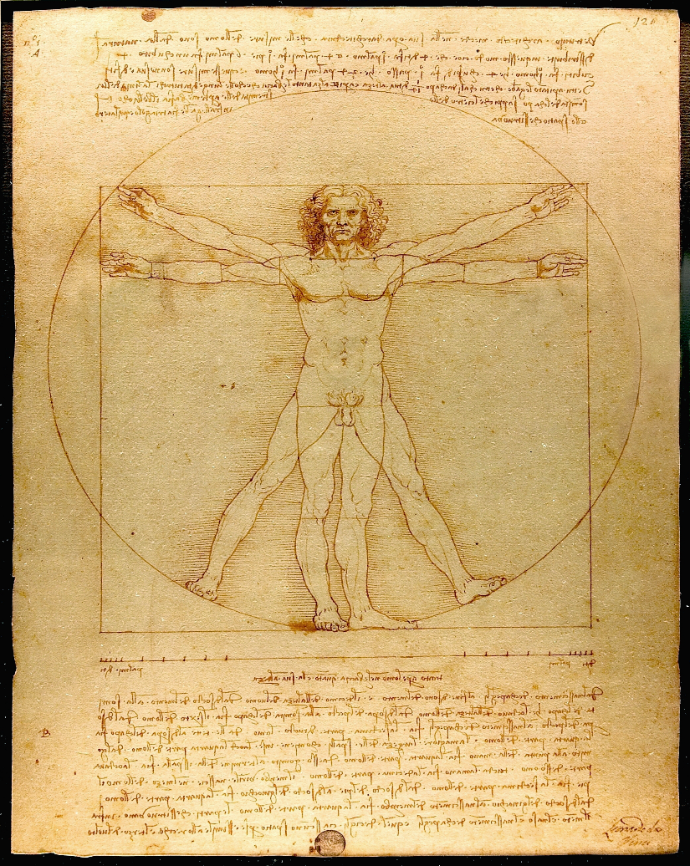
Human sciences
Social science
Natural science
Psychology
Biology
Sociology
Biochemistry
Demography
Biophysics
Ethnography
Genetics
History
Anatomy
Political science
Biometrics
Notes:
Currently, a number of sciences are engaged in the study of various characteristics of a person, each of which claims to be exceptional and the possibility of a complete or integral characteristic of the person being studied. In the existing classification, the science of a person is divided into natural and social, but there is no one unifying human science.

Slide 3
Modern psychology schools
Biological
Behavioral
Cognitive
Psychology
Psychometrics
Social
Psychoanalysis
Humanistics
…
3
Notes:
The leading position among the social sciences aimed at studying a person is occupied by psychology. Modern psychology includes a number of scientific fields, which are represented by a number of scientific schools. Each direction of psychology is focused on obtaining initial data and its own standards in psychometrics.

Slide 4
Biometrical sciences
Biology
Physiology
Genetics
Natural science
Biometrics
Biophysics
Biochemistry
Neurophysiology
…
Notes:
Many natural sciences are engaged in research of a person and are based on biometric data capturing. At present, is customary to limit biometry only to personal identification technologies, but according to the generally accepted definition of biometrics, any capturing and measurement of the biological and behavioral characteristics of a person are biometrical tasks.

Slide 5
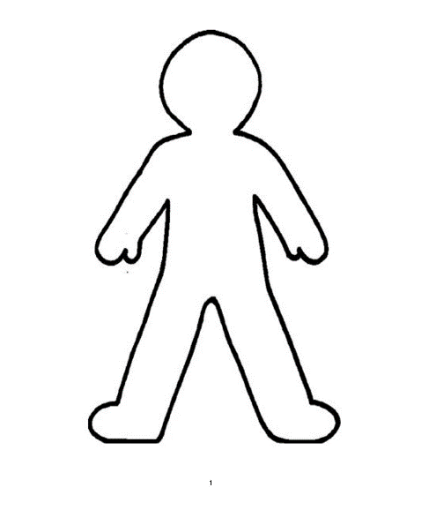
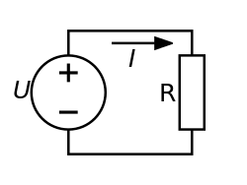
Systematic approach to the conscious and unconscious characteristics of a person
Psychometrics
Biometrics
Voltage
Electric current
Notes:
We systematize science directions for research tasks. Social science that study the characteristics of consciousness and conscious processes are based on psychometrics, while the natural sciences that study a person are based on the acquisition of its biological or unconscious characteristics. These two main components define each person as a unique personality.
But is it permissible to be limited to one of the components when characterizing any object of study?
Let's give the simplest example from the school program. To determine the resistance value, it is necessary to measure two independent physical quantities - electric current and voltage. Any number of measuring the various characteristics of the current could not calculate the resistance value, without measuring the voltage drop, it is impossible to obtain the resistance value. For the resistor its value is a personal characteristic.
However, most of the listed modern sciences claim to be independently able to obtain a full characterization of the personality. However, science is not something frozen, it is constantly develop. Most sciences investigating a person will disappear in the near or distant future, just as alchemistry disappeared. The criterion of each science is the objectivity of the obtained results, and it is impossible to obtain objective results by examining only a part of the information about the object.

Slide 6
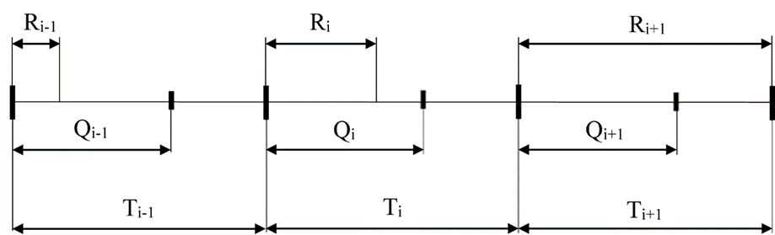
Unified approach to measuring the conscious and unconscious responses in VibraMI program
Fragment of the time diagram of the VibraMI program questionnaire
Qi - time of text question presentation;
Ti - time of stimulus picture presentation, which enhances and clarifies text question;
Ri - response time of a testee to the conscious answer to the question-stimulus.
Notes:
Let's move from general science reasoning to the description of the vibraimage technology, which makes it possible to simultaneously receive data on the conscious and unconscious human response to stimuli in the framework of the VibraMI program. The program is based on a questionnaire, the fragment of the time chart of which is shown on the presented slide. VibraMI program was developed on the basis of the genius thesis of Ivan Mikhailovich Sechenov, that thought is the first two thirds of the mental reflex. Our task was to transfer the test responses to reflexes and to make the result of the processing as objective and reproducible as possible. The VibraMI program contains 24 stimulus questions, the average time for each question presenting is 16 seconds and the total testing time is approximately 380 seconds, respectively.

Slide 7
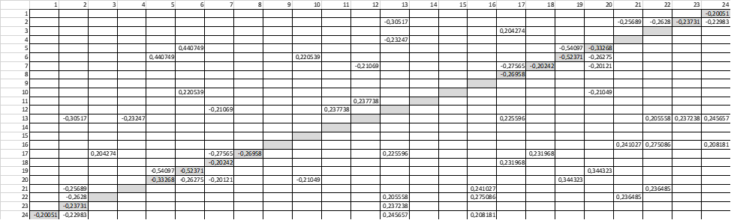
Measurement of conscious response
Correlation matrix of conscious responses to 24 questions, processed from the database of 512 testee (correlations (P) modulo more 0.2 are shown)
Assessment system of conscious responses for each pair of questions
Notes:
In testing process, a testee answers to the presented questions and stimuli are in the YES / No format or skips the answer if he doubts to answer. The specified discreteness of answers to each question does not allow to identify the existing patterns of conscious responses when answering each of 24 questions, which confirms the uncertain nature of the correlation matrix of conscious responses determined by the results of 512 subjects testing. In order to streamline conscious responses, a system was proposed for evaluating pairs of opposing questions in the bottom table of the slide.
As a result of testing by the VibraMI program in off-system measurement units or per-unit system, a conscious and unconscious responses to stimuli are determined, which are then converted into final profile of multiple intelligences of a person.

Slide 8
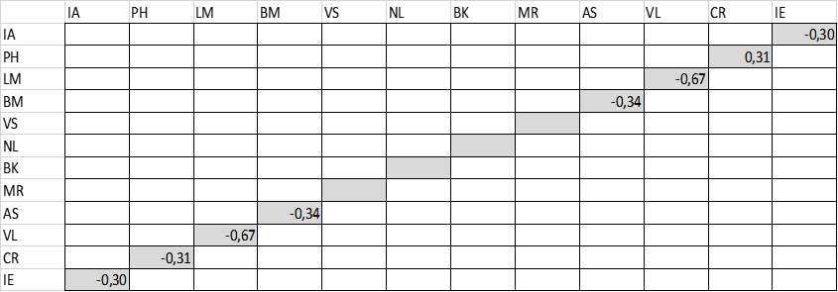
Conscious responses after pair processing
Correlation matrix of conscious responses to 12 pairs of opposite questions according to the results of 350 testing by VibraMI program
Notes:
This slide shows the correlation matrix of the conscious responses according to the test results of 350 testee using the VibraMI program, taking into account the processing according to the evaluation system of opposite questions indicated on the previous slide. The correlation matrix shows that all the noise left the correlation matrix defined on 24 issues, only negative correlations remained in the conscious responses between opposition MI types.

Slide 9
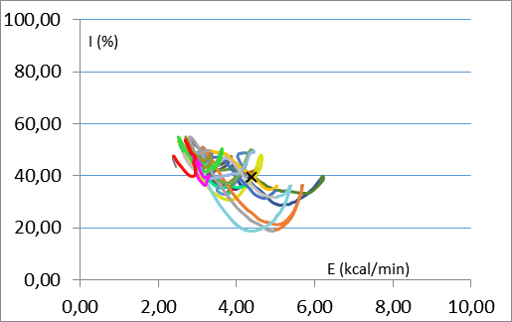
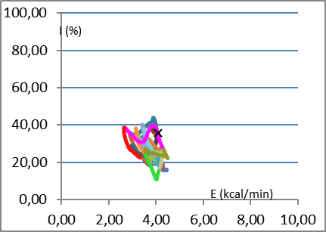
Unconscious human responses by vibraimage analysis
The PPS changes in information-energy scales by the analysis of opposition and complementary questionnaires
Notes:
Let's turn to the consideration of unconscious responses during testing by VibraMI and PsyAccent programs. Let’s consider typical examples of changes in the current psychophysiological state (PPS) of testee when persons are tested not only with the line-opposite questionnaire of VibraMI program, but also with the complementary questionnaire of PsyAccent program. From the given examples it follows that the nature of the PPS changes given in the scales of information-energy is similar in nature. Consequently, the negative correlation between information and energy, as well as variations in the PPS relative to the mass center of the PPS, does not depend on the meaning and content of the stimuli questions and is determined by the reflex processes of PPS regulation.

Slide 10
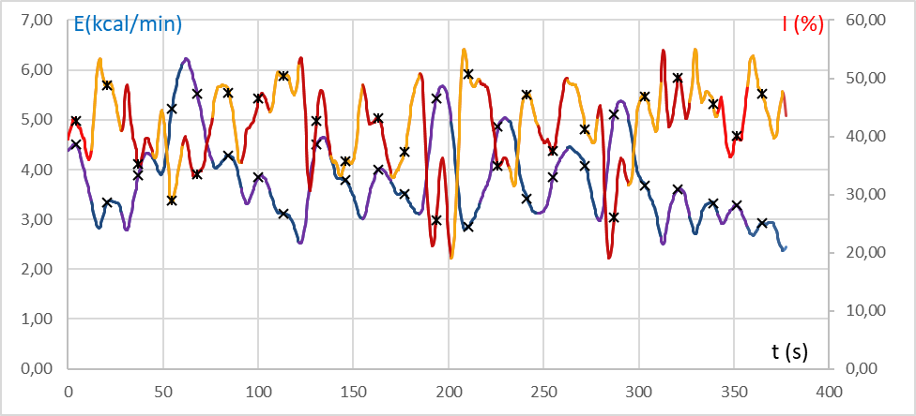
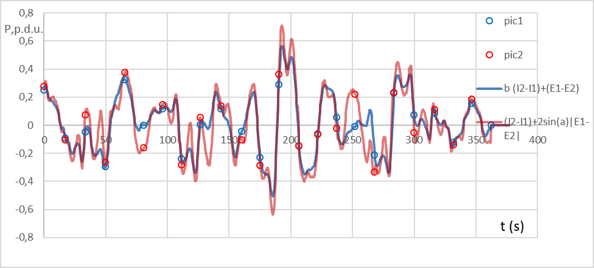
Changes in the information and energy components of PPS during testing
Time dependences of changes in the information and energy components of PPS
Time dependence of current PPS
Notes:
Additionally, we pay attention to the time dependences of changes in the information and energy components of PPS (upper graph) and the current PPS given in the lower graph. From the above temporal dependencies it also follows that during the passage of the questionnaire, the PPS fluctuates relative to the average level and the change in the direction of the PPR does not always occur at the moment of the end or the beginning of stimulus presentation.

Slide 11
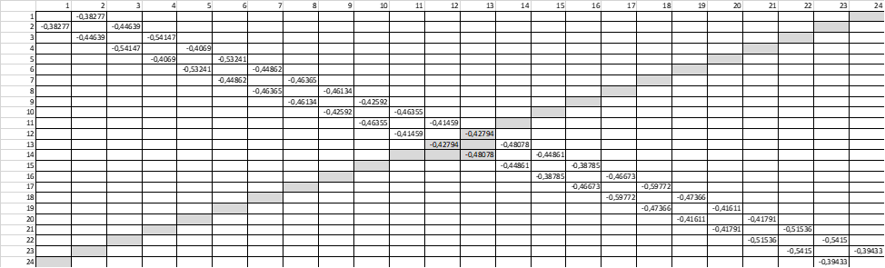
Correlation matrix of the unconscious component. Opposition questionnaire
Correlation matrix of the unconscious responses processed by the VibraMI program based on the results of 512 testing
Notes:
This slide show the correlation matrix of the unconscious responses of subjects tested by the VibraMI program based on the 512 results processing. The average Pearson correlation coefficient in the diagonal between neighbor questions is -0.45. That means a statistically significant correlation is observed only between PPS for neighboring opposing stimuli, while there is no correlation in the PPS for similar issues in the highlighted gray diagonal between oppositional types of multiple intelligences.

Slide 12
The correlation matrix of the unconscious component. Supplementary questionnaire
Correlation matrix of the unconscious responses processed by the PsyAccent program based on the results of 210 testing
Notes:
This slide shows the correlation matrix of the unconscious responses of the subjects tested by the PsyAccent program according to the results of 210 questionnaires processing . Given correlation matrix is practically the same as on the previous slide showing correlation statistics tested by VibraMI program, while the neighboring questions have different sense.
Therefore, the negative correlation with the established testing scheme practically does not depend on the meaning of the questions, but is determined by the form of their presentation and brain reflexes. Each new question is perceived by a person as opposite to the previous one, regardless of its semantic load.

Slide 13
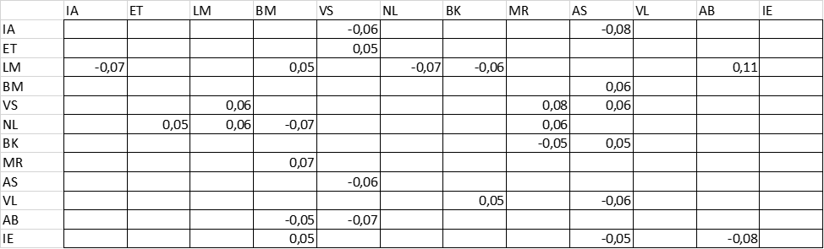
Correlation matrix between conscious and unconscious responses
Correlation matrix of conscious and unconscious reaction according to the 825 testing results by VibraMI program
Notes:
Considering separately the conscious and unconscious responses, presented in the form of additive parameters, we expected to see at least some correlation between them. However, the maximum correlation coefficient turned out to be negligible, did not exceed the value of 0.11, and the picture of the obtained coefficients was clearly random. To be honest, we tried to determine the values ​​of conscious and unconscious responses in additive units in the attempt to find a certain correlation between them and were initially disappointed with the result.
However, this result is objective, it is confirmed by testing with PsyAccent on complementary questions. Therefore, there is a scientific explanation for this fact and it turned out to be obvious. Nature does not allow duplication of functions, it is too wasteful and therefore the consciousness and the unconscious must have different properties and cannot have a significant correlation between themselves.

Slide 14
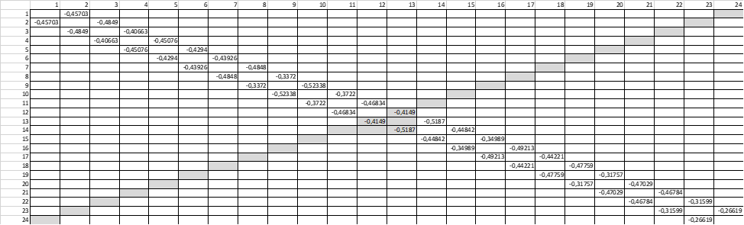
The different nature of conscious and unconscious responses correlation
Correlation matrix of conscious responses
Correlation matrix of unconscious responses
Notes:
Let's once again return to the obtained correlation matrixes of conscious and unconscious responses of tested groups, shown on this slide. Comparing the obtained correlation matrixes, we come to the conclusion that the unconscious response is responsible for the fast response of a human body, and the conscious responses reply for the processes separated in time. It turns out that the simultaneous (close in time) presentation of two opposite or similar stimuli does not cause a significant correlation in the conscious response.
The expected positive correlation in unconscious responses for two similar stimuli is observed only if these stimuli are noticeably spaced in the presentation time. Similarly, but the opposite, the presentation of two opposite stimuli will give a negative correlation only if these stimuli are consistent, their noticeable separation in time does not show a significant correlation in the unconscious responses between them.

Slide 15
Conclusions
Vibraimage technology allows simultaneous processing of a person’s conscious and unconscious responses to stimuli.
The proposed concept of mutual analysis of the conscious and unconscious confirms the possibility of joint processing and additivity of these parameters.
It is possible to get an integral characteristics of personality only by joint processing of parameters of consciousness and the unconscious
The components of consciousness and the unconscious do not have a mathematical correlation among themselves; therefore, receiving integral characteristics of personality is impossible when using only one of the components.
The proposed additive approach to conscious and unconscious components of personality can be used for various scientific and practical applications.
Notes:
This study aim was to find correlation between conscious and unconscious responses, but results allow to make practical conclusions, since our life is a constant reaction to external stimuli that arise. The vibraimage technology, due to its functional advantages (contactless and informativity), makes it possible to jointly analyze a person’s conscious and unconscious responses, which opens up new possibilities in the study of a person as an object. Unfortunately, over the past 156 years after the release of the work of Ivan Mikhailovich Sechenov, “Reflexes of the brain” have not been done by other scientific works, in practice confirming the hypotheses and assumptions put forward by him.
In my opinion, vibraimage technology gives researchers unlimited possibilities, with correct organization of experiments, proper selection of stimuli and statistical processing of the results. Consciousness and unconscious, psychology and biometrics complement each other, being independent characteristics of personality. Attempts to characterize a person with the help of one of the halves are doomed to failure, although at the moment there is no science unifying consciousness and the unconscious. I hope, vibraimage allows to make a step in this direction.

Slide 16
Thanks for the attention!
Viktor Minkin
e-mail: minkin@elsys.ru
www.elsys.ru
www.psymaker.com
Notes:
I think that psychophysiology could become the main science combining different knowledge about human. Vibraimage is only the instrument in this research, but it is very sensitive instrument.
I thank all the colleagues participating in the second international scientific conference on vibraimage technology and I wish all the participants great scientific and practical success! I am sure that our new joint development will make life safer, longer and happier with the help of vibraimage technology!

