Slide 1
MANIFESTATION OF ETHNIC IDENTITY IN AVERAGED MULTIPLE INTELLIGENCES PROFILE DURING RESEARCH IN JAPAN AND RUSSIA
The 2nd International Open Science Conference "Modern psychophysiology. The Vibraimage technology"
Tomomi Akiho¹, Yana Nikolaenko²
¹Elsys-Japan, Tokyo, Japan
²Elsys Corp., Saint Petersburg, Russia

Slide 2
Ethnic self-awareness
Ethnic self-awareness is understood not only as a stable emotional and cognitive process of awareness of a person’s belonging to any ethnic community, but also as a person’s emotional-axiological attitude to his or her ethnic group.
Notes:
Ethnic self-awareness is understood not only as a stable emotional-cognitive process of awareness of a person’s belonging to any ethnic community, but also as a person’s emotional-axiological attitude to his or her ethnic group: awareness, perception, emotional evaluation, and experience of belonging to a certain ethnic community.

Slide 3
Ethnic self-awareness and Multiple Intelligence
Suppose, emotional-value and emotional-cognitive components of ethnic identity are in close connection and can probably manifest themselves in a selective attitude to the same events / incentives in people belonging to different ethnic communities.
Can the ethnic identity of the Russian and Japanese communities manifest themselves in different profiles of multiple intelligence?
Notes:
Can the ethnic identity of the Russian and Japanese communities manifest themselves in different profiles of multiple intelligence?
Presumably, the emotional-axiological and emotional-cognitive components of ethnic identity are in close connection and can probably manifest themselves in a selective attitude towards the same events / incentives among people belonging to different ethnic communities.

Slide 4
VibraMI questionnaires
For the first time in history, ethnic self-awareness differences were studied at an unconscious level (PPS) !! For all people, testing took place in their native language
Gardner_12 RU – questionnaire is intended to identify the human abilities (in Russian language)
Gardner_12 JP – questionnaire is intended to identify the human abilities (in Japanese language)
Good
afternoon!
Notes:
For all people, testing took place in their native language. For Russians - in Russian, for Japanese - in Japan language. Because ethnic differences were studied, then English, as a second language was deliberately excluded from the study, in order to avoid the influence of third-party ethnos. Along with the traditional survey, for the first time in history, ethnic differences were studied at an unconscious level.

Slide 5
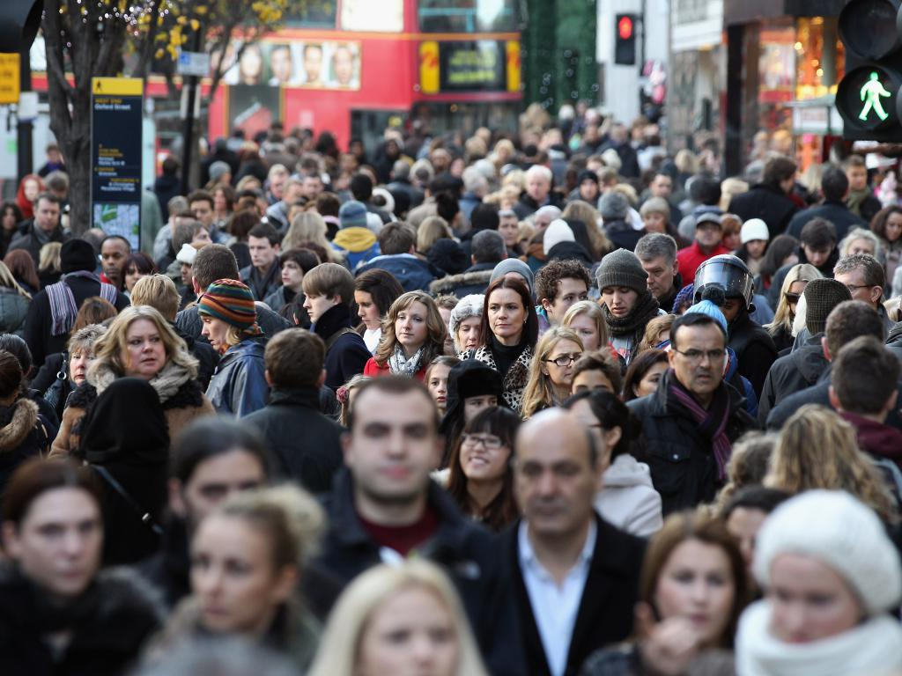
Participants VibraMI
The first study part was conducted from 2017 to 2019 in Russia. A total of 1158 people, Russian citizens, were tested. The subjects were 14 years old and older (including high school, students and specialists from different areas). The proportion of adults was 63%, minors - 37%.
The tested group of the second study part was consisted mainly of 155 company employees (including sales persons, technical staffs, office work staffs) from Kyushu to Hokkaido, Japan (age 20-71 years, male/female 83/17%) from March to April, 2019
Notes:
The research in Russia was provided about two years and includes more than one thousand people in processing. During study in Russia was see that the main statistical features in multiple intelligences profile became visible after database included more than 150 testing. So the second study in Japan was shorter in time and includes 155 testing results in the second database.

Slide 6
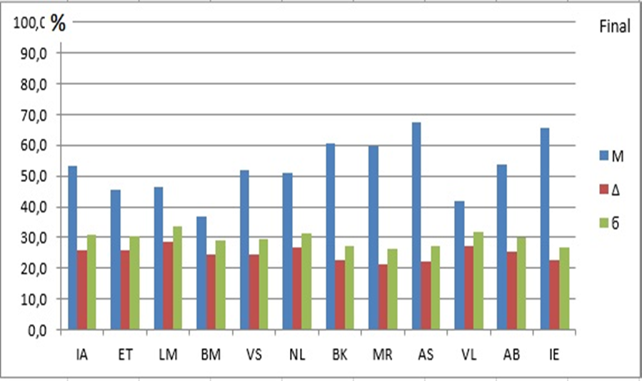
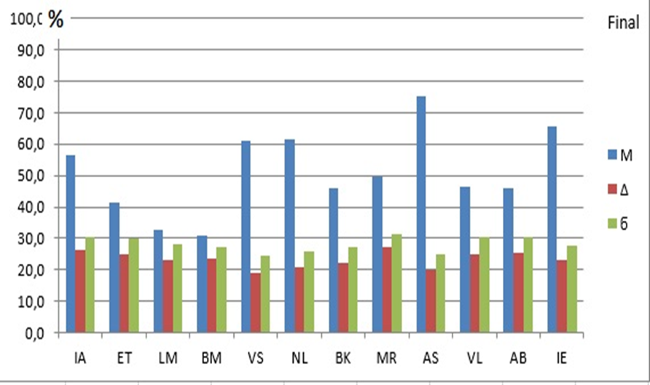
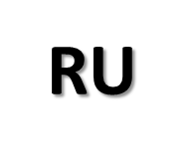
FINAL profile of multiple intelligences (Final`_JP, Final`_RU) 1158 Russians and 155 Japanese
Notes:
The VibraMI program, based on the vibraimage technology, presents a supplemented and expanded to 12 types classification of Howard Gardner's multiple intelligences. Vibraimage technology allows to obtain multidimensional dependences of the characteristics of the psychophysiological state (PPS) and processing information exchange and energy consumption for tested person.
In the group of Russians, the highest values for the general MI profile were obtained for the ascetic (AS = 68.4%), interpersonal (IE = 65.6%) and body-kinesics (BK = 62.8) MI (in decreasing order). In the Japanese group, the highest values were obtained for the ascetic (AS = 73.9%), interpersonal (IE = 64.1%) and natural (NL = 64.1%), (in decreasing order).

Slide 7
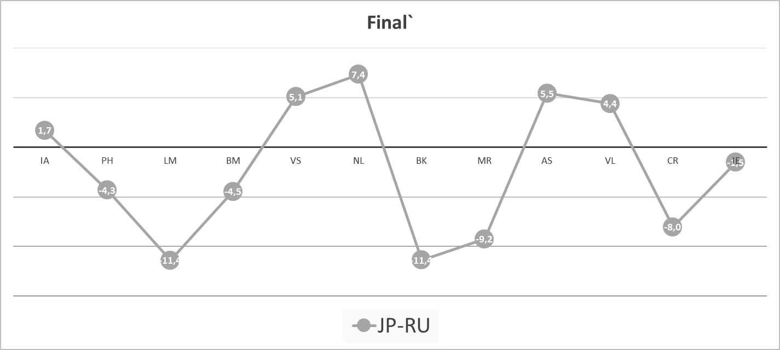
Difference Profile of Multiple Intelligences (Final`_JP - Final`_RU) 1158 Russians and 155 Japanese
Notes:
Thus, the maximum differences of the Japanese from the Russians was detected in Logical-mathematical (LM) , Visual-spatial (VS) , Naturalistic (NL), Bodily-kinesthetic (BK), Musical-rhythmic (MR) type of multiple intelligence

Slide 8
Discussion and Conclusion: conscious and unconscious reaction
RU
JP
Notes:
Human are a biosocial being. The functioning of the psyche in the norm implies a certain balance between the instinctive sphere and the sphere of self-consciousness. VibraMI program detects this balance. A comparative analysis between the groups showed that conscious reaction prevails over the unconscious in both groups. In Russians, the conscious response is more pronounced than in the Japanese.

Slide 9
Profile of conscious responses of multiple intelligences for 1158 Russians and 155 Japanese: (YN_JP - YN_RU).
Notes:
In the group of Russians, the highest values in the profile of the conscious responses (YN) were obtained from the ascetic (AS = 85.6%), body-kinesics (BK = 74.4%) and natural (NL = 60.6%) MI.
In the Japanese group, in the profile of the conscious responses (YN) the highest values were obtained for the ascetic (AS = 94.8%), interpersonal (IE = 82.8%) and visual-spatial (VS = 76.7%) MI.

Slide 10
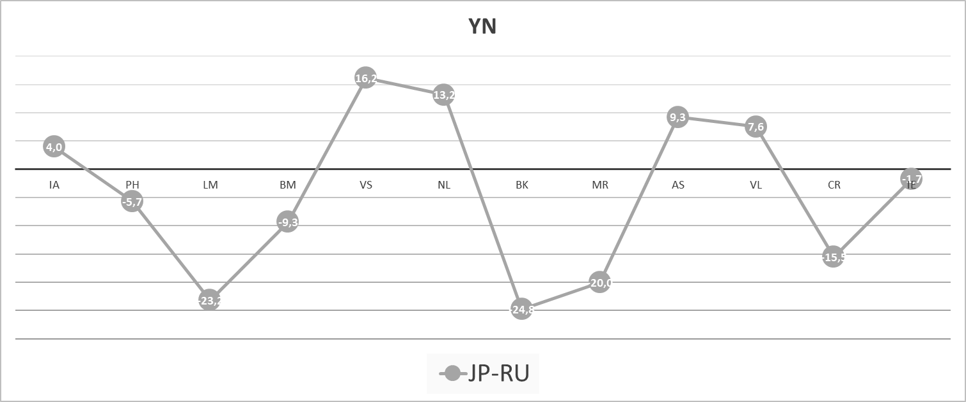
The difference profile of conscious responses of multiple intelligenses for 1158 Russians and 155 Japanese: (YN_JP - YN_RU).
Notes:
The maximum differences between the Japanese and the Russians (by analogy with the general profile of MI) appeared in relation to logical-mathematical (LM), visual-spatial (VS), natural (NL), body-kinesics (BK) and musical-rhythmic (MR) MI types

Slide 11
Differential profile (IE_JP — IE_RU) of the unconscious responses of 1158 Russians and 155 Japanese MI testing
Notes:
An the analysis of unconscious responses revealed minimal differences. In Russians, visual-spatial (VS) MI = 52.3%, among Japanese, VS MI = 46.3%. In the other histograms (Final and YN) - VS among the Japanese is significantly higher than that of the Russians. Approximately equal unconscious responses to others MI types (11 from 12) indicates physiology identity between Japanese and Russians.

Slide 12
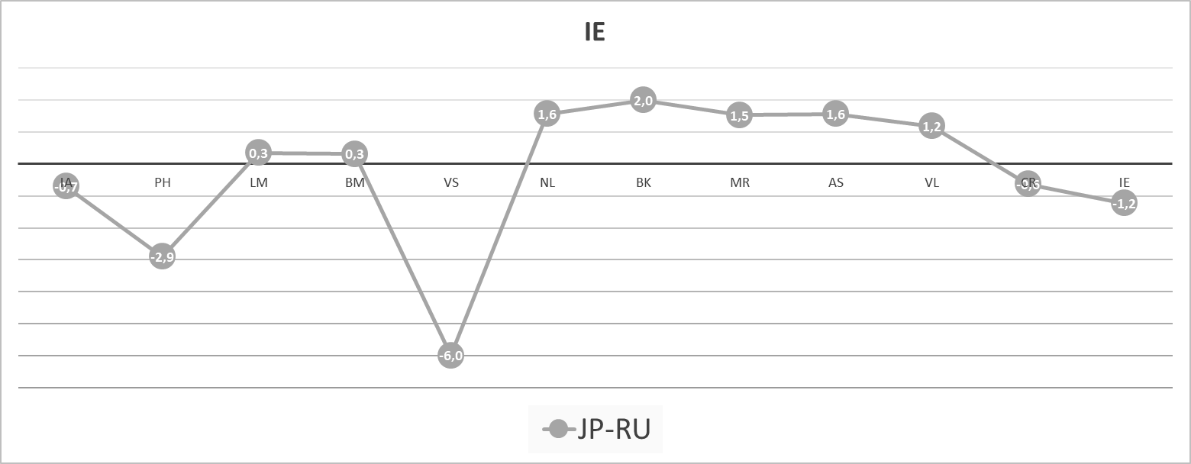
Differential profile (IE_JP — IE_RU) of the unconscious responses of 1158 Russians and 155 Japanese MI testing
Notes:
Thus, the Russians and the Japanese at the unconscious level differ significantly only in the visual-spatial (VS) type of MI.

Slide 13
Differential profile (YN_JP-IE_JP) — (YN_RU-IE_RU) of 1158 Russians and 155 Japanese MI testing
Notes:
The maximum differences of the Japanese from the Russians (by analogy with the general and profile-conscious responses of MI, figs 1, 2) appeared in relation to logical-mathematical (LM), visual-spatial (VS), body-kinesics (BK) and musical-rhythmic (MR) MI types, fig 4. The range of values on the differential profile of MI, within 40 units (from 20 to –20) is considered the coincidence of the desired (YN) and real (IE). fig. 2. There is an assumption that positive values on the differential profile of MI primarily reflect socially significant benchmarks for the use of abilities, and negative values are individually significant benchmarks for the use of abilities. The highest values for the differential profile, in the group of Russians, were obtained by interpersonal (IE = 37.7), ascetic (AS = 34.3%), motor-motor (BK = 23.2%) MI (in descending order), fig. 1.
In the Japanese group, the highest values for the differential profile were obtained in relation to the ascetic (AS = 42%), interpersonal (IE = 37.3%), visual-spatial (VS = 30.4%), and MI (in descending order).

Slide 14
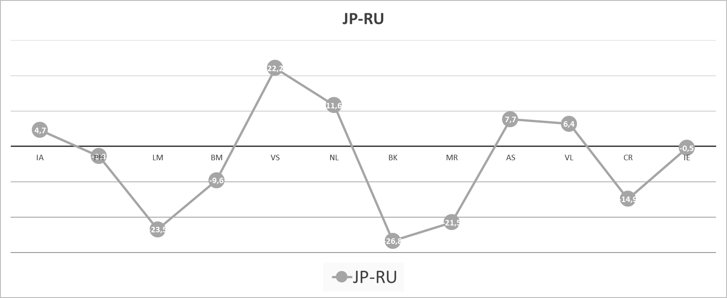
Double differential profile (YN_JP-IE_JP) — (YN_RU-IE_RU) of 1158 Russians and 155 Japanese MI testing
Notes:
Thus, the maximum differences between the Japanese and the Russians (by analogy with the general profile of MI) appeared in relation to logical-mathematical (LM), visual-spatial (VS), natural (NL), body-kinesics (BK) and musical-rhythmic (MR) MI types

Slide 15
Correlation analysis, p ≤ 0,2
RU
JP
Notes:
Statistically significant negative correlations were obtained between Intrapersonal and Interpersonal MI (-0, 48), logical-mathematical and verbal-linguistic (-0.65), ascetic and business-selfish (-0.52). (significance of differences with p ≤ 0.05)
A similar trend is observed in the group of Japanese. Only digital values ​​differ, statistically significant correlations between pairs of MI are identical in both groups. The obtained results testify to the high significance of these types of MI in the life of both ethnic communities.

Slide 16
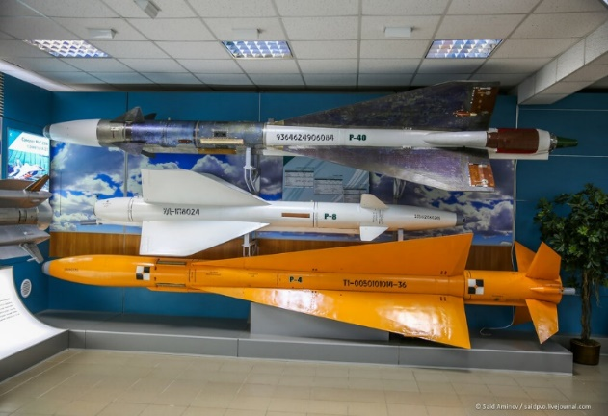
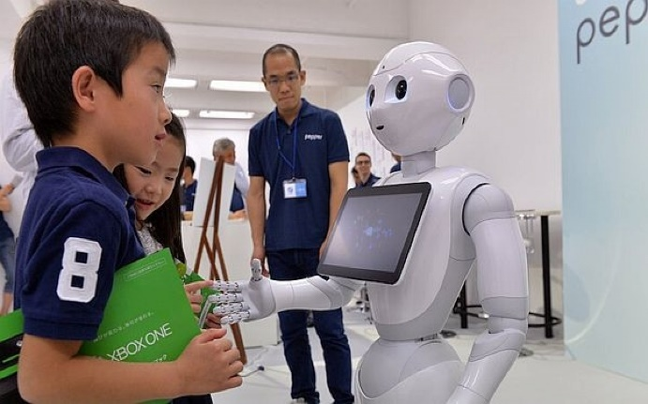
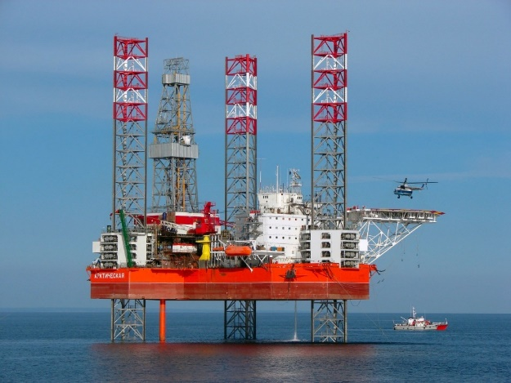
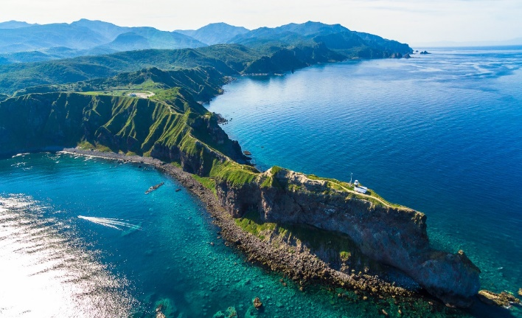
Discussion and Conclusion
Example:
Logical-Mathematical
Visual-Spatial
The results show that modern Russians and Japanese are in many ways similar in their ethnic identity and are focusing on achieving common socially significant goals.
Features of ethnic identity are manifested in a combination of ways to achieve these goals (MI different components).
RU
JP
Bodily-Kinesthetic
Business-Mercenary
Notes:
The results show that modern Russians and Japanese are in many ways similar in their ethnic identity and are focusing on achieving common socially significant goals.
For example:
Careful attitude to natural resources (NL) and the originality of the geographical location of Japan (archipelago, with limited land resources) determine the high importance of natural (NL) and motor-motor (BK) types of MI, and specialization
in high technologies (microelectronics, robotics and others) are closely intertwined with the visual projection (VS) capabilities of the data. It is the combination of these types of MI that determines the specifics of the ethnic identity of the Japanese. The Russian model of the economy is also associated with technical advances, but in the fields of fuel, energy and military-industrial complexes, where preferable the combination of logical-mathematical (LM) and body-kinesics (BK) MI types.

Slide 17
Conclusions:
Leading MI type in the Japanese group was- Ascetic-Sacrificial(AS), Interpersonal (IE) and Naturalistic (NL)
Leading types of МИ in the Russians was - Ascetic-Sacrificial(AS), Interpersonal (IE) and Body-Kinesics (BK);
The similarity of the leading types of MI in the general profile of MI indicates that modern Russians and Japanese have common socially significant goals.
Representatives of the Japanese and Russian ethnos resort to different ways of achieving socially significant goals, and this is due to the activation of different components of the MI profile: visual-spatial (VS) and motor-motor (BK) MI among the Japanese, logical-mathematical (LM) and motor-motor (BK) types of MI in Russian
Notes:
Leading MI type in the Japanese group was- Ascetic-Sacrificial(AS), Interpersonal (IE) and Naturalistic (NL)
Leading types of МИ in the Russians was - Ascetic-Sacrificial(AS), Interpersonal (IE) and Body-Kinesics (BK);
The similarity of the leading types of MI in the general profile of MI indicates that modern Russians and Japanese have common socially significant goals.
Representatives of the Japanese and Russian ethnos resort to different ways of achieving socially significant goals, and this is due to the activation of different components of the MI profile: visual-spatial (VS) and motor-motor (BK) MI among the Japanese, logical-mathematical (LM) and motor-motor (BK) types of MI in Russian

Slide 18
Thank you for your attention!
Tomomi Akiho¹, Yana Nikolaenko²
¹Elsys-Japan, Tokyo, Japan
²Elsys Corp., Saint Petersburg, Russia
Notes:
Thanks for you attention and welcome with questions!

