Slide 1
PERSONAL SECURITY AND POLITICAL LOYALTY ANALYZED WITH THE WelcomEU SYSTEM BASED ON VIBRAIMAGE TECHNOLOGY
Hans Rykaczewski, France
Panos Razis, Cyprus
Yana Nikolaenko, Eugenia Lobanova, Russia, Elsys Corp.
Notes:
Ladies and Gentelmens, I am really glad to present you our WelcomEU System and possibility of personal security and political loyalty analaze based on it We work on this program with our international team Hans Rykaczewski from France, Panos Razis from Cyprus, Yana Nikolaenko and me, Eugenia Lobanova from Russia, Elsys Corp.

Slide 2
Security and profiling
Visual profiling
Profiler – human
Detects
Emotions;
Minds
Intents of visitors
By visual control and examination
Can not operate more than 1 hour
A lot of requirements for profiler
High efforts, tension from profiler
Examples:
Screening of Passengers by Observation Techniques
Transportation Security Administration
Behavior Assessment Screening System
Behavioral Pattern Recognition Program
Terrorist Activity Recognition and Reaction
Notes:
What is security now? Modern security systems includes behavior and intents identification that means profiling.
Historically Visual profiling was the first. Profiler detects emotions, minds and intents of visitors but only by visual control and examination.
But in this kind of profiling there are some restrictions. Profiler couldn’t operates more than 1 hour without relaxation. There are a lot of requirements from profiler. It needs high efforts and tension from him.
Below I gave a few examples of visual profiling methods
SPOT (Screening of Passengers by Observation Techniques, TSA, Transportation Security Administration

Slide 3
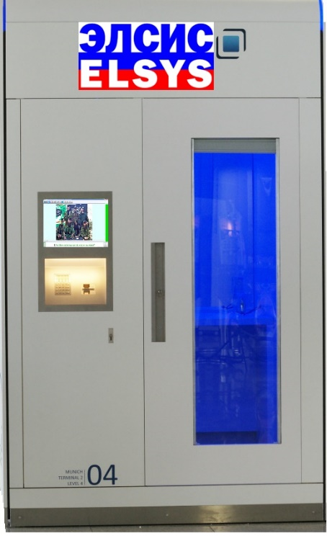
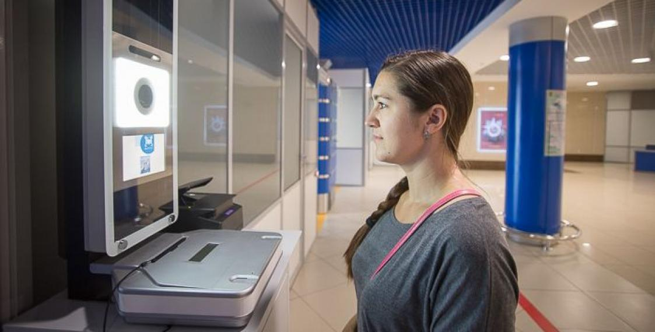
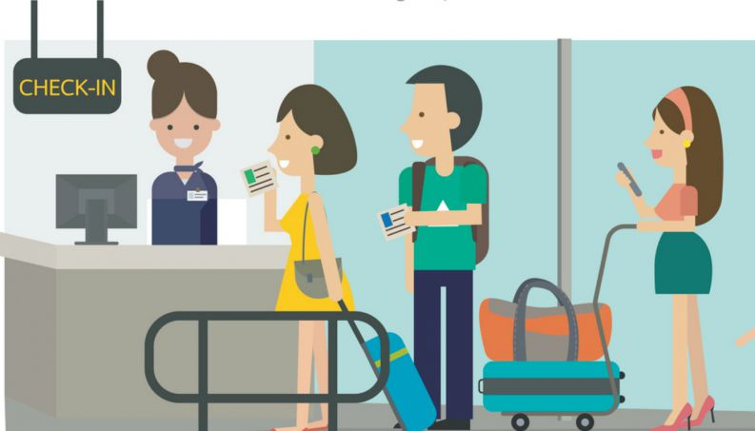
Technical profiling
3rd generation of Biometric systems Identify criminal intentions
Reliability of technical profiling
2nd generation of Biometric systems Person identification by
searching in database
Visual control
PAST
Present
FUTURE\ TODAY
Time
Notes:
Technical profiling provides security at various levels. The reliability of technical profiling is greatly enhanced if biometric systems are used.
Second generation biometric systems provide automatic identification of a person and are effective only against previously known criminals.
Third generation biometric systems provide identification of intent and are effective against people intending to commit a crime.

Slide 4
Criminal intentions
1st risk group
Going to a crime
At that moment
Examples:
There is A PLAN an explosion at the airport or an aircraft bombing TO THIS MOMENT
2nd risk group
Ready to support terrorists
In the near future
Examples:
Criminals PLAN to commit a terrorist act
IN THE NEAR FUTURE
Notes:
Criminal intentions can also be divided into two groups. The first group includes criminals going to a crime at the moment, for example, those who have planned an explosion at the airport or an aircraft bombing. The second risk group includes people who are ready to support terrorists or commit a terrorist act in the near future.
Identifying clear criminals and potential criminals are different tasks and usually they are solved by different technical means.

Slide 5
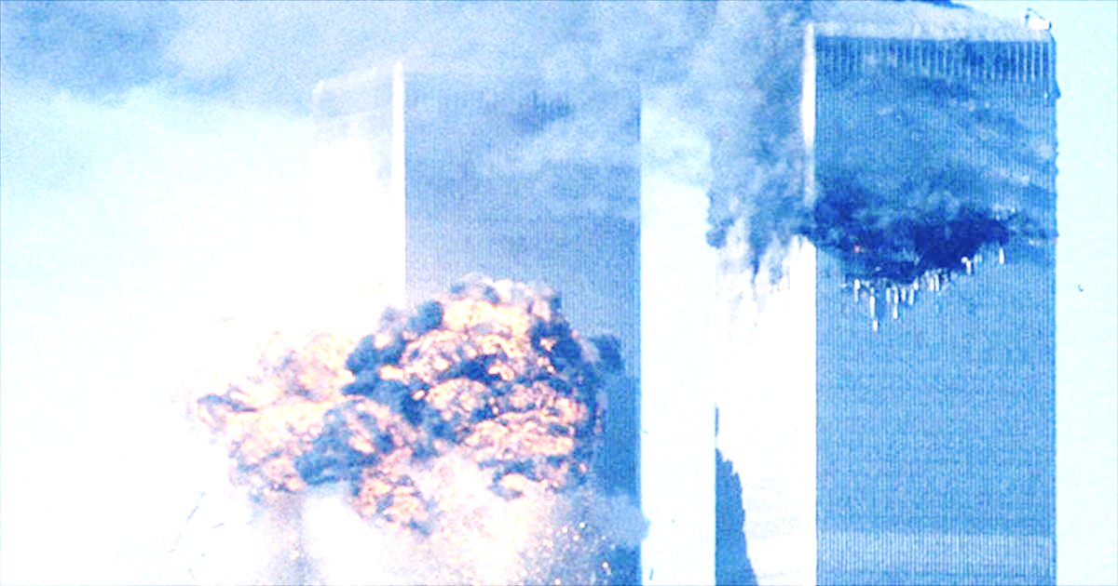
Technical profiling with VibraImage
VibraImage is high-tech profiling system.
VibraImage detects the emotions and intentions of a person and gives a signal of his criminal intentions.
VibraImage technology converts streaming video into two different image components, reflecting the amplitude and frequency characteristics of vibrations and movements of objects in the frame (standard TV cameras and PC are used).
Notes:
Thus, the VibraImage system is a means of technical profiling.
It analyzes the state and intentions of a person and gives a signal about his criminal intentions. The vibraimage system can be used to detect the current and remote in time intentions of a person.

Slide 6
VibraImage security
Notes:
Security is one of the main activities of the company
We had a good experience of using VibraImage technology at airports in Moscow and St. Petersburg, as well as at the metro station. And even in the Kremlin, this technology was used. The vibraimage system was successfully used at Sochi Olympics Games to identify potentially dangerous or suspicious visitors. This is a known fact and pride of our company. Today I will talk about new developments in this direction.

Slide 7
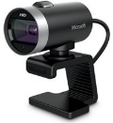
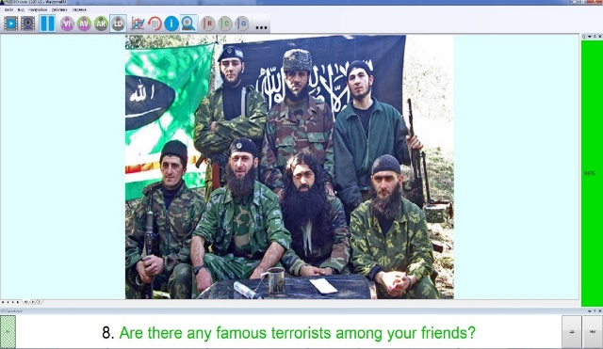
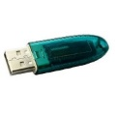
VibraImage system and WelcomEU
WelcomEU automatically controls intentions of arriving people
ADVANTAGES
Automatic system
Objective detection of intentions
Current
Remote
No sensors attached to the body
Real-time, automated data analysis
Suitable for a high traffic at the airport
Protects EUropian values
Notes:
WelcomEU program makes it possible to identify a person’s remote intentions in time and his potential to commit a terrorist act or to contribute to its commission. To do this, the passenger must answer several questions automatically arising on the screen.
Naturally, the identification of distant intentions is a more complex technical problem and requires more time to solve it. Usually, to identify distant intentions, it is necessary to present stimuli and analyze person's responses to various stimuli.

Slide 8
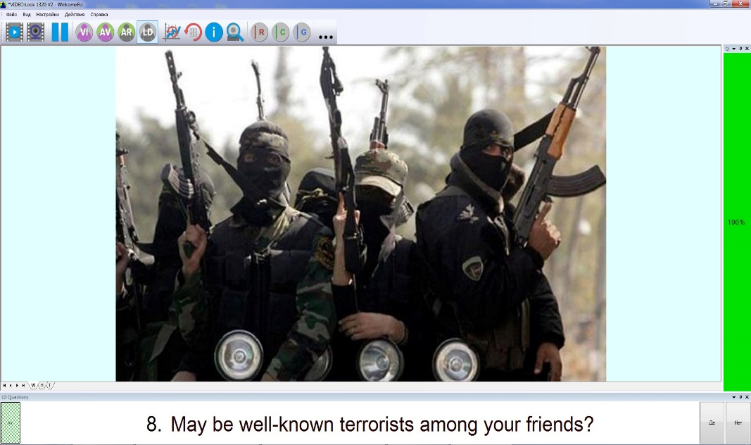
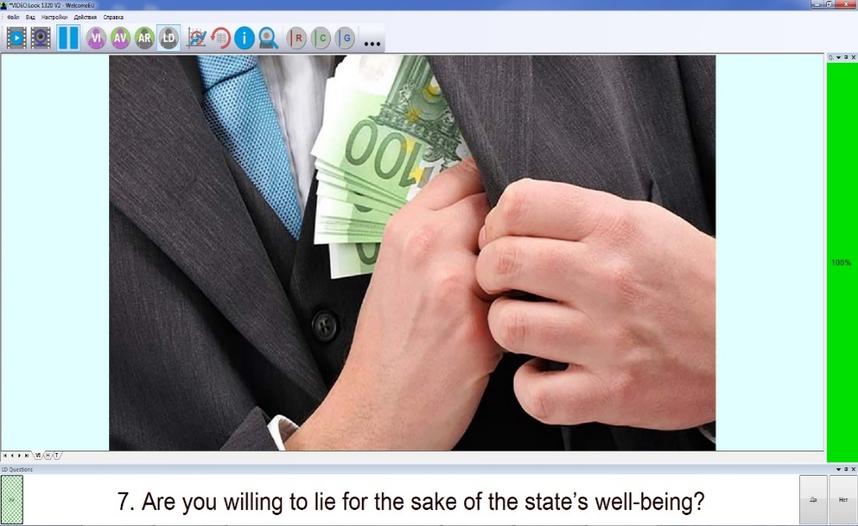
WelcomEU questionnaires
3 similar questionnaires (Id_leu, Id_leu2, Id_leu3);
13 simple questions in the Yes/No format + 13 pictures for each of them;
3 groups: control, relevant and neutral;
questions and incentives of 1 group can be replaced;
testing period 3,5 minutes.
Notes:
The current version of WelcomEU program contains several questionnaires with similar meaning. Each test includes 13 questions. The presented questions and incentives are divided into 3 groups - control, relevant and neutral. Questions and incentives of the same group are interchangeable and arise in front of the subject in a random order, which makes it difficult to prepare to pass this test for criminals.

Slide 9
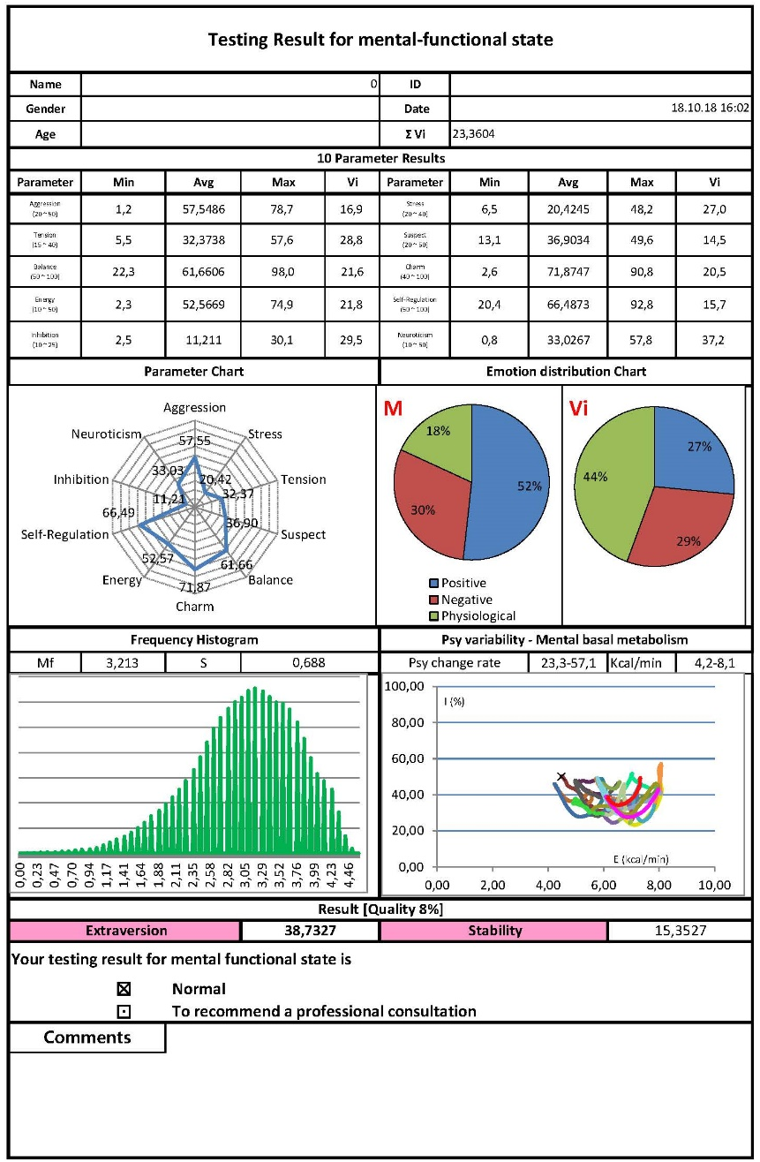
Program Results: basic psycho-physiological parameters
1st Test
 | M | S | Vi (S/M) | bMin | cMin | bMax | cMax
Aggression | 57,55 | 9,74 | 16,93 | 20,00 | 1,17 | 50,00 | 78,71
Stress | 20,42 | 5,51 | 26,97 | 20,00 | 6,51 | 40,00 | 48,17
Tension | 32,37 | 9,33 | 28,82 | 15,00 | 5,49 | 40,00 | 57,64
Suspect | 36,90 | 5,35 | 14,49 | 20,00 | 13,08 | 50,00 | 49,58
Balance | 61,66 | 13,34 | 21,63 | 50,00 | 22,26 | 100,00 | 97,98
Charm | 71,87 | 14,74 | 20,51 | 40,00 | 2,61 | 100,00 | 90,83
Energy | 52,57 | 11,47 | 21,81 | 10,00 | 2,34 | 50,00 | 74,93
Self-Regulation | 66,49 | 10,47 | 15,74 | 50,00 | 20,42 | 100,00 | 92,83
Inhibition | 11,21 | 3,30 | 29,46 | 10,00 | 2,54 | 25,00 | 30,07
Neuroticism | 33,03 | 12,30 | 37,23 | 10,00 | 0,76 | 50,00 | 57,85
Positive | 63,15 | 51,7% | 19,92 | 26,5%
Negative | 36,812575 | 30,2% | 21,8032 | 29,0%
Physiological | 22,11885 | 18,1% | 33,34665 | 44,4%
Notes:
Vibraimage processing includes several system groups of parameters.
The first group of psychophysiological parameters includes emotion 10 print, based of 4 negative, 4 positive and 2 physiological parameters based on patented calculation methods.
The second group of parameters is based on Information efficiency (I) and Energy consumption (E). Patented processing of these cybernetics parameters calculates current psychophysiological state of a person.
The third group of parameters based on frequency histogram and gives independent checking of the other parameters.

Slide 10
Questionnaire structure
Сlassical structure Starting with Backster Zone Comparison Test (ZCT) method | WelcomEU structure
I-I-I-I-C-R-I-C-R-I-C-R-I-C-R; I-SR-SYM-C-R-C-R-SYM-C-R; I-SR-SYM-C-R-C-R-C-SYM | I C I R – I C I R – I C I R I method takes into account natural chronobiological processes occurring in the human body in the Very Low Frequency range
I – Irrelevant;
SR – Sacrifice Relevant;
SYM – Symptomatic;
С – Control;
R – Relevant
Notes:
In the well-known methods of psychophysiological detection of deception, control and relevant questions are usually arranged in a row, one after the other. In the process of person's testing with vibraimage technology, it was found that this approach reduces the accuracy of obtaining the correct comparison result of the test subjects due to the lack of consideration for the natural chronobiological processes occurring in the human body in the Very Low Frequency range.
Elsys company proposed the sequence of I-C-I-R stimuli presentation which improves the accuracy of a testee response analysis when answering on comparison and relevant questions.

Slide 11
Traditional comparison
Method 1. Comparison of the response to the control (C) and relevant (R) questions within a pair
Rc > Rr = NDI Rc < Rr = DI
R - PPS
c – control question
r – relevant question
NDI – truth
DI - lie
Notes:
The general principle of responses comparing of a testee remained classical (the value of the response to the comparison (control) and relevant question is compared. But the psychophysiological reaction of the subjects themselves became almost independent of the chronobiological pulsation of brain activity with the proposed sequence of questions and stimuli.

Slide 12
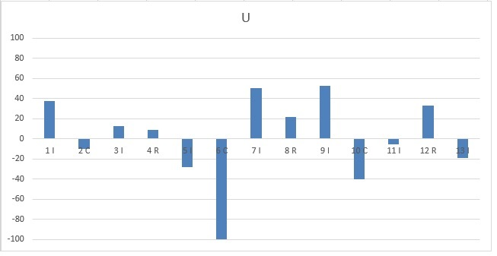
WelcomEU. Psychophysiological responses
Method 1. Traditional comparing of the responses to the comparison (C) and relevant (R) questions, within a pair
I - irrelevant question
C – control question
R – relevant question
U – unconscious or psychophysiological
Responses (PPS)
Notes:
This slide shows an example of passing the test to testee.
There is a negative reaction to all comparison (control) questions, since the vibraimage technology analyzes not only value of PPR , but also the direction or degree of positiveness of the stimulus perception.
For relevant responses PPR varies.
Conclusion: control questions to a person as a whole are less pleasant than relevant questions. The most unpleasant was the 2nd control question (serial number 6C). The intensity of the reaction to the 2nd control question is 3 times higher than the intensity of the reaction to any of the relevant (R) questions.

Slide 13
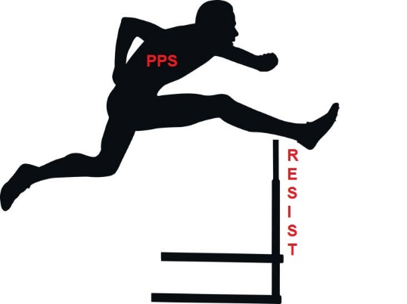
Specifics of WelcomEU comparison analysis
Method 2. Comparison between the response to the control (C) and neutral (I) question or relevant (R) and neutral (I), within a pair
WelcomEU sequence of questions
I – C – I – R
I - irrelevant question
C – control question
R – relevant question
Notes:
The proposed method allows one to compare the test responses not only directly between the comparison (control) and the relevant question, but also to additionally compare the pairs of the control - the subsequent irrelevant and the relevant - the subsequent irrelevant question. Reducing the answers of the subjects to brain reflexes, as predicted by the great Russian physiologist Ivan Mikhailovich Sechenov, says that the comparison of these pairs is identical in the case of truthful answers of the subjects. The difference between the results of the pair comparison indicates to testee attempt to hide truth during the test.

Slide 14
WelcomEU calculation
Method 2. Comparison between the reaction to the control (C) and neutral (I) question or relevant (R) and neutral (I), within a pair
U (1, 2, 3) − PPR for 1,2,3 control (C) or relevant (R) questions;
C (1, 2, 3) − conscious answer YES / NO to 1,2,3 control (C) or relevant (R) questions;
Ic – Irrelevant after the control;
Ir – Irrelevant after the relevant;
Res - is the averaged result of PPR comparison to the control (C) and relevant (R) questions;
Res` - is the averaged result of PPR comparison for control and neutral (Ic), for relevant and neutral (Ir)
Notes:
Method 1. Traditional comparison of the PPR to the control (C) and relevant (R) questions within the pair. The average PPR for control questions have values ​​(50%), and the average PPR for relevant questions matters (21%). So the PPR for control questions is more than relevant, the result (Res) indicates that the person is telling the truth (NDI) and is politically loyal, not inclined to extremism in the extreme forms of its manifestation i.e. terrorism.
Method 2. Comparison, between couples, the first couple PPR for control (C) and neutral (Ic), the second couple the relevant (R) and neutral (Ir) questions. In method 2, the PPR is added between control question and the neutral question following it, then the second PPR is added between relevant question and the neutral question that follows it. After that, a comparison of the couples amounts received. In the given example, the sum of the PPR control with neutral is 73%, and the sum of the relevant with neutral is 55%, hence the second assessment of the control question is also greater than the relevant (Res`).

Slide 15
Global result
A double check of loyalty was carried out:
the traditional way of comparing the PPR to the control (C) and relevant (R) questions, within the pair (method 1);
the comparison of PPR to the control (C) and neutral (I), relevant (R) and neutral (I) questions (method 2).
The results coincide: NDI
Notes:
Thus, a double check of loyalty to European values was carried out: the traditional way of comparing the PPR to the control (C) and relevant (R) questions, within the pair (method 1), and the comparison of PPR to the control (C) and neutral (I), relevant (R) and neutral (I) questions (method 2). The results coincide on given sample. Upon completion of testing with the help of WelcomEU, a database is formed of 11 files containing detailed information on the dynamics of the PPS throughout the test (Excel_M file) - information that is undoubtedly useful for profilers in solving controversial issues.

Slide 16
Conclusion
Modern security systems should include various means of identifying the state and intentions of a person in order to predict his behavior.
WelcomEU, based on vibraimage technology, is modern technical profiling tool, with loyalty checking of arriving passengers and migrants coming EU.

Slide 17
THANK YOU FOR YOUR ATTENTION!
Hans Rykaczewski, France
Panos Razis, Cyprus
Yana Nikolaenko, Eugenia Lobanova, Elsys Corp.
www.psymaker.com
Russia, Saint Petersburg
Notes:
Thank you for your attention! All another information about this product you can find out on our site www.psymaker.com

