Slide 1
The Effects of Drum-Club Activities Program on Mental Health of Soldiers
S.S.Kim,
MetaHealthcare Co.Ltd.
2019.05.07
Notes:
It’s a honor for me to da a presentation of our study at this International Conference. It’s first time for me to visit Russia. I and my company are quite newcomer to sell Vibraimage technology product. Personally I’d like to learn lot of knowledge through the conference and your experiences at this meeting. Now I’m exciting to be here and also I’m expecting I can have promising future with this good technology. Now I’ll start my presentation. We’ve studied the effects of drumming training and practice for mental health of soldiers using vibraimage in Korea. Before getting to the point, I’ll show you 3 photos related to the study.

Slide 2
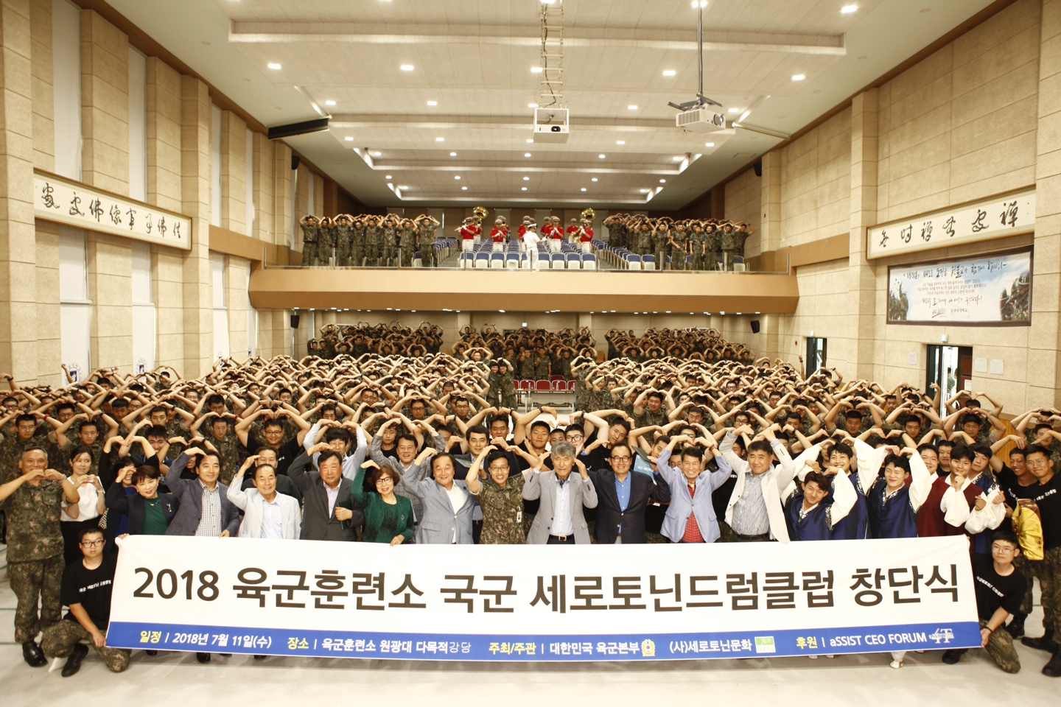
Notes:
This photo is the military training center studied our Vibraimage with Drumming session. This Nonsan Training Institute is a military camp that is trained to enlist in the military for the first time. They are celebrating for Drum Club inauguration. Can you see me here? This person is the most famous psychiatrist in Korea. He is the founder of Drumming class at school and military camp for mental health program. Drum club activities are practicing at more than 100 school for student’s mental health..

Slide 3
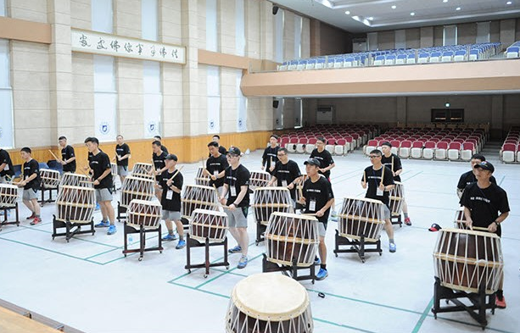
Notes:
This photo shows the soldiers are getting Drum training at the camp. After making by the Drum club organization, the soldiers get the training and practice for 12 weeks every each Friday, 2 hours a day

Slide 4
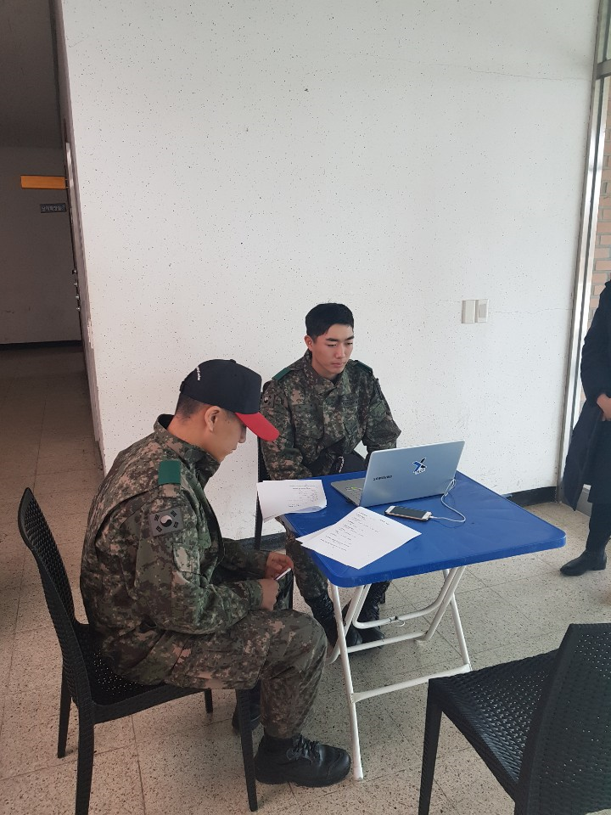
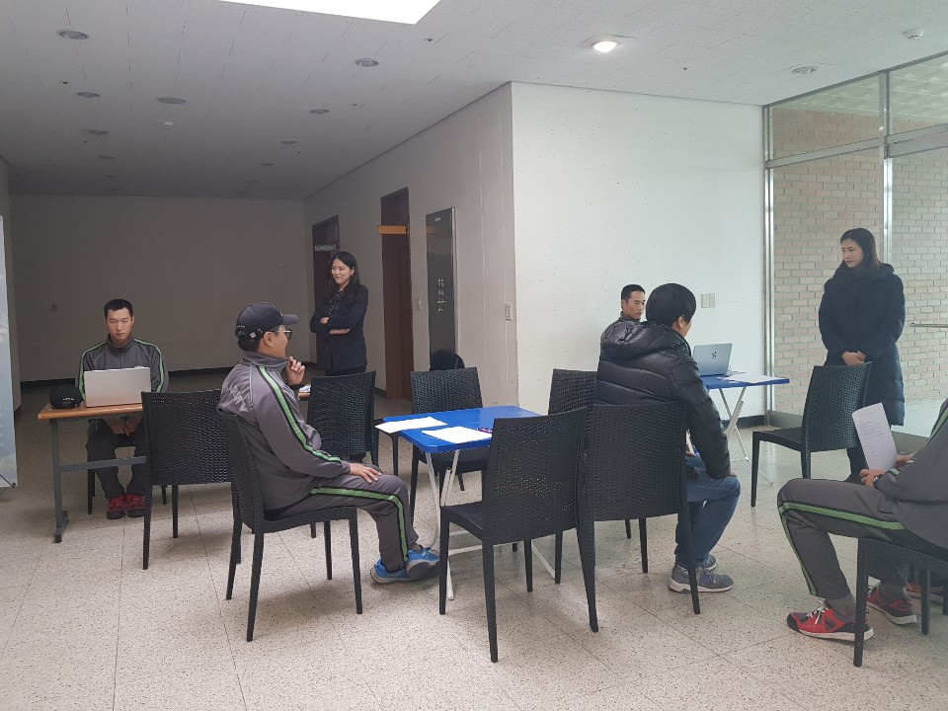
Notes:
This photo shows soldiers were checking their mental state through vibraimage program before drumming. This man is waiting after signing in the consent form to participate voluntarily into the study.

Slide 5
Necessity of Research - 1
Soldier's mental health is becoming a social issue
- The number of soldiers who have received medical treatment
10.9% increased from 2013 to 170,145
continuously increasing by more than 10% annually
Average 19 to 25 years old the early adulthood
- self-identity instability,
- internal and external change
- a strong self-assertion
Military life, some soldiers have difficulty adapting to military culture
- separation, control and obedience to their families
- stress and psychological unrest
- increase fear, anger, depression, concentration, and suicidal thoughts
Notes:
After the soldiers enlisted in the military, they should be trained in a completely different manner from the common society, leaving a familiar environment to which they have survived. In addition, the organization of the military is a strict military law not only applies, but also the upper and lower relationship according to the command and obedience is maintained thoroughly. In these armies, the new generation of soldiers in the early adulthood, mentally vulnerable, can experience stress and psychological anxiety in interpersonal relations through military service and to increase fear, anger, etc.. It affects not only depression, decreased concentration, and suicidal thoughts .. It is necessary to be interested in the mental health problems of the soldiers. In the past five years, the number of soldiers who have received mental health treatment, has increased by 10.9%, and is continuously increasing by more than 10% annually.

Slide 6
Necessity of Research - 2
The mental health problems of the soldiers.
- A shortage of research in the difficulty of recruiting and mediation studies in the nature of the military has a lot of active research is insufficient.
- effective in the military life stress through a program to utilize music through improvisation, song making, etc., but very insufficient.
Music is psychological and has the opportunity to deal with emotional problems and have a positive effect on reducing negative factors such as tension and anxiety .
- The function of the communication of music can be effectively used to express the depression and anxiety of the subjects, thoughts on death, physical pain, difficulties in interpersonal relationships, etc. .
Notes:
The military's Mental health Intervention study has been conducted research for the coping of stress in soldiers, there is little research in the difficulty of recruiting and mediation studies in the nature of the military has a lot of active research is insufficient. The study of music therapy interventions has been effective in the military life stress through a program to utilize music through improvisation, song making, etc., but very insufficient. Music is psychological and has the opportunity to deal with emotional problems and have a positive effect on reducing negative factors such as tension and anxiety .

Slide 7
Past study review of soldiers
Bittman B, Berk L, Shannon M, Sharaf M, Westengard J, Guegler KJ, et al., "Recreational music-making modulates the human stress response: a preliminary individualized gene expression strategy". Medical Science Monitor.
Fancourt D, Perkins R, Ascenso S, Carvalho LA, Steptoe A, Williamon A, “Effects of group drumming interventions on anxiety, depression, social resilience and inflammatory immune response among mental health service users”.
Bensimon M, Amir D, Wolf Y, “Drumming through trauma: Music therapy with post-traumatic soldiers”. The Arts in Psychotherapy.
Yoon, Julie. Group Music Therapy is an effect on the military life stress and adaptation of the soldiers concerned. [The Effect of Group Music Therapy for At-Risk Korean Soldiers on Adjustment and Stress Level]. Human Behavior and Music research
Notes:
Research on soldiers in the prior study in Korea has never been reported, but it has been shown to be effective in emotional intelligence, melancholy tendencies, self-interest, and positive sentiment by conducting a drum club activity program for students who have shown a misadaptation behavior . As a study of soldiers from abroad, the study was effective in reducing post-traumatic stress disorder when applying drum performance to determine the therapeutic potential for mental health in the Drum Club activity program.

Slide 8
Research purposes
to develop and apply drum club activity programs for soldiers and verify their effectiveness after applying the Drum club activity Program for soldiers
to identify the effects on aggression, stress, anxiety, suspect, balance, energy, charisma, self-regulation, neuroticism, brain fatigue, concentration, and vitality index through vibra image measurement.
Notes:
The purpose of this study is to develop and apply the Drum club activity program for military personnel and to identify the effects on the mental health of the soldiers using our vibraimage technology.. After applying the Drum club activity Program for soldiers, we want to identify the effects on aggression, stress, anxiety, suspect, balance, energy, charisma, self-control, neuroticism, brain fatigue, concentration, and vitality index through the vibraimage system measurement.

Slide 9
Research design
a single-group pre-and post-experimental design (one group Pretest-posttest designs) as a primitive experimental study to develop a drum club activity program for soldiers and to examine its effectiveness.
Notes:
This study was applied to a single group pre-and post-experimental design as a preliminary experimental study, the Drum Club activity program was applied to the soldiers once a week for 12 weeks, two hours.

Slide 10
Research subjects
This study is aimed at soldiers of the army, and the criteria for inclusion and exclusion of this study are as follows:
1) Inclusion criteria
-Those who agree to research
-Adult soldiers over 20 years of age
-Korean soldiers
-To continue to participate in the Drum
Club activity program during the
mediation period.
Notes:
This study is aimed at soldiers of the army, and the selection criteria for this study are those who agree to research, adult soldiers over 20 years of age, Korean soldiers , and those who are able to continue to participate in the Drum Club activity program during the mediation period

Slide 11
Research subjects
2) Exclusion criteria
-Those who have mental illness (manic, mental retardation, etc.)
- Those who are hard to play the drums or or hearing problems
-Those who are taking antidepressants or anti-anxiety drugs
-Those who have experience using drums or other instruments as a prerequisite for mental health
Notes:
The exclusion criteria are those with mental illness (schizophrenia, mental retardation, etc.), who are hard to play drums or have problems with the hand or hearing, those taking antidepressants, anti-anxiety agents, who have experience using drums or other instruments as a prerequisite for mental health.

Slide 12
Selection of sample number
Selected 33 people.
During a total of 12 sessions during the holidays and training, the program did not participate in more than three of the 18 people were dropped out and finally analyzed 15 data.
Notes:
The subjects were recruited for a total of 33 people at the army headquarters. Among total of 33 people, some were not participated in the program for more than three sessions of a total of 12 sessions by vacation and training, 18 were eliminated and finally analyzed 15 people data.

Slide 13
Research Tools
Mental health measurement through the Vibraimage system
aggression, stress, anxiety, suspect, balance, energy, charisma (attraction), self
-regulation, neuroticism, brain fatigue, concentration, vitality index
The measurement method was to look at the fixed laptop camera for one minute, say, laugh or do not move as much as possible, so as not to expect the back in a position sitting upright on the chair
The measurement place was a quiet space, the study assistant explained the precautions before measurement, and adjusted the measuring distance.
Notes:
. The method of measurement was to look at the fixed laptop camera for one minute, not to speak or laugh, and not move as much as possible, so as not to expect the back in a position upright on the chair. Light maintains a bright light so that the movement of the fine muscles of the face can be seen best. The measurement place was a quiet space, the study nurse explained the precautions before measurement, and adjusted the measuring distance.

Slide 14
Drum club activity program
The standardized method by examining the previous study
- professional lecturer(4 years),
- one professor and one registered nurse
- On the basis of Korean traditional rhythm beat
- One size and sound type drum for beginners
The duration : 12 weeks , once a week, for two hours once
The main weekly education content
- Teaching each rhythm and breathing method
- Playing a goal rhythm as a group
- Each week drum club activity program
Notes:
The Drum Club Activity program was developed in accordance with the standardized method by examining the previous study with a professional lecturer, one professor, one nurse who played a assorted drum on the basis of Korean traditional rhythm beat for more than four years with a vigorous experience in the field of drum club activities. Assorted Drums play a variety of different sizes and sounds, and you can play various rhythms by collecting multiple drums . However, the subjects of this study are beginners and not adept was carried out by placing one type

Slide 15
How to collect Data
Approval from the university's Institutional Review Board
(KWNUIRB-2018-11-002-001).
The data collection period was from January 11 to March 29, 2019.
The study was conducted after obtaining permission through the purpose and research plan of the study to meet each of the two regiments to register
Notes:
The recruitment announcement of the subjects was in the Military bulletin board representative , and before starting this study to the subjects wishing to participate by looking at the recruitment announcement, explained in detail the purpose and method of research in oral and written in the military camp. In addition, it was pre-guided to measure the mental health state by applying the vibraimage system to study participants. A written consent was received after explaining the anonymity of the collected data, the confidentiality of the collected data, storage and disposal after the study, and the withdrawal of the study.

Slide 16
Data analysis method
Statistical methods using SPSS version 22.0.
General characteristics of the study subjects were calculated as real numbers and percentages, and averages.
Mental health conditions through the before and after the vibraimage system was analyzed by Wilcoxon signed ranks Test.
Notes:
Data analysis of this study was analyzed using SPSS version 22.0. General characteristics of the study subjects were calculated as real numbers and percentages, and averages. Mental health status through the pre-and post-vibraimage system was analyzed by Wilcoxon signed ranks Test.

Slide 17
General Characteristics of Subjects
Table 1. General Characteristics of Subjects (N=15)
Characteristics | Classification | n(%) or M±SD
Gender | Male | 15(100.0)
 | Female | 0(0.0)
Age (years) |  | 21.47±0.79
Religion | Christianity | 6(40.0)
 | Catholic | 1(6.7)
 | None | 7(46.6)
 | Others | 1(6.7)
Marital status | Unmarried | 15(100.0)
 | Married | 0(0.0)
Taking medication | Yes | 0(0.0)
 | No | 15(100.0)
Military service period (months) |  | 9.00±4.80
 | Less than 6 months | 6(40.0)
 | 7 months~10months | 5(33.3)
 | More than 11months | 4(26.7)
Notes:
General characteristics of the study subjects are shown in this Table . The gender of the subjects was male. The average age was the average 21.47 years, and religion was the most common in seven people without religion, Next was six of Christianity. All were unmarried, and drug intake was not all. The military service was at an average of 9 months..

Slide 18
Effects of the Drum club activity Program
(N=15)
Variables | Pre-test | Post-test | Difference (post-pre) | z | p
 | M±SD | M±SD | M±SD
Aggression | 35.40±9.05 | 35.11±6.47 | -0.29±8.62 | -1.70 | .865
Stress | 26.70±4.52 | 29.46±6.91 | 2.767.39 | -1.13 | .256
Anxiety/tension | 37.40±3.79 | 29.03±5.59 | -8.38±7.47 | -3.12 | <.001
Suspect | 33.11±3.10 | 31.16±2.96 | -1.95±4.23 | -1.59 | .112
Balance | 67.44±3.97 | 65.19±4.84 | -2.25±7.92 | -1.10 | .067
Energy | 18.64±7.27 | 18.47±6.36 | -0.17±8.16 | -0.00 | 1.000
Charm | 70.51±11.52 | 70.57±13.23 | 0.06±18.21 | -0.22 | .820
Self-regulation | 69.22±6.21 | 67.04±7.54 | -2.19±11.17 | -0.56 | .570
Neuroticism | 24.26±10.64 | 26.20±7.26 | 1.93±14.55 | -1.02 | .307
Brain fatigue | 1.12±1.06 | 0.15±1.30 | 0.96±1.96 | -1.70 | .088
Concentration | 49.83±18.38 | 51.52±16.57 | 1.69±18.77 | -0.28 | .776
Vitality | 1.39±0.48 | 1.38±0.36 | -0.01±0.48 | -0.22 | .820
Notes:
The effect of the Drum club activity Program of the study subjects is the same as this Table . Anxiety was a pre-score 37.40 , the post-score was a statistically significant difference appeared in the 29.03. The remaining variables are aggression, stress, suspect, balance, energy, charisma (attraction), self-control, neurosis, cerebral fatigue, concentration, vitality Index, etc., there was no statistically significant difference.
Anxiety can cause many health problems, especially in soldiers, anxiety was found to be related to the suicide of a soldier , as well as anxiety in a soldier is a factor in predicting drinking motivation or overdrinking, anxiety reduction in soldiers is important.

Slide 19
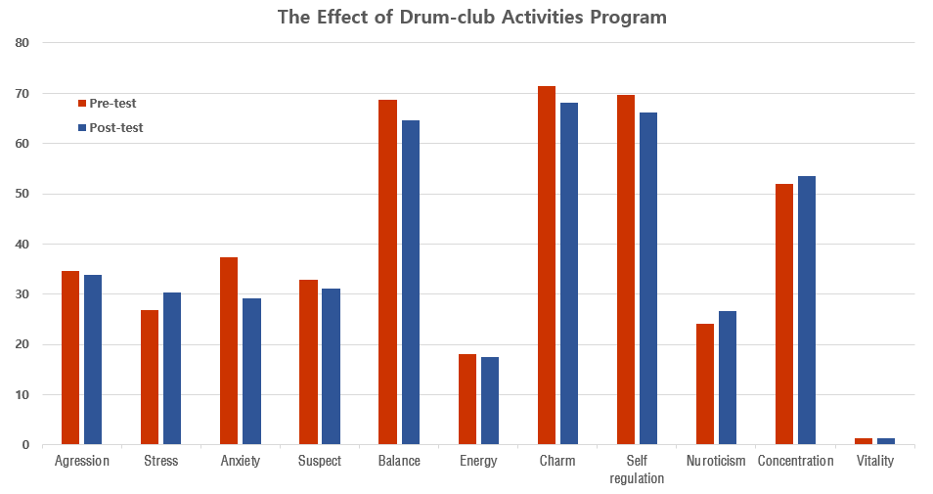
Notes:
This figure shows the bar chart between pre and post result.
Drumming training was not easy to adjust percussion sounds as a group activity, so stress and neuroticism
were slightly worsened before proficiency, but those were within a normal range. But at 12th week, there
was statistically significant improvement in anxiety and tension. Other parameters of aggression, suspect,
and concentration were slightly improved.

Slide 20
Conclusion
Vibraimage Technology is easily and quickly measure the psychological emotional state of a person,
Some changes in the state of the person after the education training of the drum as well as the normal and psychological emotional state
The effectiveness of the drumming education and training was positive in various psychophysiological conditions and, the result proved to be effective.
The differences between the two conditions are relatively marked by psychophysiological parameters.
The significant difference was so remarkable in Anxiety and Tension.
Notes:
In this study, the Drum Club activity program for soldiers significantly reduced the anxiety of soldiers, and other aggression, stress, suspect, balance, energy, charisma (attraction), self-control, neurosis, brain fatigue, concentration, vitality Index, etc. There was no statistically significant difference. Based on this study, the Drum Club activity program for soldiers is considered a nursing arbitration that can help reduce the anxiety of soldiers.

Slide 21
Significance of This Study
Despite having a problem with the mental health of the military, the special situation in the military is the first study to try a program that is likely to be utilized by soldiers in a difficult state to mediate.
The degree of anxiety was demonstrated the effect of reducing anxiety through the study in the large soldiers of the military enlisted.
It is easy to apply interventions that do not require a lot of professional training and can be used later.
Vibraimage techology is in the sense that soldiers attempted to measure mental health status as an objective measurement tool.

Slide 22
Limitations of this study
First, there is a limit to generalize the results of the study as a single group before and after design.
Second, the subjects are confined to the army soldiers of the two regiments, and it is necessary to be cautious in making generalizations.
Third, because the evaluation of mental health only through an objective measurement tool did not grasp the effect on how to feel subjectively of subjects.
Notes:
Limitations of this study are as follows: First, there is a limit to generalize the results of the study as a single group before and after design. Second, the subjects are confined to the army soldiers of the two regiments, and it is necessary to be cautious in making generalizations. Third, because the evaluation of mental health only through an objective measurement tool did not grasp the effect on how to feel subjectively of subjects.

Slide 23
Suggestions
First, to secure the number of samples to repeat through the conduct of the Randomized control arbitration study with Air Force and Navy
Second, to suggest to evaluate subjective effects.
Third, to suggest integrating with qualitative research to analyze the effects program in depth.
Finally to suggest that they evaluate the effect by recruiting many subjects that included various periods
Notes:
Based on the results of this study, there are 4 suggestions.

Slide 24

Thank you
4metahc@metahc.com
This document, including any attachments, is the property of Meta Healthcare Corp., and may contain confidential information, privileged material or constitute non-public information.
Any use, retention, dissemination, distribution or reproduction of this transmission by unintended recipients is strictly prohibited and may be unlawful.
Tuesday, June 25, 2019

