Slide 1


The 2nd International Open Science Conference
The Vibraimage Technology
ABOUT THE ACCURACY OF VIBRAIMAGE TECHNOLOGY
Viktor Minkin,
Elsys Corp, Saint Petersburg, Russia
2019
Notes:
The question about the accuracy of vibraimage technology is the most popular question from any user or scientist reading the reports about vibraimage research.

Slide 2
Vibraimage error rates
Instrumental
Methodological
Intrinsic
Complementary
Random
Systematic
Measurement
errors
Absolute
Relative
Statics
Dynamics
Standard Deviation
Math
Average
Periodical
Constant
Notes:
Let's consider the vibraimage technology as the standard measurement instrument based on the metrology – the science studding the measurements, errors and accuracy. Specialists in metrology know that there are a lot of different errors in any measurement system. The influence and significance of every error depends on several factors. On this study we will limit by three main error rates, because I show that these errors have more influence to vibraimage results. These are instrumental, methodological and complementary errors.

Slide 3
VibraMed10 program. PC
VibraMed10 PC interface. LifeCam Cinema camera with resolution 640x480 pxl
3
Notes:
The standard approach for errors study is doing serial measurements of a stable physical value. So I did 100 measurement of my psychophysiological parameters by VibraMed10 program setting on Windows based PC. Measurements were done in two neighboring days in one time on the morning during 11 to 12 o’clock for deleting the influence of psychophysiological parameters instability giving complementary error. Hardware was taken based on vibraimage Manual recommendations, LiveCam cinema webcam sets VGA resolution and head size on horizontal line was about 200 pixels.

Slide 4
VibraMed captured results. M page
M, SD and Var of emotion 10print
Emotion10print parameters graphs
for total 60 s time
I-E parameters time dependences
Notes:
VibraMed10 program is doing about 2,5 accounts per second, total testing time was default (60 seconds), so program calculates about 150 parameter accounts during every test. Average value for every psychophysiological parameter was calculated together with standard deviation and variability. It is understandable that chronobiological physiological processes have influence to the current measurement accounts, so current psychophysiological parameters have high level of variability. But the average values of parameters taken by all 150 accounts are more stable than current values.

Slide 5
VibraMed captured results. dMeasurement page
Emotion10print parameters graphs
for two 30 s periods
Emotion10print parameters
for two 30 s periods
Notes:
VibraMed10 program indicates the difference between the first and the second measurement half in the dMeasuremnt page of the excel file. The comparison of two measurement parts allows to assess the stability of person psychophysiological state during the measurement, mostly based on frequency histogram. The most part of emotion 10print is based on frequency histogram so it instability has significant influence to result errors. So the comparison of Measurement page and dMeasurement page gives information not only about a person psychophysiological parameters but also about the errors during the measurement.

Slide 6
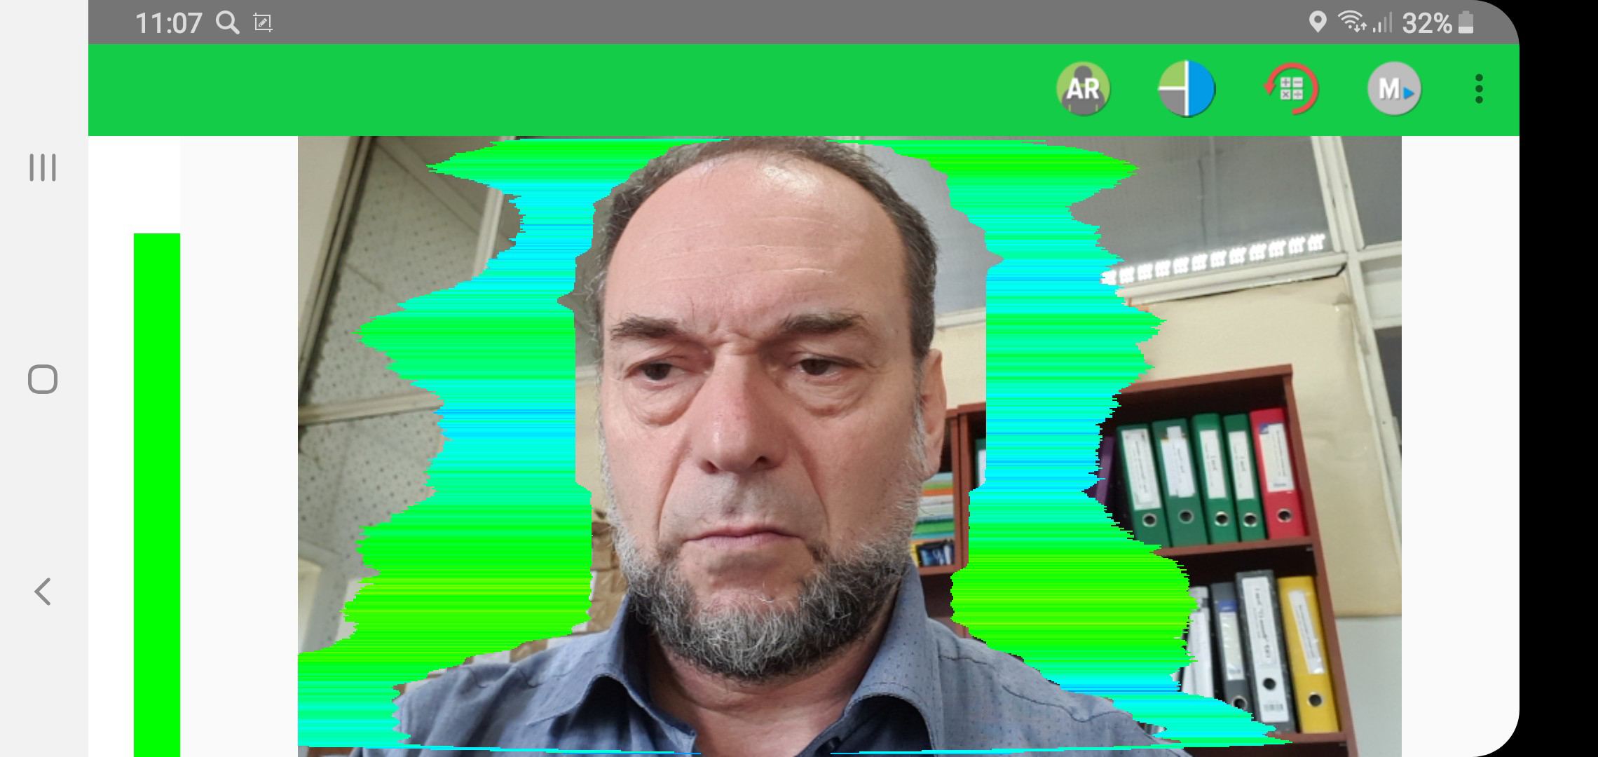
VibraMA program. Android mobile
VibraMA program interface on Android mobile phone Samsung S8. Camera resolution 800x480 pxl
Notes:
For estimation of instrumental error it is necessary to do measurements on different hardware. Mobile phone Samsung S8 was selected as the second type of hardware for testing. It includes powerful processing and sensitive camera more better than Microsoft LifeCam Cinema taken for first serial of measurements. The resolution of S8 camera was sett 800x480 pixels and head size in horizontal line was the same as for webcam about 200 pixels.

Slide 7
VibraMA captured results. M page
1st Test
 | M | S | Vi (S/M) | bMin | cMin | bMax | cMax
Aggression | 55,33 | 3,45 | 6,24 | 20,00 | 47,02 | 50,00 | 67,07
Stress | 28,67 | 2,48 | 8,65 | 20,00 | 21,90 | 40,00 | 31,49
Tension | 16,85 | 6,72 | 39,84 | 15,00 | 7,84 | 40,00 | 36,97
Suspect | 33,53 | 2,67 | 7,96 | 20,00 | 25,77 | 50,00 | 40,13
Balance | 67,34 | 5,30 | 7,87 | 50,00 | 53,98 | 100,00 | 76,53
Charm | 75,25 | 7,61 | 10,12 | 40,00 | 44,61 | 100,00 | 80,53
Energy | 38,12 | 2,72 | 7,14 | 10,00 | 34,81 | 50,00 | 45,61
Self-Regulation | 71,40 | 5,74 | 8,04 | 50,00 | 49,76 | 100,00 | 76,47
Inhibition | 19,65 | 2,67 | 13,57 | 10,00 | 15,34 | 25,00 | 28,23
Neuroticism | 26,67 | 3,67 | 13,78 | 10,00 | 0,00 | 50,00 | 28,53
Positive | 63,02 | 52,6% | 8,29 | 22,0%
Negative | 33,5939484 | 28,0% | 15,675716 | 41,6%
Physiological | 23,1574106 | 19,3% | 13,67641 | 36,3%
Correlation matrix of unconscious responses for each pair of questions
Notes:
VibraMA program for Android phones has the same processing as the VibraMed10 program for PC and near the same program interface. But the camera of Samsung S8 see more vibrations from the same object so the frequency histogram from mobile phone is moved to the right side so it gives significant difference for all parameters based on human energy consumption in processing algorithm.

Slide 8
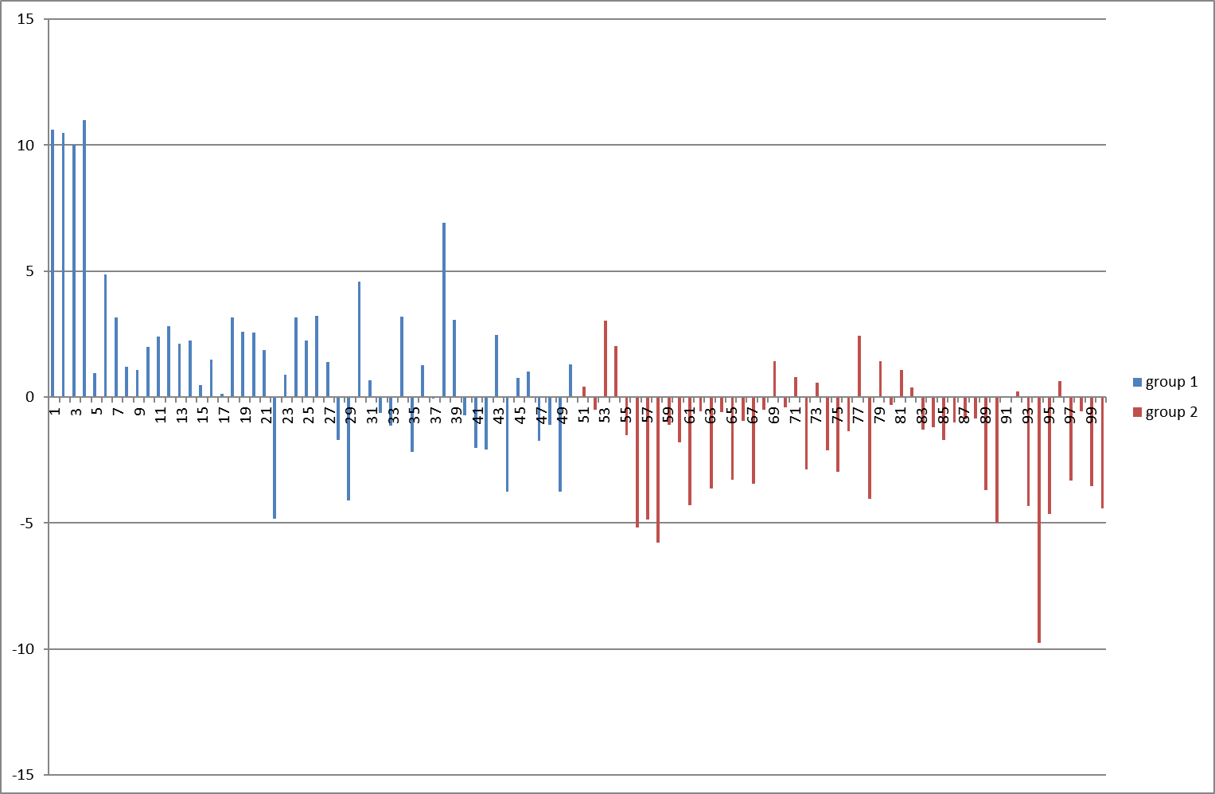
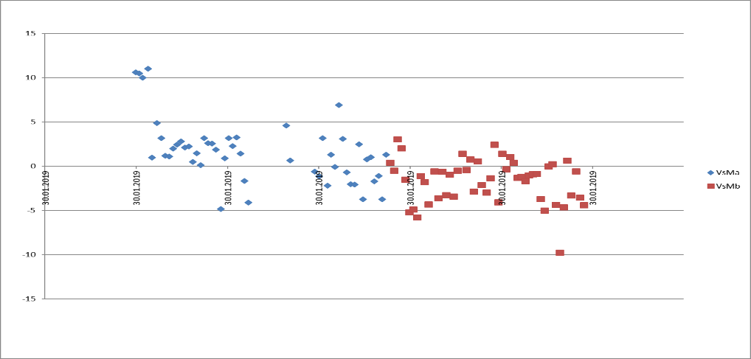
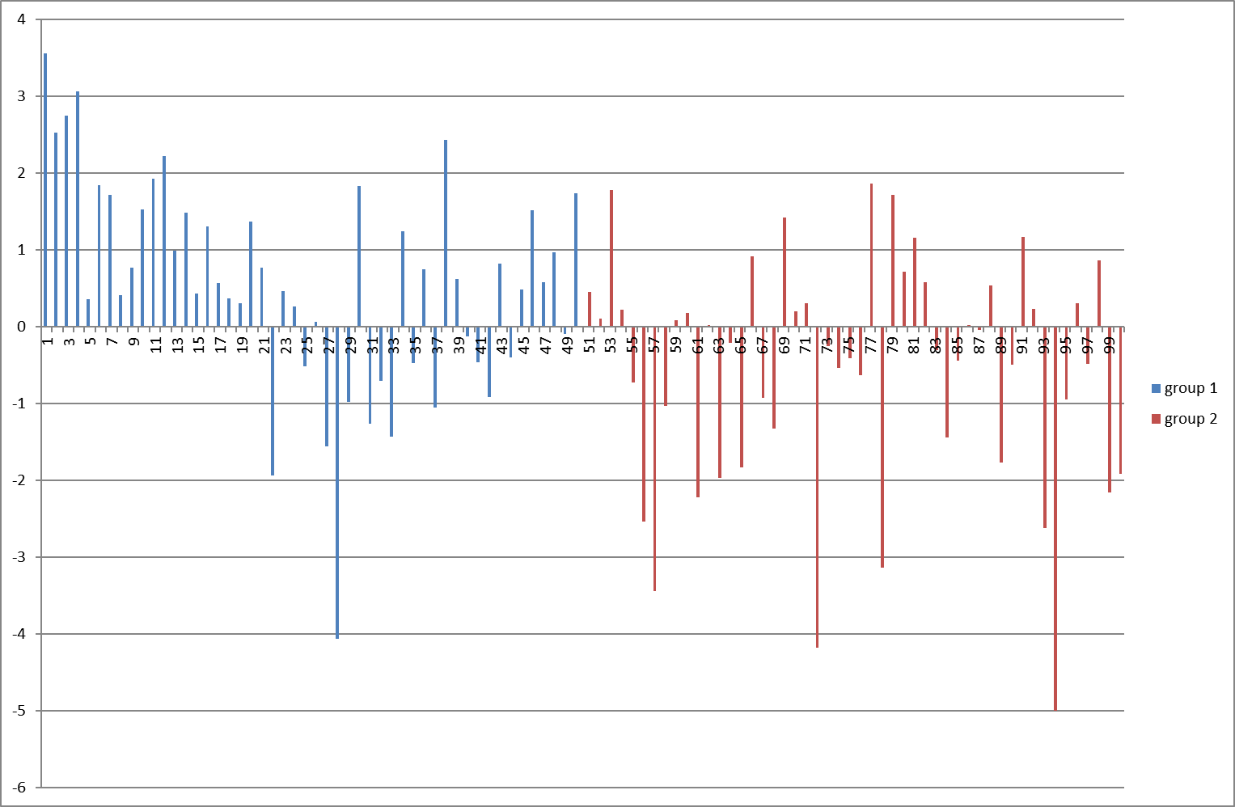
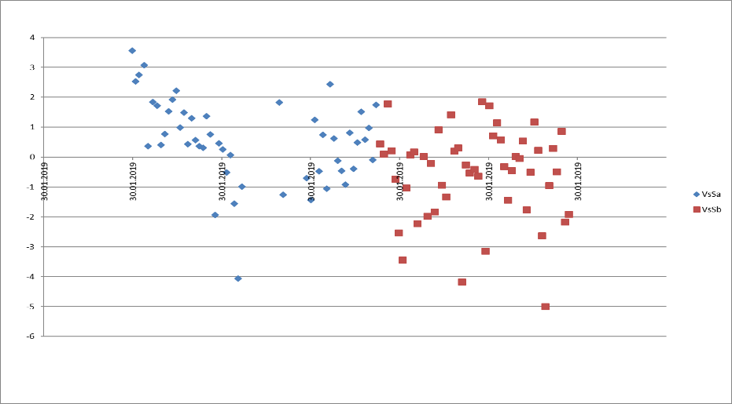
PC testing. PPS changes
Vs graph M
Vs graph Mt
Vs graph S
Vs graph St
Notes:
Let’s look for person parameters distribution during measurements on the PC given on this slide. On the upper line we see the distribution of general psychophysiological state calculated from math expectation of emotion 10print into one status level. Left histogram has measurement number on horizontal axes, right histogram has time data on horizontal axes. We see some down trend in given measurements from left to right side and this trend is more concentrated for math expectation and has more distribution for standard deviations of parameters.

Slide 9
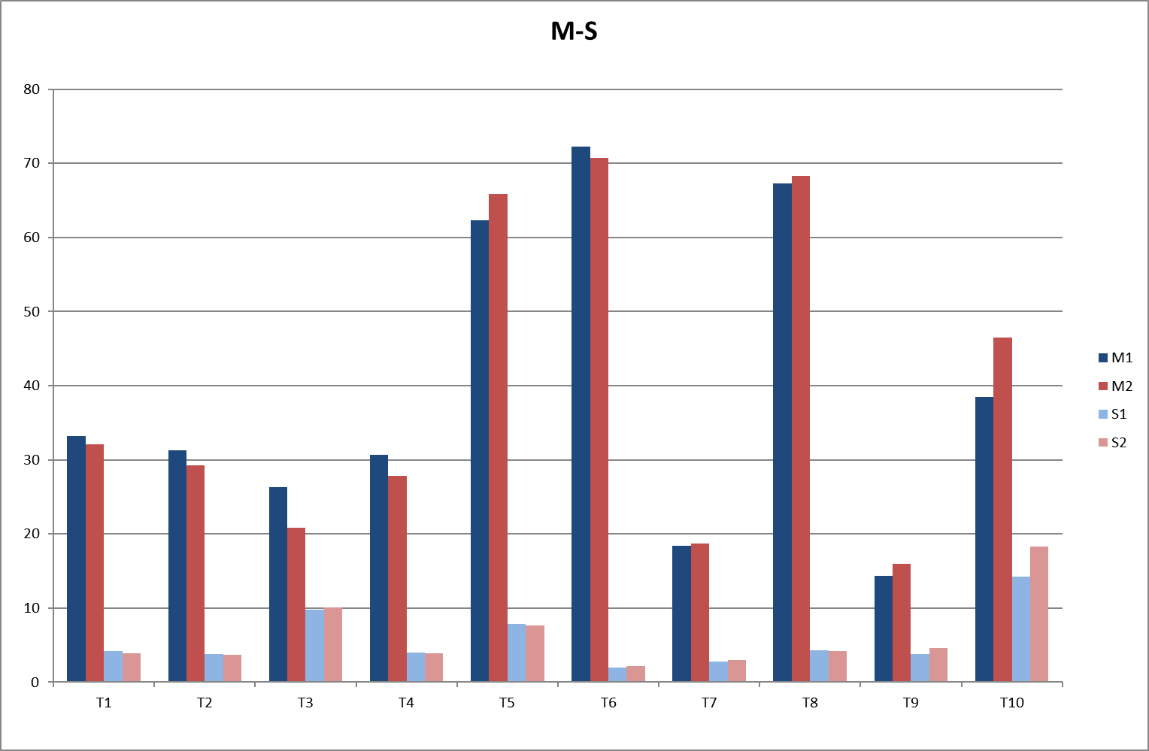
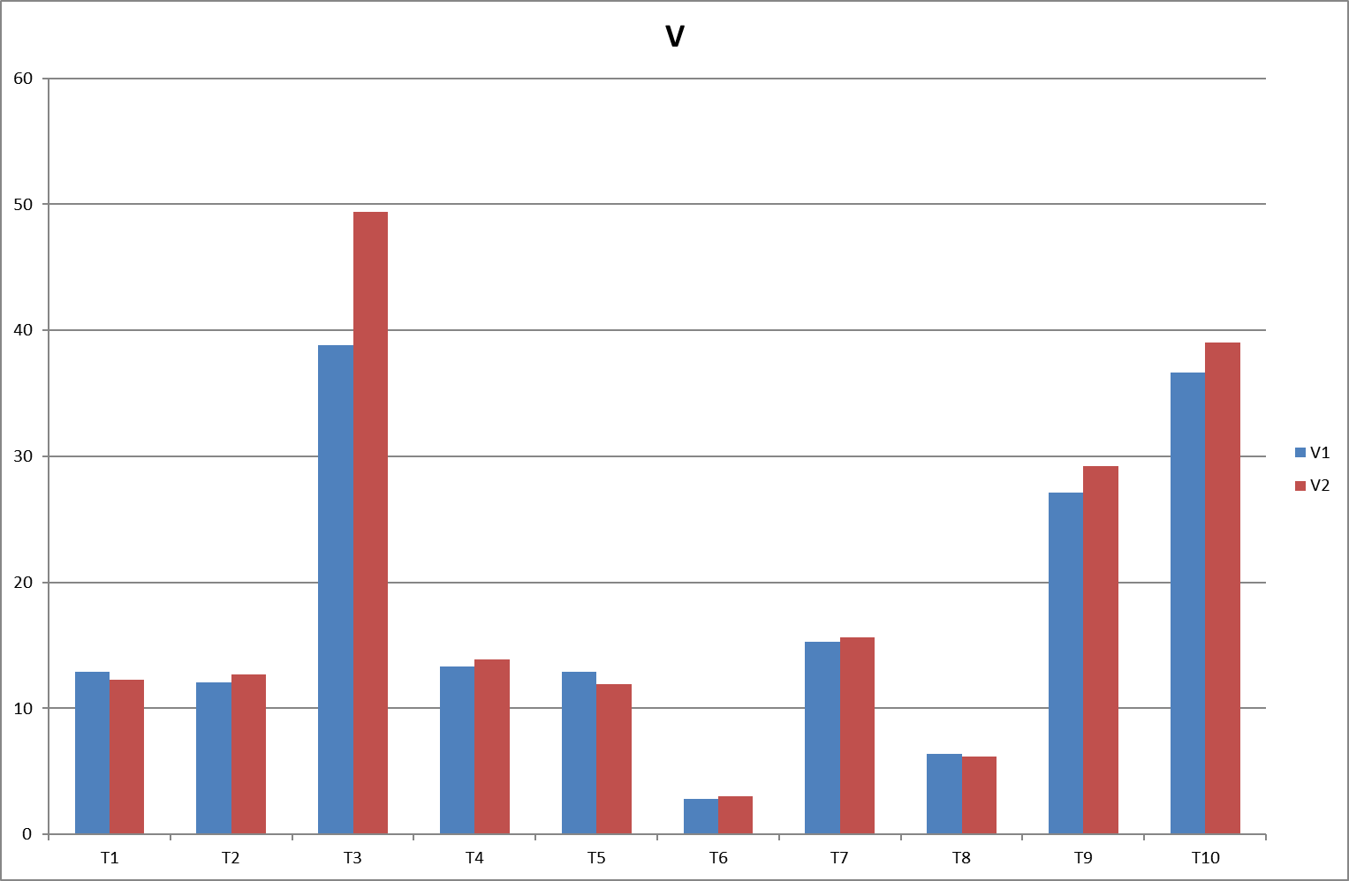
PC testing. PPS parameters change
Emotion 10 print for M and SD values between 2 groups of 50 measurements
Emotion 10 print for variability values between 2 groups of 50 measurements
Notes:
On the said slide we see differences between average parameters in groups does not linked with the measuring time, only divided on two groups. We see that histogram for Math expectation and Standard Deviation shown on the left picture have different changes for different parameters of emotion 10print. On the right picture we see more significant changes for variability of Tension or T3 parameter. Average tension level from the second group is greatly higher than from the first group.

Slide 10
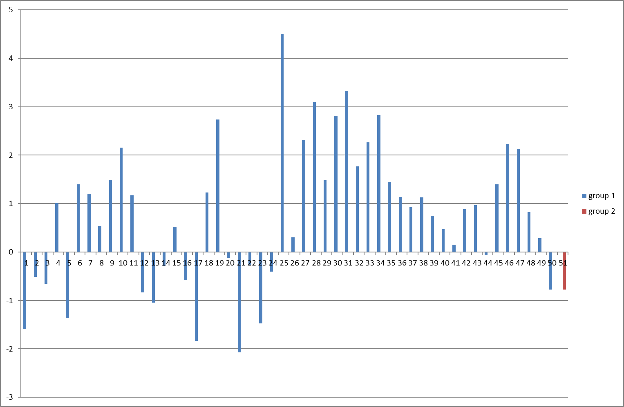
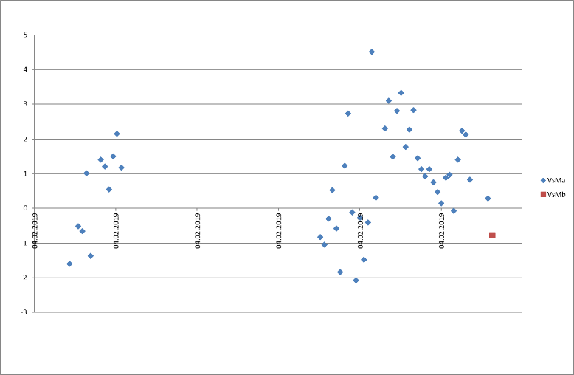
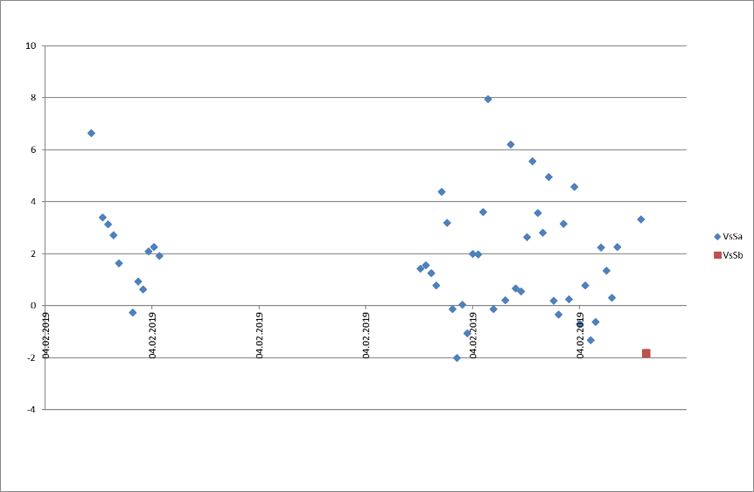
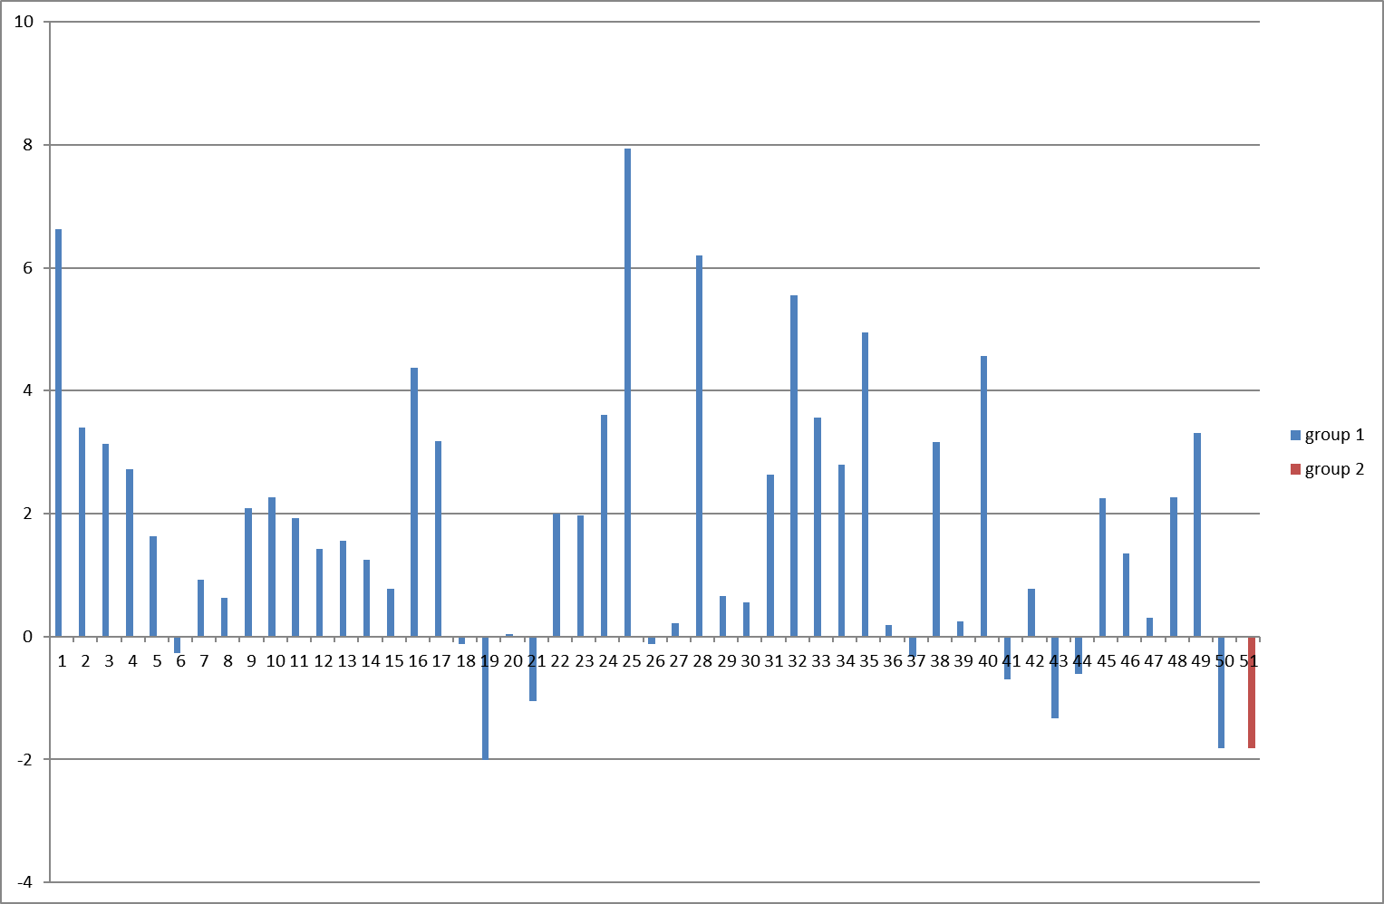
Mobile testing. PPS changes
Vs graph Mt
Vs graph M
Vs graph Ms
Vs graph S
Notes:
Let’s look to the time changes in psychophysiological parameters calculation measured by mobile phone by the same histograms as for PC measurements. We do not see the same trend as for the PC measurements, but it could be understandable because all mobile phone measurements were taken in one day, but PC measurements were provided in two day sequence. Also we do not see more distribution of mobile phone measurements for standard deviation values comparison to math expectation values.

Slide 11
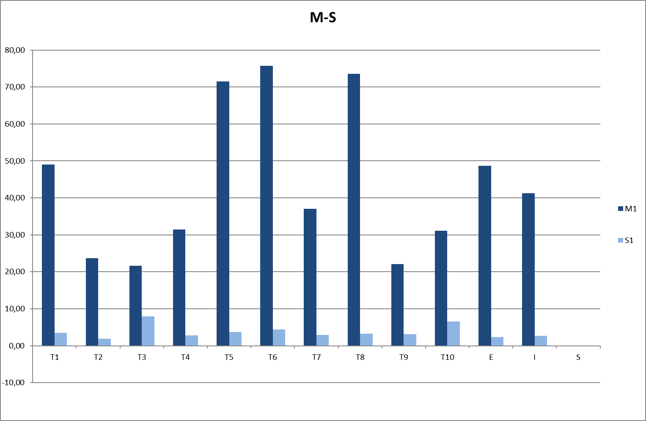
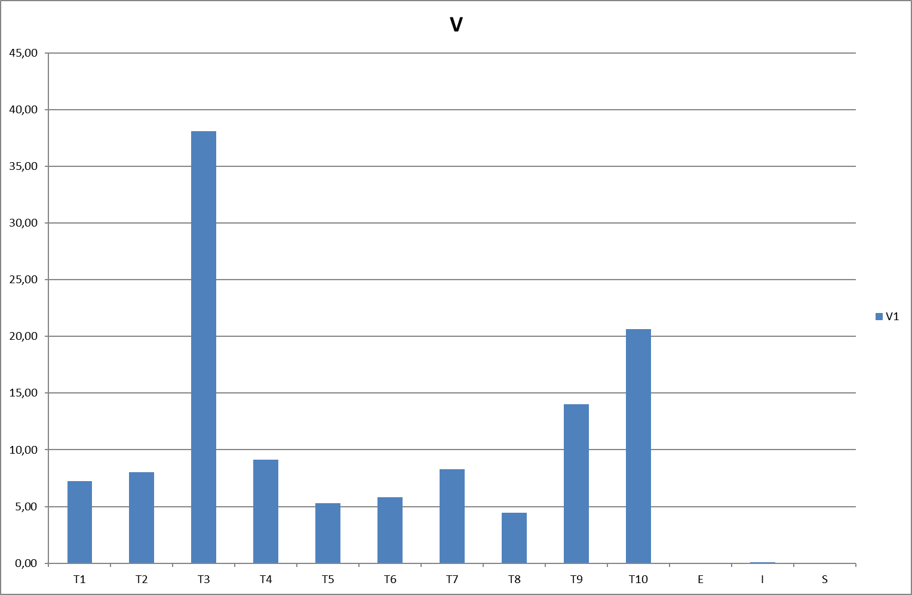
Mobile testing. PPS parameters change
M and SD values for emotion 10print parameters
Variability values for emotion 10print parameters
Notes:
On the histograms for emotion 10print parameters we also see the significant difference between tension or T3 parameters distribution which has high variability level. We will analyze the reasons for given histograms on the next slides while discussing the difference between PC and Mobile phone measurements.

Slide 12
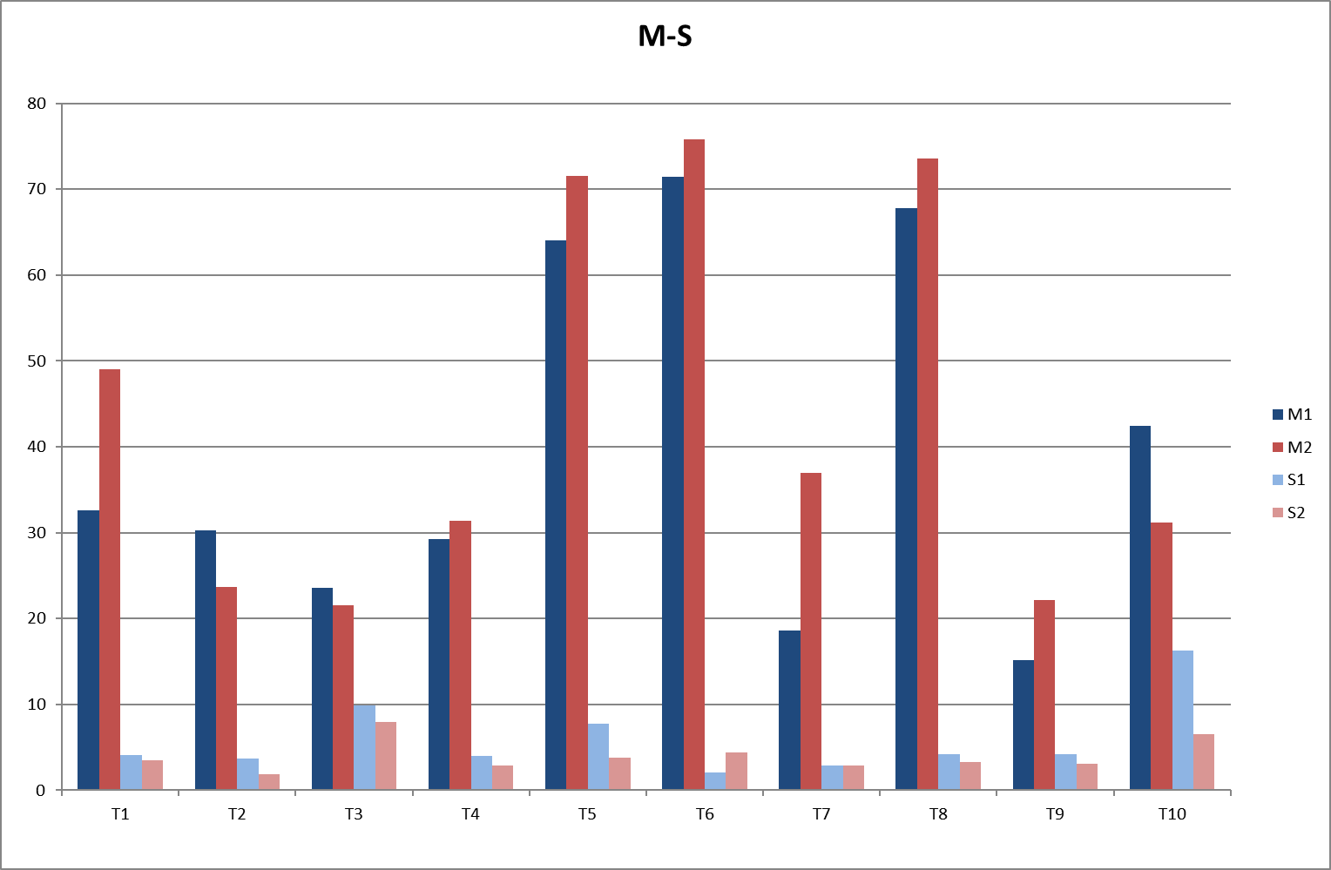
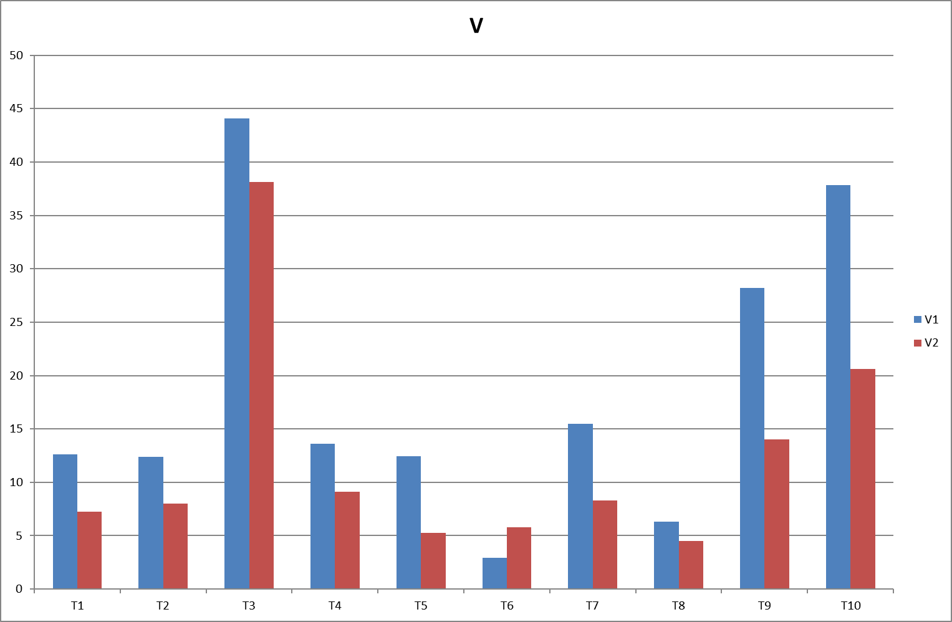
Comparison PC – Mobile testing
M and SD values for PC (blue) and Mobile (red) emotion 10print parameters
Variability values for PC (blue) and Mobile (red) emotion 10print parameters
Notes:
On this histograms are given average values of measurement parameters for PC (blue graphs) and Mobile (red graphs). We see that 9 from 10 parameters have more variability for PC measurements than for Mobile measurements. That can be simply explain by the fact of more high accuracy of Mobile phone camera. It better detects vibrations and shows better results for vibraimaging. Only T6 parameter shows opposite picture, but the variability of T6 parameter is lowest between all and this parameter has very low influence to the total errors calculation.

Slide 13
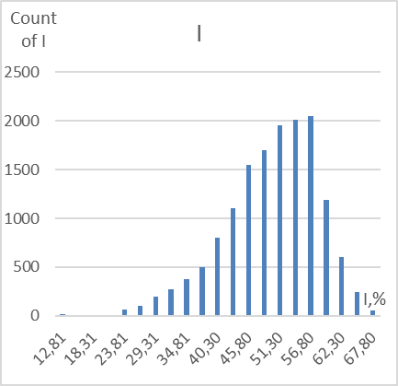
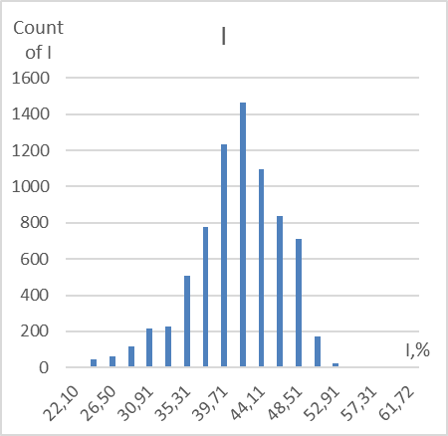
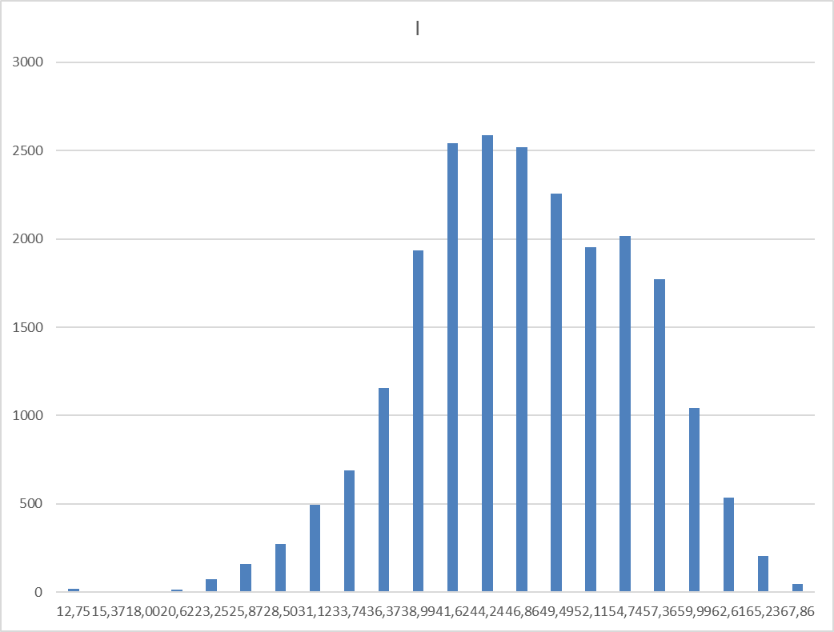
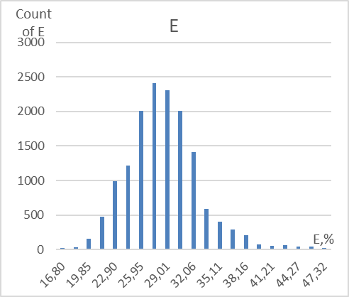
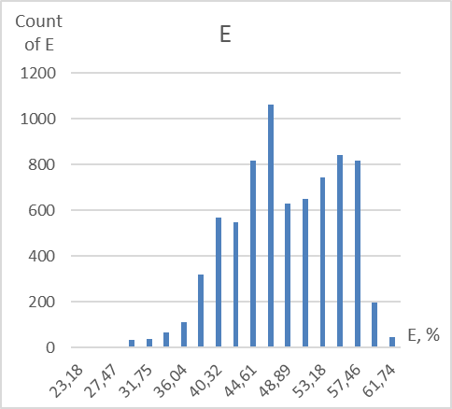
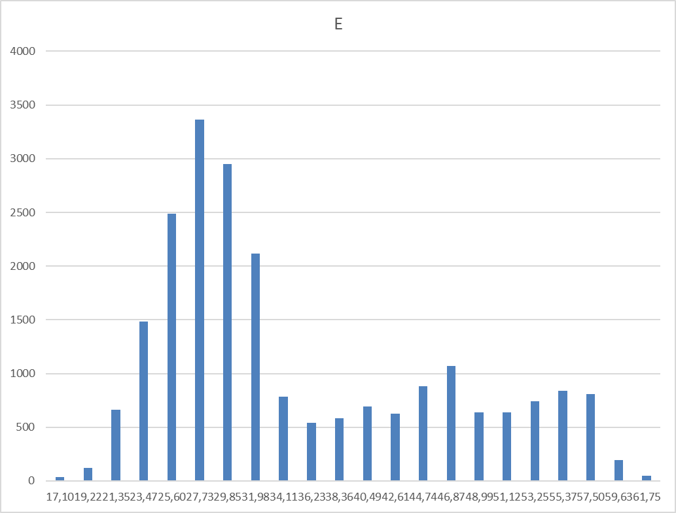
Psychophysiological parameters distributions
PC histogram for I
Mobile histogram for I
Total histogram for I
PC histogram for E
Mobile histogram for I
Total histogram for E
Notes:
Let’s look to the values distributions of information and energy parameters, which are more important for psychophysiological parameters calculation. We see that Mobile phone parameters distribution differs from PC distribution also we see that both distributions are far away from normal distribution form. The distribution form of the accounts is very important function in the theory of measurements because different distribution forms request different methods for errors estimation. We can also note that addition of both measurement groups into one does not give more similarity to the normal distribution, that means there are special factors during the measurements having influence to the results.

Slide 14
Errors table for vibraimage measurements
var | M1 avg | Ϭ1 avg | Ϭ1(M) | M2 avg | Ϭ 2 avg | Ϭ2(M) | M avg | Ϭ avg | Ϭ(M)
T1 | 49,00 | 3,54 | 5,04 | 32,63 | 4,09 | 3,55 | 38,09 | 3,91 | 8,74
T2 | 23,67 | 1,92 | 2,26 | 30,26 | 3,72 | 3,05 | 28,07 | 3,12 | 4,19
T3 | 21,59 | 7,97 | 3,75 | 23,57 | 9,91 | 5,86 | 22,91 | 9,26 | 5,33
T4 | 31,43 | 2,85 | 1,72 | 29,25 | 3,95 | 3,12 | 29,98 | 3,59 | 2,92
T5 | 71,56 | 3,76 | 2,92 | 64,09 | 7,77 | 6,29 | 66,58 | 6,43 | 6,45
T6 | 75,76 | 4,38 | 4,91 | 71,48 | 2,08 | 1,81 | 72,91 | 2,85 | 3,78
T7 | 36,99 | 2,94 | 5,52 | 18,58 | 2,89 | 2,51 | 24,72 | 2,90 | 9,47
T8 | 73,62 | 3,28 | 2,06 | 67,80 | 4,23 | 3,35 | 69,74 | 3,91 | 4,06
T9 | 22,15 | 3,12 | 1,71 | 15,14 | 4,25 | 2,20 | 17,48 | 3,87 | 3,89
T10 | 31,15 | 6,56 | 8,18 | 42,46 | 16,29 | 11,69 | 38,69 | 13,05 | 11,91
E | 48,65 | 2,35 | 10,46 | 28,58 | 2,61 | 3,05 | 35,27 | 2,52 | 10,39
I | 41,29 | 2,67 | 6,46 | 49,81 | 5,79 | 5,14 | 46,97 | 4,75 | 6,48
S | -0,01 | 0,00 | 0,08 | -0,01 | 0,00 | 0,09 | -0,01 | 0,00 | 0,08
The results of 150 PPS measurements of the parameters T1-T10 and I-E, divided into group 1 (50 mobile measurements), group 2 (100 computer measurements) and combined into one group. M is the average value of the parameters, M is the average value of the parameters, Ϭ avg is the average value of the standard deviation of the measurement group, Ϭ (M) is the measurement standard deviation (MSD).
Notes:
See the same results as on the past graphs given in the table format for the mobile measurement (group 1), PC measurements and mixed group. Both measurements of standard deviation reflects errors rate differs by calculation method.
Given table confirms past graphs that mobile phones results have higher accuracy than PC results and mix group has error rates near to the PC group. Also is need to note that all given results are received by processing of VibraStat program that simply calculates all tables and graphs by one button pressing.

Slide 15
Conclusions
The average value of total error for vibraimage psychophysiological parameters measurement was ± 6.1% (without instrumental error ± 4.3%).
The instrumental error can make a significant contribution to the errors of vibraimage. The parameters of a television camera (sensitivity, contrast, dynamic range, temporal noise) have a significant impact on the result, for some parameters the instrumental error can reach ± 4%.
The systematic error is mainly determined by the additional error associated with the one-sided trend from changing PPS under the influence of external factors (time, stimuli); it is not eliminated by averaging the measurement results used in each test.
The methodological error has influence to the results for the measurements taken with violation of vibraimage instructions
Notes:
This study shows that vibraimage technology measures psychophysiological parameters with total errors rate about 6%, that is very good result in comparison with the other technologies of psychophysiological detection. Having correct instruments for vibraimage allow to reduce the errors to 4% and give more accuracy to the technology. The complimentary error is near to systematic error and mostly depends from the trends in psychophysiological parameters changing based on the time and ambient factors. For vibraimage as for any technology of psychophysiological detection is greatly difficult to create the stable etalons for psychophysiological parameters and is need to understand that we are measuring unstable value and this instability is not random.
We suppose that for given results the value of methodological error was minimum because the measurement was provided based on vibraimage Manuals. But for the unprepared users methodological error could be greatly higher if any of vibraimage rules is broken. For example, illumination instability could give proportional influence to the results, like reducing illumination to 50% can give the same error in the vibraimage results.

Slide 16
Thanks for the attention!
Viktor Minkin,
e-mail: minkin@elsys.ru
www.elsys.ru
www.psymaker.com
Notes:
Maybe this report is more technical on the conference than others. Vibraimage technology requests different knowledge from partners and users, so for professional operation with vibraimage you need to combine technics with psychology and physiology. Elsys is mostly the technical team and we try to provide the most part of technical solutions inside hardware and software. But is preferable that users also have base knowledge about measurements, it helps to have better results in vibraimage technology.

