Slide 1
The 2nd International Open Science Conference
The Vibraimage Technology
THE OPTIMAL SEQUENCE OF STIMULI PRESENTATION FOR PROFILING AND PSYCHOPHYSIOLOGICAL DETECTION OF DECEPTION
Viktor Minkin,
Elsys Corp, Saint Petersburg, Russia
2019
Notes:
In this report I will talk about stimuli sequences for lie detection and this field request knowledge of terms in psychophysiological detection of deceptions.

Slide 2
Psychophysiological detection of deception Comparison Testing
Main terms and abbreviations
Comparison test format – CTF;
Deception Indicated – DI;
No Deception Indicated –NDI;
Psychophysiological Detection of Deception – PDD;
Relevant/Irrelevant –R/I;
Zone Comparison Test –ZCT;
Significant Response – SR;
Comparison Question – CQ;
Relevant Question – RQ;
Irrelevant Question - IQ
Notes:
Psychophysiological detection of deception is the specific field in modern science, I think that half of scientist do not accept polygraph measurements as real science. In spite of this fact, more and more polygraph testing every year are providing by government agencies and private companies. So for looking on vibraimage as polygraph instrument we need to know the terms and principals of modern psychophysiological detection of deception.

Slide 3
PDD examination
Fragment of PDD examination
Qi - time of text question presentation;
Ti - time of stimulus picture presentation, which enhances and clarifies text question;
Ri - response time of a testee to the conscious answer to the question-stimulus
3
Notes:
Psychophysiological detection of deception examination includes presenting the sequence of questions to examined person or testee. For science analysis of testee psychophysiological response we need to divide periods inside one question presentation into three parts given on the slide picture. Also we need to take in account that psychophysiological response has inertia, like in physics, so it is impossible to stop emotion instantly and person need time to return psychophysiological state in normal position after his response to stimulus. So usually in PDD there are some pause between questions about 10-15 seconds.

Slide 4
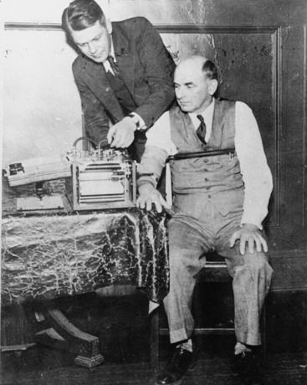
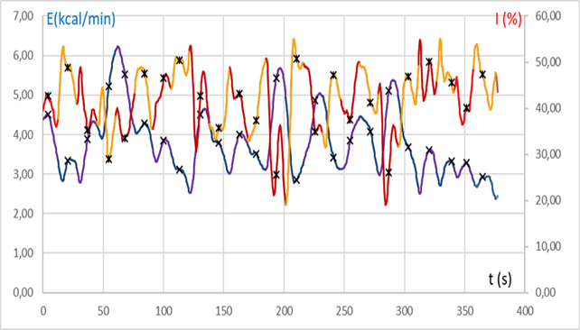
Chronobiological processes in psychophysiological responses. Time dependences
American inventor Leonarde Keeler (1903–1949) testing his improved lie-detector
Record of time dependences for physiological parameters
Notes:
Standard contact polygraph was developed in the beginning of the past century and includes the time dependences measurement of several physiological parameters as blood pressure, pulse, respiration, and skin conductivity while a person is asked and answers a series of questions. It was supposed that lie accompanied by the significant changes in time dependences of physiological parameters, so examiner need to look for correspondence between questions and physiological parameters changes. Taken physiological parameters have not direct links with person emotion state so for standard PDD only value of physiological parameter changes is important.

Slide 5
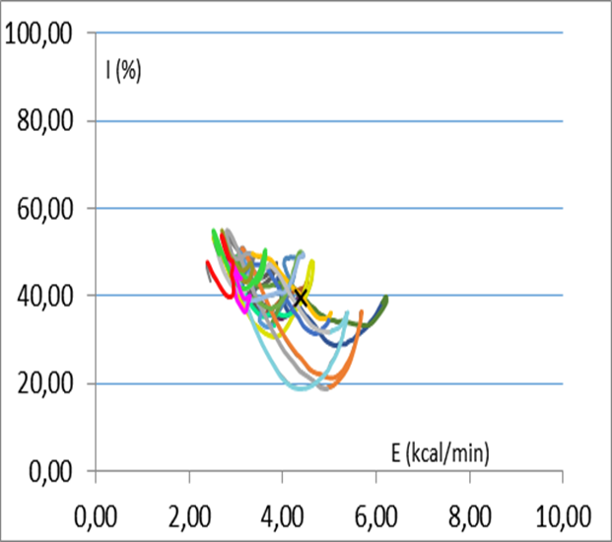
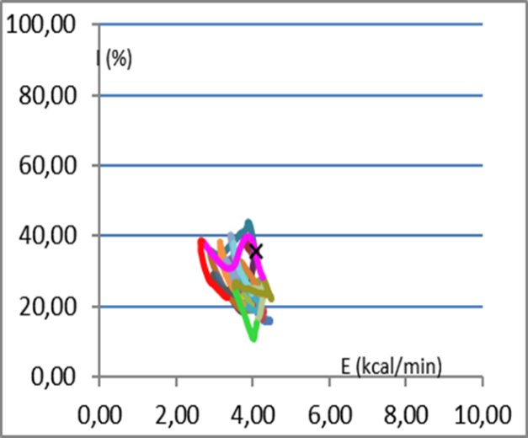
Vector information from vibraimage
PPS changes in information-energy scales by the analysis of opposition questionnaire examination
PPS changes in information-energy scales by the analysis of complementary questionnaire examination
Notes:
Vibraimage technology captures information not only about the value of physiological parameters changes but also about the direction of changes for complicated vibraimage parameters having links with emotion state of person. On this slide is shown two pictures for typical changes of person psychophysiological state during examination given in information and energy scales. I do not stop on information and energy parameters calculation because it was explain in detail in the other articles. I only put attention on the fact that the character of parameters changes is identical for different types of questionnaires, including opposite and complementary questions. We see the same negative correlation between information exchange and energy consumption and it fluctuation from mass center.

Slide 6
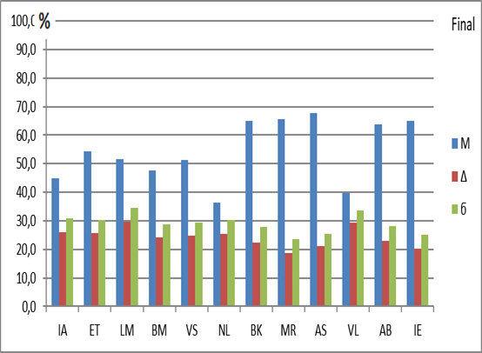
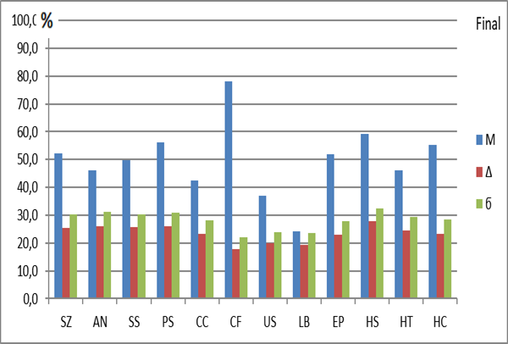
Database of psychophysiological testing
Evoked PPS changes in 380 seconds
Testing by VibraMI program
Evoked PPS changes in 380 seconds
Testing by PsyAccent program
Notes:
In my understanding the main problem of current PDD is consideration of lie as special case in psychophysiology. This approach request testing statistics only in lie detection samples, that limits PDD research because it is very difficult to provide lie detection testing with normal motivation. From the other side the most part of PDD calculation is based only on significance of physiological response to presented stimulus. Said two approaches are opposite one to the other.
It is necessary to consider lie as only special case of normal psychophysiological response, in this case all research results received in study psychophysiological responses are actual for the PDD. This approach allows to use all databases received in vibraimage testing for understanding laws of psychophysiological responses actual for lie detection.
During vibraimage testing we have database of more than 1000 testing with different questionnaires, including questionnaires with opposite questions from VibraMI program and complimentary questions from PsyAccent program. Programs built the profiles of exanimated person based on his conscious and psychophysiological response but in this study we will pay attention only on the psychophysiological responses during these testing.

Slide 7
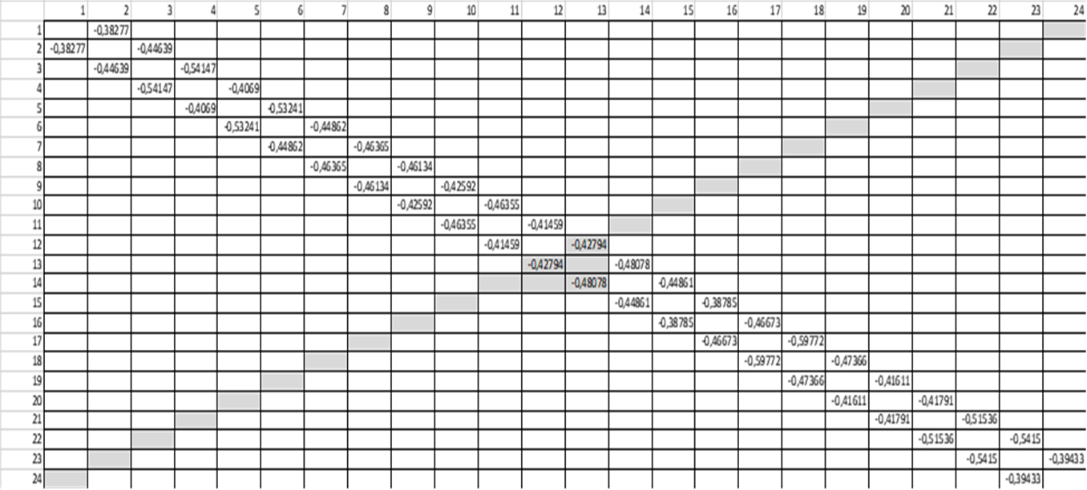
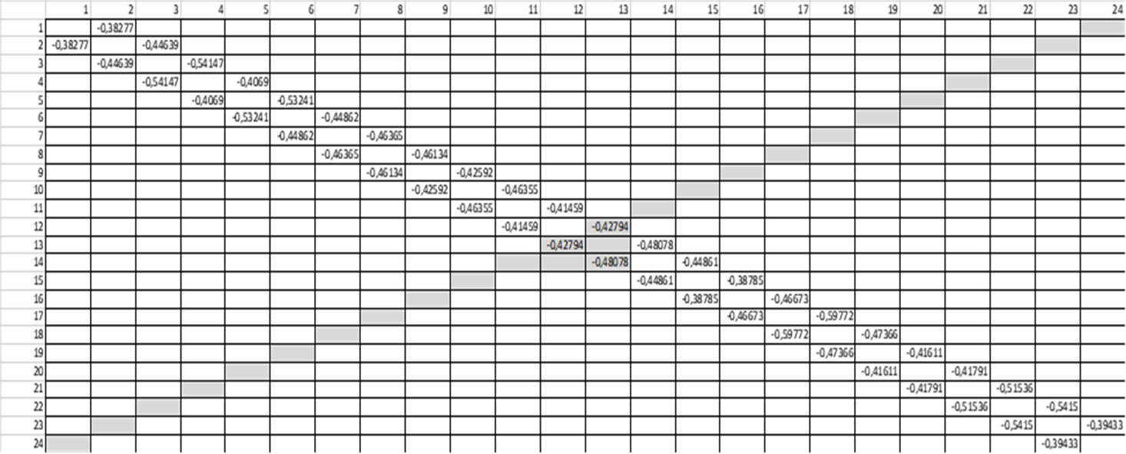
Opposite, Irrelevant and Complementary questions
Correlation matrix of unconscious responses for each pair of questions provided by VibraMI and PsyAccent programs
Notes:
VibraMI and PsyAccent programs present questions and stimulus to testee and capture the psychophysiological responses to presented stimuli. On the correlation tables for the presented slide we see that negative correlation has only neighboring responses and this rule does not depend on the sense of the question. Because during multiple intelligences testing or personality accentuation testing some questions would be important for some participants, other questions would be important or significant to other participants. Given statistics shows that in general every question gives some moving to the position of psychophysiological state and the next question gives moving of psychophysiological state in the opposite direction. As we remember it was shown on slide 4 pictures of this presentation in information-energy scales.

Slide 8
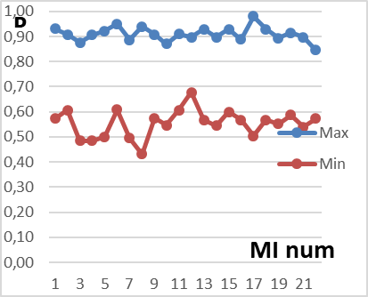
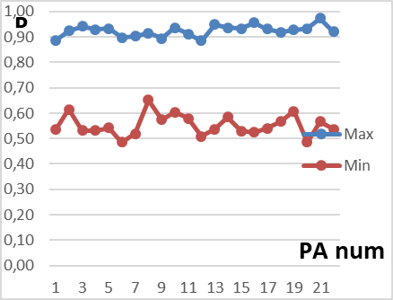
Significant and irrelevant questions
More than 10 000 M testing results
Notes:
Previous slide gives the information about the moving direction of psychophysiological responses between neighboring questions. The other question is also very important for understanding of general rules of psychophysiological testing – Do we see the dependence between the values of previous and next response. As we remember, vibraimage technology calculates the values of psychophysiological responses, so we can divide the responses to the two equal groups by the average value. The group having minimum response (red lines) have responses less than 0,12 conventional units and the group having maximum response (blue lines) have responses more than 0,12. This calculation was done for different programs testing and show the identical results given on the upper graphs. For the group with the small previous response (less than 0,12) the probability of direction changes is about 50% and for the group with high previous response the probability of changing the direction is more than 90%.

Slide 9
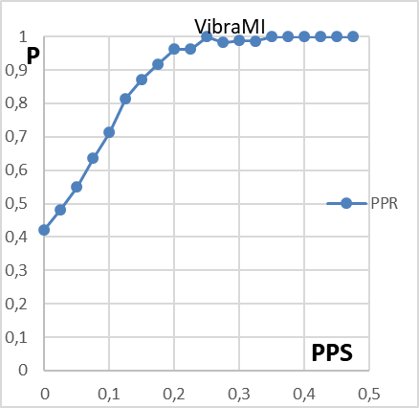
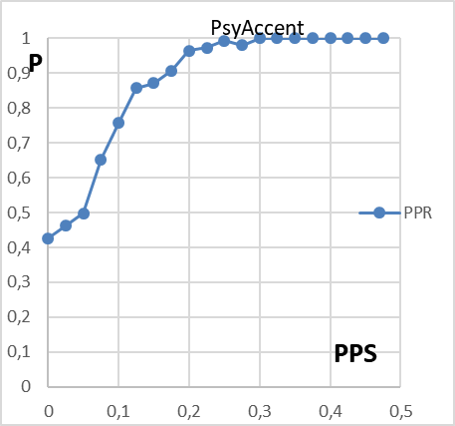
Probability of direction changes
PPS spectrogram calculated by FFT for 825 tests conducted by VibraMI program
Notes:
Let’s look on the dependence of PPS direction changing from the value of previous psychophysiological response and we see the monotone dependence of direction changing probability from the value of previous response. It is very important result, it proved that current response value depends not only from the current question and stimulus but greatly depends from the previous response. After previous response value equal and more of 0,2 the probability of changing the direction to the current response is near to 100%. That means significant previous response greatly influenced to the current response.
Great Russian physiologist Ivan Sechenov said that thought is two-thirds of brain reflex. According to our results, we can develop this thesis and say that the significance of thought is proportional to the brain reflex.

Slide 10
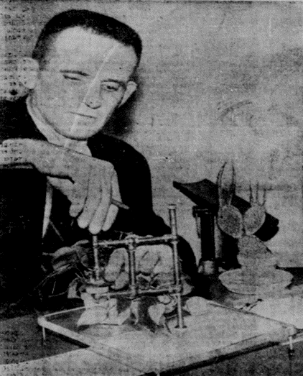
Zone Comparison Test. Question sequences
I-SR-SYM-C-R-C-R-SYM-C-R;
I-I-I-I-C-R-I-C-R-I-C-R-I-C-R;
I-SR-SYM-C-R-C-R-C-SYM;
I-C-R
Where: I – Irrelevant;
SR – Sacrifice Relevant;
SYM – Symptomatic;
С – Comparison; (Control)
R – Relevant.
Notes:
Return to lie detection and zone comparison test developed by American specialist Cleve Backster in the middle of the past century together with other specialists from Central Intelligence Agency. He suggested to control the comparison between two questions psychophysiological responses. From metrology we know that there are two main principals of measurement, the direct measurement of physical value and balancing method of physical value measurement. People are different by psychophysiological responses to the same stimulus, so direct measurement of psychophysiological response could not provide the high accuracy. Balancing between two stimulus gives the difference independent from person sensitivity because person psychological sensitivity is included in the responses to both stimulus.
Comparison testing is widely used in modern psychophysiological detection of deception with some modification of questions-stimulus sequences. The most popular sequence of questions includes repeating of irrelevant question-control question (sometimes it named comparison) and relevant question.

Slide 11
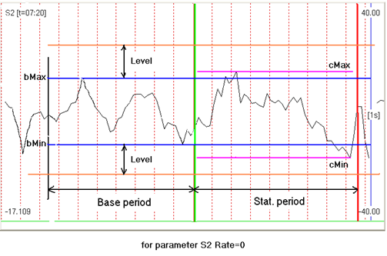
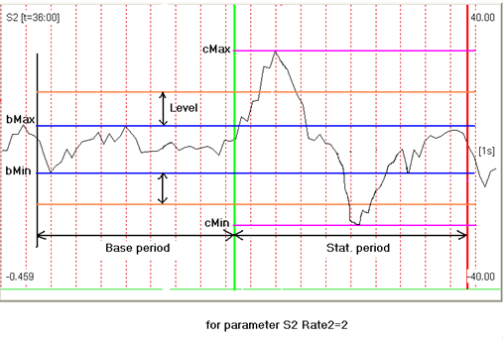
Traditional Comparison PDD Methods
Rc > Rr = NDI
Rc < Rr = DI
R - PPS
c – control question
r – relevant question
Comparison of the response to the control (C) and relevant (R) questions within a pair
Notes:
Standard lie calculation based on the hypothesis that if the psychophysiological response to the relevant question (concerning concrete criminal event) is higher than the psychophysiological response to control question (concerning significant general problem) means that person tells lie. And in opposite, if the psychophysiological response to the relevant question (concerning concrete criminal event) is lower than the psychophysiological response to control question (concerning significant general problem) means that person tells true. So the main problems of PDD is correct formation of comparison and relevant questions also as correct measurement and comparison of psychophysiological responses to said questions.
This method does not take account brain reflexes and chronobiological fluctuation of psychophysiological state described in this study. But these two processes have greatly influence to the comparison results as it was shown on the previous slides.
We see that after significant control question with the high response level (more than 0,2) we will receive high response to the next question without dependence on it significant level! So suggested question sequence Irrelevant-Control-Relevant gives high level of errors in comparison of Control-Relevant responses.
But if we change the sequence of questions to Irrelevant-Control-Irrelevant-Relevant-Irrelevant we delete these additional errors.

Slide 12
Advanced Comparison PDD Method
Calculation of Irrelevant questions responses
 | U1 | C1 | U2 | C2 | U3 | C3 | Σ|U| | Σ|C| | Σ|UI| | Σ|CI| | ΣU | ΣC | ΣUI | ΣCI
C | 7 | 100 | 100 | -100 | -11 | -100 | 39 | 100 | 70 | 200 | 32 | -33 | 28 | 0
R | -46 | -100 | 25 | -100 | -2 | -100 | 24 | 100 | 57 | 200 | -8 | -100 | -24 | -67
Ic | 12 | 100 | -52 | 100 | 28 | -100 | 31 | 100 |  |  | -4 | 33
Ir | -63 | 100 | 24 | -100 | -11 | 100 | 33 | 100 |  |  | -17 | 33
ΣU | Σui |  | Res | Res'
39 | 70 |  | NDI | NDI
24 | 57
 |  |  | NDI
WelcomEU program calculation algorithm
Notes:
Suggested sequence of Irrelevant-Control-Irrelevant-Relevant-Irrelevant questions is realized in several vibraimage programs for lie detection and detection of intentions. Founder of modern psychophysiology Ivan Sechenov in his work The reflexes of brain claims that thoughts, memories and intentions are doing the same processes in brain as a live stimulus. The same as vibraimage system do not see difference between live video and recorded video, the processing is the same. So we developed WelcomEU program processing the results based on comparison of Control and Relevant questions, also as comparison of results Control plus next Irrelevant with Relevant plus next Irrelevant question. This double protection method shows more accuracy and low errors than traditional ICR sequence.

Slide 13
Comparison of conscious and unconscious responses
Final
responses
Unconscious
responses
Conscious
responses
Notes:
We also see more possibilities in including comparison between conscious and unconscious responses into lie detection as it was done on VibraMI and PsyAccent programs. Current questionnaires of PDD supposed conscious reply No to every Relevant and Control question. This replies do not depend on the real psychophysiological state of tested person, every person telling lie and try say no to these questions. So we lost information of comparison conscious and unconscious responses. Taking other approach for preparing Control and Relevant questions could suppose to receive significant response to the Control question but without unambiguity of responses. This method need to be tested in the nearest future and could provide next level of accuracy for detection of deception and detection of intentions.

Slide 14
Conclusions
Chronobiological brain activity must be take in account in PDD testing
Vector direction of psychophysiological response must be take in account in PDD testing
Vibraimage technology gives information about period of brain activity and vector direction of psychophysiological responses so it could be used for high accuracy PDD testing
Questions sequence I-C-I-R-I gives lower errors rates than standard sequence I-C-R-I
Current WelcomEU program with I-C-I-R questions sequence gives high accuracy for PDD testing and intentions profiling
Next generation of PDD programs need to use conscious and unconscious responses comparison for low errors rates.
PDD examination must be consider as a part of normal psychophysiological responses and reflexes
Notes:
Psychophysiological detection of deception must be consider as the part of psychophysiological responses and reflexes. This approach gives more science approval to lie detection, because reflexes are more objective response to stimulus than subjective lie testing. Combining statistics of psychophysiological testing gives new level of understanding to lie detection. From psychophysiological point of view there is no lie at all, there are different levels of psychophysiological responses to presented stimulus. Vibraimage technology gives more information about psychophysiological responses because it calculates value and vector direction of psychophysiological state changes. Of course, it is necessary to check received results by the others technology of psychophysiological detection, we are open to cooperation with any partners for receiving objective results.

Slide 15
Thanks for the attention!
Viktor Minkin,
e-mail: minkin@elsys.ru
www.elsys.ru
www.psymaker.com
Notes:
Again, this study combines science theoretical research with practical applications. Programs VibraLie and WelcomEU provides free testing by any users with possibility of custom design to questions and stimuli. Our aim is to provide objective instruments for psychophysiological detection of deception and intentions detection. Vibraimage technology gives unlimited possibilities in this field to every user.

