Slide 1


The 2nd International Open Science Conference "Modern psychophysiology. The Vibraimage technology”
COMPARATIVE ANALYSIS OF VARIOUS ALGORITHMS FOR VIBRAIMAGE CAPTURING
Valery Akimov, Sergey Didenko, Viktor Minkin
Elsys Corp., RF, St. Petersburg,
minkin@elsys.ru
Notes:
Hello. Glad to see you here.
I will speak about different mathematical algorithms for vibraimage capturing. I will compare some of them: Fast Furrier Transformation and Frequency VibraImage algorithms (I will call it FFT and FVI)
It`s designed for calculation of objects movement frequency for vibraimage technology.
Also we will see test videos of various grey contrast objects, making vibrations in the frequency range (1-10) Hz. These objects with different displacement resolution and I`ll try to explain meaning of this tests.

Slide 2






Amplitude and frequency
Amplitude:
x, y – the coordinates of the point;
U x,y,i – signal value at the point x, y in the i-th frame;
U x,y (i+1) – signal value at the point x, y in the (i + 1) frame;
N – is the number of frames for which the amplitude component of the vibraimage is accumulated.
F_{in} – video signal processing frequency.
Frequency:
Notes:
Vibraimage technology converts streaming video by software processing into two different image components: that reflect the amplitude and frequency characteristics of object vibrations and movements in frame.
Vibraimage technology use the generated amplitude and frequency images of objects and analyze it to get additional information about objects.
In case of a living object monitoring, it can be different psychophysiological characteristics, in the case of control of a non-living object, it can be mechanical parameters. In the general case, the amplitude and frequency vibraimage of an object can be calculated in various ways.
The basic principle of vibraimage capturing is maximum information with minimal operating power and cost. So, the following formulas can be used to calculate amplitude and frequency components of the vibraimage.

Slide 3



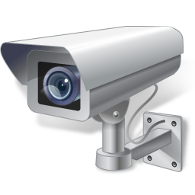
Video stream
…
N
Pa
A:
…
N
Pf
F:
VibraImage technology converts video into parameters
Notes:
The amplitude and frequency components of the vibraimage are parallel video streams, similar in format to the original video signal. Signal of the amplitude and frequency component carrying information about the past of this video stream, limited in time by the number of accumulated frames for frame difference N.
Vibraimage technology converts these video streams into primary vibraimage parameters (P). Primary vibraimage parameters converts into informative parameters of an object, depending purpose.

Slide 4

Real video processing
FVI
(1):
F depends from recorded signal changing
FFT
(2):
For example N=100, 30 frames/sec, time=3sec
F <= 15 Hz
Notes:
But the proposed formulas for calculating the amplitude and frequency components are inherent in the real vibraimage, rather than ideal, which should reflect the movement parameters of all points of the object.
So we have a formula 1 on slide. It`s reflects the frequency of recorded changes in the signal in each element, and does not reflect the actual frequency of the signal in time for each element.
Ok, for example we can try to use Fast Fourier Transformation method (formula 2).
At the default settings for a period of 100 frames with a frame frequency of 30 Hz, corresponding to a time of 3 seconds, the measured frequency of the signal at the selected point X (for example, determined by the fast Fourier transform, FFT or DFT) should have a value of no more than 15 Hz (in accordance with the Kotelnikov-Shenon-Nyquist theorem.
The calculation for the same settings for the frequency of a signal change of an element according to the formula (1) can give a different value because the frequency of the signal change does not depend on the signal period. It depends from quantity of signal changes, i.e. from the signal-to-noise ratio of the photodetector.
Ok. Let`s try to make experiment ant try to compare different algorithms.

Slide 5
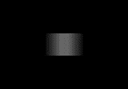

Types of testing objects
Type 1
Type 2
Notes:
We try to use different objects during our tests.
Type 1: grey block with gradient and black background. Borders are not contrast to background
Type 2: grey block and black background.

Slide 6


Types of testing objects
Type 3
Type 4
Notes:
Type 3: it`s black, without any gradient.
Type 4: gradient from black to grey and white background.
So we think, that it`s important, that these objects have contrast borders. It`s very similar to real object in live.

Slide 7
Test video 1
1st test video: test_b_g5d1f010 (1 point displacement in pixels, 1Hz frequency)
50x30 rectangle, 160x120 video, background -200 (0-black, 255-white)
Notes:
The test object is a rectangle with the size of 50x30 elements, having a gradient. The background around the rectangle in the test video is uniform and close to white (brightness 200/255).
The total size of the test video was 160x120 elements, data on the frequency, displacement and gradient of test objects. The duration of the test video files was 120 seconds.
During the experiment, the created test objects were loaded into the Vibraimage 10 PRO program (Vibraimage10, 2019) and processed by various processing algorithms and, focusing on the compliance of the real vibraimage with the ideal one and the load of the Intel Core i7-5600U CPU 2.6GHz.

Slide 8

Test video 2
2nd test video: test_b_g5d3f010 (3 points displacement in pixels, 1Hz frequency)
50x30 rectangle, 160x120 video, background -200 (0-black, 255-white)
Notes:
(3 points displacement in pixels, 1Hz frequency)

Slide 9
Test video 3
3rd test video: test_b_g5d3f030 (3 point displacement in pixels, 3Hz frequency)
50x30 rectangle, 160x120 video, background -200 (0-black, 255-white)
Notes:
(3 point displacement in pixels, 3Hz frequency)

Slide 10
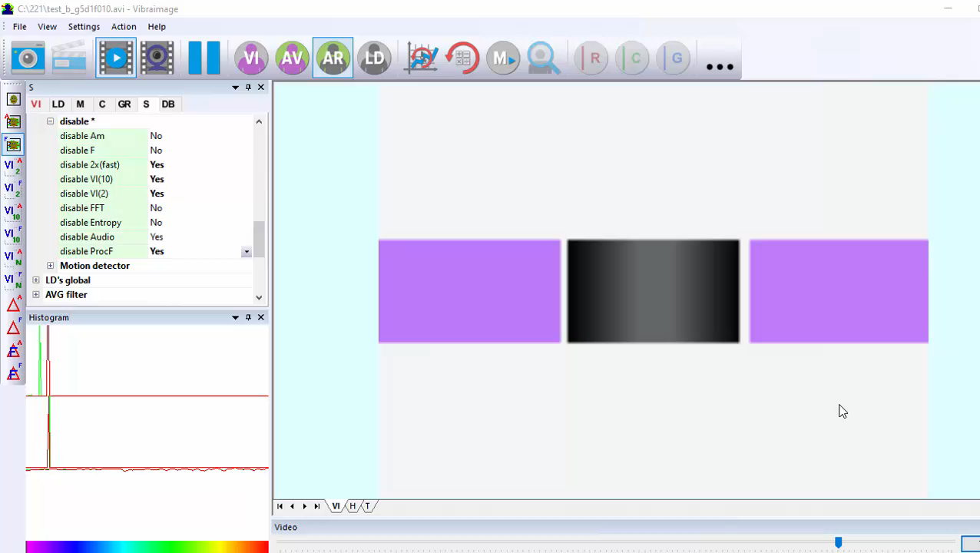
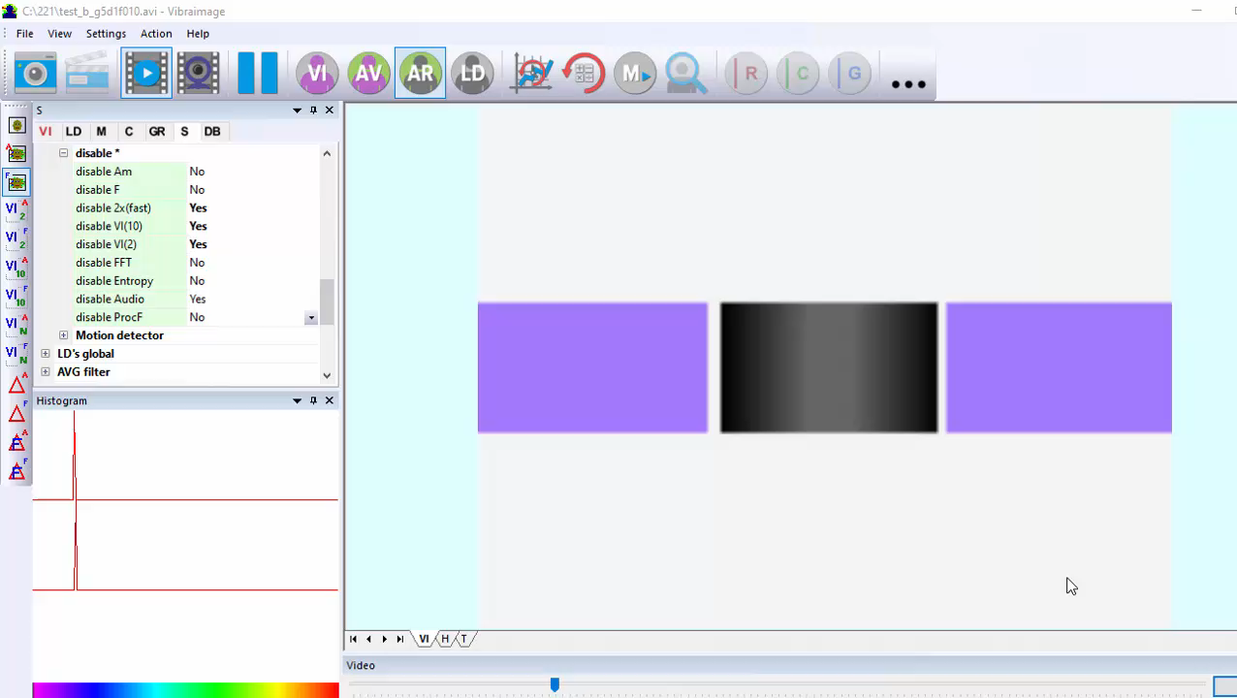
FFT vs FVI results
1 points, 1Hz
FVI
FFT
Notes:
For the 1st test video (1 Hz frequency, 3 points offset), almost identical vibraimages are observed for both algorithms.

Slide 11
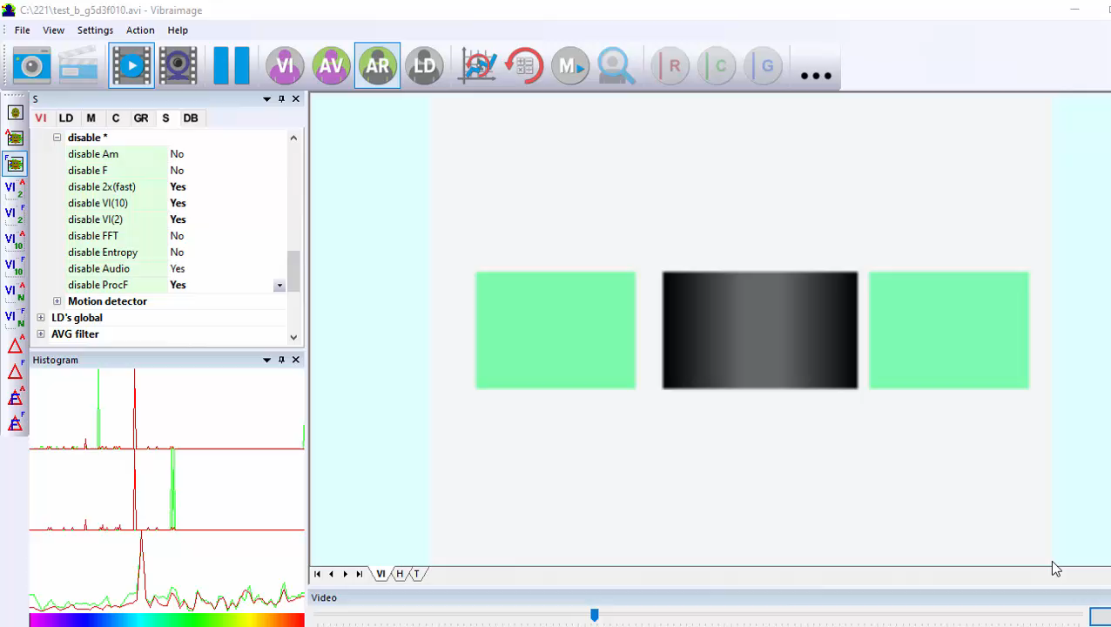
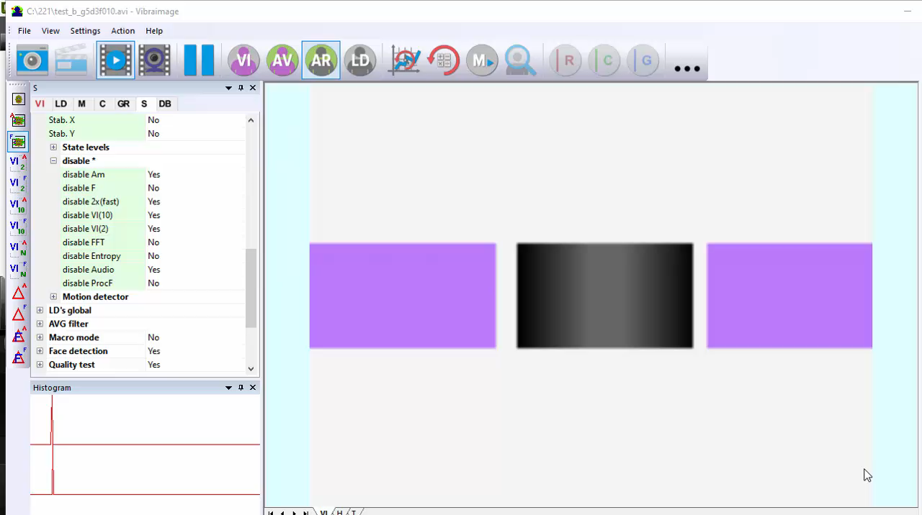
FFT vs FVI results
3 points, 1Hz
FVI
FFT
Notes:
For the second video and frequency 1Hz we can see that pictures.

Slide 12
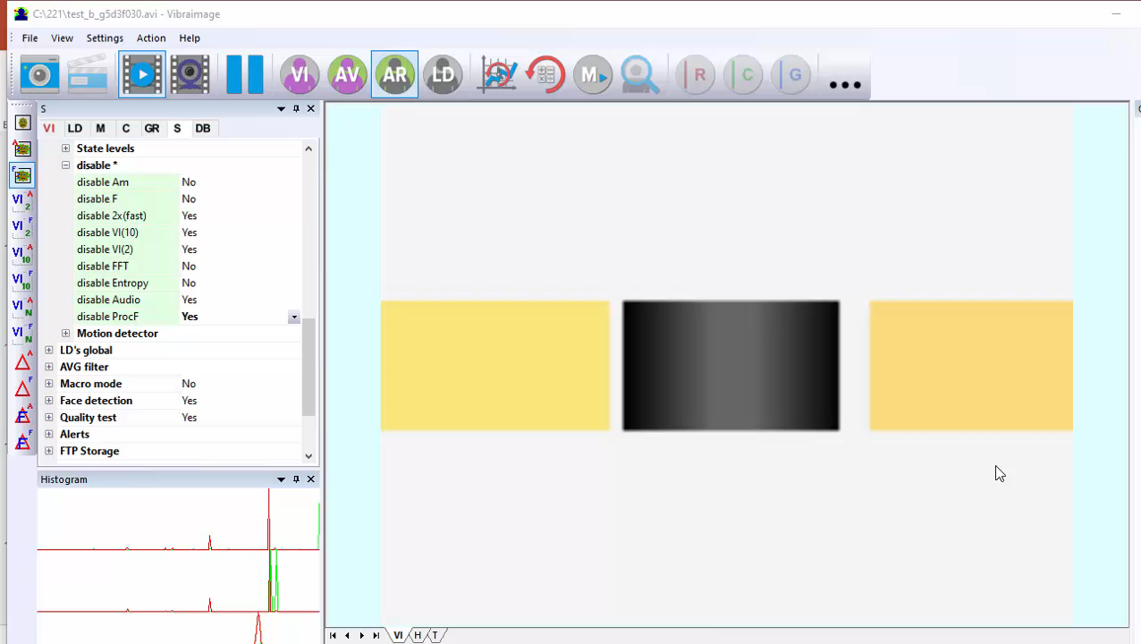
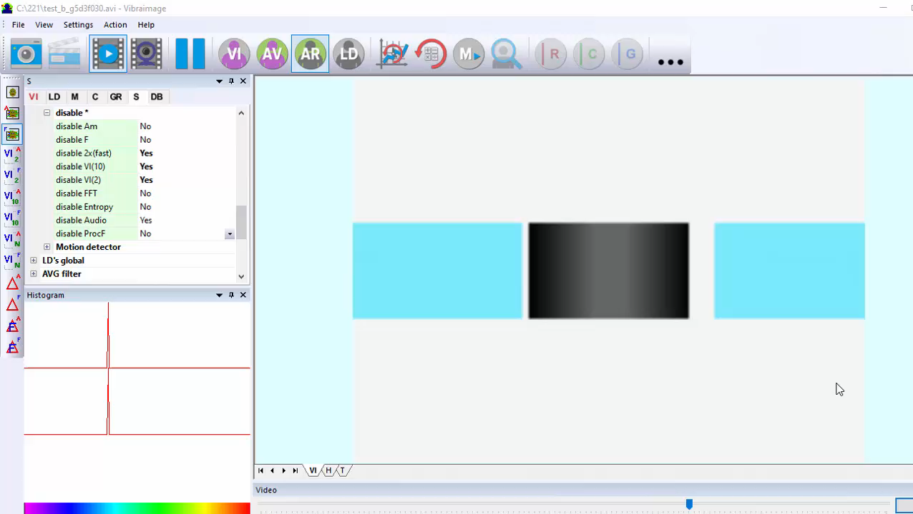
FFT vs FVI results
3 points, 3Hz
FVI
FFT
Notes:
And for the 3rd video and frequency 3Hz we can see picture like this:

Slide 13
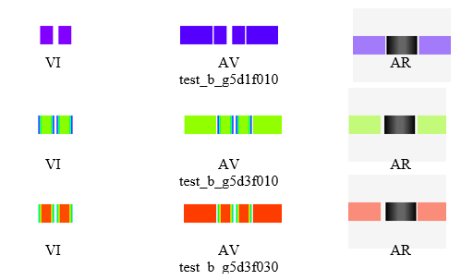
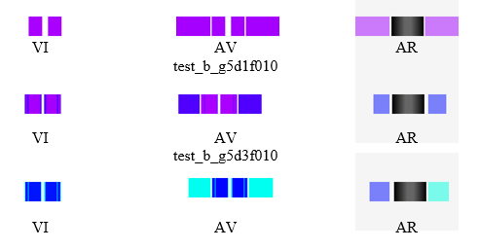
FFT vs FVI results
Test machine: Intel Core i7-5600U CPU 2.6GHz
FVI
FFT
VI – internal vibraimage;
AV – external vibraimage around internal vibraimage (aura-vibraimage);
AR – external vibraimage around real image (aura to real).
Notes:
All pictures in one table:

Slide 14
How it works?
Step 1:
Step 2:
Step 3:

Slide 15
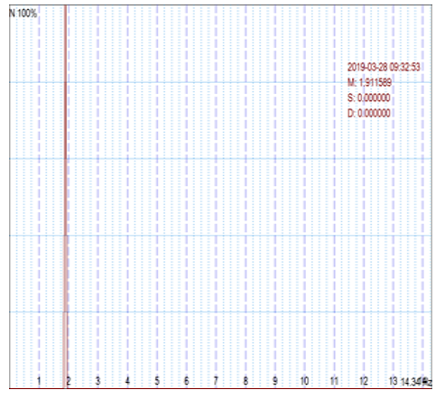
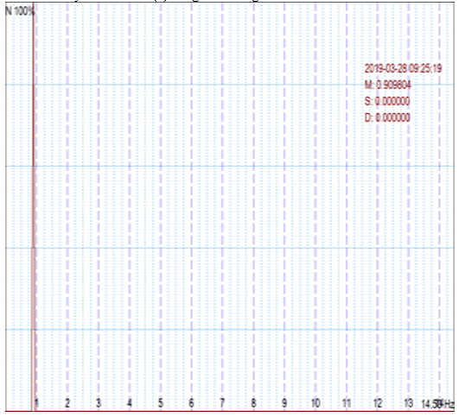
FFT vs FVI results (1st video)
FVI
FFT
1st test video: test_b_g5d1f010 (1 point displacement in pixels, 1Hz frequency)
Notes:
But very important to analyze histograms: frequency histograms are quite similar, however, the stability of the FVI is the same as the stability of the FFT algorithm for first test video and differs for second and third test videos.

Slide 16
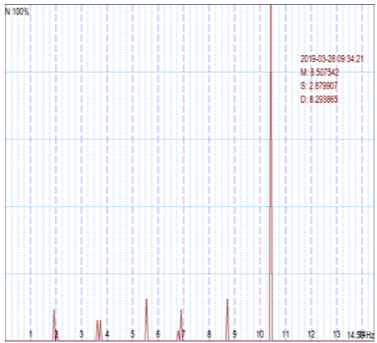
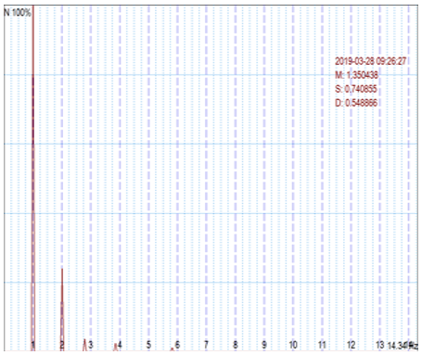
FFT vs FVI results (2nd video)
FVI
FFT
2nd test video: test_b_g5d3f010 (3 points displacement in pixels, 1Hz frequency)
Notes:
For the second test video (frequency 1 Hz, shift 3 pixels) results have significant differences.
the real frequency for this test video was 1 Hz, for the algorithm (2) there was an apparent shift in the frequency of the vibraimage in the direction of increasing, due to the fact that the real object shift was 3 elements, and not one, as the frame frequency the survey was 15 Hz, and within 15 counts, each element of the test object made a movement in one and the other direction, returning to its place. Thus, the frequency of the signal change (8 Hz) significantly exceeded the real frequency of the object's movement (1 Hz).
Only at the edges of the testing object vibraimage, determined by the FVI algorithm, coincided with the vibraimage, determined by the FFT.

Slide 17
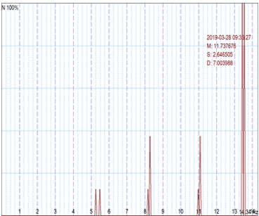
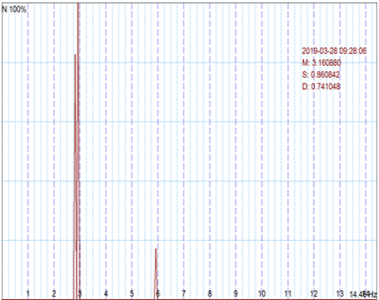
FFT vs FVI results (3rd video)
FVI
FFT
3rd test video: test_b_g5d3f030 (3 point displacement in pixels, 3Hz frequency)
Notes:
For the third test video, a similar discrepancy was observed between the results of the FVI algorithm and FFT, and again the magnitude of the vibraimage obtained by the FVI algorithm exceeds the magnitude of the vibraimage obtained by the FFT algorithm.
In this case, we note that both algorithms detect the movement of only optically contrasting objects. The middle of the test object, which has no contrasting details (uniform gray background), turned out to be invisible for both algorithms.

Slide 18
Processor loading
Frame size Algorithm | 160x120 | 320x240 | 640x480
FVI | 12% | 15% | 23%
FFT | 33% | 70% | >100%
Intel Core i7-5600U CPU 2,6GHz
Notes:
The vibraimage obtained by the FFT algorithm showed greater accuracy in determining the real frequency of moving an object than the traditional FVI algorithm.
At the same time, the software power of supporting the FFT algorithm substantially exceed the traditional FVI algorithm.
For full-format work with FFT, you must have processors with a capacity of about 100 times higher than the Intel Core i7-5600U CPU 2,6GHz used in this work.
The development of processor's technology allows us to forecast that such processors will be available on the mass market of electronic devices in about 6–8 years.

Slide 19
FVI or FFT
FVI or FFT?
Notes:
The number of detected vibraimage elements captured by the FVI and FFT algorithm is almost the same.
Therefore, the number of detected vibraimage elements and methods of vibraimage parameters calculation determine the accuracy of PPS parameters measurement. It remains an open question whether the vibraimage is more informative in terms of PPS detection, FVI or FFT?
The answer to this question will be available soon, since processors with a capacity of 100 times more than i7 are already available on the current market, for example, as i9 processor.

Slide 20
Thank you for attention!
Valery Akimov, Sergey Didenko,
Viktor Minkin
Elsys Corp., RF, St. Petersburg,
minkin@elsys.ru
Notes:
Thank you for attention!

