Slide 1


The 5th International Open Science Conference
Modern Psychophysiology. The Vibraimage Technology
Microvibration analysis using vibraimage technology
and artificial intelligence for COVID-19 diagnosis
Viktor Minkin
Elsys Corp
Saint Petersburg, Russia, 2022
Notes:
Dear colleagues!
COVID-19 pandemic changed the life of the whole world for 2 years, not ended on its own, and we could not say science and medicine thanks for the victory over the disease. It is necessary to take into account the huge losses that have affected almost all of us, and try to draw the right conclusions that should strengthen modern medicine. According to the WHO, the total number of deaths directly or indirectly related to covid exceeded 15 million people in 2 years. In my understanding, this is largely due to the fundamental mistakes of modern medicine and insufficient attention to the integral characteristics of human health, which should be used as physically measured behavioral parameters.

Slide 2
Physiology of Activity
Movement is fulfillment of what exists potentially.
(Physics III, 335 BC) Aristotle
Every reaction of brain activity could be characterized as muscular movement. (Reflexes of the brain, 1863)
Ivan Sechenov
Reflex movements associated with emotions.
(The Expression of the Emotions in Man and Animals, 1872)
Charles Darwin
A person does not have random movements.
(The Interpretation of Dreams, 1899)
Sigmund Freud
The main processes in physiology are excitation and inhibition.
(Nobel Prize speech, 1904) Ivan Pavlov
An introvert and an extrovert differ in the direction of the energy distribution
(Psychological types, 1921)
Carl Jung
2
Notes:
In the beginning, I want to stop on the fact that all great scientists of the past, who have been study human, set the base of vibraimage technology. I will start from ancient Greek philosopher Aristotle, the first thinker created comprehensive system of philosophy, politics, logic, and physics. He said that life is a movement, and hence the description of the movement can characterize the state of life.
The great Russian physiologist Ivan Mikhailovich Sechenov was the first scientist who described the direct connection between brain activity and muscle movement in his work "Reflexes of the brain", which opened objective psychophysiology and was published in my city - St. Petersburg about 150 years ago.
Approximately at the same time, but a little later, as the next step of the evolution theory development, Charles Darwin, one of the most famous scientists in the world, published the work “The Expression of the Emotions in Man and Animals." He focused on the classification of facial expressions and their evolutionary reasons.
Two these works and two different approaches to a person from Sechenov and Darwin determine the development of psychophysiology in the last 150 years, and vibraimage technology unites them in the single solution.
I think that everyone knows the statement of Sigmund Freud that a person does not have random errors. But Freud also argued that a person does not have random movements, so thoughts and movements are linked.
The first Russian Nobel laureate in physiology Ivan Pavlov, the creator of higher nervous activity science and practical researcher of physiological reflexes, paid special attention to the speed of physiological processes, as the most important information about the physiological state of a person or an animal.
Сarl Jung the founder of analytical psychology, who introduced the fundamental characteristics of person as extraversion, suggested that extravert state differs from introvert by the direction of the Energy distribution. It seems that, this hypothesis is not related to the physiology of movements, but vibraimage technology empirically confirmed this assumption by movement analysis.

Slide 3
Physiology of Activity
Human movements are discrete in time, as they are corrected by feedback. (Biomechanics research, 1935)
Nikolai Bernstein
Psychophysiological processes are associated with the exchange of energy and information within or between physiological systems of a person. (Cybernetics: Or Control and Communication in the Animal and the Machine, 1948)
Norbert Wiener
Amplitude and intensity of reflex movements characterized aggression.
(On Aggression, 1966) Konrad Lorenz
Every intention is linked by a muscle settings (Myokinetic psychodiagnostics, 1954) Mira y López
All people have not one intelligence, but having a number of autonomous intelligences (Frames of Mind: The Theory of Multiple Intelligences, 1983)
Howard Gardner
Notes:
Researchers of the past differs from current scientists by general questions understanding, since in the 19th century and the beginning of the 20th century most of the research was carried out with the help of visual observations, and the measuring equipment did not exist.
It is not random that the founder of a new science direction - the physiology of activity was the Soviet physiologist Nikolai Bernstein. About 100 years ago, Bernstein published an extensive work "General Biomechanics" and developed a method of cyclography using a movie camera, which allowed to record in detail all the phases of the movement. It was so near to vibraimage, but there were no webcam and computer at that time.
One of the most famous scientific books of the past century was the work of cybernetics founder Norbert Wiener - Cybernetics, or Control and Communication in the Animal and the Machine. In this book were firstly shown information-energy approaches existing in nature. The cybernetic principles stated by Wiener are successfully developing in technical solutions, but the same principles described by Wiener for living organisms are not given due attention.
The previous studies of great scientists have more theoretical nature, although Nikolai Bernstein tried to use his knowledge to improve work and sport efficiency. Also was practical myokinetic technique developed by the Spanish-Brazilian psychologist Mira-Y-Lopez, makes possible to calculate the regularity of hand movements and establishing a connection between these movements and the psychological state of tested person.
Conrad Lorenz - the founder of animal behavior science and the Nobel Prize laureate of 1973, believed that the methods for assessing the emotions of animals and humans by movements are identical.
The only scientist (from said list) who lives today (God gives him health and success) is American professor Howard Gardner, the developer of multiple intelligences theory. Despite the fact that Gardner never engaged in physiology of movements, I allowed myself to include him in the list of said citations for a number of reasons. Firstly (and this may be enough), his theory fits well with Wiener's information-energy approach, only more focused on the processes of decision-making by a person. Secondly, the main reproaches of the opponents of Multiple Intelligences Theory consisted in the absence of practical confirmation of Gardner's theory, and vibraimage confirms the theory of multiple intelligences in practice. Therefore, I believe that the indirect connection between the theory of multiple intelligences and physiology of motion is also one of the basis for the practical applications of vibraimage technology.
All said scientists created the theoretical base of vibraimage technology in the different forms of reflex movement’s information. For me was only necessary to develop technical and science solutions for realization of movement analysis principals by vibraimage technology.

Slide 4
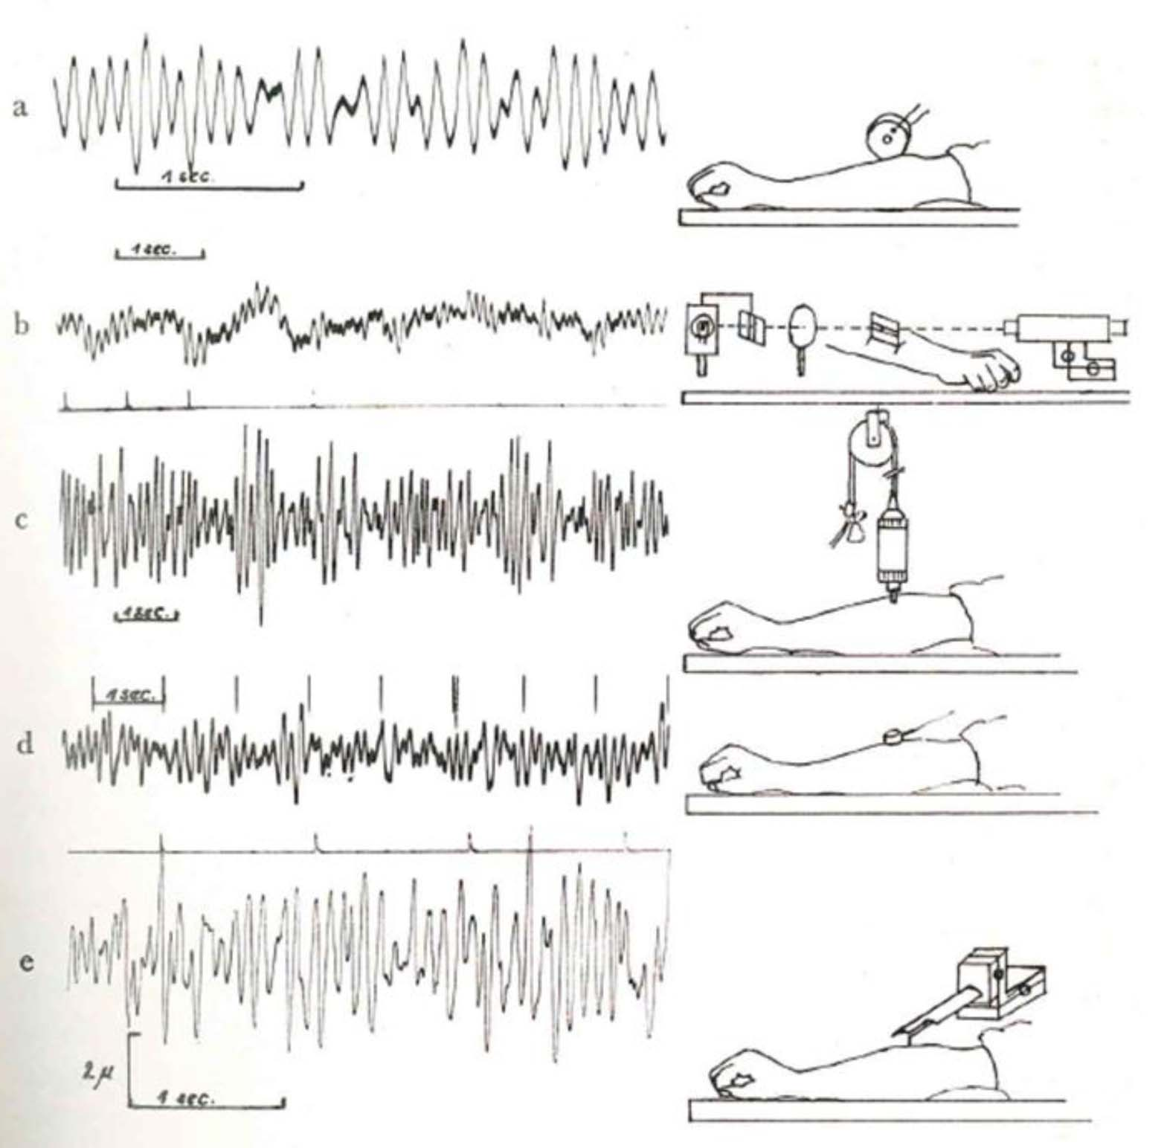
Muscle Microvibration - the Source of Energy for Warm-blooded Animals, Hubert Rohracher
Constant microvibration of muscles provides energy for constant temperature of a human body and is the basis of thermoregulation in humans and warm-blooded animals.
Hubert Rohracher (1946)
Various mechanical methods and devices for studying microvibrations used by
professor Rohracher.
Notes:
In my current report, I will dwell in more detail on the studies of microvibrations by the Austrian professor Hubert Rohracher, who established in 1946 that humans and warm-blooded animals have constantly vibrate muscles. He suggested that the physiological basis of this process is the production of heat to maintain a constant temperature of the body and, above all, the brain.
Rohracher investigated the microvibrations of humans and animals using the most advanced mechanical vibration sensors or accelerometers at that time.

Slide 5
Muscle Microvibration is Constant Process during Sleep and Wakefulness
Microvibration during sleep and under anesthesia,
a = state of wakefulness,
b = deep sleep (in the same person),
c = waking state,
d = anesthesia.
Rohracher&Inanaga (Microvibration, 1969)
Notes:
Since Rohracher had a medical, psychological and legal education, his study were quite extensive and were carried out in the best clinics and universities in Austria on humans and animals for about 20 years from the end of the 40s to the end of the 60s of the 20 century. He found that the amplitude of muscle vibration depends on the PPS, in sleep and anesthesia it decreases, and in the waking state it increases.

Slide 6
Microvibration of Skeletal Muscles
Microvibration of various parts of the body. The numbers on the top indicate the amplitude in microns, the numbers on the bottom indicate the frequency in hertz. Roracher&Inanaga, Microvibration, 1969
Notes:
The frequency and amplitude of muscle microvibration depends on their location on the human body, the minimum amplitude can be fractions of microns, and the maximum can exceed tens of microns in the excited state of a person. The frequency of muscle vibrations was usually in the range from 1 to 15 Hz. Using contact vibration sensors, Rohracher investigated the amplitude and frequency of microvibrations of all muscles and parts of the human and animal body.

Slide 7
Interpretation of Skeletal Muscle Microvibration
Interpretation of microvibration from a biological point of view is possible only if the mechanism of its origin is clear. Two views have been put forward on the origin of microvibration: American authors have argued that microvibration (“normal tremor at rest”) arises solely due to shaking of the body caused by cardiac activity, while Japanese authors, including myself, assumed from the moment of receiving the first registration data of microvibration that it is caused by constant muscular activity.
(Rohracher&Inanaga, Microvibration, 1969)
The average microvibration frequency measured in 505 people (249M and 256F) during relaxation with a Philips vibration sensor on the back of the left forearm.
Notes:
At that time, there was an active discussion about the biological causes of microvibration, and many American scientists were convinced that cardiac activity was the only cause of the recorded vibration. While Rohracher and some Japanese scientists were convinced that the main component of microvibration are muscle contractions.

Slide 8
Origin of Human Microvibration
Cardiovascular (ballistocardiographic) hypothesis.
The ballistocardiographic hypothesis can be summarized as covering only one microvibration component.
2. Neuromuscular hypothesis.
Research have shown that microvibration persists for 1-2 hours after clinical death.
(Rohracher&Inanaga, Microvibration, 1969)
Microvibration frequencies of 4 rabbits before and after clinical death
Notes:
To prove his case, Roracher conducted many studies on various warm-blooded animals and found that microvibration persists for several hours after the removal of the heart or the cessation of cardiac activity. Also proof of the muscular origin of microvibrations is its absence in cold-blooded animals. At the same time, Rohracher did not deny that the cardiac component also contributes to the process of vibration registered in a person.

Slide 9
Theory of Alternating Contractions of Muscle Fibers
"Theory of alternating contractions of muscle fibers" can be used to satisfactorily explain both the origin of the continuous micro-movements of our body and the absence of currents of muscular action during relaxation and sleep. According to this theory, it is incorrect to talk about “resting muscles”, muscles are never at rest throughout life - they continuously undergo alternating contractions of individual fibers, which together lead the whole body into a constant microtremor.
Muscle tone is not a constant low basic tension of all parts of the muscle, but the result of constantly changing individual contractions. (Rohracher&Inanaga, 1949)
Notes:
The human body does not have a single organ responsible for maintaining thermal balance, but it is the theory of constant contraction of muscle fibers that has made it possible to explain many physiological processes and, in my opinion, is undeservedly little mentioned at the present time. I would like to note that sports applications of vibraimage technology have been widely used, and reports on this will be presented at this conference. Probably, sports technologies based on the analysis of muscle contraction intuitively feel closeness to the vibraimage technology, although they did not fully understand how much this connection is caused by real physiological processes.

Slide 10
Microvibration and Constancy of Body Temperature
"Warm-blooded" means that the body is able to maintain a constant body temperature of 36.5 degrees Celsius or more; this makes warm-blooded beings largely independent of outside temperature; they remain capable of continuous action despite the change of seasons.
In all warm-blooded animals, including thick-skinned ones, microvibration was constantly detected with approximately the same frequency and amplitude as in humans, while it was absent in all cold-blooded animals:
What percentage of total musculature must always contract in order to produce enough heat to maintain body temperature at 36.5 degrees when relaxed?
2.5% of muscles constantly contracting provide 1700 kilocalories.
1 gram of muscle produces 0.003 calories per contraction, and therefore 0.03 calories per second for 10 movements; this gives 1.80 calories per minute, 108 per hour, and 2592 calories per gram of contracted muscle per day.
Body temperature is kept constant with high accuracy; this means that the muscular processes that serve to produce heat must be very finely regulated.
Notes:
Only 2.5% of an adult's total musculature needs to constantly contract to produce the 1,700 kilocalories per day needed to maintain a constant body temperature. This result is obtained from the following calculation: according to the well-known studies of the English physiologist Hill, 1 gram of muscle produces 0.003 calories per contraction, and therefore 0.03 calories per second for 10 movements; this gives 1.80 calories per minute, 108 per hour, and 2592 calories per gram of contracted muscle per day. The weight of the entire musculature of an adult should be taken as 38% of body weight (Sieglbauer), so that it is 26.6 kg for a person with a body weight of 70 kg.
If one gram of muscle at 10 contractions per second produces 2592 calories in 24 hours, then to produce 1700 kilocalories (= 1,700,000 calories) 656 grams of muscle (= 1,700,000: 2592) must be constantly contracted. 656 grams is 2.44% of 26,600 grams, that is, of the total muscle weight of a person with a body weight of 70 kg.

Slide 11
Microvibration Applications by Rohracher
Microvibration as an indicator of psychological stress.
Average vibration frequency is proportional to stress
Change in the frequency and amplitude of microvibration during the removal of gypsum in case of fractures of the hands and a decrease in pain.
Notes:
I have to state that the merit of establishing a connection between the parameters of microvibration and the psychophysiological state of a person does not belong to vibraimage technology, but was established and confirmed by Professor Rohracher about 50 years before us. I am really glad that vibraimage technology, independently analyzing the microvibration of the neck muscles, as a special case of microvibration, came to absolutely identical results established by Rohracher in the middle of the 20 century.

Slide 12
Microvibration Applications by Rohracher
Standing out among the psychological findings of MV research is the fact that microvibration can be conditioned to a certain extent (i.e., it can be turned into a "conditioned reflex" to a neutral stimulus if it was previously provided along with an appropriate biological stimulus).
Differences in microvibration between healthy people, neurotics, schizophrenics and people with brain damage.
Phylogenetic aspects
The phylogenetic aspect of microvibration is follows: if the body of warm-blooded creatures is continuously shaken, the endolymphatic fluid in the labyrinth arches of the inner ear is in constant motion, due to which the receptors located there are constantly stimulated.
"The derivation of action potentials of the vestibular nerve showed that in the <resting position> a large number of sensory cells activate continuous impulses in a steady rhythm" (Rein, 1964). These continuous excitations, the cause of which must probably be sought in microvibration, can form the basis of positional sensations of a person who is in a state of rest. (Roracher, 1969)
Notes:
According to Rohracher, microvibration is necessary for a person, just like the activity of the heart. An indication of the correctness of this hypothesis was provided by the studies of Nagafuchi, who was able to show that patients with balance disorders of various origins have significantly higher MV frequencies and lower MV amplitudes than healthy people (Nagafuchi, 1969). As a consequence of this hypothesis, cold-blooded creatures, because they lack microvibration, receive less information about their body position from the labyrinth than warm-blooded creatures, so it should be more difficult for them to maintain balance. It is near to vestibulo-emotional reflex discovered by Elsys team in 2008.

Slide 13
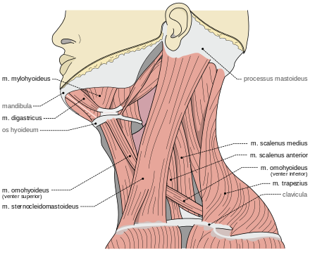
Conclusions about Microvibration According to Rohracher
Microvibration is a constant invisible microtremor of the body of a warm-blooded animal. Its frequency is from 1 to 18 oscillations per second with a distinct increase from 7 to 13 per second; amplitude - from 0.5 to 10 microns with the possibility of relaxation.
The cause of microvibration is continuous, alternating contractions of individual motor units distributed throughout the muscles. These alternating contractions, which occur simultaneously in many muscles, cause the whole body to make very irregular micro-movements, similar to macroscopic tremors, which never stop from birth to death.
The calculation of the heat amount that can be generated by constant contractions of the muscles fibers showed that at rest only 2.5% of the total muscle mass must be in a state of constant alternating contraction in order to generate the heat necessary to maintain body temperature at a constant level.
Notes:
When Roracher studied the microvibration of muscles, it was practically inertialess, since the muscles practically instantly contract under the action of a control signal, as Mikhail Sechenov established. When we study the microvibrations of the head, determined by the muscles of the neck, the head, as a heavy mechanical object, mechanically integrates the work of the muscles and filters the high frequencies of movement. For this reason, microvibration frequencies measured by vibraimaging technology are always somewhat lower than those recorded during contraction of individual muscles.

Slide 14
Conclusions about Microvibration According to Rohracher
In psychological studies, microvibration amplitude has proven to be a useful indicator of mental tension and arousal. It is suitable for testing pharmaceutical relaxants.
Theoretical considerations suggest that microvibration, caused by constant oscillation of the whole body, is a long-term irritant of the endolymphatic fluid in the labyrinth and, thus, contributes to the fine regulation of balance during the movements of warm-blooded creatures.
The use of microvibration (MV) in pharmacology
Anesthetics. All anesthetics decrease MV amplitude and reduce frequency.
Tranquilizers. Chlorpromazine inhibits MV in many cases.
Relaxants. MW is inhibited by relaxants.
Antiepileptic drugs. The introduction of medium doses of antiepileptic drugs does not have a clear effect on MV.
The effect of drugs on human MV
Frequency analysis of MW. Alcohol strengthens the theta group; sleeping pills, drugs or muscle relaxants suppress CF. Adrenaline increases theta group.
Notes:
Rohracher and Japanese scientists studied not only the change in microvibration parameters with a change in the PPS, but also with the influence of medications. For us, the results obtained by Roracher turned out to be quite important, since it is necessary to take into account the effect of medicines on microvibrations when diagnosing various diseases, including
COVID-19.

Slide 15
Treatment of Schizophrenia with Microvibration Control
6 cases of CF with
successful treatment
Rohracher&Inanaga, 1969
6 cases of CF with
ineffective treatment
Rohracher&Inanaga, 1969
Notes:
The Japanese professor Inanaga, co-author of Rohracher, in his book on microvibrations provides data on the use of microvibration control as an indicator of the effectiveness of the treatment of certain diseases, including schizophrenia.
Thus, most of the reproaches from modern medicine for the lack of connection between the disease and microvibrations turned out to be caused by ignorance of the history of medicine and human physiology.
I have my own version of the reason for such ignorance and forgetfulness of Rohracher’s study.
Hubert Rohracher, like Konrad Lorenz, was born in 1903. Both lived in Austria and were engaged in psychology, Lorenz received the Nobel Prize in 1973, and Roracher died in 1972. in 1960 Rohracher became president of the German Society of Psychologists. Rohracher headed the Psychological Institute of the University of Vienna for many years. He was a full member of the Austrian Academy of Sciences.
At the same time, Roracher and Lorenz do not have joint works, and I did not find their references to each other's works, although Lorenz's studies were also devoted to vibration.
Perhaps this is due to the fact that Roracher was engaged in the denazification of the University of Vienna as a member of two special political commissions. In addition, he was extremely critical of various varieties of American behaviorism, which he characterized as a heresy that hindered the progress of psychological research for many years. Roracher was inspired by Berger's work on the EEG and was personally acquainted with Freud, but he was critical of his theory of psychoanalysis, as well as other purely psychological methods, preferring the instrumental measurement of physiological signals. Moreover, he did most of his publications in German, although his students (and he trained more than 40 professors) had English-language publications.
It seems to me that many of his opponents in psychology hush up Rohracher's significant contribution to modern science. This also affects to vibraimage, which continues the study of microvibration by a modern contactless method.

Slide 16
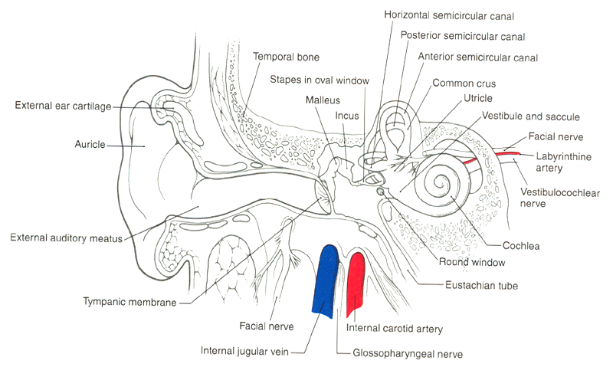
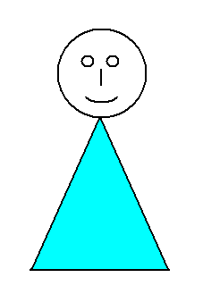
Vestibulo-Emotional Reflex (VER)
Behavioral symptoms
diseases
Head microvibration
video
Normal psychophysiological
state
Vibraimage + AI
Software processing
COVID-19
Diagnostic result
VER
Notes:
The vestibulo-emotional reflex lies in the fact that the reflex movements of the neck muscles to vertically maintain the human head in the gravitational field of the earth, controlled by the vestibular system, depend on many factors. Any disease leads to certain physical and biochemical changes in the body that affect the normal functioning of all physiological systems, including the vestibular apparatus. Moreover, the vestibular system is practically inertialess and very sensitive to any changes in the human body, since its main function is to maintain mechanical balance. Thus, the working hypothesis that by analyzing changes in head micromovements in patients with COVID-19 and people without COVID-19 disease, it would be possible to diagnose the presence or absence of the disease.
Considering the work of Rohracher, it is necessary to add the process of thermoregulation as one of the components of vibraimage, since the work of the neck muscles is determined not only by the mechanical balance of the head, but also by the constant work of the muscles for thermoregulation.
It turns out that vibraimage informativity is determined by the mutual superposition of the several physiological systems functioning:
- Vestibular system;
- thermoregulation;
- cardio-vascular system;
- brain, which regulates the work of the 3 listed physiological systems with the help of feedback through sensory systems.

Slide 17



Vibraimage Systems of the First Generation.
Direct Conversion Measuring Instruments
Head micro
vibration
$$\frac{dE}{dt}$$
Y₂
$$\frac{dq}{dt}$$
Y₃
$$\frac{dU}{dt}$$
Y₄
Δ_{i}
F_{i}
S_{i}
P_{i}
P
E_{i}
Y_{i}
X
Y₁
Y₅
Y_{вых}
Block diagram of vibraimage system for direct measurements.
X − PPS characteristics,
Y₁ − change in the light flux depending on the contrast of the object and its motor activity,
Y₂ − spatial transformation of the light flux using the optics of a television camera,
Y₃ − charge conversion in the photodetector,
Y₄ − analog-digital signal-to-digital conversion,
Y₅ − primary parameters of vibraimage,
Y_{out} − PPS characteristics measurement result.
Notes:
To understand the analysis of head microvibration or micromovements, I will give the principle of operation of the first generation vibraimage systems, which, due to several measuring transformations, converts head micromovements into human behavioral parameters. Thus, using a conventional television camera connected to a computer, the behavioral characteristics of a person are determined in real time. In the case of security systems, 5-10 seconds of being in the frame is enough to identify aggressive and potentially suspect people.

Slide 18





Basic Parameters of Vibraimage System of the First Generation
Amplitude Ai-A6
Frequency Fi- F12
Symmetry Si-S7
Processing Pi-P30
Behavioral E1-E16
Systemic I; E; P; M; SD
Notes:
The measurement of human behavioral parameters is carried out according to statistically confirmed formulas, i.e. each person is considered as a physical object, and the principles of behavioral parameters measurement in vibraimage technology do not differ from the principles of measuring known physical quantities, which makes the measured behavioral parameters an objective characteristic of a person.

Slide 19
Behavioral Parameters as Characteristics of Head Microvibration Having Minimal Correlation
 | M | SD | Vi (S/M) | С
(P1) Aggression | 38,28 | 5,50 | 14,36 | 0,56
(P2) Stress | 35,50 | 8,32 | 23,44 | 0,58
(P3) Tension | 34,99 | 5,17 | 14,78 | -0,27
(P4) Suspect | 36,25 | 5,07 | 13,99 | 0,68
(P5) Balance | 45,41 | 9,81 | 21,61 | -0,1
(P6) Charm | 65,36 | 7,75 | 11,85 | -0,32
(P7) Energy | 10,66 | 4,87 | 45,70 | 0,41
(P8) Self-Regulation | 54,27 | 7,48 | 13,78 | 0,81
(P9) Inhibition | 18,04 | 3,90 | 21,60 | -0,48
(P10) Neuroticism | 38,97 | 8,64 | 22,16 | -0,43
(P11) Depression | 43,61 | 7,90 | 18,11 | 0,54
(P12) Happiness | 28,24 | 5,42 | 19,18 | 0,39
+ I, E, P; C; - 68 behavioral parameters measured at 10 fps
Notes:
The standard analysis of behavioral parameters by vibraimage system includes the measurement of parameters over a certain period of time, and the minimum measurement discreteness of 0.1 seconds was determined by the famous Soviet physiologist Nikolai Bernstein, the founder of biomechanics and sports physiology back in the middle of the last century. Thus, for the 5 second period, 50 values ​​of each parameter are measured, and not only the average or instantaneous value of the parameter is informative, but also the standard deviation of the parameter, its variability and the degree of correlation with other behavioral parameters.

Slide 20






Vibraimage System of the 4th Generation. Application of AI and ANN
ST
AI
VI
AI training
1
VI
C
0
Measuring Behavioral Parameters by VI+AI
Notes:
Initially, we tried to establish a difference in virbraimage parameters for patients with COVID-19 and healthy people using our intellect, but failed. We turn to AI to solve this problem.
Vibraimage systems of the 4th generation makes possible to use the algorithms of trained ANN or AI in processing measurement results. To do this, is necessary to initially train ANN on a study behavioral database and medical parameters obtained using another standard technology, such as RT-PCR tests for COVID-19.
In this case, the standard technology (RT-PCR) divides the sample into two groups: sick and control. Simultaneous testing of the sample under study with vibraimage technology makes it possible to train AI and develop criteria for dividing the initial database of behavioral parameters into sick and healthy ones with a certain accuracy.

Slide 21
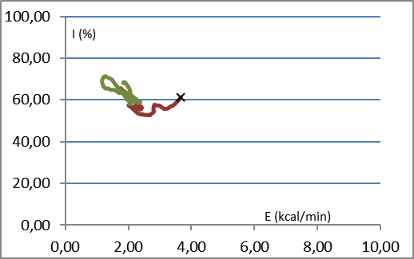
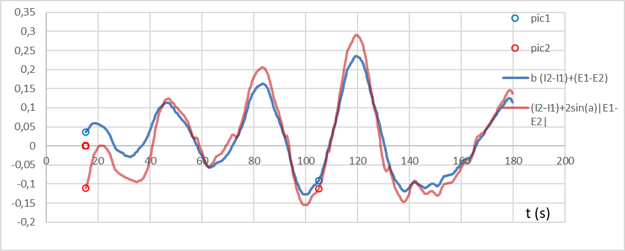
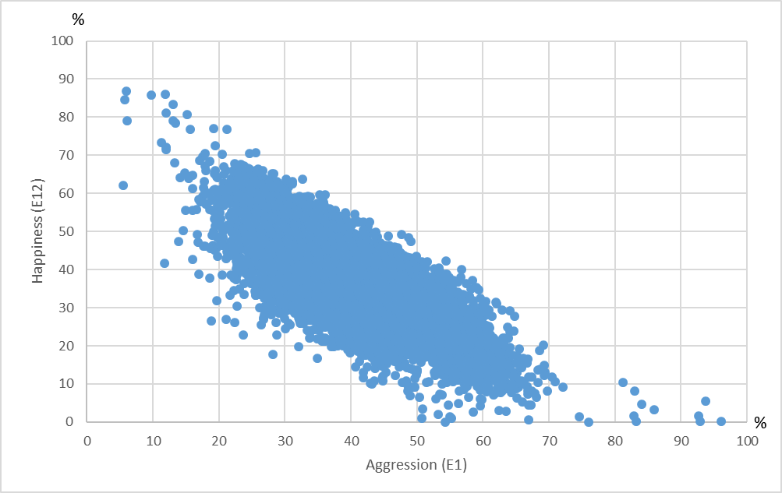
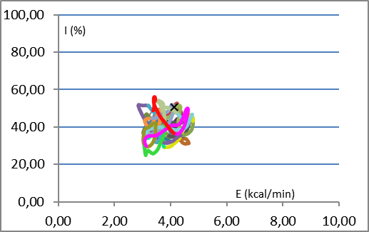
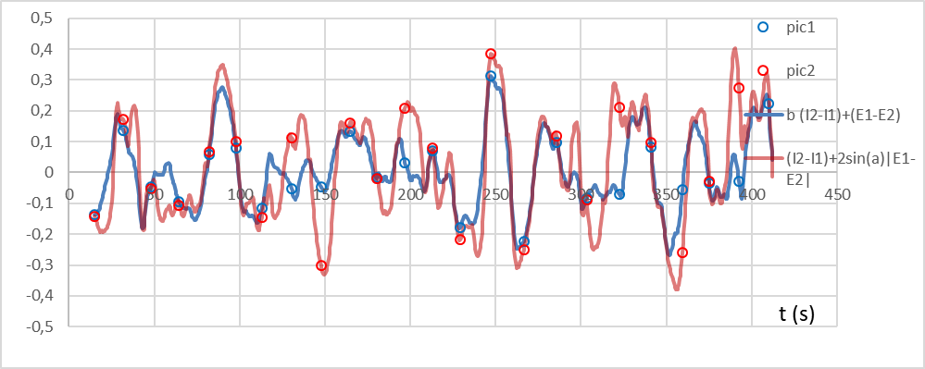
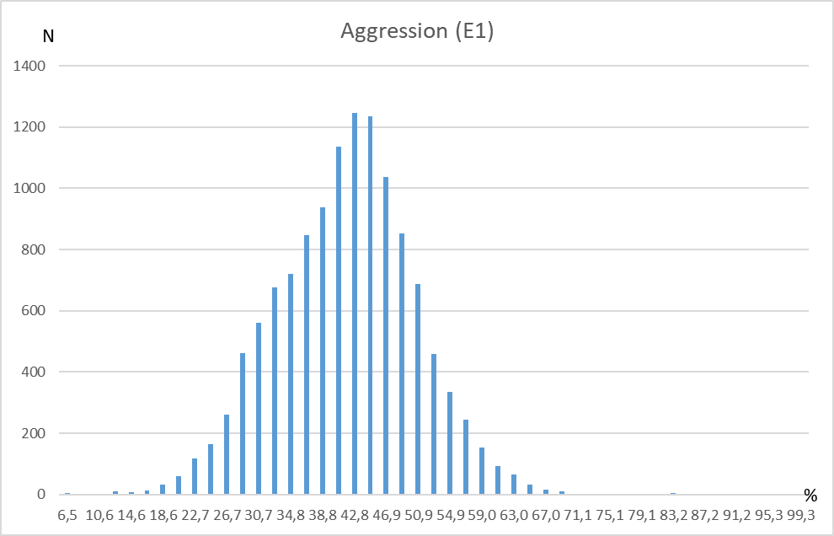
Variability for Behavioral Parameters
Без предъявления внешних стимулов
При предъявлении внешних стимулов
Notes:
To carry out accurate measurements, is necessary to clearly understand the nature of the change in the measured value.
The physical principles underlying the development of vibraimage technology make possible to measure behavioral parameters with the frequency limited only by the technical capabilities of the equipment and algorithms for behavioral parameters measurement. If before the behavioral and psychophysiological parameters of a person seemed to be a constant or very slowly changing characteristic, then with the advent of vibraimage technology, the situation has changed significantly.
We see chronobiological changes in behavioral parameters that means is possible to have several measurements from one person and every measurement gives new information. So 100 consecutive measurements from one person give the same number of information as 100 measurements from different persons, because one person could not be the same in different moments.

Slide 22
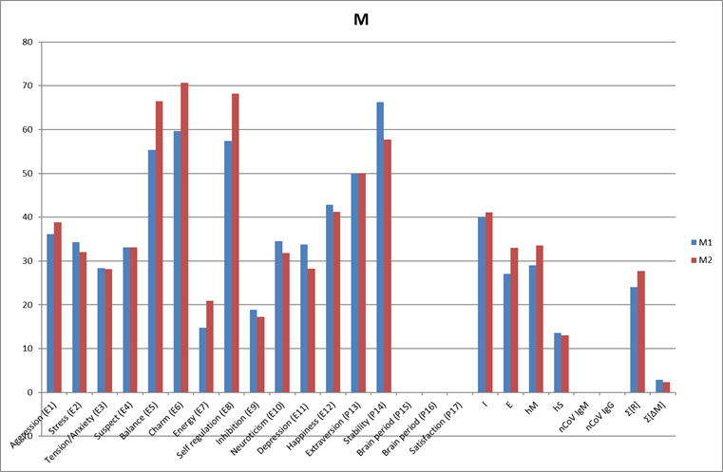
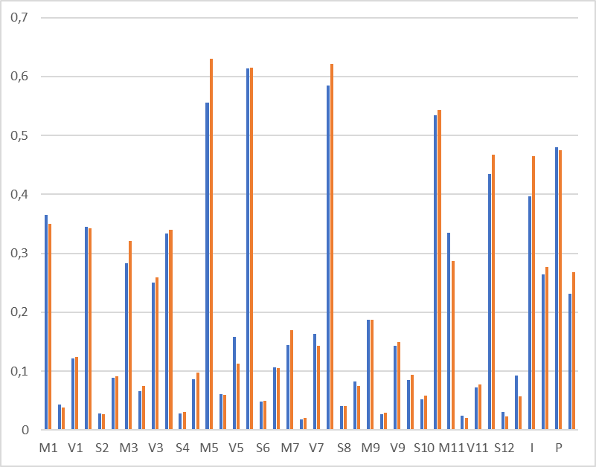
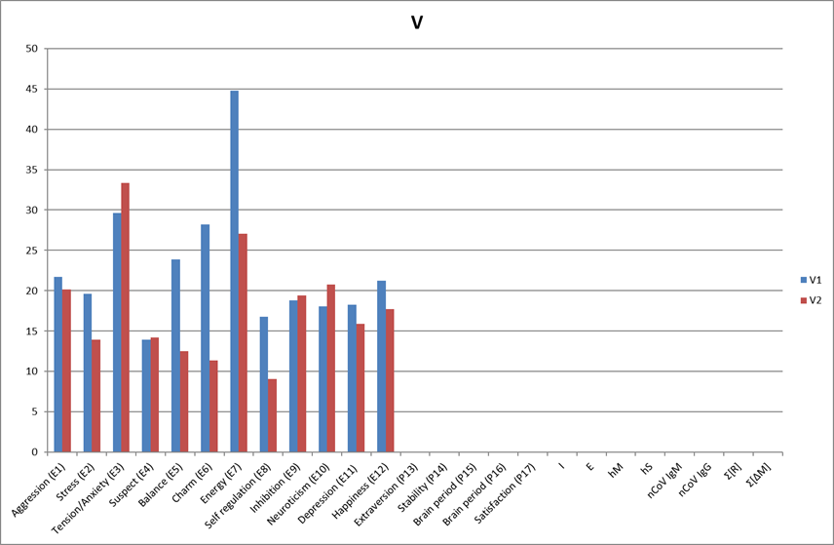
Mean and Instant Values ​​of Behavioral Parameters for COVID-19 Diagnosis
Comparison of Patients and Controls based on instant
BP values
Comparison of Patients and Controls based on BP
mean values
Notes:
To create a database of behavioral parameters, is possible use both the average values ​​of behavioral parameters over the measurement period and instant values. Naturally, the size of Mean and Instant databases varies significantly, since the vibraimage technology allows obtaining 10 readings of behavioral parameters per second, respectively, 600 values ​​of each parameter per 1 minute of measurements. Thus, the Mean and Instant databases differ in size by a factor of 600 for minute measurements and by a factor of 1800 for 3-minute measurements.
The size of the database significantly affects the learning rate of AI, naturally, learning from a smaller database takes proportionally less time, so when setting the task of developing COVID-19 diagnostics based on behavioral parameters, we initially chose a database of Mean and started working on the algorithm using it. Moreover, as shown by the comparative histograms, the Mean values ​​of behavioral parameters differ more significantly in groups of patients and in controls than histograms obtained from Instant values.

Slide 23
ANN Training Structure by Behavioral Parameters
Layer 1
Layer 2
Layer 2
N1 111N111 1
Layer 1
N1 1
Layer 3
P11
N1 111N111 1
P1
P2
N2 2
P2
N2 2
N2 2
Result
P3
N3 3
Result
P3
N3 3
N3 3
NF 1
P4
NFNТN2N 1
P4
…
…
…
…
…
Pi
Pi
Pn
Pn
Ni 40
Ni 40
Nk 20
Fig. 1. Block diagrams of linear neural networks with feedforward for discrimination of databases in two groups: patients and control, a) − the simplest feedforward network; b) − a feedforward network with one hidden layer of neurons.
Notes:
During the development of ANN optimal structure various options for its construction were investigated. The results obtained are presented in a number of published scientific papers. At this stage of the work, we came to the conclusion that the best option for processing databases of behavioral parameters, in terms of increasing accuracy, is a three-layer feed-forward structure using 68 input behavioral parameters.

Slide 24
Databases and ANN Testing Format
BPIV database structure used for AI learning and diagnosis accuracy testing. Preliminary study database size given without (). Basic study database size given in ().
Notes:
Currently, the overall database that Elsys uses to diagnose COVID-19 consists of more than 1 million measurements of instant behavioral parameters, including patients with a confirmed diagnosis of COVID-19 and a controls with a confirmed absence of COVID-19 disease. Moreover, the control group included not only healthy people, but also carriers of various diseases, including the cardiovascular system, oncology and influenza.
This approach allows us to identify the specific impact of COVID-19 on micromovements, and not the severity of the disease. The standard approach in AI training is to create an independent database on which the AI ​​is trained, and a test database on which the accuracy of the disease diagnostic algorithm is tested.

Slide 25
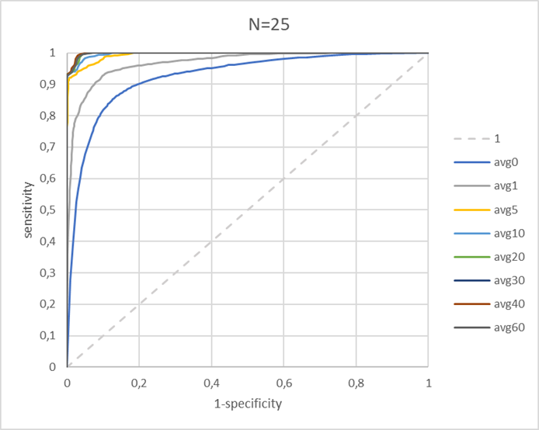
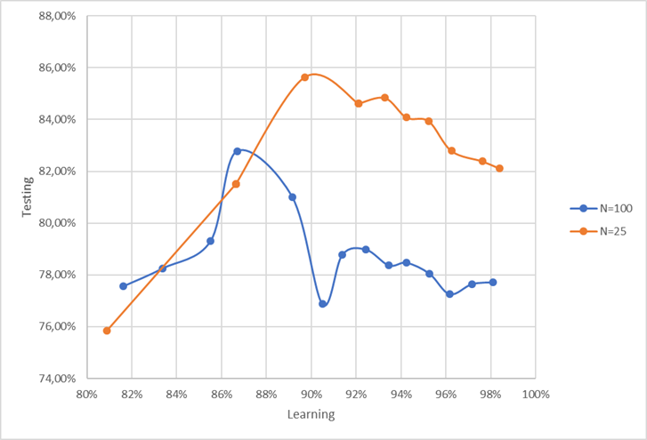
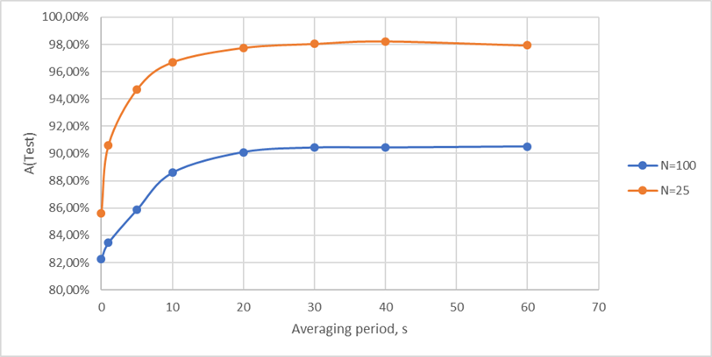
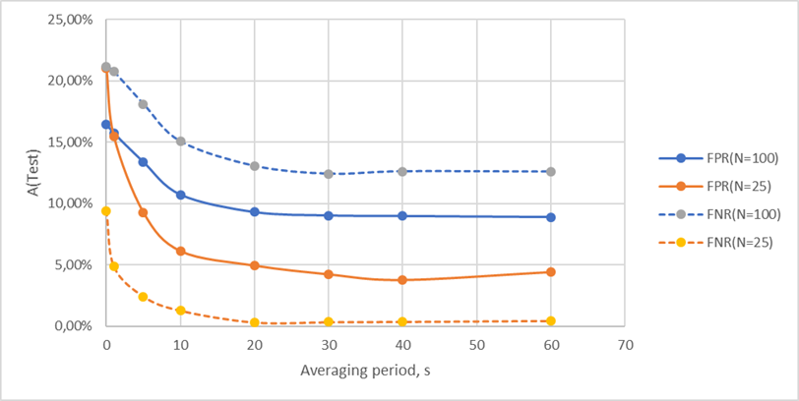
COVID-19 Diagnostic Accuracy by VI+AI
ROC dependency diagnostic sensitivity-specificity
Dependence of test DB diagnosis accuracy on discrimination accuracy of trained DB
Dependence of accuracy on integration time of diagnostic result for (N=100) and (N=25).
Dependences of errors on the integration time of the diagnostic result for (N=100) and (N=25).
Notes:
We have analyzed various settings of vibraimage systems, including the sampling interval of 5 and 10 Hz, as well as the period of accumulation of information about micromotion from 2.5 to 20 seconds. Results demonstrating the accuracy of the method obtained on current databases are shown on this slide. Naturally, an increase in the time of observation of a person leads to a certain increase in the accuracy of diagnostics.
At the same time, only a 5-second analysis allows reaching approximately 90% accuracy and the sensitivity and specificity differ slightly from each other. 20-second measurements allow another 2 times to reduce the probability of error, and 20-second measurement allows to bring the accuracy of diagnosis to 98%.

Slide 26
Principles for Improving the Accuracy of Diagnosing Diseases
Discretization. The frequency of video conversion to vibraimage parameters should be maximum at the minimum level of video image noise.
Conformity. The time of accumulation of the interframe difference should coincide with the period of the analyzed physiological process.
Optimality. The number of measured behavioral parameters should be minimally sufficient for the analysis of the studied physiological process or response to the presented stimulus.
Infinity. Vibraimage technology allows extracting any amount of biometric information about the object under study from a video image.
Notes:
In the course of work on improving the accuracy of COVID-19 diagnostics, we formulated several principles that should be used to diagnose an arbitrary disease using vibraimage technology.
It is no coincidence that I am talking about an arbitrary disease, since the vibraimage system uses physical, mathematical and cybernetic principles in its work, which do not depend on the biological characteristics of the object, since a person is, first of all, a physical object that obeys physical laws.

Slide 27
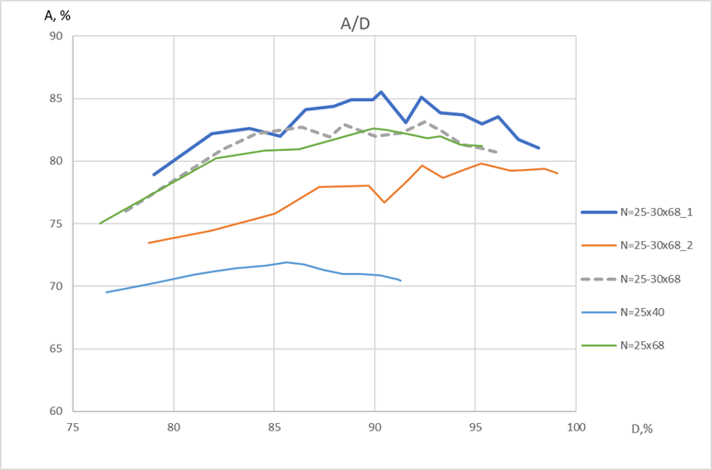
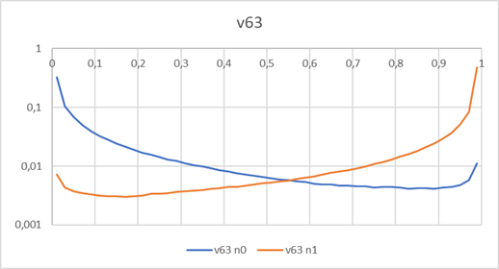
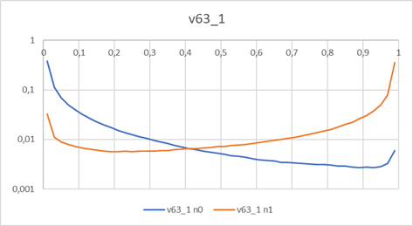
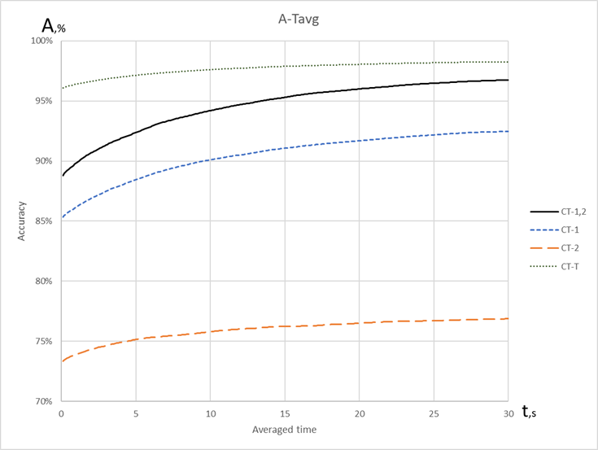
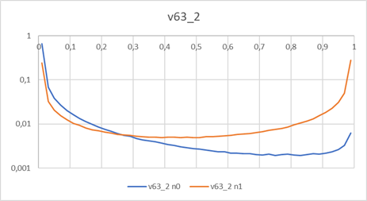
Determining the Stage of a Disease
Dependence of instant diagnosis accuracy of testing database A on the discrimination accuracy of training database D
Calculation of experimental and theoretical accuracy of diagnostics according to the equation; A_{CT-T} =1 − (1−A_{CT1}) х (1−A_{CT2})
Errors density on different stages
of COVID-19
Notes:
Training AI on behavioral parameters measured at different stages of the disease makes possible to diagnose not only a specific disease, but also its stage. For example, training AI on behavioral parameters obtained at an early stage of COVID-19 makes possible to successfully diagnose patients at the stage of the incubation period 5-7 days before the onset of obvious symptoms of the disease and before positive RT-PCR test result.
While training AI from videos of patients at the late stage of COVID-19 differs markedly in behavioral parameters from the early stage of the disease. For each of the algorithms, it is enough to have a sensitivity of about 50% so that the total algorithm that detects the disease by the maximum indicator of the two algorithms has a sensitivity close to 100%.

Slide 28
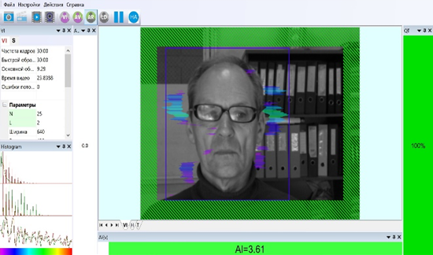
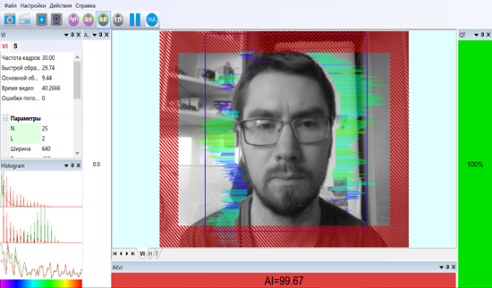
Medical Research of the Contactless Method
of COVID-19 diagnosis. Covid5s Software
Negative diagnostic result
COVID-19. Software Covid5s
Positive diagnostic result
COVID-19. Software Covid5s
Notes:
Covid5s program developed by ElsysCorp makes possible to detect COVID-19 by 5-second testing with approximately 90% accuracy. Increasing person observation time to 20 seconds increases the accuracy or reduces errors about 2 times to 95%. The diagnostic result is displayed instantly on the monitor screen, and an object of study may be far enough from the television camera and not even know that it is being examined for COVID-19 detection.

Slide 29
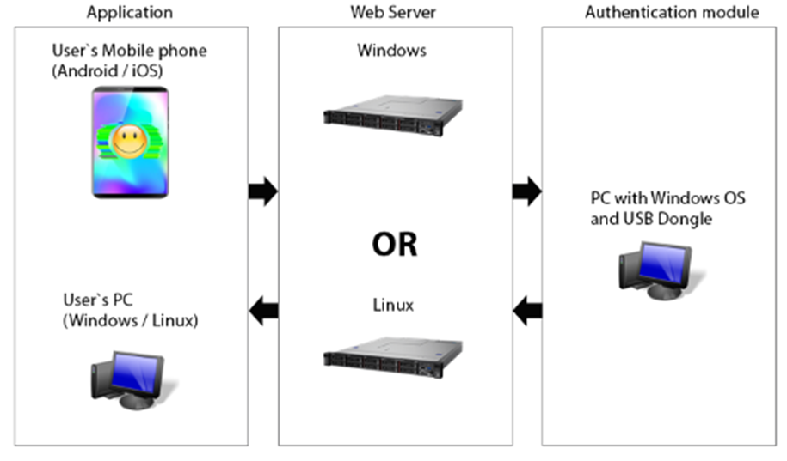
Contactless COVID-19 Diagnosis by Mobile Devices
Various structures and OS used for contactless diagnostics of COVID-19.
Notes:
Naturally, the described method COVID-19 diagnosis, based on the analysis of a human head microvibration, allows possibility of not only computer diagnostics, but can be transferred to mobile devices, since the cameras of modern mobile phones are superior in their parameters to the webcams used, and mobile phone processors close in power to computer processors. However, a number of purely technical problems associated with the different power of telephone processors require serious investments in the development of software that successfully detects the disease on various phone types.

Slide 30

Future for Dangerous Diseases Diagnosis
Contactless auto diagnosis of diseases should have
wide application all over the world!
Notes:
Only early diagnosis of COVID-19 have the chance to stop the pandemic. Existing biochemical diagnostic methods are inertial and detect the disease when it begins to manifest itself as obvious symptoms. The analysis of reflex movements is practically inertialess, human movements instantly react to changes in the physical state and the appearance of viruses in a minimum concentration. Using contactless COVID-19 diagnostic system at our enterprise as a pre-shift control, we detected COVID-19 for employees at 5-7 days before a positive result in RT-PCR testing. Moreover, the system trained on the alpha variant of COVID-19 confidently identified carriers of the delta and omicron variants.

Slide 31
The Main Problems of Contactless Diagnostics of Diseases
Medical distrust of contactless methods for diagnosing diseases.
Distrust of decisions made by AI regarding to a person.
Distrust of modern medicine to behavioral parameters as clinical symptoms of the disease.
Distrust of Russian innovative technologies.
Lack of statistically confirmed results of clinical trials conducted in accordance with ISO 14155-2014.
Notes:
The subjective distrust of the developed technology has led to insufficient investment in conducting clinical trials of the Covid5s program and the lack of medical certification of the COVID-19 diagnostic program.
However, our research was not in vain, the proven AI training technology using the example of a specific disease and the control group allows us to be optimistic about the possibility of diagnosing infectious and non-infectious diseases using trained AI and vibraimage technology.

Slide 32
The Main Advantages of Contactless Diagnostics of Diseases
Contactless method and the possibility of auto diagnostics eliminates the possibility of infection of personnel in the diagnosis of infectious diseases.
Rapid AI training with a database of standard patient and control group videos.
The possibility of using a single database of the control group for the diagnosis of various diseases.
The speed of diagnosis of diseases and the ability to detect the disease at an early stage of development before the appearance of visible symptoms of the disease.
Open algorithms for checking the accuracy of diagnosing diseases and the possibility of creating open databases for diagnosing diseases using the example of COVID-19 https://psymaker.com/downloads/NN3.zip
Notes:
Naturally, contactless and remote diagnosis of diseases, especially infectious ones, is the dream of any practicing doctor, as it reduces the risk of getting infected from a patient and getting sick. We remember how many doctors became infected and seriously ill during the covid pandemic. In addition, physical approaches to the disease allow diagnosing almost immediately after AI training, and the training itself requires only receiving videos from a certain category of sick patients.
It seems that everything is quite simple and you can quickly set up a program, for example, to diagnose AIDS, hepatitis or cancer. Unfortunately, everything is not so simple and the main difficulty is the selection of patients with a strictly defined disease. And people who have only one desired disease cannot exist, so the sample of patients must be very significant in order to compensate for the influence of multiple diseases on the main study. However, in my opinion, the benefits of the possibilities of contactless diagnostics far outweigh the difficulties of collecting information.

Slide 33
Conclusion
Contactless method for COVID-19 diagnosis, despite the fantastic simple implementation, is based on a scientific approach to the analysis of reflex movements, statistically confirmed and has proven its practical feasibility.
Head motion video processing is not limited to PC processing, the next obvious step is to bring this technology to mobile phone platforms.
The original databases of diagnostic results are made publicly available in additional materials, allows independent developers to refine their COVID-19 diagnostic algorithms based on the available results.
Operational 5-20-60-second video testing of COVID-19 protects against the spread of the pandemic more reliably than QR codes and vaccination passports, since real-time diagnostics of COVID-19 provides more guarantees of health than formal documents, that do not confirm the absence of infection.
Contactless technology for diagnosing COVID-19 has created the prerequisites for the successful diagnosis of different infectious and non-communicable diseases.
Notes:
Currently, methods using AI in medicine are actively developing all over the world. Vibraimage technology makes possible to use a cybernetic approach to a person and objectively measure behavioral characteristics as standard physical quantities. The combination of AI and VI creates almost unlimited possibilities for the development of scientific and practical applications that can be used to stop the COVID-19 pandemic. However, this requires overcoming distrust of new methods in medicine, as well as broken significant organizational and bureaucratic barriers.
I hope that today's report will add supporters of the new technology, as we are interested in partnership proposals, and significant efforts are needed to develop the medical direction in vibraimage technology, since the proposed approach is potentially applicable to the diagnosis of any disease.

Slide 34
Thank you for the attention!
Viktor Minkin
e-mail: minkin@elsys.ru
www.elsys.ru
www.psymaker.com
Notes:
Thank you for your attention, I am ready to answer questions about the presentation and any questions and suggestions now and by e-mail on possible cooperation in the development of contactless medical diagnostic technologies.

