Slide 1


The 5th International Open Science Conference
Modern Psychophysiology. The Vibraimage Technology
Detailed Psychophysiological Profiling.
Development Principles of Adaptive Multifactor Testing
Viktor Minkin
Elsys Corp
Saint Petersburg, Russia, 2022
Notes:
Dear colleagues. I am glad to welcome you at the opening of the fifth vibraimage technology conference . I will start the conference with a report on new MI-Sins psychophysiological profiling program. MI-Sins program is so named because it determines the profile of multiple intelligences (MI) and the profile of sins or vices of the investigated person.

Slide 2
Methods of psychological or psychophysiological testing (profiling)
№ | Stimuli types | Captured psychophysiological response (PPR) | Technologies | Stimuli period
1 | Text | Conscious | MMPI; EPI | unlimited
2 | Graphic | Conscious | Luscher, Szondi | unlimited
3 | Text & graphic | Conscious | ТАТ; РАТ | unlimited
4 | Текстовые (аудио) | Conscious and unconscious | Polygraph | > 20s
5 | Текстовые & графические | Conscious and unconscious | Vibraimage, EEG, HRV, MRI | 5−20s
Notes:
I use the term profiling to combine psychological and psychophysiological testing, since the tasks of testing are the same, but the means differ in the additional use of a psychophysiological response during psychophysiological testing. Vibraimage technology allows the use of conscious and unconscious or physiological information when conducting contactless testing, which is a significant advantage compared to most known psychophysiological technologies that use physiological signals, such as electroencephalography, heart rate variability or magnetic resonance imaging.

Slide 3
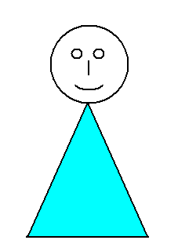
VER and thermoregulation – physiological bases of profiling informativity by vibraimage technology
Vestibular-emotional
reflex (VER)
Muscles microvibration on the various parts of the body (Rohracher, Microvibration, 1969)
Notes:
The physiological basis of the vibraimage is the processes of mechanical and thermal regulation, constantly occurring in the human body. It is the imposition of the vestibular-emotional reflex on the process of constant microvibration of the muscles to release heat in the human body that determines the micromovements of the head recorded by the vibraimage technology. Constant microvibration of muscles was discovered by the Austrian professor Hubert Rohracher in 1946 using contact vibration sensors and is the main process for the release of thermal energy in humans and warm-blooded animals.
Vibraimage technology as a contactless method of vibration analysis has made it possible to create a number of practical applications that analyze both free vibrations of the human head and changes in vibrations upon presentation of external stimuli.

Slide 4
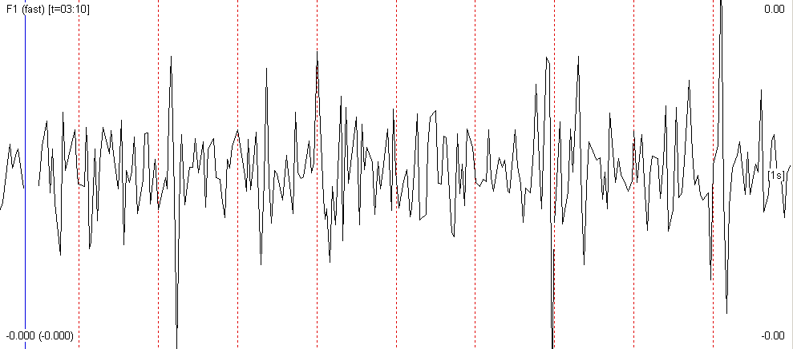





FVT (DVT) - fast (discrete) transformation of vibraimage
Amplitude Ai-A6
Frequency Fi- F12
Symmetry Si-S7
Processing Pi-P30
Psychophysiological E1-E16
System I; E; P; M; SD
Vibraimage parameters as functions of time and space
Notes:
Modern vibraimage systems use various methods and formulas to obtain the most complete information about the micromovements of the head when processing a human video image. The head movement parameters are calculated in real time and the measured parameters significantly depend on the sampling settings when converting a video image into a vibraimage. By analogy with the fast or discrete Fourier transform, one can speak of a fast or discrete transformation of vibraimage.
At the same time, unlike the purely information-mathematical Fourier or Hartley transformations, the parameters of vibraimage include both mathematical and biological meanings, since, depending on the purpose and settings of the system, vibraimage can reveal various psychophysiological characteristics of investigated person.

Slide 5
Adaptive profiling and differential psychology
Xy₂
Multifactor
stimuli
X
Head
MV
Convert motion to digital video
Y₂
Vibraimage
processing
Y_{вых}
Y₁
Xy₁
Control
stimuli
Structural diagram of the vibraimage system of adaptive profiling with double feedback during pretesting and basic testing
5
Notes:
Most methods of psychological and psychophysiological testing use the presentation of external stimuli to reveal hidden characteristics of a person's personality. It is known that people with different psychological types react differently to presented stimuli, and differential psychology studies individual differences. Therefore, it is advisable at the pretest stage to determine the individual characteristics of a person, and at the stage of the basic testing to present stimuli that reveal the factor under study.
During the development of vibraimage technology, we chose the theory of multiple intelligences of Professor Howard Gardner as a technology that allows us to most accurately classify people according to the profile of abilities or multiple intelligences that determine the type of a personality. At past conferences, reports were presented on VibraNLP program and the basic principles of adaptive testing and neurolinguistic profiling.
The development of the above principles led to the creation of detailed profiling program with the still unsettled names Profiler ++, MI-Sins or Blitz Judgment. Which of the names will win will be determined by our discussion with you and the future choice of users of vibraimage programs.

Slide 6
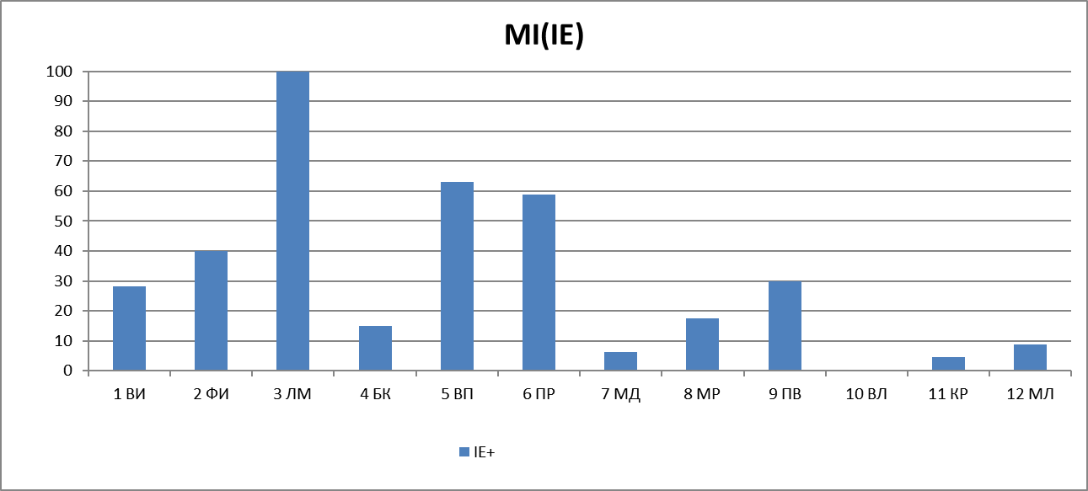
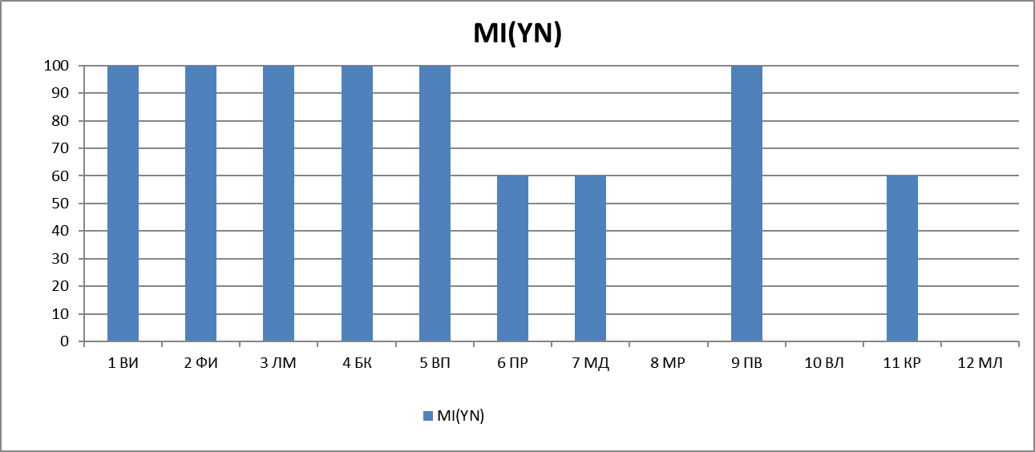
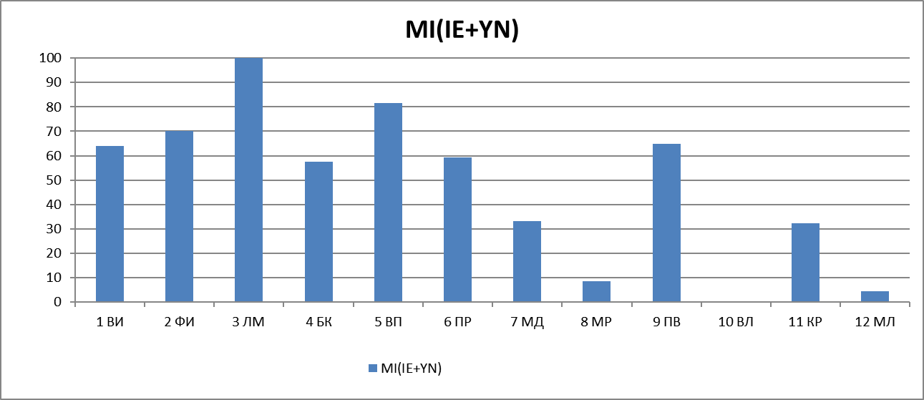
Joint processing of conscious and unconscious psychophysiological responses (PPR)
I/E
IE+YN
Notes:
In this report, I will call the new program MI-Sins, since at the preliminary testing stage it determines the profile of multiple intelligences, and at the main testing stage it determines the profile of vices and sins of the person under study. The principle of determining the abilities and profile of multiple intelligences is similar to the principle used in the VibraMI program, which is quite fully described in previous publications and presented at past conferences.
It is based on the presentation of an external stimulus associated with the studied type of MI and the synchronous analysis of the unconscious I/E and conscious Y/N responses to the stimulus. Similarly, the response to stimuli associated with human vices is studied, only in this case the stimulus has a double binding to the leading type of MI and one of the vices. By vices we mean recurring sins, so I can use both terms: vices profile and sins profile depending on linguistic justification.

Slide 7
Structure of multifactorial stimuli and profiles of MI and Sins
MI | 12_MI | № | 12_Sins (vises) | PS
IA | Intrapersonal | 1 | Suicide | SU
PH | Philosophical | 2 | Sloth | SL
LM | Logical-mathematical | 3 | Cyber addiction | GA
BM | Business-Mercenary | 4 | Greed | GD
VS | Visual-spatial | 5 | Alcoholism, drug addiction | AD
NL | Naturalistic | 6 | Gluttony | GL
BK | Bodily-kinesthetic | 7 | Anorexia | AN
MR | Musical-rhythmic | 8 | Pride, vanity | PV
AS | Ascetic-Sacrificial | 9 | Bribe, theft | BT
VL | Verbal-linguistic | 10 | Envy | EN
CR | Creative | 11 | Lust | LT
IE | Interpersonal | 12 | Wrath | WR
Sequence of MI types and personality sins (PS)
formed by increasing level of extraversion
Notes:
By analogy with the 12 types of multiple intelligences, we proposed 12 personality vices (sins), which we consider the most relevant at the present time. Modern vices include 7 deadly sins taken from the Christian religion, highlighted in color in the table. We have added 5 vices to them, which we consider no less important than those described earlier. Perhaps it will seem to someone that we missed certain vices or added unnecessary ones. In my opinion, this is not so important at this stage of development, we are ready to discuss various proposals and adjustments.
The following seems to me important:
For the first time, we propose a detailed profiling method by measuring the positive and negative characteristics of a personality, which were previously the subject of religious or ethical reasoning.
For the identity of the measurement and balance of positive and negative personality traits, their sequence is formed according to the increase in the level of extraversion and contains the same number of types of MI and vices. A person's abilities are his virtues and therefore positive personality characteristics
We believe that a person's abilities and vices are independent scales that most fully determine a personality, and measuring profiles on these scales allows us to determine other personality characteristics. Even Pushkin argued that Genius and Villainy are incompatible things, which means that these are basic uncorrelated characteristics that carry information about other personality traits.

Slide 8
Adaptive Matrix of Personality
Personality profiling matrix with the measurement of vices profiles tied to the
two leading types of MI
Notes:
Detail personality profiling could include filling in all 144 cells in the personality matrix formed by vices on the horizontal axis and multiple intelligences on the vertical axis. However, personality psychology is designed in such a way that undeveloped abilities do not matter when making important decisions. Leading abilities and intellects determine our behavior. This is approximately the same as in society, the mass follows the leaders. Therefore, it is logical to determine only the profiles of sins tied to the leading types of multiple intelligences, they determine our behavior and intentions.
In general, personal matrices have been known in psychology for a long time, starting with Hippocrates. At the same time, for the most part, personal matrices offer to choose one type of character or temperament for a person. Moreover, most of the personal matrices known to me consist of quantities of the same name - emotions, character types, etc. MI-Sins is built on 2 independent scales of multiple intelligences and vices. Aristotle argued that every positive quality is a middle ground between two extremes, each of which is a vice.
That is why we do not present scales in the form of vice-virtue, since these concepts have a clear correlation, and the most informative representation of a person is possible only with a minimum number of uncorrelated characteristics.

Slide 9
Line-opposite testing with reference to an increase in extraversion. Comparison Zone Test (I-C-R-I-C-R) by Cleve Backster
Stimulus presentation scheme tied to the level of extraversion displayed on the vertical axis
Notes:
Many psychophysiologists believe that scientific psychophysiological testing began with the technology of comparison zones for lie detection, proposed in the middle of the last century by Cleve Baxter, which consists in the formation of several sequences of similar stimuli, including control and relevant questions. The method proposed by Baxter for analyzing the psychophysiological reaction of the subject is similar to the methods for reducing errors in metrology and includes the following basic principles:
Averaging the measurement result leads to an increase in accuracy and a decrease in the random component of the measurement error.
The presentation of stimuli that are as close as possible in meaning, differing only in the factor under study (the principle of operation of a differential amplifier with feedback) makes it possible to most accurately identify the reaction of the subject to the factor under study.
We followed these principles when compiling the structure of the MI-Sins questionnaire:
- The total number of MI control stimuli (24) coincides with the total number of relevant or multifactorial stimuli (24) aimed at detecting defects.
-Presentation of control and factor stimuli is tied to the level of extraversion. This provides a differential approach and closeness of perception of control and factor stimuli.
- Averaging the measurement results for at least two values ​​of MI and personality defects. Therefore, at the stage of preliminary testing, 2 leading types of MI are identified, and at the main stage of testing, the presented stimuli are linked to those that are significant for each type of MI being tested and the defect under study.
More details about the principles of formation of multifactorial incentives will be discussed in the next report at the conference.

Slide 10
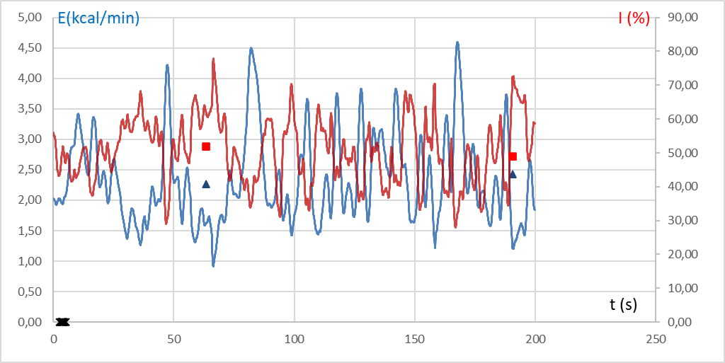
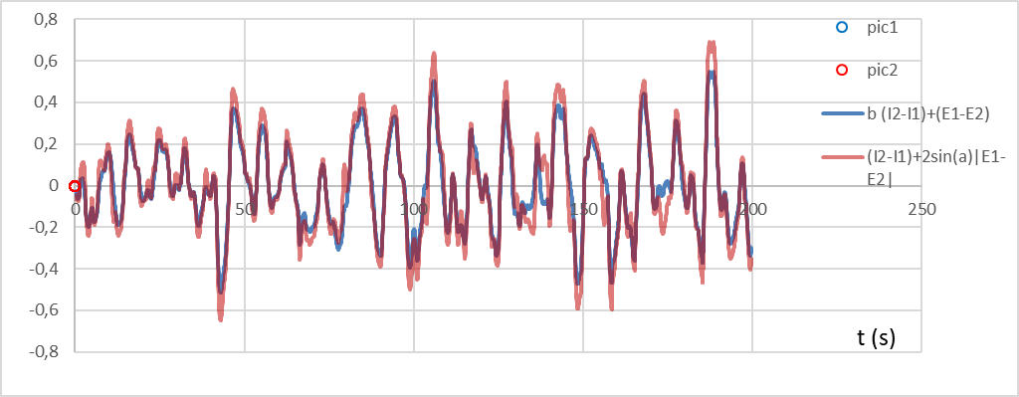
Chronobiology and external stimuli
Time dependences of I-E upon presentation of 48 stimuli
Time dependence of current psychophysiological
state PPS=f(I,E) upon presentation of 48 stimuli
Notes:
After a brief presentation of the testing structure, I want to dwell on the analyzed psychophysiological reaction, which in vibraimage technology is traditionally calculated on the basis of the information and energy component of the psychophysiological state. A typical time dependence of I, E, P upon presentation of 48 stimuli is presented on this slide. The frequency and magnitude of changes in the current psychophysiological state is determined by internal physiological processes and the significance of the stimuli presented.

Slide 11
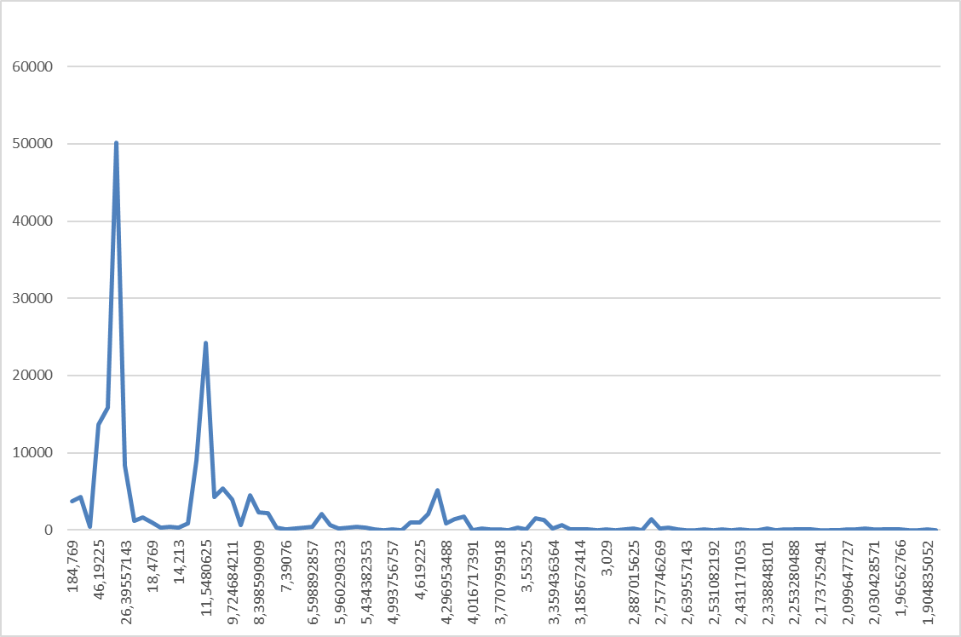
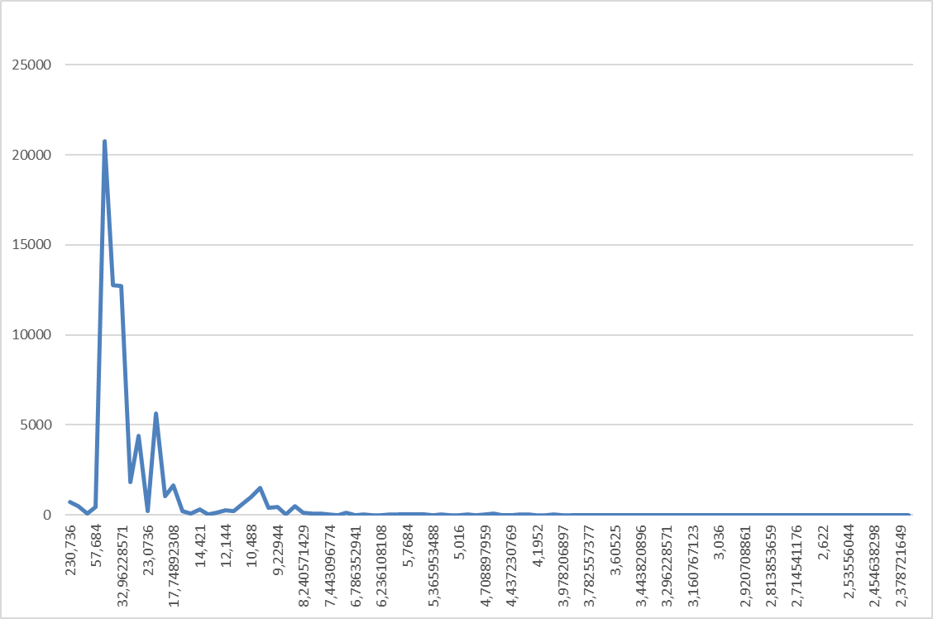
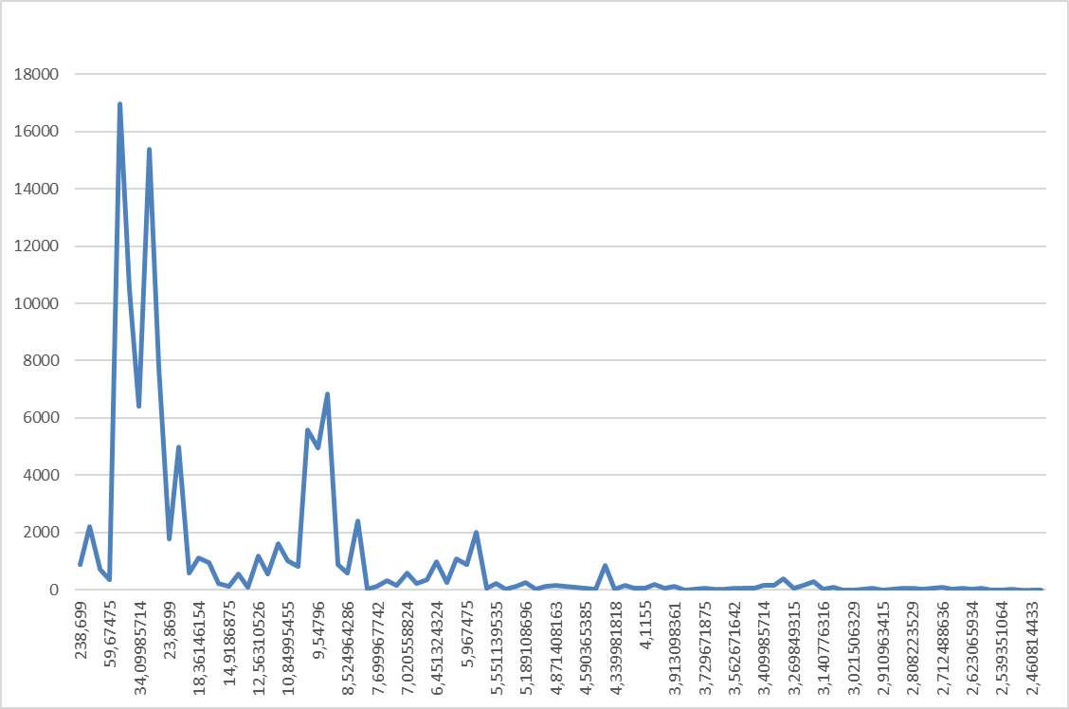
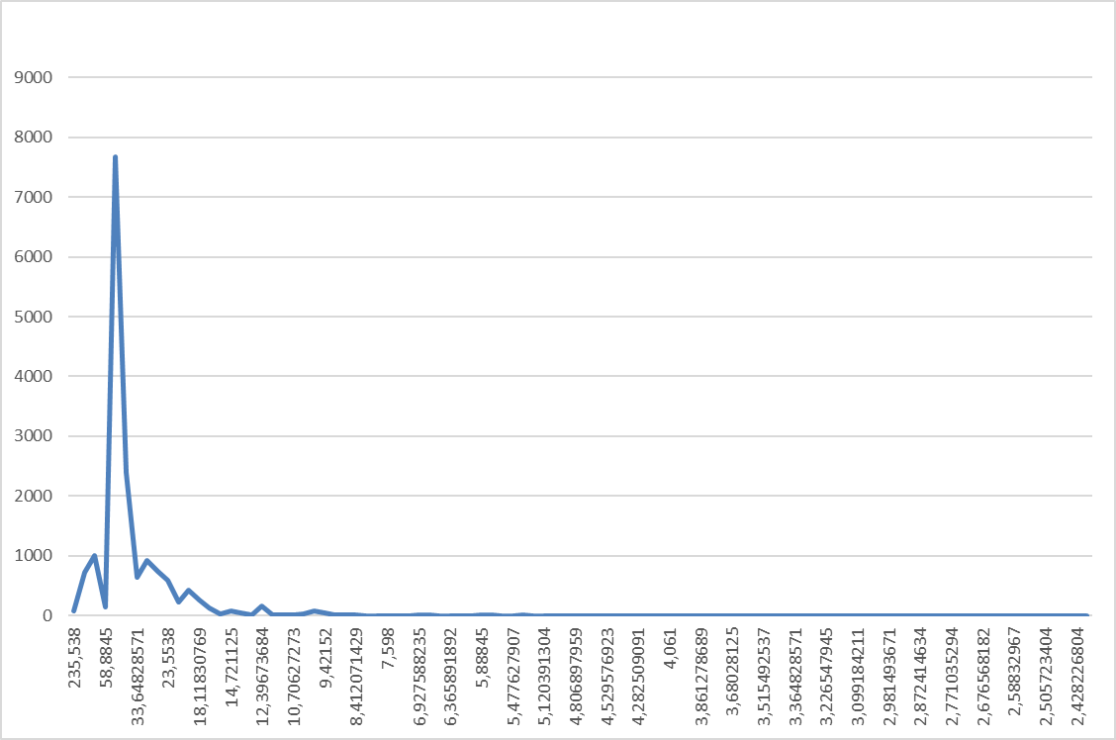
Psychophysiological Response Indication to 5-second Stimuli at Different Settings
N=25; f=10 Hz
N=50; f=5 Hz
N=25; f=5 Hz
N=100; f=5 Hz
Notes:
Of course, the settings of vibraimage system do not affect the psychophysiological response of a subject in any way. But since the main principle of vibraimage technology is the accumulation of the interframe difference over the period of micromotion analysis, the choice of the period and sampling frequency of vibraimage can have the significant impact to the recorded result. This slide shows the signal spectrum of the current PPS upon presentation of 48 stimuli by the MI-Sins program. The upper left graph shows two maxima at 10 seconds (caused by external stimuli) and approximately 30 seconds (caused by internal chronobiological processes).
When the sample rate is reduced from 10 to 5 Hz (lower left graph), there is a smearing of clear maxima at 10 and 30 seconds. Increasing the accumulation period from 25 to 50 frames leads to a decrease in the evoked maximum by 10 seconds, and increasing the accumulation to 100 frames leads to its disappearance.
It should be noted that all previous versions of vibraimage programs worked with slow settings, and settings N=25; f=10 Hz were used for the first time only in the COVID-19 diagnostic program.
Therefore, the correct analysis of the results is impossible without the correct settings of the vibraimage system, since we see on the graphs that slow vibra settings kill information about fast physiological processes.

Slide 12
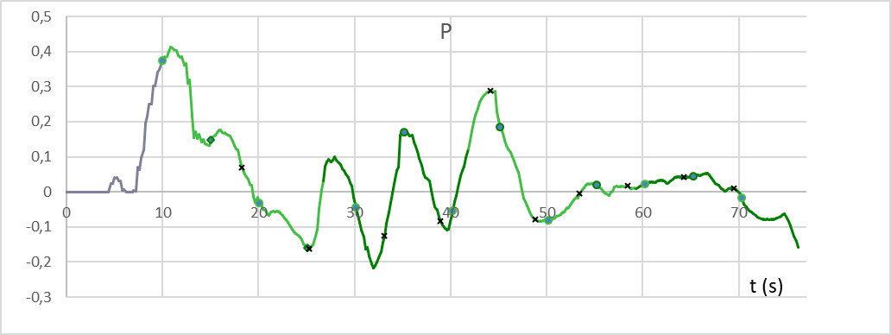
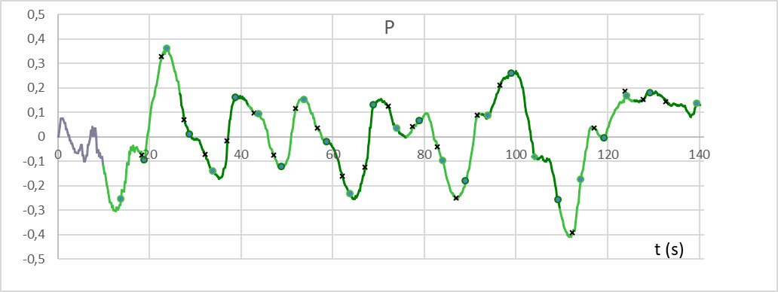
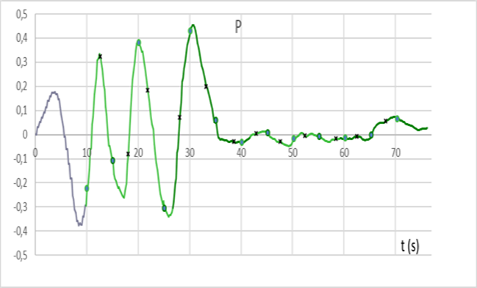
Binding the Testing Start to the Local Minimum of PPS
MAX
RANDOM
MIN
Старт предъявления стимулов с различного значения текущего ПФС
Notes:
I draw your attention to one of default setting in MI-Sins program. Earlier in the VibraNLP program, 3 possibilities were introduced to start the presentation of stimuli:
From the local minimum of the PPS.
From the local maximum of the PPS.
Without reference to the PPS after a fixed time interval of 10 s.
Since the start from PPS local minimum showed the highest profiling accuracy, this setting is the default in MI-Sins program.
Most likely, when starting from PPS minimum, synchronization of the external rhythm with the internal one occurs earlier, which reduces the measurement error of the PPR.

Slide 13
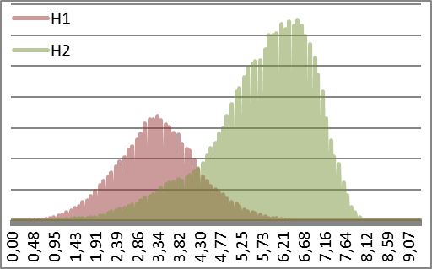
I-E the basic characteristics of behavioral parameters
Ec - the current value of the energy consumed by a person;
Fi - the value of the frequency component of the vibraimage of the
i-th element;
Fproc - frequency of the main vibraimage processing;
n - the number of photosensitive matrix pixels.
Ic - Information efficiency
Fproc – frequency of the main processing of the vibraimage;
F – average value of vibraimage frequency;
Fi - the value of the frequency component of the vibraimage of the i-th element;
n - the number of photosensitive matrix pixels.
M and SD of
vibrations at
PPS changes
Notes:
Let us dwell in more detail on the calculation of the information and energy components of PPS, since they are the basis for determining the PPR and PPS. It follows from the above formulas that the information component is inversely proportional to the SD of vibrations, and the energy component is directly proportional to the average frequency of vibrations M. Thus, the two main mathematical characteristics of vibrations distribution M and SD determine the PPS. An increase in the information component leads to a decrease in the value of the current PPS, and an increase in the energy component leads to an increase in the value of the PPS.

Slide 14
PPS and PPR calculating methods
P=dI – dE VibraMED
dP=P2-P1 VibraMI
dP=(/P2/ +/P1/)/2 VibraNLP
dP=/ P2-P1/ MI-Sins
Notes:
The unambiguity of determining the current PPS does not mean the unambiguity of the determining of PPR, which is determined depending on the methodology and the used settings of vibraimage. For example, in the VibraMED program, in the absence of external stimuli and the maximum accumulation time N=100 frames, it makes no sense to determine the PPR for stimuli, since the PPR is determined only by internal physiological processes
In VibraMI program with a classical stimulus presentation period of more than 15 seconds, the PPR was determined as the arithmetic difference between the current PPS values
In VibraNLP program with the presentation of short 5-second stimuli at a standard sampling rate of 5 Hz, the PPR had a strong dependence on the previous state (so-called Kuleshov effect)
In the MI-Sins program, the best measurement accuracy of the PPR was obtained by calculating the modulus of the difference between the current and previous values ​​of the PPS

Slide 15
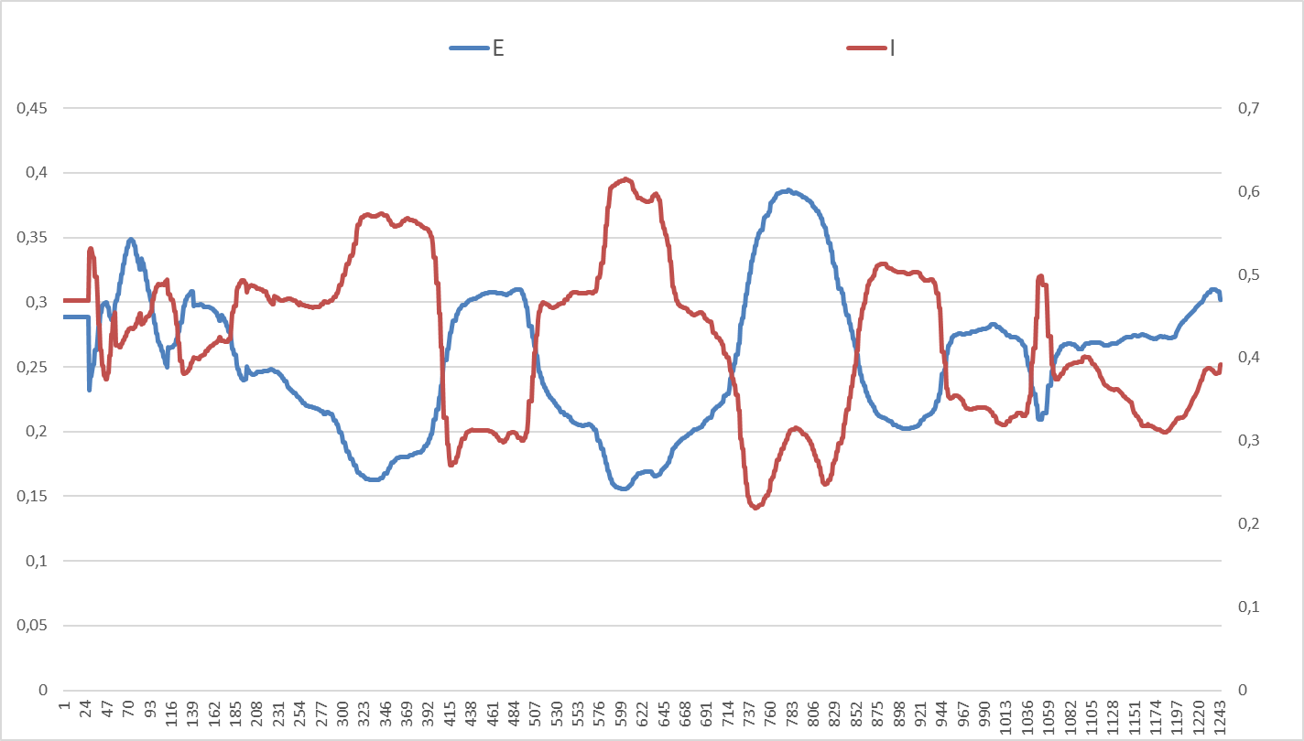
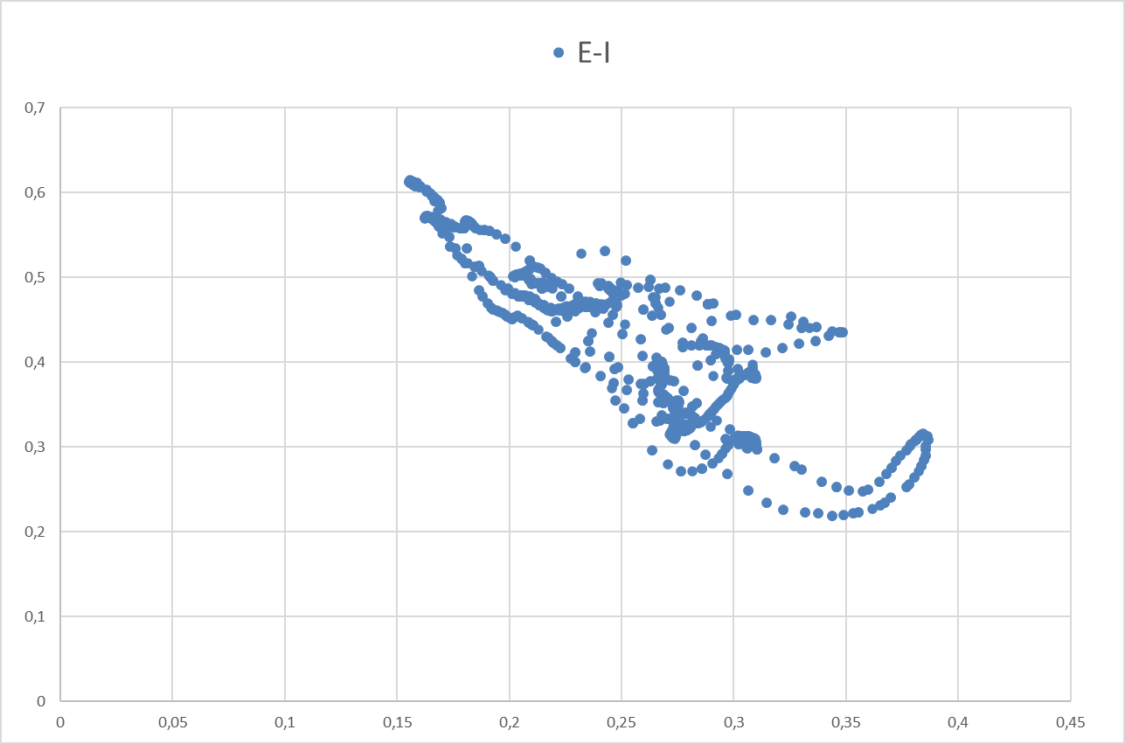
Correlations of Behavioral Parameters
Total correlation of behavioral parameters during testing
Typical oppositional I-E change upon presentation of stimuli
Correlation I-E distribution
during testing
Notes:
PPR analysis by changing the current value of the physiological signal is traditionally used in psychophysiology, for example, in the analysis of heart rate, blood pressure, SRR, HRV. However, vibraimage technology makes it possible to measure more than 100 vibration characteristics of a human head, therefore, the use of only one characteristic potentially reduces the accuracy of PPR measurement.
The most natural way to increase the information content in PPR determining is to analyze the correlation between the two main components of information and energy. Moreover, it was previously noted that in response to insignificant stimuli, a negative correlation is observed between the main components of the PPR.
Another opportunity to use all measured parameters of vibraimage to determine the PPR is the possibility of analyzing the total correlation between all measured parameters, since it was previously noted that the total correlation of behavioral parameters significantly characterizes the PPS.

Slide 16
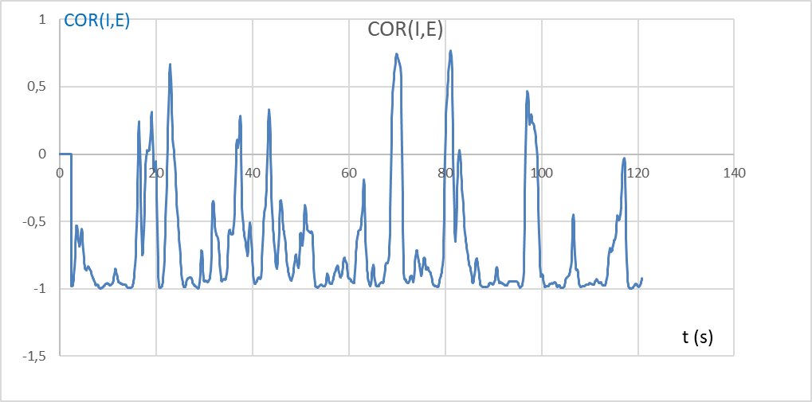
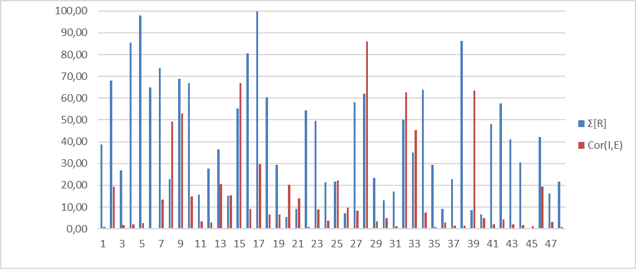
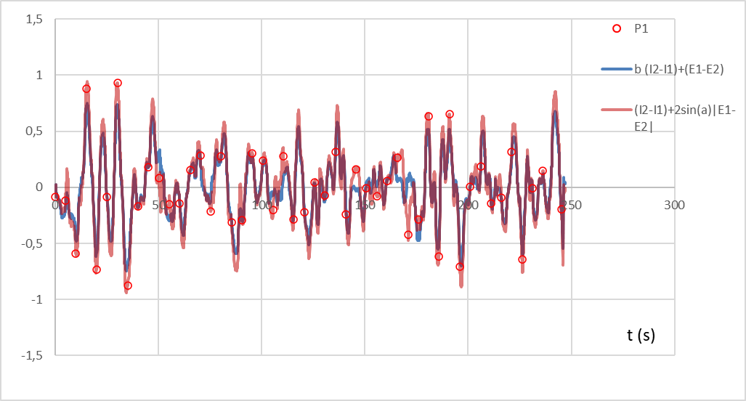
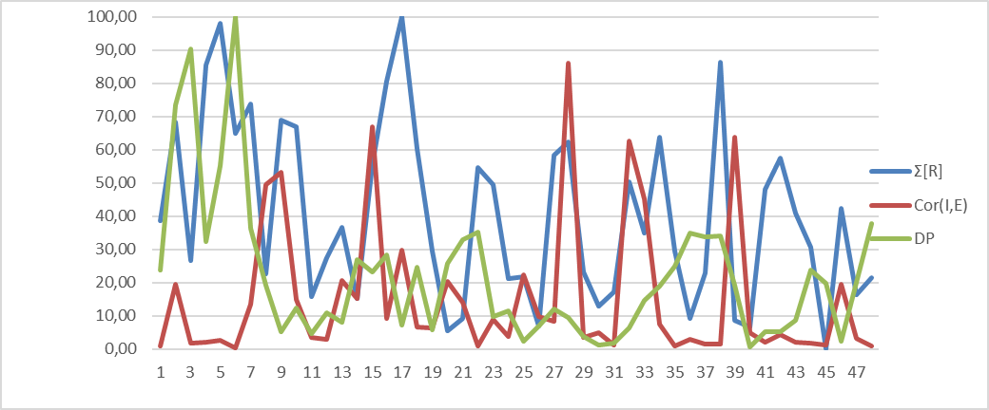
PPR assessment using correlation between behavioral parameters
Cor (I,E)
Reduced Cor (I,E) и Ʃ[R]
Current PPS
Reduced PPR, Cor (I,E), Ʃ[R] by MI-Sins testing
Notes:
The use of correlation of behavioral parameters to estimate the PFR requires the collection of more statistics and a greater understanding of the relationship between different estimates of the PFC. Combining dissimilar values ​​into one PFR processing is quite difficult, first of all, not from a technical point of view, but from the point of view of understanding the interactions between various behavioral parameters. It is technically possible to combine all scores and bring them to the same format, as shown in the lower left figure.
I hope that in the near future, with the advent of more statistics, we will understand the relationships between the current PPS and correlations and be able to switch using the integral characteristic to estimate PPR for short stimuli.
Ideally, one of the correlation parameters should give the sign of the change in the PPR, since the time of Backster, only the significance of the PPR has been analyzed. If the relevant stimulus gives a larger PPR than the control stimulus, this means that the subject gives a false answer to the question in psychophysiological detection of deception.

Slide 17
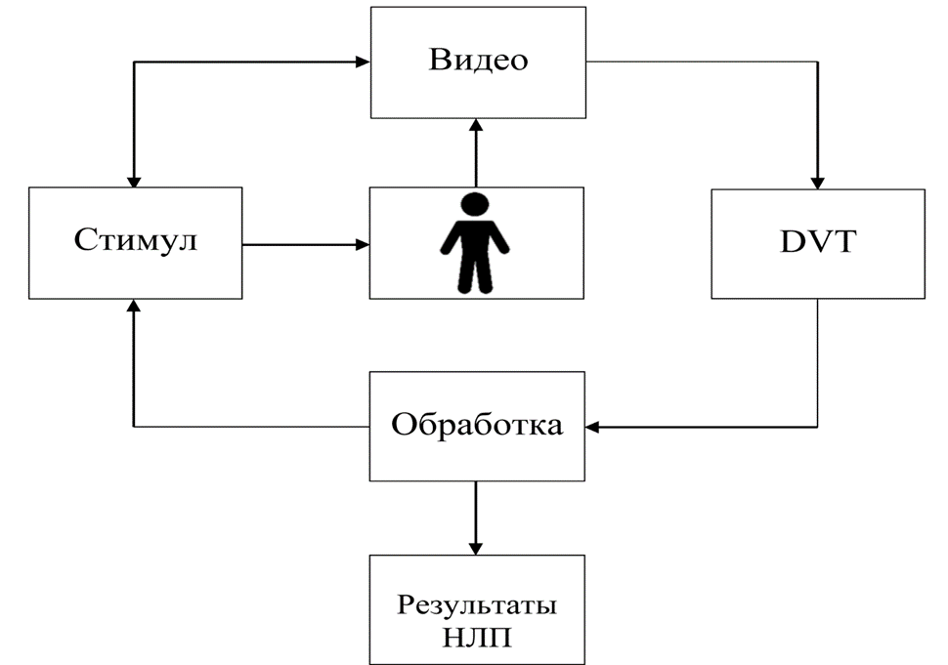
Neuro-linguistic Profiling (NLP)
Block diagram of NLP
Notes:
Let us return to the general scheme of neuro-linguistic profiling, including the presentation of short stimuli and synchronous processing of the PFC upon presentation of stimuli. As it was shown earlier, the perfection of each block (adequate stimuli, high-quality video, correct vibraimage sampling settings and correct processing of results) affects the accuracy of detailed personality profiling.
Unfortunately, an error or inaccuracy in any block affects the final result of NLP, so there are no simple solutions in the above scheme, especially since changes in one block automatically cause changes in all others due to the feedback given.

Slide 18
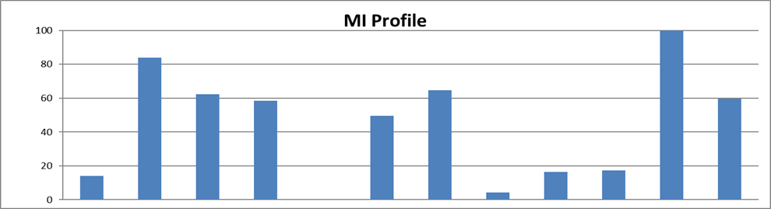
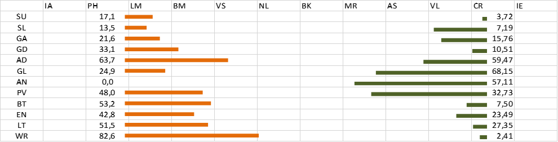
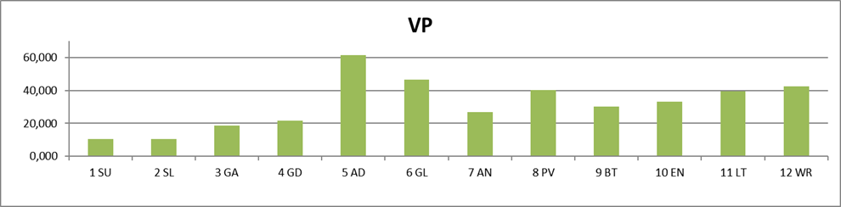
Adaptive Testing Method
Notes:
It is to reduce errors that one has to use a double check of each PPR for the stimuli presented, and the stimuli presented to one factor differ somewhat from each other in order to avoid habituation from repetitions.
In the first part of testing, consisting of 24 stimuli, 2 stimuli are presented for each type of MI, and these two stimuli are oppositional in order to exclude an unambiguous reaction of the subject and a decrease in attention to stimuli.
In the above picture of the MI profile, two leading MI types were identified: 11- Creative and 2-Philosophical.
The presented stimuli in the second part of the testing are semantic linked to these types of MI, and in the final profile of sins-vices, the results of the profiles obtained for the Creative and Philosophical intellect are averaged for each individual sin-vice.
Moreover, the normalization of the sins profile is carried out from the maximum level obtained in MI profile of the control responses given 100%, therefore, the calculated values ​​of sins can be above 100% and below 0%.

Slide 19
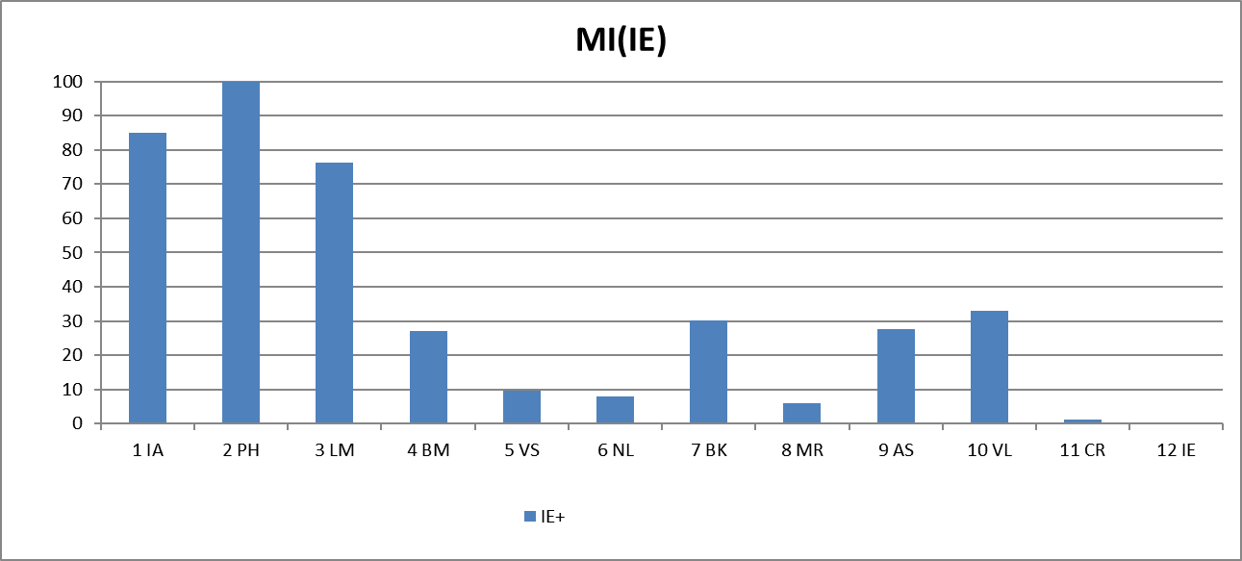
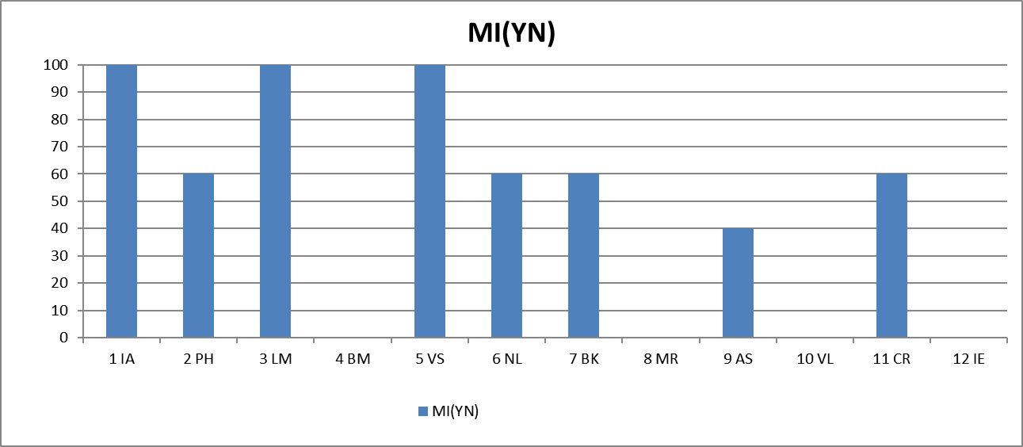
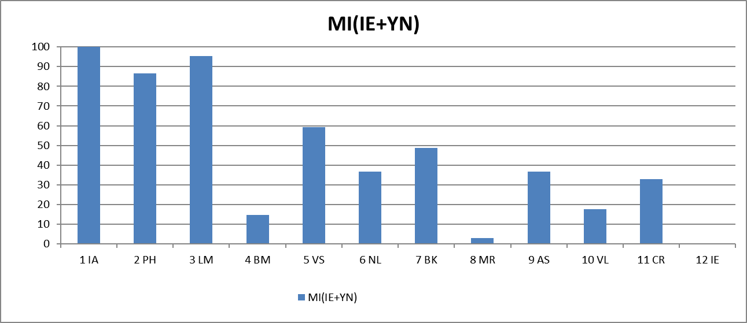
Determination of the Profile and Leading Types of MI
Variability of MI profiles depending on the type of PPR for the unconscious (IE), conscious (YN) and integral (IE + YN) responses
Notes:
Let's consider the measurement of MI and vice profiles on a specific example of my personality testing in more detail.
Please note that all my MI profiles are somewhat different from each other.
According to the unconscious reaction, the leading types are philosophical and intrapersonal types of MI, according to the conscious reaction, intrapersonal, logical-mathematical and visual-spatial, and the integration of the results gives the leading types of MI according to the conscious reaction - intrapersonal and logical-mathematical.
If a person gives truthful conscious answers, then the integral PPR can be used to identify the leading types of MI.
However, to avoid the possible influence of false conscious responses on the result, the current program is configured to use only the unconscious response in determining the leading types of MI, and they are defined by the program as philosophical and intrapersonal on this slide.

Slide 20
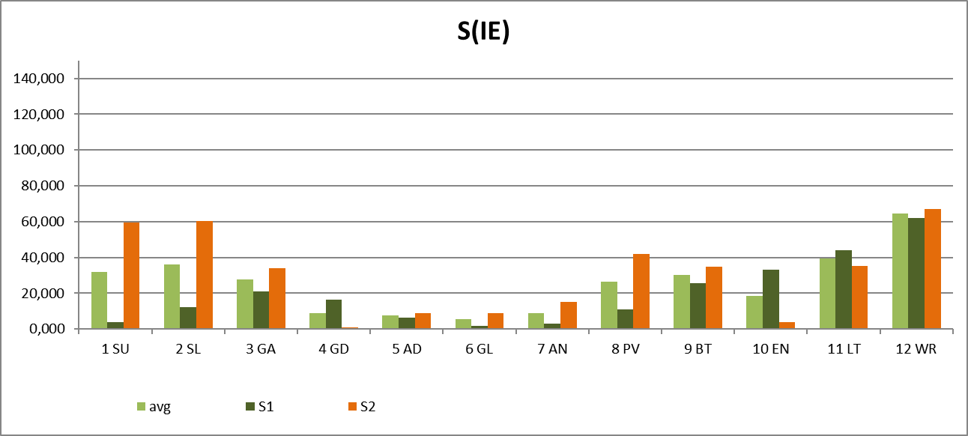
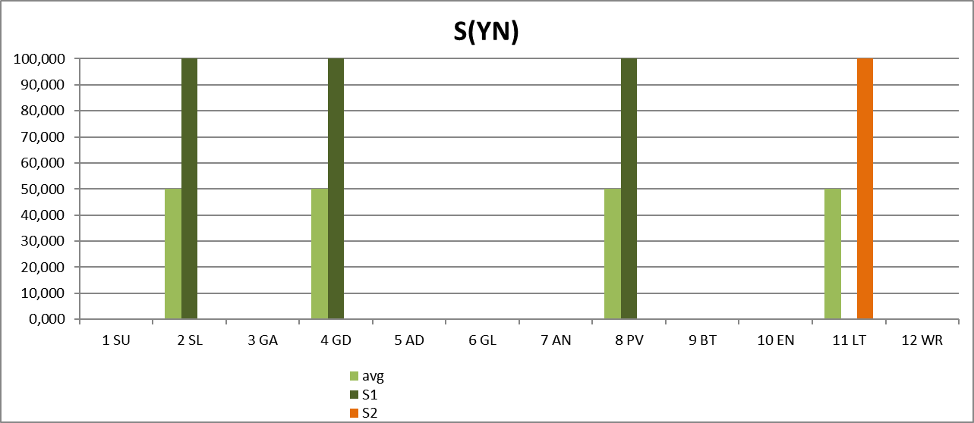
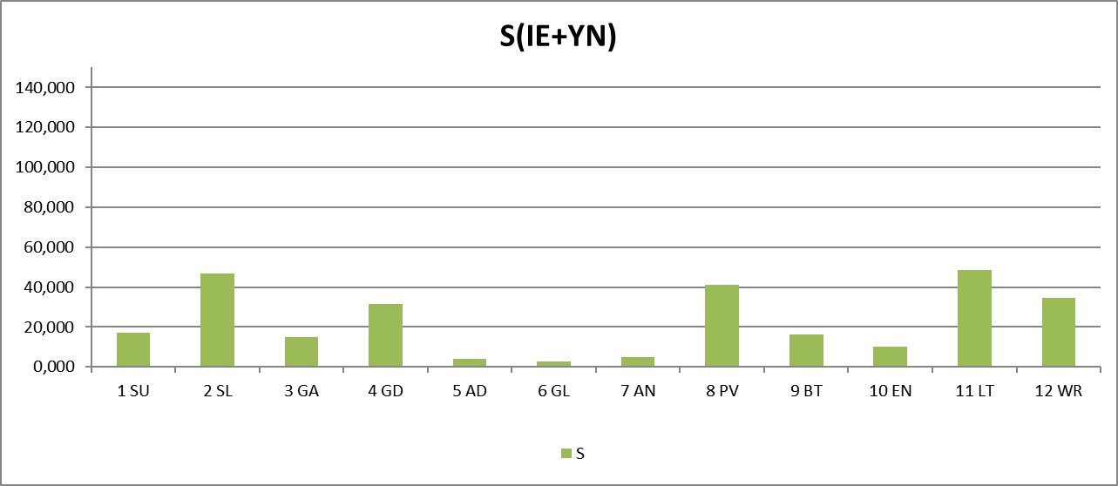
Profile of Personality Sins-Vices Measurement
Notes:
Determination of vices profile occurs with reference to intrapersonal and philosophical stimuli that are significant for me.
Similar to the definition of MI profile, the profile of my vices differs somewhat depending on the choice of the unconscious, conscious or integral responses.
According to the unconscious responses, my leading vices are: anger, lust and laziness, while the conscious reaction showed the main vices: laziness, greed, pride and lust.
The integral reaction revealed - lust, laziness and pride.

Slide 21
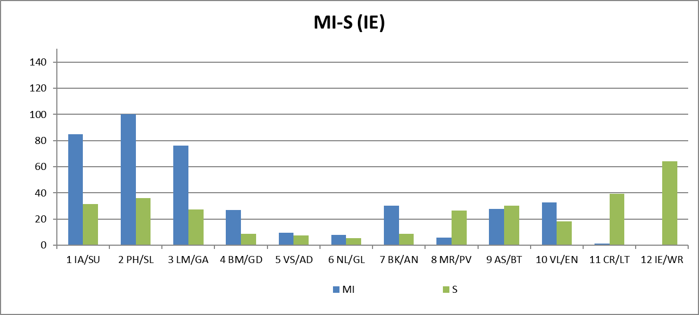
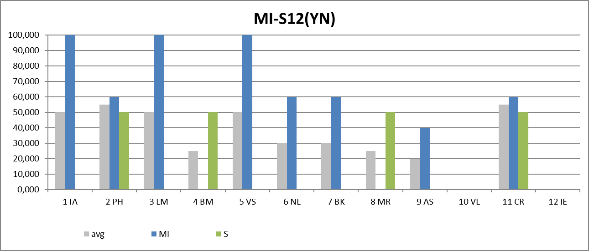
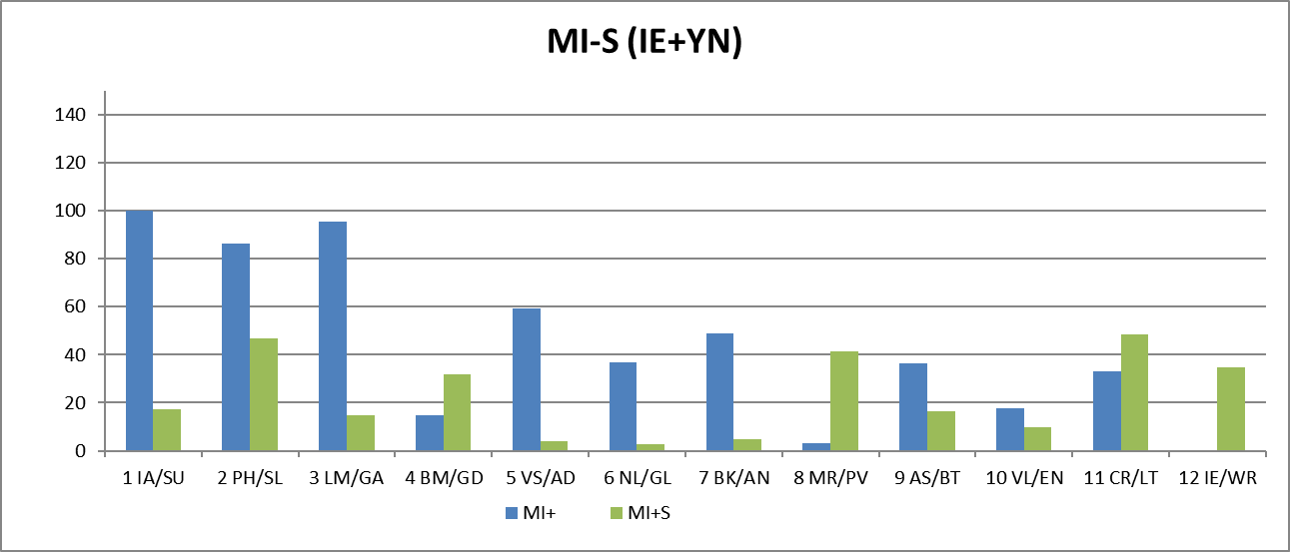
The Ratio of Abilities and Personality Sins (profile of righteous)
Notes:
The histograms on this slide show the ratio of my responses to control stimuli associated with MI and multifactor stimuli associated with personality sins. The program shows the value of the development of the corresponding ability and sin in each subject, the blue color on the histograms shows the value of MI, and the green color shows the value of the sins .
On the given histograms of my testing, we see that the value of the blue bars significantly exceeds the value of the green bars for all comparison options for unconscious, conscious and integral reactions, which means that my positive qualities are noticeably superior to my sins-vices.
The quantitative ratio of the general development of abilities to vices calculates an indicator that we called the level of a person righteousness. Perhaps this name will seem too religious, but so far we have not come up with another more technical term that also well reflects the ratio of positive and negative qualities in a person.

Slide 22
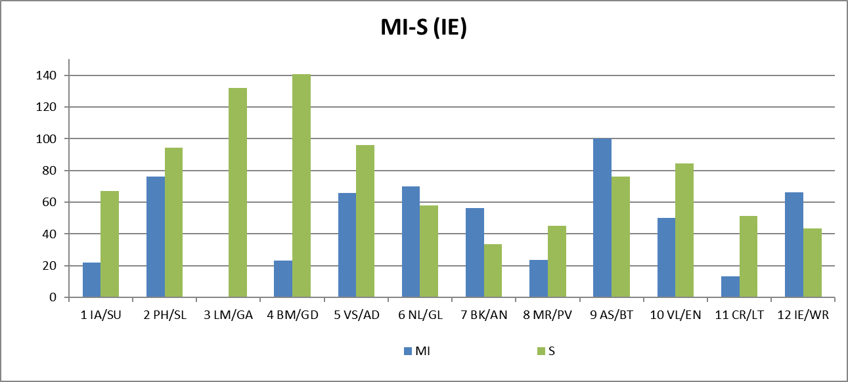
Ratio of Abilities and Vices of Personality (profile of a sinner)
The profile of the sinner in which the PPR for sinful stimuli significantly exceeds the PPR for control stimuli associated with MI
VSR (MI/Sins)
79%
Notes:
In the tests carried out, PPR for sinful stimuli is not always noticeably less than for stimuli associated with MI.
Many people have more significant responses to sinful stimuli as shown in this slide. At the same time, the indicator of righteousness is not necessarily defined as low (79%), because the average level of all sinful PPR is compared with the average level of the leading types of MI

Slide 23
Ratio Table of Abilities and Sins
 | MI (IE) |  |  | Sins (IE)
1 | 100,0 | PH | Philosophical (PH) | 64,3 | WR | wrath
2 | 85,0 | IA | Intrapersonal (IA) | 39,6 | LT | lust
3 | 76,4 | LM | Logical-mathematical (LM) | 36,3 | SL | sloth
4 | 32,9 | VL | Verbal-linguistic (VL) | 31,7 | SU | suicide
5 | 30,2 | BK | Bodily-kinesthetic (BK) | 30,4 | BT | bribe, theft
6 | 27,7 | AS | Ascetic-Sacrificial(AS) | 27,5 | GA | cyber addiction
7 | 27,1 | BM | Business-Mercenary (BM) | 26,4 | PV | pride, vanity
8 | 9,5 | VS | Visual-spatial (VS) | 18,5 | EN | envy
9 | 7,9 | NL | Naturalistic (NL) | 9,0 | AN | anorexia
10 | 5,8 | MR | Musical-rhythmic (MR) | 8,7 | GD | greed
11 | 1,1 | CR | Creative (CR) | 7,7 | AD | alcoholism, drug addiction
12 | 0,0 | IE | Interpersonal (IE) | 5,3 | GL | gluttony
Notes:
Numerical values ​​characterizing the abilities and vices of the tested person (in this case, mine) are given in the table in descending order. Naturally, the proposed method for determining the merits and demerits of a person assumes the presence of a magnitude of merits and demerits in each person, one should not be afraid of the identified vices, everyone has them! Determining for detailed profiling is precisely the ratio between virtues and vices. If the leading vices matter less than the leading types of MI, then this means the predominance of positive qualities in the person under study.
Moreover, for the choice of certain professions, certain vices may be more important than virtues. For example, for some sports, a high level of anger or greed may be necessary qualities to achieve high athletic performance.

Slide 24
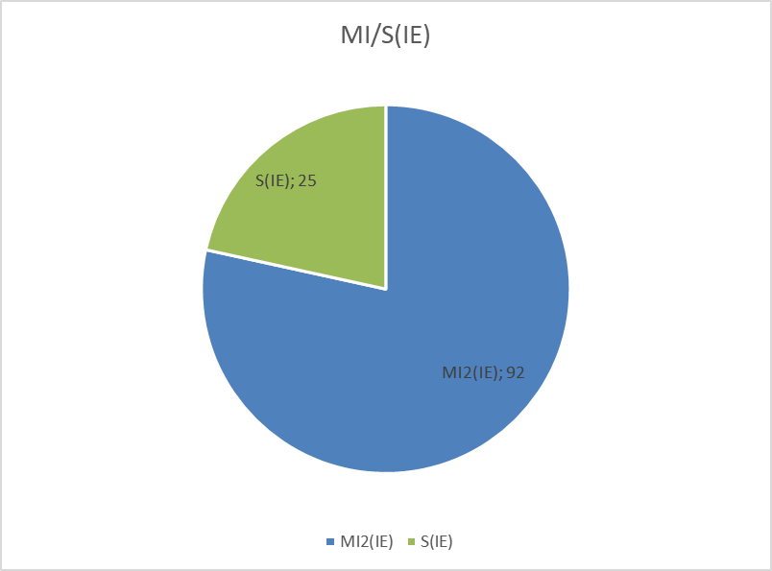
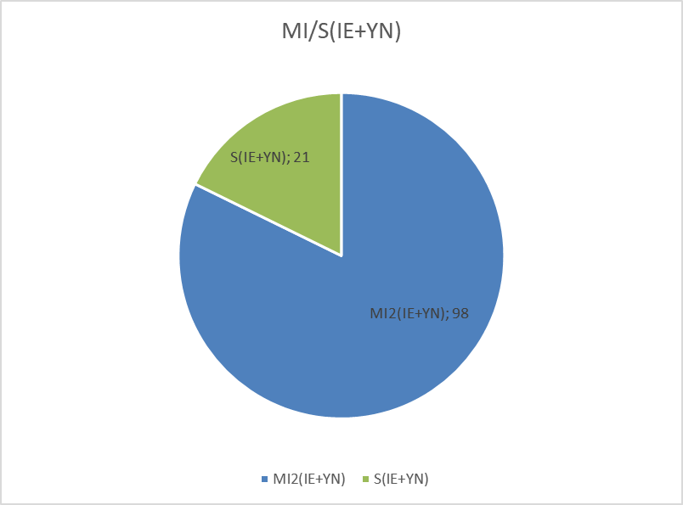
Conscious and unconscious reaction. What's more important?
 | MI(IE+YN) |  |  | Грехи(IE+YN)
1 | 100,0 | ВИ | Внутриличностный (ВИ) | 48,4 | ПТ | похоть
2 | 95,3 | ЛМ | Логико-математический (ЛМ) | 46,6 | ЛН | лень
3 | 86,5 | ФИ | Философский (ФИ) | 41,3 | ГТ | гордыня, тщеславие
4 | 59,2 | ВП | Визуально-пространственный (ВП) | 34,8 | ГЯ | гнев, ярость
5 | 48,8 | МД | Моторно-Двигательный (МД) | 31,7 | ЖД | жадность
6 | 36,7 | ПР | Природный (ПР) | 17,1 | СУ | суицид
7 | 36,6 | ПВ | Подвижнический (ПВ) | 16,4 | ВВ | воровство, взятки
8 | 33,0 | КР | Креативный (КР) | 14,9 | ГЗ | кибер-зависимость
9 | 17,8 | ВЛ | Вербально-Лингвистический (ВЛ) | 10,0 | ЗТ | зависть
10 | 14,7 | БК | Бизнес-Корыстный (БК) | 4,8 | АР | анорексия
11 | 3,2 | МР | Музыкально-Ритмический (МР) | 4,2 | АН | алкоголизм, наркомания
12 | 0,0 | МЛ | Межличностный (МЛ) | 2,9 | ЧР | чревоугодие, булимия
Notes:
Currently, we prioritize the unconscious response in profiling, as it is more difficult to falsify in testing. At the same time, in most of the tests, the results of the analysis of the unconscious and integral responses are close to each other (if the subject does not falsify conscious answers), which is also shown by the upper circle diagrams of the ratios of the positive and negative qualities of my testing.
At the same time, individual values ​​of the value of virtues and vices may differ somewhat for the calculation of the unconscious and integral responses.

Slide 25
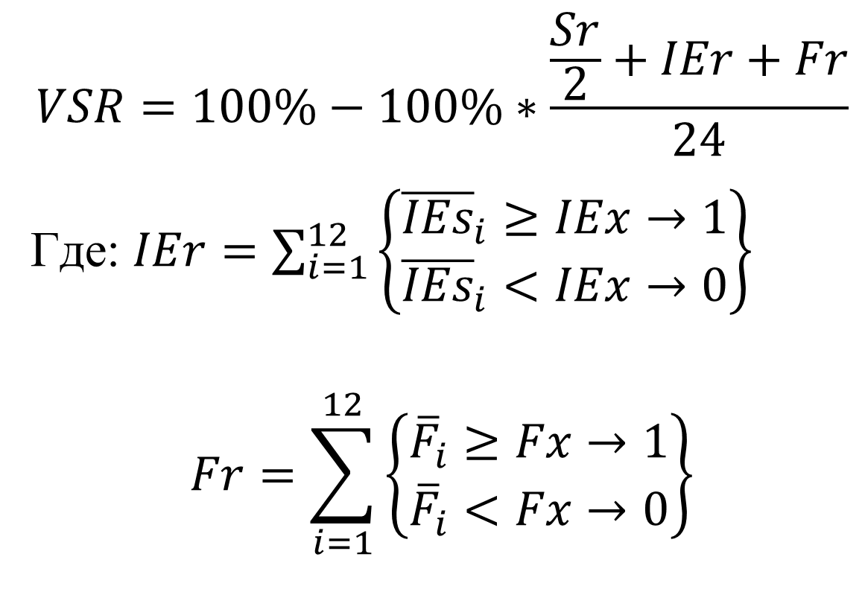
Calculation of Righteous Level -VSR
(MI/Sins Ratio)
$$VSR=100\%−100\%∗\frac{\frac{Sr}{2}+IEr+Fr}{24}$$
Где: $IEr=\sum_{i=1}^{12}{\left\{\begin{aligned}{\overline{IEs}}_{i}≥IEx→1 \\ {\overline{IEs}}_{i}<IEx→0\end{aligned}\right\}}$
$$Fr=\sum_{i=1}^{12}{\left\{\begin{aligned}{\overline{F}}_{i}≥Fx→1 \\ {\overline{F}}_{i}<Fx→0\end{aligned}\right\}}$$
количество I-E реакций, превышающих порог
количество Y-N реакций, превышающих порог
Notes:
With the relative simplicity of explanations that the level of righteous is determined by the ratio of the magnitude of the response to MI stimuli and Sins-vices, its calculation turns out to be rather complicated, since it includes the subject's responses to each of the 48 stimuli. For the given results of my testing, the level of righteousness turned out to be 100%, but this does not mean that next time it will be as high.

Slide 26
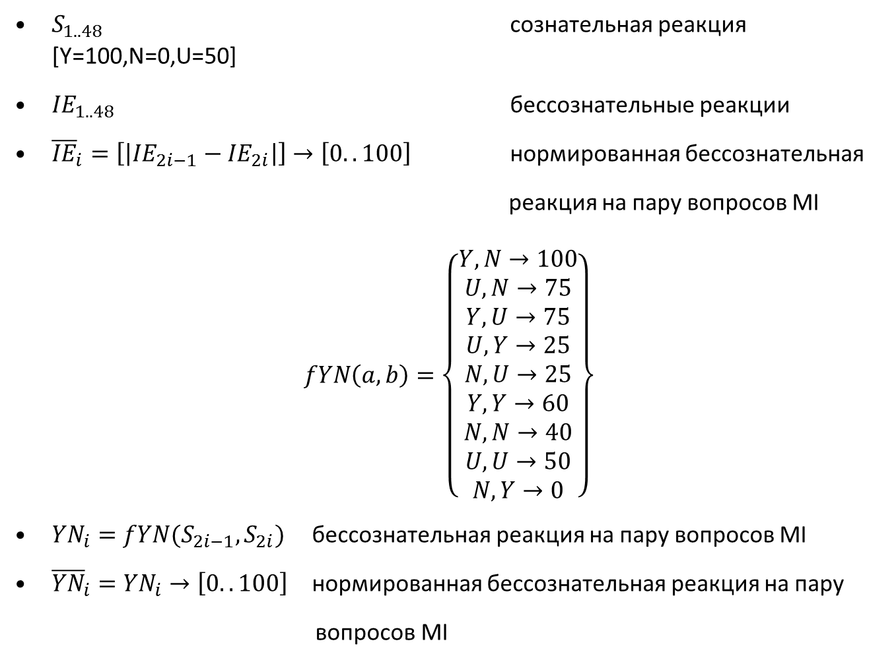
Components of Righteous Level
$S_{1..48}$ сознательная реакция [Y=100,N=0,U=50]
${IE}_{1..48}$ бессознательные реакции
${\overline{IE}}_{i}=\left[\left|{IE}_{2i−1}−{IE}_{2i}\right|\right]→\left[0..100\right]$ нормированная бессознательная
реакция на пару вопросов MI
$$fYN\left(a,b\right)=\left\{\begin{aligned}Y,N→100 \\ U,N→75 \\ Y,U→75 \\ \begin{aligned}U,Y→25 \\ N,U→25 \\ Y,Y→60 \\ N,N→40 \\ U,U→50 \\ N,Y→0\end{aligned}\end{aligned}\right\}$$
${YN}_{i}=fYN(S_{2i−1},S_{2i})$ бессознательная реакция на пару вопросов MI
${\overline{YN}}_{i}={YN}_{i}→\left[0..100\right]$ нормированная бессознательная реакция на пару
вопросов MI
Notes:
Кроме того, при реакции на каждый стимул учитывается отдельно бессознательная и сознательная реакция, поэтому количество анализируемых вIn addition, when responding to each stimulus, the unconscious and conscious reactions are taken into account separately, so the number of analyzed input parameters increases to 48x2=96.
As in lie detection and the Baxter comparison zone test, the calculation of the unconscious response is based on a quantitative comparison of responses to control and significant stimuli. In our case, these are incentives tied to MI and vices.ходных параметров увеличивается до 48х2=96.
Как в детекции лжи и тесте зон сравнения Бакстера расчет бессознательной реакции основан на количественном сравнении реакций на контрольные и значимые стимулы. В нашем случае это стимулы привязанные к МИ и порокам.

Slide 27
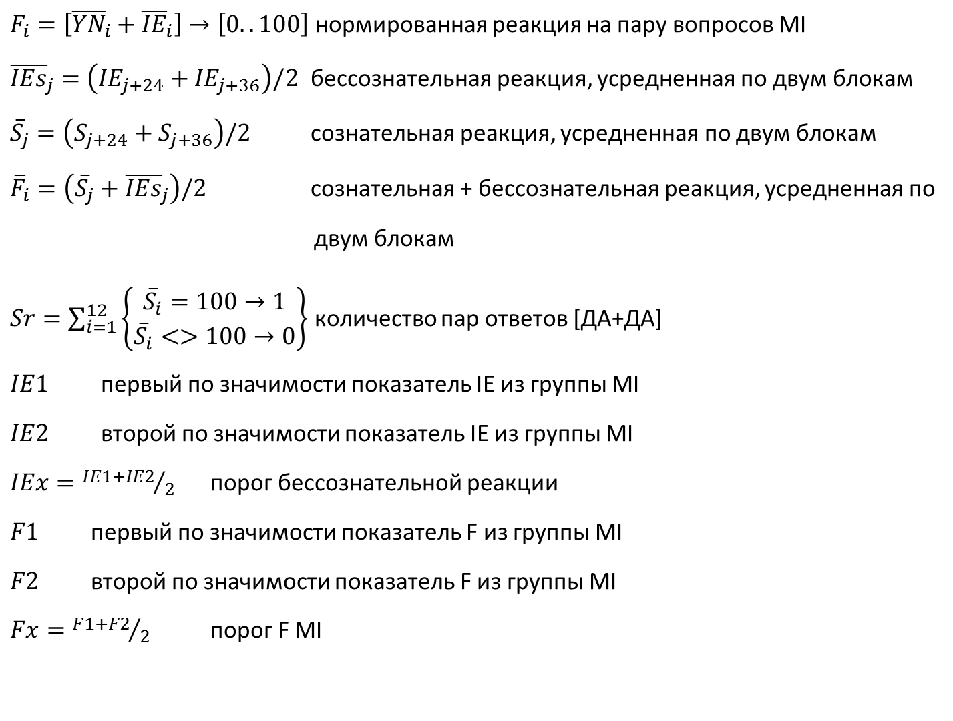
Components of Righteous Level
$F_{i}=\left[{\overline{YN}}_{i}+{\overline{IE}}_{i}\right]→\left[0..100\right]$ нормированная реакция на пару вопросов MI
${\overline{IEs}}_{j}=\left({IE}_{j+24}+{IE}_{j+36}\right)/2$ бессознательная реакция, усредненная по двум блокам
${\overline{S}}_{j}=\left(S_{j+24}+S_{j+36}\right)/2$ сознательная реакция, усредненная по двум блокам
${\overline{F}}_{i}=\left({\overline{S}}_{j}+{\overline{IEs}}_{j}\right)/2$ сознательная + бессознательная реакция, усредненная по
двум блокам
$Sr=\sum_{i=1}^{12}{\left\{\begin{aligned}{\overline{S}}_{i}=100→1 \\ {\overline{S}}_{i}<>100→0\end{aligned}\right\}}$ количество пар ответов [ДА+ДА]
$IE1$ первый по значимости показатель IE из группы MI
$IE2$ второй по значимости показатель IE из группы MI
$IEx={IE1+IE2}/2$ порог бессознательной реакции
$F1$ первый по значимости показатель F из группы MI
$F2$ второй по значимости показатель F из группы MI
$Fx={F1+F2}/2$ порог F MI
Notes:
I will not now dwell on each of the analyzed parameters, since the time of the presentation is limited.
I will only clarify that such a complex calculation is done almost instantly and does not yet use the influence of the correlation between behavioral parameters. The introduction of correlation dependencies will further complicate the calculation formulas.

Slide 28
Open Questions of Psychophysiology
Interaction of chronobiological changes in PPS and external stimuli.
Vibraimage can measure any change in PPS, behavior and physiology. But in order to interpret these changes, knowledge about the nature of these processes is needed.
At the moment, the understanding of the processes of control and transmission of information in the human body are being replaced by statistics.
Notes:
With all the benefits that I see in conducting adaptive neuro-linguistic profiling, I understand that many fundamental questions remain without a clear answer.
First of all, this is the imposition of chronobiological processes on the presentation of external stimuli. The method of multiple repetition of stimuli, which most psychological techniques use to reduce the influence of fast-moving chronobiological processes (periods less than 1 minute), does not seem to me correct, since it significantly increases the testing time and falls under the influence of average speed chronobiological processes and daily rhythms. In addition, it is difficult to exclude the effect of fatigue on the results of many hours testing.
A person is an extremely complex cybernetic system, but its functioning is based on unambiguous physical laws that will be discovered sooner or later, I hope that the MI-Sins program will help find answers to many questions

Slide 29
Profiling Issues
Variability of behavioral characteristics over time and external factors
Objectivity of comparison with a measure (definition of standards)
Long-term set of statistics
The historical load of terms and approaches to the virtues and vices of the individual
Difficulty in using general personality traits in specific applications
Notes:
The next issue that has received insufficient attention is the variability of human behavioral characteristics.
Even Heraclitus said that one cannot enter the same water twice, but most psychological and psychophysiological approaches prefer to obtain a stable result, although, in my opinion, this is not always justified.
Determining the characteristics previously operated by religion and ethics will clearly add opponents to our approach to personality profiling.
Indeed, the MI-Sins program is designed to solve a complex problem that was previously solved with the help of faith.
Replacing faith with technical measurements of personality traits as physical quantities is the only possible scientific approach to personality professionalization.

Slide 30
Stability of the profiling result - an advantage or a disadvantage?
Should one strive for the stability of the results of profiling one person, if a person is constantly changing - the key question of profiling
Detailed profiling should show stable and variable personality characteristics
Notes:
Ideal profiling should show the possible variability of human behavioral characteristics.
That is why the MI-Sins program offers various options for analyzing virtues and sins, linking them to the conscious and unconscious characteristics of a person.
Depending on many external factors, a person can make decisions using one or another of his soul mates: conscious or unconscious.
Therefore, a certain amount of unstability in the profile of each person is mandatory, and an experienced profiler should pay close attention to the difference in the unconscious and integral profile of the personality.

Slide 31
Physics and Ethics. Blitz Judgment or Last Judgment
Reflexes of the brain 2.0
Physics, Ethics or Religion that defines consciousness and unconscious processes
Is God the first profiler?
Information about the inner world of a person is biometric information?
Formation of the legislative base for behavior analysis
Notes:
Ivan Sechenov did not hesitate to write in his works about the lack of understanding of certain processes and mechanisms of human physiology.
Ivan Pavlov extended the understanding of reflexes, but failed to show that the reflexes of the brain work as definitely as the digestive reflexes.
The task of technical profiling is to reduce testing a person with complex stimuli to the same unambiguous results that Academician Pavlov demonstrated on dogs. Of course, this is not an easy task, but human physiology obeys physical laws, so the task of detailed personality profiling will be solved anyway. And with the help of vibraimage technology or without it, it depends on our efforts.

Slide 32
Benefits of technical profiling
Objectivity of assessments and measurement results. Single approach to all tested persons
Synchronization of stimulus presentation and PPR processing
Speed ​​of assessment of behavior, intentions and emotions
Digitization of feelings, storage of results and monitoring of dynamics
Ability to create a passport of a person's emotional characteristics
Notes:
With all the described and understood problems and unsolved questions, I see a huge advantage of the developed method for assessing the positive and negative qualities of a person. Problems will be solved, many questions will be answered, a report on vibraimage terminology will be presented at this conference, it is difficult to move on without standardization of terms and definitions.
One should not be afraid of the digitalization of feelings - this is a natural evolutionary process of the development of IT technologies in modern society.
Vibraimage technology shows high sensitivity in registering practically any processes occurring in the human body. But the vibraimage technology is only a means of studying the changes occurring in a person, a correct understanding of the changes taking place and statistical confirmation of the theories and principles put forward can significantly expand the practical application of detailed profiling.

Slide 33
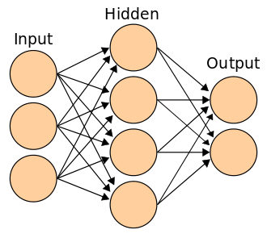
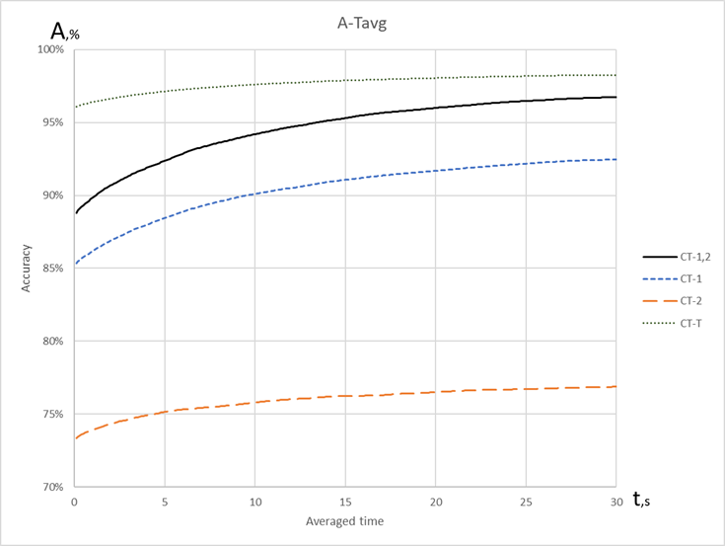
Emotional Artificial Intelligence (EAI) in Psychophysiology
Theoretical and practical accuracy of decision-making in the diagnosis of COVID-19 by vibraimage technology
Artificial neural networks (ANN) sample
Notes:
Currently, AI is actively used in various fields of knowledge, including psychophysiology, to determine emotions, behavioral parameters and intentions of a person. The development of practical applications of the so-called emotional AI is accompanied by a powerful protest movement trying to limit the use of AI for any applications related to humans. The main argument of EAI opponents is the opacity of decision making.
The main advantage of AI is the high accuracy of decision making, also confirmed by applications based on vibraimage technology in the diagnosis of COVID-19. My second report at the conference will be entirely devoted to the joint use of vibraimage technology and AI, so now I will not dwell on this topic in detail. In my opinion, the main reason limiting the use of AI in psychophysiology is the lack of standards in AI training. I hope that the future dataset of the MI-Sins program, confirmed by practical results, becomes the basis for training emotional AI. Then the accuracy of detailed profiling will be significantly increased.

Slide 34
Application of MI-Sins
Security (airports, companies), detection of terrorist plans and intentions
Career guidance (universities, schools, companies), primary or retraining
Adequacy check - issuance of licenses (weapons, drivers…)
Pre-shift control
Notes:
The use of MI-Sins program and its modifications covers all traditional areas of practical psychological and psychophysiological applications, including security, career guidance, periodic and pre-shift testing of employees, etc.
A distinctive feature of MI-Sins program is an unusual combination of speed and accuracy of profiling results, as it has been proven that the presentation of short 5-second stimuli makes it difficult to falsify the PPR of the subjects.
Currently, there is a wide time range of periods for presenting stimuli for PPR research, ranging from the 25-frame technology to an unlimited decision-making time in some psychological methods. 5-second stimuli make it possible to achieve the maximum effect of influence, since they synchronize natural chronobiological rhythms (which simplifies the processing of the PPR), while leaving no possibility of conscious adjustment of the PPR, which makes it possible to use the PPR as the main indicator of the influence of the stimulus.

Slide 35
Conclusion
Vibraimage technology in combination with the developed settings and stimuli makes possible to detect deviations in behavior and psychophysiological state
The formation of short 5-second stimuli together with the synchronous processing of the PPR increases the accuracy of hidden behavioral characteristics and intentions
A set of significant amount of statistical data on short stimuli is needed for a correct understanding of the norms, pathologies and mechanisms of the formation of psychophysiological responses and reflexes
Notes:
To date, MI-Sins program includes all the accumulated knowledge in vibraimage technology and is the most accurate tool that reveals the inner abilities and vices of the test subject in the minimum testing time.
This absolutely does not mean that it cannot be improved; on the contrary, most likely, with a set of statistical data, settings, processing algorithms, and the presented stimulus material will be improved.
We do not take on the function of a god and sort people into hell or heaven, as some try to make it out to be.
Detailed profiling based on physics, mathematics and cybernetics should help man and mankind to develop abilities and fight shortcomings. It is necessary to determine the merits and demerits of people during life, and not after death, then the merits can be developed and the shortcomings corrected.
Now is a paradoxical situation when psychophysiological testing of workers or drivers is the norm, and testing for the adequacy of politicians on whose decisions millions of lives depend is not provided at all. Perhaps in the distant future, testing on systems like MI-Sins will become the norm of life from school to presidential elections in all countries, because the proposed testing is based on universal human values ​​and physical laws actual in all the world. Then I hope there will be much less wars and conflicts, since only adequate people will make important decisions.

Slide 36
Thanks for the Attention!
Viktor Minkin
CEO Elsys Corp
e-mail: minkin@elsys.ru
www.elsys.ru
www.psymaker.com
Notes:
I thank all colleagues participating in the 5th International Scientific and Technical Conference on Vibraimage Technology and wish all participants great scientific and practical success!
Ready to answer questions about the report. Thank you for your attention!

