Slide 1


The 1st International Open Science Conference
The Vibraimage World
VIBRAIMAGE SYSTEMS OPERATION
FOR PARTNERS AND USERS
Eugenia G. Lobanova
Notes:
Hello, today I want to tell you about
how to reduce the number of mistakes that users have with VibraImage systems.
It can be interesting also for our partners who help users to set up their systems.

Slide 2
VibraImage WORLD
What difference between programs?
100%
PRO
All tasks
50%
Medium
Tasks from 1 area
20%
Light
Specific task
10%
Mobile
Rare specific task
Notes:
Let’s look at the slide which shows the VibraImage World. There are almost 100 versions for different applications. With PRO version we can perform any tasks connected with emotions measuring.
But a lot of people use VibraImage system only for one or some specific applications. For them we created medium, light and mobile versions which are easier to use but less functional.

Slide 3
Typical mistakes
Important requirements for the system
1
Recording conditions
Computer
Error’s type 1
Small test person head
Windows/Android, power,
loading
2
Recording conditions
Camera
Error’s type 2
Noise from moving objects
Resolution, noise level,
frame rate
Recording conditions
Mode
3
Error’s type 3
Small frame rate from camera
MICRO, MIX, MACRO, LD etc.
Notes:
VibraImage Technology has rather strict requirements to the conditions of the recording and operation with system in general.
It’s very important to set up our system correctly.
In the program we have a quality test mode that helps users to set up the correct conditions for the recording.
Because there are many reasons for mistakes they were divided into three groups.
Also users need to check if the computer and camera meet to requirements of our system
In addition it’s very important to choose the correct mode MICRO, MIX, MACRO, LD in order to get the best result.
Let’s take a look at 3 types of mistakes.

Slide 4

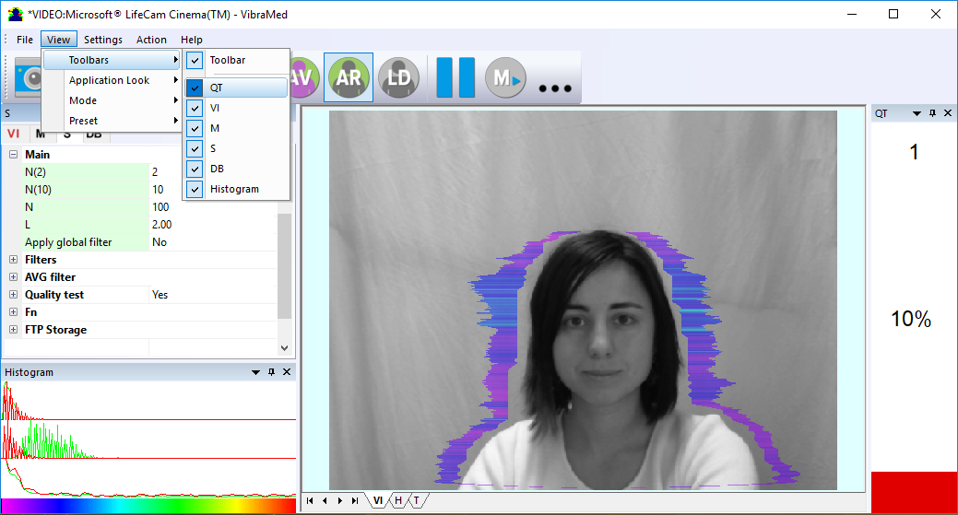
Error 1
Small image head size
Must be more than 200 px
The key is always you
Notes:
Look at the left part of the program image. In your program you should enable quality test mode. Here we have the first type of mistake in the quality test mode. In the right part of the program image you can see it as number 1. What is wrong in this case? It means that you need to change conditions of the recording so that width of the head in the image takes more than 200 px. You can fix this mistake by zooming of your camera but It’s much much better move camera or test person closer to each other. Later I will tell you why using electronic zoom in the camera is not recommended in our system.

Slide 5
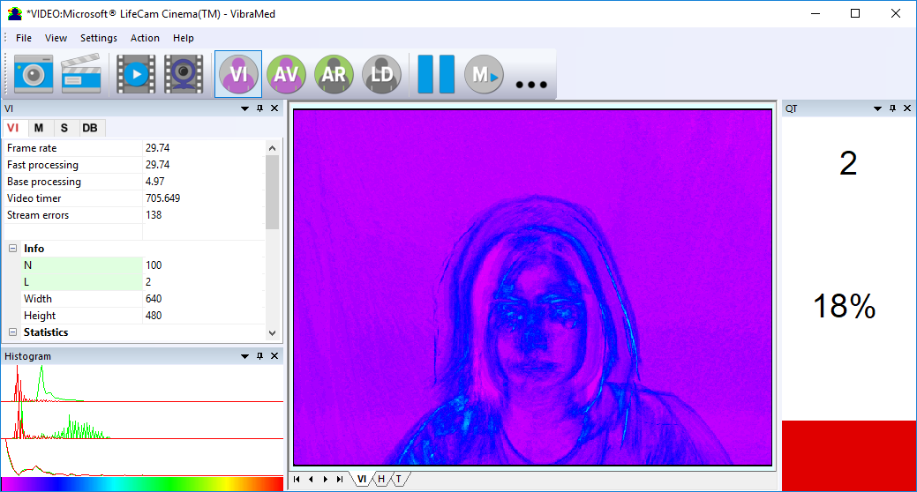
Error 2
Noise from moving objects
The key is always you
Notes:
On this slide you can see the second type of the widespread mistake which is caused by the presence of noise on the vibraimage.
You can see noise on this picture as colored dotes.
It means that microvibrations of human head are compatible with microvibrations of background or of your camera.
To fix this mistake you need to stabilize the camera, during the testing you shouldn’t touch the table.
It’s important that behind the subject there were no moving objects, running commercial text etc, Test person also would not move on the chair.
And the stability and equality of light level is very imperative.

Slide 6
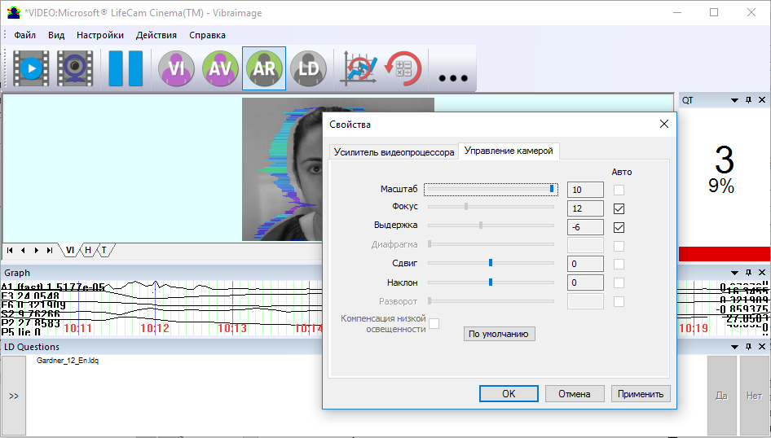
Error 3
Low frame rate
Must be more than 25 fps
The key is always you
Notes:
Here we have mistake number 3. which is connected to the frames per second of your camera. Frame rate must be more than 25 fps.
Very often this mistake appears when we change the scale with camera zoom to fix the mistake number 1.
As you can see we discussed the problems which can be in MICRO mode. When we measure the emotions of only one person.

Slide 7

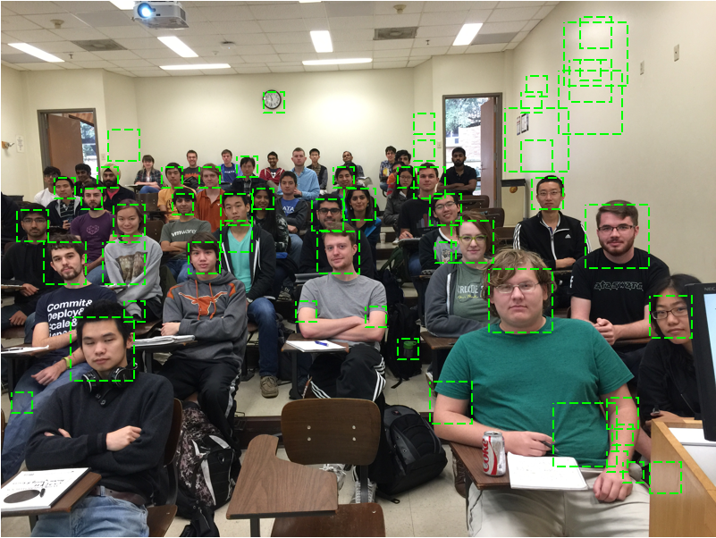
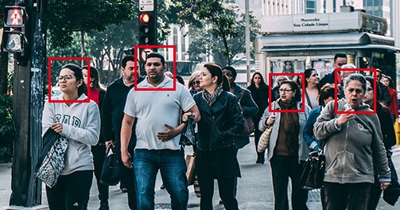
Mistakes in the MACRO mode
Get under way MICRO
A lot of images of faces
of different sizes
Large, equal in size
images of faces
Notes:
The above errors relate to the MICRO mode when only 1 person is in the frame. If you are going to control macrovibrations of many persons at the same time in MACRO mode, then if it’s possible you need to reduce it to the MICRO mode. Before setting up the system in MACRO mode, you can go to MICRO and test the system with the quality test mode.
In MACRO mode it is necessary to try to approach the camera as close as possible to the test subjects, try to compare people in the same psycho-physiological state, compared faces should be approximately the same size. Incorrect setting of the face detection mode leads to processor overloading and improper operation of the entire system. The left side of the slide shows an example of an incorrect setting, and the right one is the right one.

Slide 8
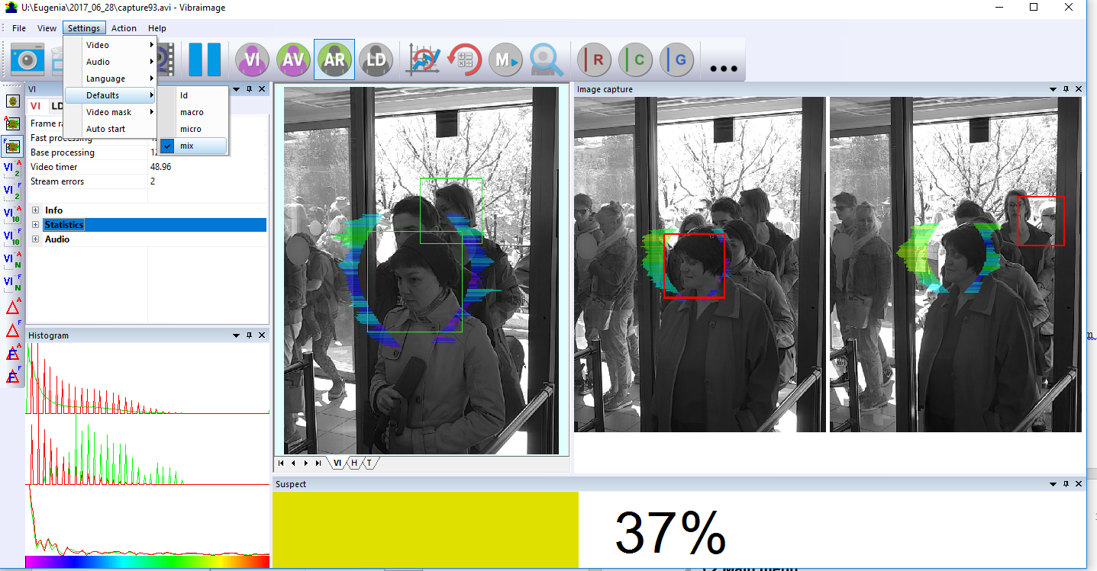
Mode MIX
The ideal solution for queue
Notes:
In the case where the crowd is a queue the ideal solution is the MICS mode, combining the advantages of the MICRO and MACRO modes. In this mode, the level of emotion of 1 person in a crowd with the largest size of the face image is controlled. The mode is recommended when the crowd passes through 1 point, for people line, for queue.

Slide 9
Learning for using
How to reduce number of mistakes?
You must | VibraImage PRO | VibraImage Medium | VibraImage Light, Mobile
Complete educational course | 
Study the manual |  |  | 
Notes:
It’s impossible to avoid mistakes while using our system because the VibraImage technology is still (sometimes) hard to understand.
To reduce the number of mistakes it’s recommended to complete the educational course, And it is obligatory to do it for PRO version users.
To operate with lite and medium versions it’s enough to read the manuals attentively
that helps you to avoid mistakes on each step from installing program to analyzing results.
In the manuals you will find an answer for your every question.

Slide 10
VibraImage manual’s structure
What is structure of VibraImage manuals?
Basic operational principles
4
3
Toolbars
Menus
Saving and analyzing results
5
2
Installation
First program start
6
Warranty
1
Introduction
Application
Requirements
Notes:
To make the reading of manual easier I will tell you about manual’s structure.
Для облегчения работы с описаниями далее я расскажу про структуру описаний. В первом разделе, как видно на данном слайде, обычно приведены введение, назначение системы и требования к системе. Как установить программу и запустить ее в первый раз можно найти во втором разделе. Обозначение значков на панели инструментов и расшифровка пунктов меню находится в 3 разделе. Четвертый раздел очень важен для эффективного использования системы, так как там приведены основные принципы работы с системой. В пятом разделе приводятся примеры файлов с сохраненными результатами и примеры анализа результатов. Шестой раздел посвящен гарантиям и ответственности Элсис перед пользователями. Рассмотрим поподробнее содержимое каждого раздела.

Slide 11
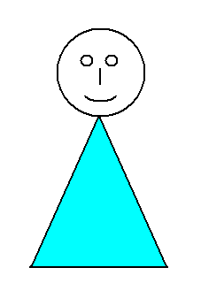
Part 1
Answers the questions:
Which scientific theories are the basis of the system?
Vibraimage, vestibule-emotional reflex,
the theory of multiple intelligence etc.
Application of the program?
Providing personal or public safety, the definition of a lie, the patient control in medicine, the definition of human abilities etc.
What are the requirements for the system?
Requirements for the camera, the computer, the system in general
What the system consists of?
Software + camera * + computer * + protection / key + manual + microphone*
* Optional
Notes:
В разделе 1 можно узнать какие теории лежат в основе системы. Так, кроме общей для всех продуктов теории виброизображения и вестибулярно-эмоционального рефлекса, например, VibraMI основана на теории Говарда Гарднера множественного интеллекта.

Slide 12
Part 1
Answers the questions:
Which scientific theories are the basis of the system?
Vibraimage, vestibule-emotional reflex,
the theory of multiple intelligence, etc.
Application of the program?
Providing personal or public safety, the definition of a lie, the patient control in medicine, the definition of human abilities etc.
What are the requirements for the system?
Requirements for the camera, the computer, the system in general
What the system consists of?
Software + camera * + computer * + protection / key + manual + microphone*
* Optional
Notes:
В первом разделе также расположена очень важная информация о том для чего можно использовать данный продукт. Рекомендуется изучить перед приобретением продуктов.

Slide 13
Part 1
Answers the questions:
Which scientific theories are the basis of the system?
Vibraimage, vestibule-emotional reflex,
the theory of multiple intelligence, etc.
Application of the program?
Providing personal or public safety, the definition of a lie, the patient control in medicine, the definition of human abilities etc.
What are the requirements for the system?
Requirements for the camera, the computer, the system in general
What the system consists of?
Software + camera * + computer * + protection / key + manual + microphone*
* Аппаратное обеспечение
Notes:
Кроме вышесказанного в первом разделе обычно приведены требования к компьютеру, камере, системе в целом,. Показано, что входит в систему.

Slide 14

Part 2
Answers the questions:
How to install the program?
Steps to install the program, security drivers
How to activate and launch the program?
+
steps to activate the program in the normal mode,
in DEMO mode, the first start of the program
How to reinstall the program?
Steps to reinstall the program
How to set up camera?
+
Camera settings menu, important parameters for setting, checking settings on the test table and on the column "Quality test"
Notes:
В разделе два приведены пошаговые инструкции как установить программу, как активировать, как переустановить. Показаны действия при первом запуске программы. Также во втором разделе приведены рекомендации по настройке видеокамеры, в том числе с использованием тестовых таблиц и режима «Тест качества»

Slide 15
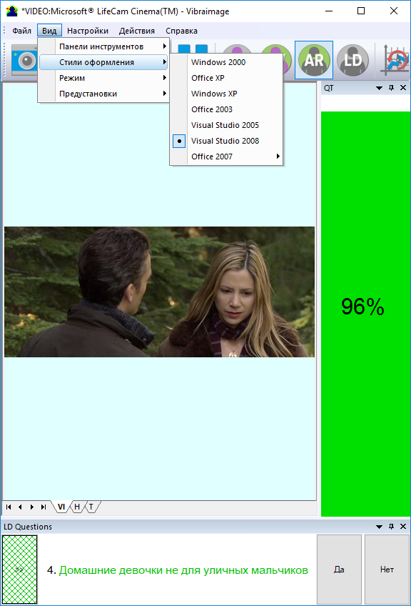
Part 3
Answers the questions:
What is the main window of the program?
Designation of all parts of the program that the user can see to facilitate further searching in the manual
What do the main program menus mean?
Main menu, submenus
What do the items and subitems mean?
All items is described in detail
What do the buttons on the toolbar mean?
All the buttons on all toolbars are described in detail
Notes:
Из раздела три можно узнать перечень меню и подменю программы, значения всех пунктов и подпунктов, обозначения всех кнопок на панелях инструментов.

Slide 16
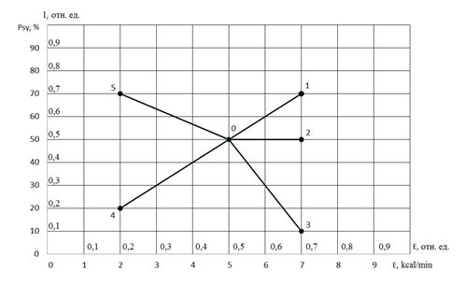
Part 4
Answers the questions:
How to operate with program?
The principles of program operation and ideas underlying the program
are described in detail
What do diagrams, histograms mean?
The explanation of the basic graphs
What geneal modes our system has?
MICRO, MIX, MACRO, LD etc
What do these results mean?
A detailed description of the interpretation of the results
Notes:
В разделе 4 подробно описаны идеи и режимы, лежащие в основе программы, приведены основные принципы работы и интерпретации результатов.

Slide 17

Part 5
Answers the questions:
How to save your results?
Result saving instruction
What do the different result files mean?
A detailed explanation of each file, created after the operation
How to interpret results?
A short example of result interpretation
How does the main result file look?
A demonstration of the main result file
Notes:
Раздел 5 поможет ответить Вам на вопросы где и как сохранить результаты измерений? Что означает каждый из автоматически создаваемых файлов с результатами? Приведены примеры интерпретации конкретных результатов, примеры результирующих общих файлов, чтобы понимать, какой именно файл следует использовать в дальнейшем.

Slide 18
What do you need to do if you have questions?
You should to read manuals
Write to technical support
Answer on your question
Read manuals
Yes
Efficient operation with VibraImage
?
No
Notes:
Итак, если у Вас появились вопросы в процессе работы с системой VibraImage необходимо прочитать соответствующий раздел описания. Если Вы не нашли ответ на свой вопрос, то не отчаивайтесь, попробуйте сформулировать свой вопрос более конкретно и еще раз загляните в описание. Если же Вам это удалось, то наслаждайтесь миром VibraImage.

Slide 19
Thanks for attention!
Eugenia G. Lobanova
Elsys corp.
lobanova.eg@yandex.ru
lobanova@elsys.ru
www.psymaker.com
Notes:
Thank you for attention! All the latest versions of the manuals you can download for free in the Downloads section on our website www.psymaker.com.

